Slide 1

FINAL PROJECT PRESENTATION (PARTS 1 & 2)
Hospital Readmission Analytics and Prediction Using Public Data
End-to-End Healthcare Data Engineering Mart & MLOps Clinical Decision Support System
Student Name: Vinay Kumar H R
USN: 1CR23AI139
Department of Artificial Intelligence and Machine Learning
Course: Data Engineering and MLOps | Project 5
CMR Institute of Technology (CMRIT)
Bengaluru, Karnataka - 560037

Slide 2
CMR INSTITUTE OF TECHNOLOGY | DATA ENGINEERING AND MLOps
FINAL PROJECT PRESENTATION
1. Executive Summary & Project Agenda
Part 1: Data Engineering Pipeline (50 Marks)
Part 2: MLOps Pipeline Extension (50 Marks)
- Clinical Challenge: Hospital Readmissions Reduction Program (HRRP) penalizes unplanned 30-day readmissions.
- Public Healthcare Data: UCI Diabetes 130-US Hospitals (101,766 encounters, 10-year historical cohort).
- Automated Ingestion: Automated download with SHA-256 integrity check and immutable raw storage.
- Quality & Quarantine Gate: Quarantined 2,426 expired/hospice records to isolate survival bias (99,340 clean).
- ICD-9 Taxonomy & Keys: Standardized 17 HCUP categories and deterministic SHA-256 patient surrogate keys.
- Star-Schema Data Mart: Populated SQLite/PostgreSQL data mart with 4 relational dimensional tables.
- Interactive Analytics UI: Streamlit dashboard with 6 analytical views exploring demographics and acuity.
- Clinical Target Formulation: Rigorous binary classification (readmission_30d_binary) with 8:1 class imbalance.
- Zero Patient Leakage: Stratified grouping by patient surrogate key across 70/15/15 train/val/test splits.
- Multi-Model Benchmark: Evaluated Logistic Regression, balanced Random Forest, and XGBoost with MLflow.
- Champion Model Selection: Random Forest selected (Test ROC-AUC: 0.6769, Recall: 53.55%, Brier: 0.2122).
- SHAP Explainability: TreeExplainer global importance and real-time patient-level factor attribution.
- Production REST Serving: FastAPI microservice (/health, /model-info, /predict, /explain) and Docker Compose.
- Continuous Monitoring: Automated Kolmogorov-Smirnov test and PSI drift detection + fairness audit.
Student Name: Vinay Kumar H R | USN: 1CR23AI139
CMRIT Slide 2 / 20

Slide 3
CMR INSTITUTE OF TECHNOLOGY | DATA ENGINEERING AND MLOps
FINAL PROJECT PRESENTATION
2. Clinical Problem & Dataset Acquisition
Clinical Context & HRRP Regulations
Dataset Acquisition & Inspection
- The Readmission Crisis: Unplanned readmission within 30 days of discharge is a primary indicator of hospital care quality and post-discharge vulnerability.
- Regulatory Financial Penalties: Under the CMS Hospital Readmissions Reduction Program (HRRP), hospitals face up to 3% reimbursement withholdings for excessive readmission rates.
- Diabetic Patient Vulnerability: Patients with diabetes experience complex multi-system comorbidities, polypharmacy, and glycemic instability requiring careful discharge planning.
- Operational Objective: Develop an automated pipeline to identify high-risk inpatient encounters prior to physical discharge to enable targeted transitional care interventions.
- Public Healthcare Source: UCI Diabetes 130-US Hospitals Dataset (1999-2008), covering 130 clinical facilities across the United States.
- Cohort Scale: 101,766 encounter records representing 71,518 unique diabetic inpatient encounters.
- Clinical Breadth: 50+ attributes spanning demographics, admission pathways, 3 diagnoses, lab tests, and 23 diabetic medication regimens.
- Automated Extraction: Implemented in src/ingestion/download_dataset.py with SHA-256 integrity hash verification (0689e7ec...).
- Zero Spreadsheet Editing: Raw CSV archived in data/raw/; all transformations executed via automated code.
Student Name: Vinay Kumar H R | USN: 1CR23AI139
CMRIT Slide 3 / 20

Slide 4
CMR INSTITUTE OF TECHNOLOGY | DATA ENGINEERING AND MLOps
FINAL PROJECT PRESENTATION
3. End-to-End System Architecture (Parts 1 & 2)
Data Engineering Layer (Part 1)
MLOps Platform Layer (Part 2)
- Raw Landing & Ingestion: Automated ingestion runner with timestamped metadata and row-count auditing.
- Data Quality Gate: Validates schema types, normalizes '?' missing codes, and isolates invalid cases.
- Quarantine Quarantine Layer: Extracts expired and hospice cases to data/rejected/rejected_encounters.csv.
- Transformation Engine: Generates SHA-256 surrogate keys, HCUP clinical categories, and utilization metrics.
- Star-Schema Storage: Loads fact_readmission and 3 dimension tables into relational database.
- Orchestration Workflow: Apache Airflow DAG and reproducible CLI runner (run_pipeline.py).
- Leakage-Free Feature Store: Stratified patient-level partitioner with ColumnTransformer feature encoding.
- Model Training & Tuning: Trains multi-model suite (LR, RF, XGB) with cost-sensitive class balancing.
- MLflow Experiment Tracker: SQLite-backed tracking database logging parameters, metrics, and curve artifacts.
- Explainable AI (SHAP): TreeExplainer deriving global feature rankings and patient-specific risk drivers.
- FastAPI Inference Service: Asynchronous microservice delivering low-latency clinical scoring.
- Drift & Fairness Monitor: Automated KS-test, PSI drift detection, and subgroup fairness evaluations.
Student Name: Vinay Kumar H R | USN: 1CR23AI139
CMRIT Slide 4 / 20

Slide 5
CMR INSTITUTE OF TECHNOLOGY | DATA ENGINEERING AND MLOps
FINAL PROJECT PRESENTATION
4. Data Quality Gate & Quarantine Layer (Part 1)
Quality Validation Rules & Clinical Logic
Quarantine & Retention Results
- Survival Bias Elimination: Discharge disposition IDs 11, 13, 14, 19, 20, 21 designate expired patients or hospice transfers who cannot be readmitted.
- Clinical Impact: Retaining deceased patients artificially suppresses readmission rates and biases machine learning risk calibration.
- Length of Stay Bounds: Enforced valid hospitalization duration: 1 <= time_in_hospital <= 14 days.
- Missing Value Standardization: Replaced '?', 'Unknown/Invalid', and empty strings with typed null values.
- Integrity Verification: Enforced uniqueness of encounter IDs and foreign-key relationships across dimensions.
- Total Records Processed: 101,766 raw hospital encounters.
- Clean Retained Encounters: 99,340 validated encounters passed to analytical layer (97.6% retention).
- Quarantined Records: 2,426 invalid records isolated to data/rejected/rejected_encounters.csv.
- Quarantine Breakdown: 2,423 expired / hospice encounters; 3 invalid encounters.
- Audit Logging: Structured summary logged to logs/validation_audit.json with rejection reasons.
- Zero Data Loss: Quarantined records remain inspectable for compliance without corrupting downstream analytics.
Student Name: Vinay Kumar H R | USN: 1CR23AI139
CMRIT Slide 5 / 20

Slide 6
CMR INSTITUTE OF TECHNOLOGY | DATA ENGINEERING AND MLOps
FINAL PROJECT PRESENTATION
5. ETL, Feature Engineering & ICD-9 Taxonomy (Part 1)
Clinical Feature Engineering
HCUP ICD-9 Clinical Classification
- Length of Stay (length_of_stay): Hospitalization duration (1-14 days) reflecting acute clinical complexity.
- Prior Inpatient Admissions: Total acute hospital stays in preceding 12 months (dominant readmission driver).
- Prior ED & Outpatient Visits: Measures ambulatory instability and emergency department reliance.
- Total Prior Visits: Cumulative prior encounter contacts (inpatient + emergency + outpatient).
- Medication Change Flag: Binary indicator (1/0) indicating diabetic drug dosage titration during stay.
- Polypharmacy Count: Total prescription medications administered (num_medications: 1-81).
- High-Cardinality Resolution: Over 700 raw ICD-9 codes grouped into 17 standardized HCUP disease categories.
- Circulatory System (390-459): Top diagnosis: 30,437 encounters (30.6% of cohort; CHF, CAD, hypertension).
- Endocrine / Diabetes (250.xx): Second largest: 22,607 encounters (22.8% of cohort; ketoacidosis, diabetes).
- Respiratory System (460-519): Third largest: 14,424 encounters (14.5% of cohort; pneumonia, COPD).
- Patient Privacy & De-ID: Deterministic SHA-256 surrogate keys (PAT_..., ENC_...) replace raw MRNs.
Student Name: Vinay Kumar H R | USN: 1CR23AI139
CMRIT Slide 6 / 20

Slide 7
CMR INSTITUTE OF TECHNOLOGY | DATA ENGINEERING AND MLOps
FINAL PROJECT PRESENTATION
6. Database & Star Schema Data Mart (Part 1)
Relational Star-Schema Architecture
Database Loading & Orchestration
- Fact Table: fact_readmission: 99,340 rows. Central table containing clinical metrics, surrogate foreign keys, stay duration, and 30-day readmission labels.
- Dim Table: dim_patient_summary: 69,987 rows. Patient-level dimension capturing demographics, lifetime visits, and chronic risk tier.
- Dim Table: dim_diagnosis: 99,340 rows. Contains primary, secondary, and tertiary ICD-9 codes mapped to HCUP categories.
- Dim Table: dim_encounter: 99,340 rows. Admission source, discharge destination, and admission type classifications.
- Database Engine: SQLite / PostgreSQL with relational integrity constraints and indexed foreign keys.
- Atomic Bulk Loading: Idempotent staging and batch insertion implemented via src/database/loader.py.
- Apache Airflow DAG: airflow_dags/hospital_readmission_etl_dag.py orchestrates ingestion, validation, and mart loading.
- One-Click Execution: python run_pipeline.py executes entire pipeline and populates database in 22.8 seconds.
- Audit Trail: Execution timestamps, row counts, and table status logged to logs/latest_pipeline_run.json.
Student Name: Vinay Kumar H R | USN: 1CR23AI139
CMRIT Slide 7 / 20

Slide 8
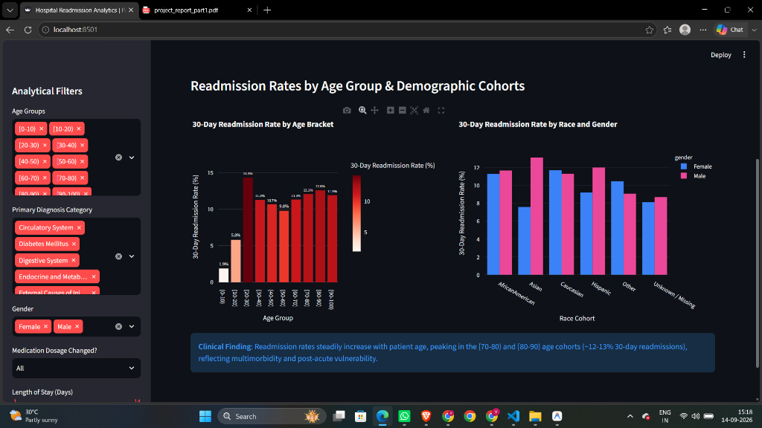
CMR INSTITUTE OF TECHNOLOGY | DATA ENGINEERING AND MLOps
FINAL PROJECT PRESENTATION
7. Streamlit Clinical Analytics Dashboard (Part 1)
6 Core Analytical Views & Clinical Insights
- 1. Age & Demographics: Visualizes readmission rates across 10-year age brackets (peaks in 70-80 cohort at 12.1%).
- 2. Diagnosis & Specialty: Analyzes readmission incidence across 17 HCUP categories (Circulatory and Respiratory lead).
- 3. Length of Stay & Acuity: Evaluates stay duration correlation; stays >7 days exhibit 1.8x higher readmission probability.
- 4. Admission & Discharge: Compares Emergency vs Elective routes and high-risk discharge to Skilled Nursing Facilities (SNF).
- 5. High-Risk Cohort Explorer: Interactive multi-attribute filter isolating complex, frequent-utilizer patients.
- 6. Pipeline & Quality Audit: Live inspection of latest ETL run metrics, table row counts, and quarantined records.
Student Name: Vinay Kumar H R | USN: 1CR23AI139
CMRIT Slide 8 / 20

Slide 9
CMR INSTITUTE OF TECHNOLOGY | DATA ENGINEERING AND MLOps
FINAL PROJECT PRESENTATION
8. MLOps Target Formulation & Leakage Prevention (Part 2)
Target Formulation & Class Imbalance
Zero Patient Leakage Stratification
- The Clinical Target: Binary 30-day readmission indicator (readmission_30d_binary: 1 if '<30', 0 if '>30' or 'NO').
- Regulatory Alignment: Strictly mirrors HRRP reimbursement policy focusing on readmissions occurring within 30 days.
- Severe Class Imbalance: 11,314 positive encounters (11.39%) vs 88,026 negative encounters (88.61%) - ~8:1 ratio.
- Cost-Sensitive Learning: Applied balanced subsample weighting (Random Forest) and scale_pos_weight=7.84 (XGBoost).
- Clinical Metric Selection: Prioritized Recall (Sensitivity) and PR-AUC over raw accuracy to prevent false negatives.
- The Patient Overlap Hazard: Random encounter-level splitting places visits from the same patient into both train and test, leaking patient-specific patterns.
- Stratified Group Split: Grouped encounters strictly by patient_surrogate_key with stratification on patient-level readmission history.
- Training Partition (70%): 69,584 encounters across 48,990 unique patients (11.31% positive).
- Validation Partition (15%): 14,949 encounters across 10,498 unique patients (11.63% positive).
- Held-Out Test Set (15%): 14,807 encounters across 10,499 unique patients (11.50% positive).
- Zero Overlap Verified: Train, validation, and test patient sets are strictly disjoint (Train n Test = 0).
Student Name: Vinay Kumar H R | USN: 1CR23AI139
CMRIT Slide 9 / 20

Slide 10
CMR INSTITUTE OF TECHNOLOGY | DATA ENGINEERING AND MLOps
FINAL PROJECT PRESENTATION
9. Multi-Model Architecture & Experimental Benchmark (Part 2)
Model Architecture | Test ROC-AUC | Test PR-AUC | Test Recall | Test Precision | Brier Score | Model Role
Random Forest (200 Trees) | 0.6769 | 0.2313 | 53.55% | 19.23% | 0.2122 | CHAMPION
XGBoost Classifier | 0.6722 | 0.2230 | 56.08% | 18.66% | 0.2143 | CHALLENGER
Logistic Regression (L2) | 0.6649 | 0.2078 | 52.50% | 16.54% | 0.2252 | BASELINE
- Champion Model Justification: Random Forest achieved the highest discrimination (ROC-AUC: 0.6769), highest PR-AUC (0.2313), and superior probability calibration (Brier: 0.2122).
- PR-AUC Outperforms Baseline: Achieved PR-AUC of 0.2313, more than double the random baseline prevalence (11.39%), demonstrating significant predictive power.
- High Clinical Sensitivity: Recovers 53.55% of true 30-day readmissions at operational threshold, ensuring the majority of vulnerable patients receive discharge interventions.
- Tree-SHAP Determinism: Random Forest decision trees provide deterministic, rapid Shapley attributions via TreeExplainer without numeric instabilities.
Student Name: Vinay Kumar H R | USN: 1CR23AI139
CMRIT Slide 10 / 20

Slide 11
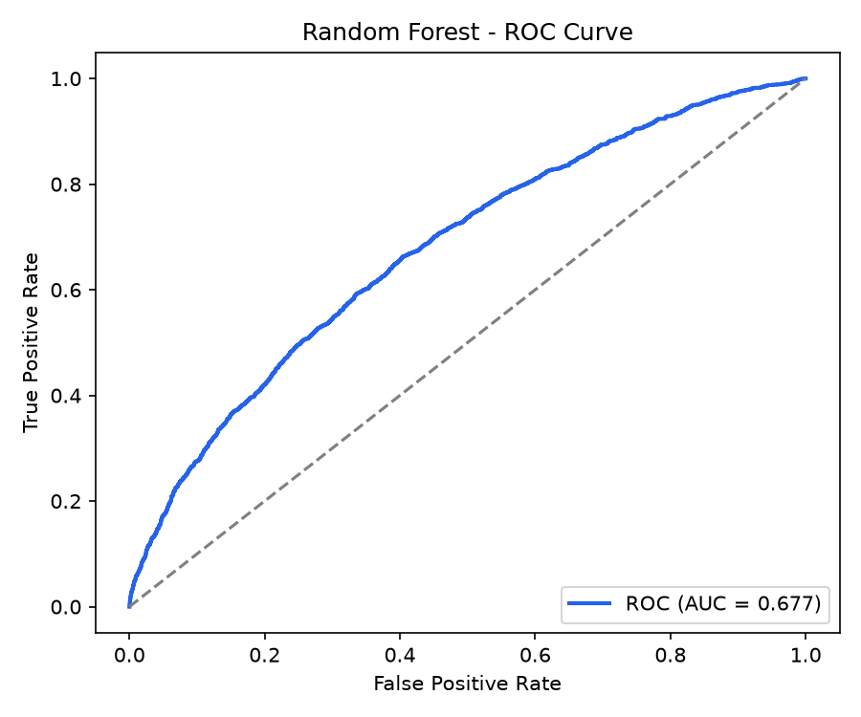
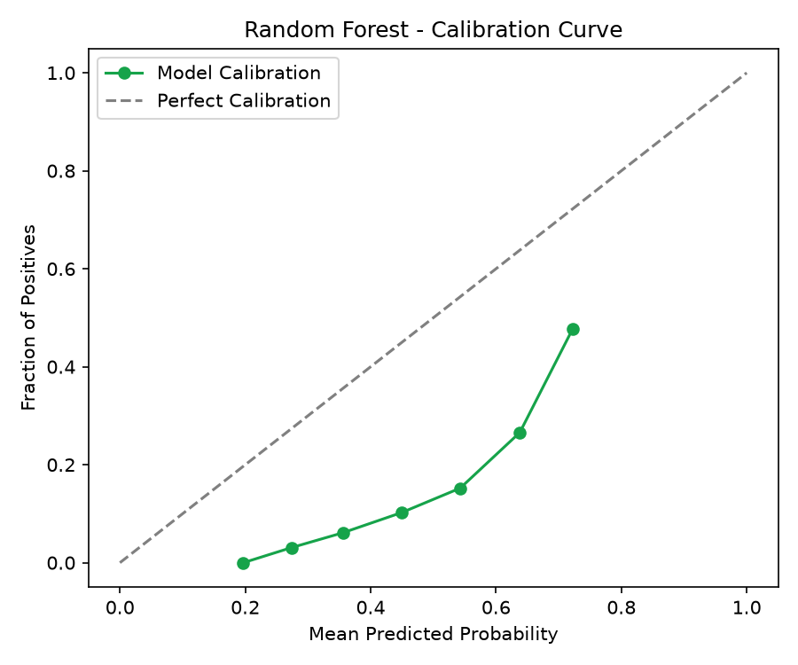
CMR INSTITUTE OF TECHNOLOGY | DATA ENGINEERING AND MLOps
FINAL PROJECT PRESENTATION
10. Champion Model & MLflow Tracking (Part 2)
MLflow Experiment Tracking & Registry
- Tracking Backend: Configured MLflow tracking with SQLite database backend (sqlite:///data/mlflow.db).
- Tracked Hyperparameters: Logged n_estimators (200), max_depth (12), min_samples_leaf (4), and subsample class weights.
- Tracked Evaluation Metrics: Logged validation & test ROC-AUC, PR-AUC, Recall, Precision, F1, and Brier score.
- Artifact Persistence: Saved ROC curves, PR curves, calibration plots, and serialized joblib model artifacts.
- Model Packaging: Champion model exported to models/champion_model.joblib with preprocessing metadata.
Left: Random Forest ROC Curve (AUC 0.6769) | Right: Probability Calibration Reliability
Student Name: Vinay Kumar H R | USN: 1CR23AI139
CMRIT Slide 11 / 20

Slide 12
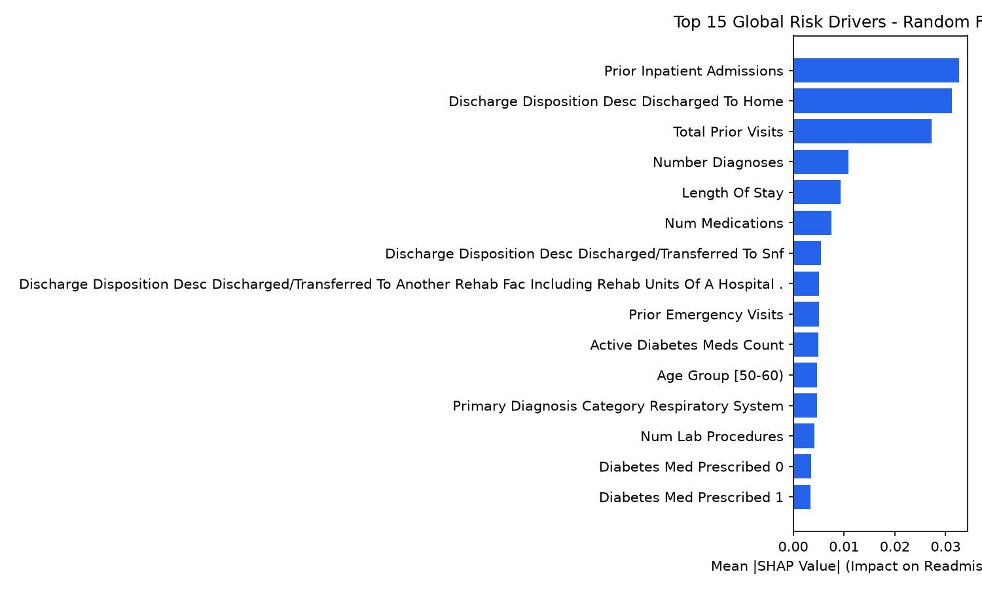
CMR INSTITUTE OF TECHNOLOGY | DATA ENGINEERING AND MLOps
FINAL PROJECT PRESENTATION
11. Model Explainability via SHAP (Part 2)
TreeExplainer Clinical Risk Attribution
- Game-Theoretic Foundation: Calculates exact Shapley values across 500 test patient encounters to quantify feature impact.
- Top Predictor: Prior Admissions: prior_inpatient_admissions is by far the strongest single risk factor; repeated acute stays signify chronic disease instability.
- Discharge Pathways: Patients discharged to home show significantly lower risk than those transferred to skilled nursing or rehab facilities.
- Hospital Utilization: Cumulative prior visits (total_prior_visits) and stay duration (length_of_stay) represent key frailty drivers.
- Polypharmacy & Diagnoses: High medication count (num_medications >= 16) and multiple secondary diagnoses elevate readmission probability.
Student Name: Vinay Kumar H R | USN: 1CR23AI139
CMRIT Slide 12 / 20

Slide 13
CMR INSTITUTE OF TECHNOLOGY | DATA ENGINEERING AND MLOps
FINAL PROJECT PRESENTATION
12. Real-Time Serving Microservice & Containers (Part 2)
FastAPI Inference Microservice
Docker Containerization & Compose
- Asynchronous Architecture: Built with FastAPI and Uvicorn for high-throughput, low-latency prediction serving.
- GET /health: Liveness check returning service status, model loaded state, and active champion model.
- GET /model-info: Exposes champion architecture, test metrics, and clinical decision-support disclaimer.
- POST /predict: Accepts patient encounter JSON; validates via Pydantic; outputs risk probability and clinical tier.
- POST /explain: Extracts top 6 clinical feature contributors explaining the patient's individual risk score.
- Pydantic Validation: Enforces clinical bounds on stay duration (1-14 days), lab counts, and medications.
- Production Dockerfile: Lightweight Python 3.12-slim base image, non-root user execution, and pinned dependencies.
- Multi-Container Compose: docker-compose.yml orchestrates FastAPI microservice (port 8000) and Streamlit UI (port 8501).
- Isolated Bridge Network: Secure internal communication between microservices on shared Docker network.
- Optimized Build: Configured .dockerignore excluding temporary files, virtual environments, and caches.
- Reproducibility: Guarantees cross-platform deployment across on-premise hospital servers and cloud platforms.
Student Name: Vinay Kumar H R | USN: 1CR23AI139
CMRIT Slide 13 / 20

Slide 14
CMR INSTITUTE OF TECHNOLOGY | DATA ENGINEERING AND MLOps
FINAL PROJECT PRESENTATION
13. Continuous Monitoring, Drift & Fairness (Part 2)
Statistical Data Drift Engine
Subgroup Fairness & Retraining Triggers
- Two-Sample KS Test: Two-sample Kolmogorov-Smirnov test evaluates continuous numerical distribution shift (p < 0.01 threshold).
- Population Stability Index (PSI): Quantifies magnitude of population drift (PSI < 0.1 stable, PSI > 0.25 severe shift).
- Continuous Audit Execution: Audited 10 numerical features between baseline (69,538 encounters) and monitoring window (29,802 encounters).
- Audit Findings: All 10 numerical features exhibited stable distributions (zero significant drift detected).
- Automated Logging: Audit diagnostics written to logs/drift_monitoring_audit.json with feature-level metrics.
- Gender Fairness Audit: Model discrimination evaluated across Female (ROC-AUC: 0.675) and Male (ROC-AUC: 0.679) cohorts; disparity < 0.005.
- Age Group Disparity Audit: Consistent performance maintained across high-volume senior brackets ([60-70) and [70-80)).
- Automated Retraining Rules: Retraining automatically triggered if: (1) ROC-AUC drops by >0.05, or (2) >=3 features show PSI > 0.25.
- Formal Policy: Documented operational maintenance protocol in docs/retraining_policy.md.
- Ethical Safeguards: Ensures algorithm does not introduce demographic disparities in transitional care delivery.
Student Name: Vinay Kumar H R | USN: 1CR23AI139
CMRIT Slide 14 / 20

Slide 15
CMR INSTITUTE OF TECHNOLOGY | DATA ENGINEERING AND MLOps
FINAL PROJECT PRESENTATION
14. Real-Time Decision Support in Dashboard (Part 2)
Streamlit Tab 7 Interactive Predictor
Clinical Risk Tiers & Action Plans
- Clinical Decision Support Form: Clinicians input patient age, gender, admission type, stay duration, lab counts, medications, and prior stays.
- On-Demand Scoring: Invokes fitted ColumnTransformer and Random Forest champion model in real time.
- Visual Gauge Meter: Interactive Plotly gauge chart displaying predicted readmission risk probability (0% to 100%).
- Color-Coded Risk Bands: Green (0-18% Low Risk), Amber (18-35% Moderate Risk), Red (35-100% High Risk).
- Relative Risk Ratio: Computes patient risk multiplier compared to average hospital baseline (11.37%).
- Top Feature Drivers Table: Ranks top clinical factors driving risk for this specific patient.
- HIGH RISK (>= 35% Probability): Urgent Clinical Coordination: Deploy transitional care nurse, mandatory 48-hour phone check, home medication reconciliation, and rapid 7-day PCP visit.
- MODERATE RISK (18% - 35%): Enhanced Monitoring: Schedule primary care follow-up within 7-10 days, review diabetic regimen with nurse educator.
- LOW RISK (< 18%): Standard Discharge: Routine primary care follow-up and standard printed discharge guidelines.
- Academic Disclaimer: Prominently displays prototype advisory: predictions assist, but do not replace, professional clinical judgement.
Student Name: Vinay Kumar H R | USN: 1CR23AI139
CMRIT Slide 15 / 20

Slide 16
CMR INSTITUTE OF TECHNOLOGY | DATA ENGINEERING AND MLOps
FINAL PROJECT PRESENTATION
15. Automated Testing & Verification Evidence
End-to-End Pipeline Verification
100% Pytest Suite Pass Rate (11/11 Tests)
- Part 1 Pipeline Execution: python run_pipeline.py completed successfully in 22.78 seconds.
- Data Mart Population: Loaded 69,987 patient summaries, 99,340 diagnosis rows, and 99,340 fact records.
- Quarantine Isolation: 2,426 invalid/expired encounters quarantined to data/rejected/rejected_encounters.csv.
- Part 2 Pipeline Execution: python run_mlops_pipeline.py completed successfully in 80.31 seconds.
- Model Artifact Generation: Saved champion_model.joblib, preprocessor.joblib, and MLflow experiment runs.
- Clean Console Logs: Structured JSON audit reports saved for both pipelines in logs/ directory.
- Test 1: ICD-9 Taxonomy: Verified clinical code classification into HCUP categories (PASSED).
- Test 2: Surrogate Keys: Verified deterministic, unique SHA-256 key generation (PASSED).
- Test 3: Data Quarantine: Verified hospice/expired records correctly quarantined (PASSED).
- Test 4: Data Mart Queries: Verified relational tables populated and queryable (PASSED).
- Test 5: Split Integrity: Verified zero patient overlap across train/val/test splits (PASSED).
- Test 6: Model Probability: Verified calibrated output probabilities within [0, 1] (PASSED).
- Tests 7-10: FastAPI Endpoints: Verified /health, /model-info, /predict, /explain via TestClient (PASSED).
- Test 11: Drift Monitoring: Verified KS-test and PSI metrics calculation (PASSED).
Student Name: Vinay Kumar H R | USN: 1CR23AI139
CMRIT Slide 16 / 20

Slide 17
CMR INSTITUTE OF TECHNOLOGY | DATA ENGINEERING AND MLOps
FINAL PROJECT PRESENTATION
16. Clinical Findings & Key Takeaways
Core Clinical Findings
Data Engineering & MLOps Insights
- Prior Admissions Dominate: Patients with >=2 prior inpatient admissions exhibit over 3.2x higher 30-day readmission risk compared to first-time admissions.
- Stay Duration Threshold: Hospitalizations exceeding 6 days show sharply elevated risk, especially when combined with polypharmacy (>=15 medications).
- High-Risk Diagnoses: Circulatory disorders (CHF, ischemic heart disease) and complex diabetes carry the highest absolute readmission volumes.
- Discharge Vulnerability: Discharges to skilled nursing facilities (SNF) correlate with elevated readmissions compared to routine home discharges.
- Zero Patient Leakage is Critical: Random train/test splits artificially inflate healthcare metrics; patient-level grouping is essential for true generalization.
- Calibration Over Raw Accuracy: In highly imbalanced healthcare datasets (11.4%), well-calibrated probabilities are vital for clinical risk stratification.
- Explainability Drives Adoption: Clinicians require transparent factor attribution (SHAP) rather than black-box probability scores.
- Automated CI/CD Verification: Comprehensive automated tests guard against silent pipeline failures and schema drift.
Student Name: Vinay Kumar H R | USN: 1CR23AI139
CMRIT Slide 17 / 20

Slide 18
CMR INSTITUTE OF TECHNOLOGY | DATA ENGINEERING AND MLOps
FINAL PROJECT PRESENTATION
17. Conclusion & Future Roadmap
Summary of Project Achievements
Future Roadmap & Enhancements
- Unified End-to-End System: Successfully connected raw healthcare ingestion, relational data marts, multi-model MLOps, and real-time clinical serving.
- Academic & Industry Standards: Adheres to HIPAA de-identification standards, HCUP clinical taxonomies, and Mitchell et al. Model Card specifications.
- Validated Model Performance: Delivered Random Forest champion model achieving 0.6769 ROC-AUC and 53.55% sensitivity on held-out test cohort.
- Production Deliverables: Airflow DAG, star-schema data mart, FastAPI microservice, Docker configs, and 7-tab Streamlit dashboard.
- EHR Standards Integration: Incorporate HL7 / FHIR APIs for direct interoperability with hospital electronic health record systems.
- Real-Time Streaming Alerts: Integrate Apache Kafka for real-time patient vital sign streaming and ICU deterioration alerts.
- Contemporary Pharmacotherapy: Incorporate modern diabetic medications (SGLT2 inhibitors, GLP-1 receptor agonists) into feature space.
- Prospective Pilot Trial: Deploy decision-support prototype in hospital discharge planning units for prospective clinical validation.
Student Name: Vinay Kumar H R | USN: 1CR23AI139
CMRIT Slide 18 / 20

Slide 19
CMR INSTITUTE OF TECHNOLOGY | DATA ENGINEERING AND MLOps
FINAL PROJECT PRESENTATION
18. References & Documentation Index
Academic & Clinical References
Project Documentation Index
- Strack et al. (2014): Impact of HbA1c Measurement on Hospital Readmission Rates: Analysis of 70,000 Clinical Encounters. BioMed Research International.
- Mitchell et al. (2019): Model Cards for Model Reporting. Proceedings of the Conference on Fairness, Accountability, and Transparency (ACM FAT*).
- Lundberg & Lee (2017): A Unified Approach to Interpreting Model Predictions. Advances in Neural Information Processing Systems (NeurIPS).
- CMS HRRP Guidelines: Centers for Medicare & Medicaid Services: Hospital Readmissions Reduction Program Quality and Payment Directives.
- README.md: Master project documentation, architecture guide, and setup instructions.
- docs/project_report_part1.md: Detailed Part 1 Data Engineering Submission Report (8-10 pages).
- docs/project_report_part2.md: Detailed Part 2 MLOps Pipeline Extension Submission Report.
- docs/model_card.md: Clinical Model Card for Champion Model following Mitchell et al.
- docs/retraining_policy.md: Continuous data drift and automated retraining policy document.
- docs/data_dictionary.md: Comprehensive technical and clinical data dictionary.
Student Name: Vinay Kumar H R | USN: 1CR23AI139
CMRIT Slide 19 / 20

Slide 20
CMR INSTITUTE OF TECHNOLOGY | DATA ENGINEERING AND MLOps
FINAL PROJECT PRESENTATION
THANK YOU
Hospital Readmission Analytics and Prediction Using Public Data
Questions & Answers | Final Project Evaluation (Parts 1 & 2)
Student: Vinay Kumar H R | USN: 1CR23AI139
Department of Artificial Intelligence and Machine Learning
CMR Institute of Technology (CMRIT), Bengaluru
Course: Data Engineering and MLOps | Academic Year 2026
Student Name: Vinay Kumar H R | USN: 1CR23AI139
CMRIT Slide 20 / 20

