Slide 1
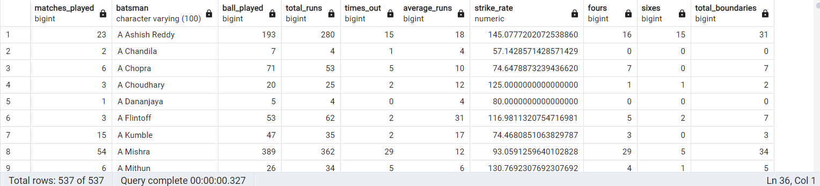
--creating table iplball
create table ipl_ball (id int,inning int,over int,ball int,batsman varchar(100),non_striker varchar(100),bowler varchar(100),batsmen_runs int,extra_run int,total_runs int,is_wicket int,dismissal_kind varchar(100),pyaler_dismissal varchar(100),fielder varchar(100),extras_type varchar(100),batting_team varchar(100),bowling_team varchar(100) );
--copy data from csv in ipl ball
copy ipl_ball from 'C:\Program Files\PostgreSQL\16\data\copy data\IPL_Ball.csv' delimiter ',' csv header;
--making table of batsmen stats data
create table batsmen_stats as select count(distinct (id)) as matches_played ,batsman,count(ball) as ball_played ,sum(batsmen_runs) as total_runs , sum(is_wicket) as times_out, case when sum(is_wicket)>0 then (SUM(batsmen_runs) / NULLIF(SUM(is_wicket), 0)) else SUM(batsmen_runs) end AS average_runs, (SUM(batsmen_runs) * 100.0) / NULLIF( COUNT(*) , 0) AS strike_rate , SUM(CASE WHEN batsmen_runs = 4 THEN 1 ELSE 0 END) AS fours, SUM(CASE WHEN batsmen_runs = 6 THEN 1 ELSE 0 END) AS sixes,SUM(CASE WHEN batsmen_runs IN (4, 6) THEN 1 ELSE 0 END) AS total_boundaries from ipl_ball where not extras_type= 'wides' group by batsman;
--showing demo data of batsmen stats
select * from batsmen_stats ;
NOTE*- THIS IS ONLY LITTLE PART OF TABLE WHOLE TABLE CAN,T BE CAPTURE IN ONE SCREENSHOT

Slide 2
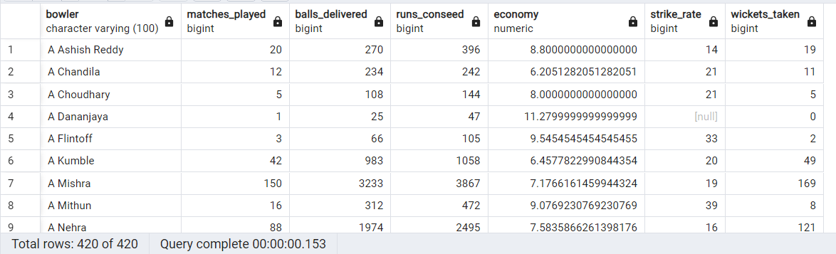
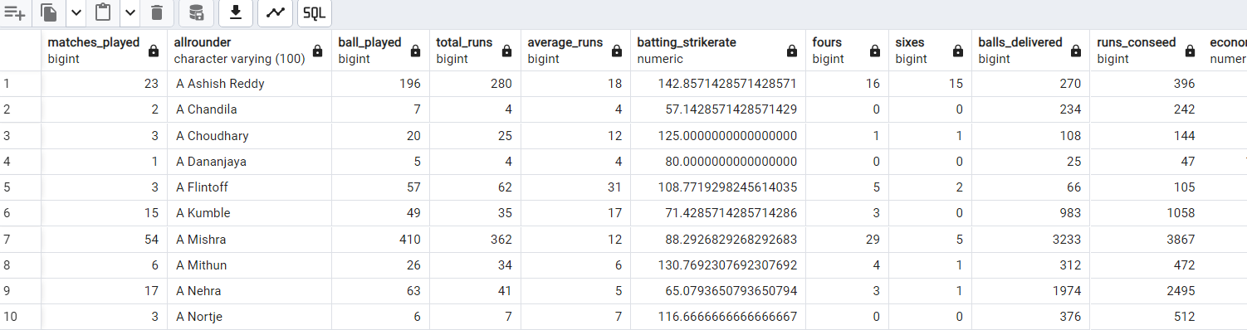
-- creating table from bowler stats
create table bowler_stats as SELECT bowler, COUNT(DISTINCT id) AS matches_played, COUNT(ball) AS balls_delivered,SUM(batsmen_runs + CASE WHEN extras_type NOT IN ('byes','legbyes') THEN extra_run ELSE 0 END) as runs_conseed,(SUM(batsmen_runs + CASE WHEN extras_type NOT IN ('byes', 'legbyes') THEN extra_run ELSE 0 END) / (COUNT(*) / 6.0)) AS economy, COUNT(ball) / NULLIF(SUM(is_wicket), 0) AS strike_rate, SUM(is_wicket) AS wickets_taken
FROM IPL_Ball GROUP BY bowler;
--showing demo of table bowler_stats
select * from bowler_stats ;
NOTE*- THIS IS ONLY LITTLE PART OF TABLE WHOLE TABLE CAN,T BE CAPTURE IN ONE SCREENSHOT
--creating table for allrounders_stats
create table allrounder_stats as select a.matches_played,a.batsman as allrounder,a.ball_played,a.total_runs,a.average_runs,a.strike_rate as batting_strikerate ,a.fours,a.sixes,b.balls_delivered,b.runs_conseed,b.economy,b.strike_rate as bowling_strikerate,b.wickets_taken from batsmen_stats as a join bowler_stats as b on a.batsman=b.bowler;
--showig data of all rounder
select * from allrounder_stats;
NOTE*- THIS IS ONLY LITTLE PART OF TABLE WHOLE TABLE CAN,T BE CAPTURE IN ONE SCREENSHOT

Slide 3
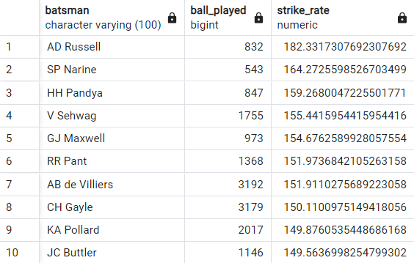
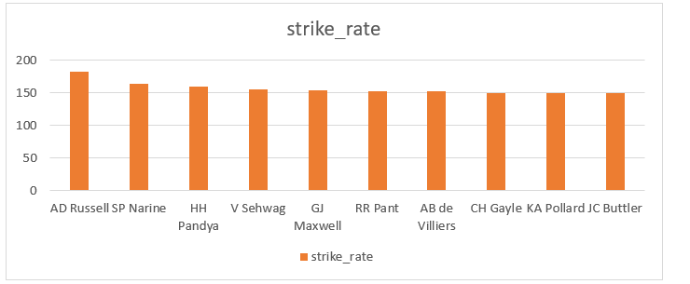
/* Your first priority is to get 2-3 players with high S.R who have faced at least 500 balls.
And to do that you have to make a list of 10 players you want to bid in the auction so that when
you try to grab them in auction you should not pay the amount greater than you have in the purse
for a particular player.*/
select batsman , ball_played , strike_rate from batsmen_stats where ball_played>500 order by strike_rate desc limit 10;

Slide 4
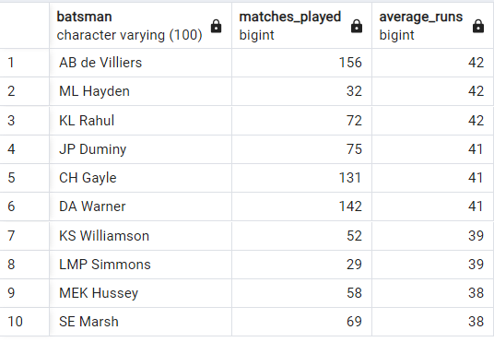
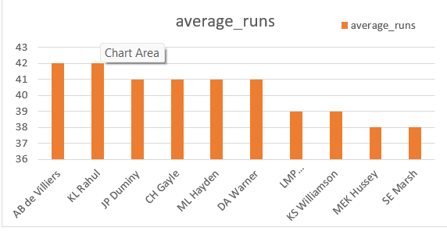
/* Now you need to get 2-3 players with good Average who have played more the 2 ipl seasons.
And to do that you have to make a list of 10 players you want to bid in the auction so that
when you try to grab them in auction you should not pay the amount greater than you have in
the purse for a particular player. */
select batsman, matches_played , average_runs from batsmen_stats where matches_played>28 order by average_runs desc limit 10;

Slide 5
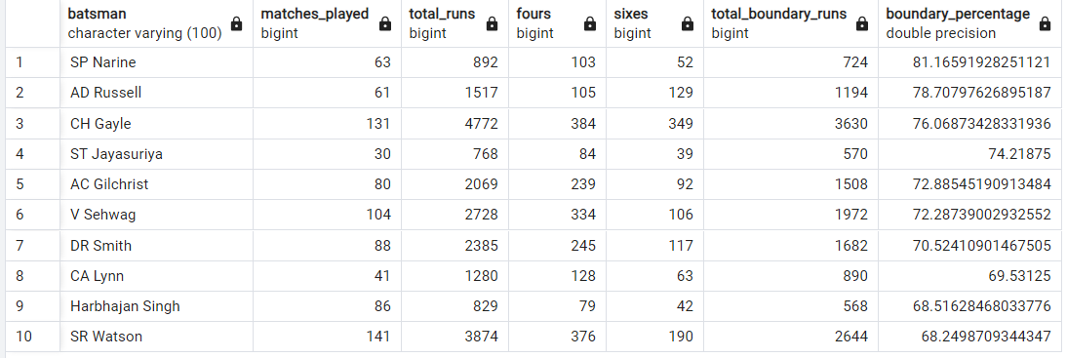
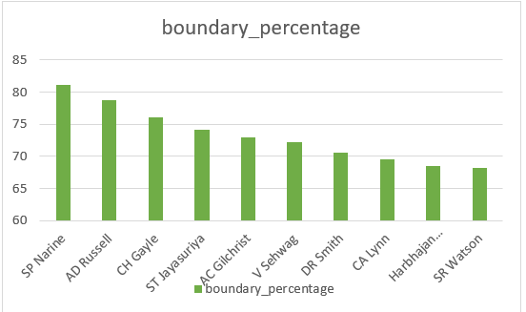
/* Now you need to get 2-3 Hard-hitting players who have scored most runs in boundaries and have
played more the 2 ipl season. To do that you have to make a list of 10 players you want to bid in
the auction so that when you try to grab them in auction you should not pay the amount greater than
you have in the purse for a particular player.*/
SELECT batsman , matches_played, total_runs , fours , sixes , (fours * 4 + sixes * 6) AS total_boundary_runs,
CASE WHEN total_runs = 0 THEN 0 ELSE ((fours * 4 + sixes * 6) / total_runs::float) * 100 END AS boundary_percentage FROM batsmen_stats where matches_played>28 ORDER BY boundary_percentage DESC limit 10;

Slide 6
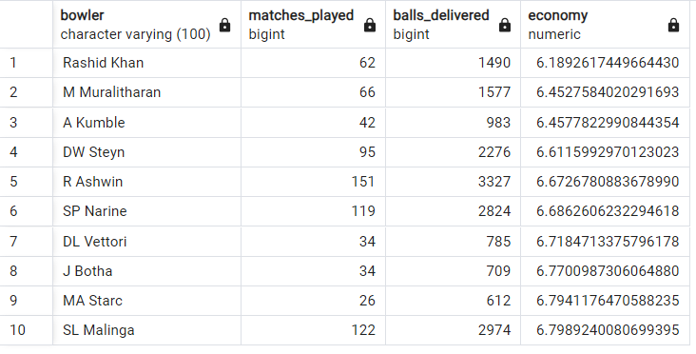
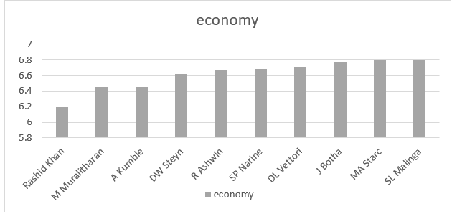
/* Your first priority is to get 2-3 bowlers with good economy who have bowled at least 500 balls
in IPL so far.To do that you have to make a list of 10 players you want to bid in the auction so
that when you try to grab them in auction you should not pay the amount greater than you have in
the purse for a particular player.*/
select bowler ,matches_played , balls_delivered ,economy from bowler_stats
where balls_delivered>500 order by economy limit 10;

Slide 7
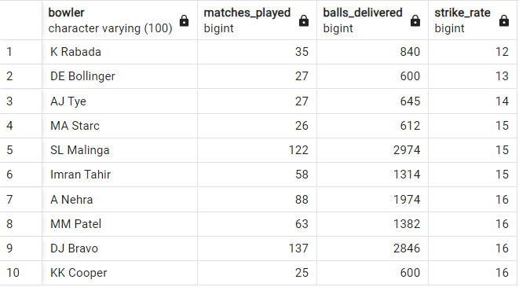
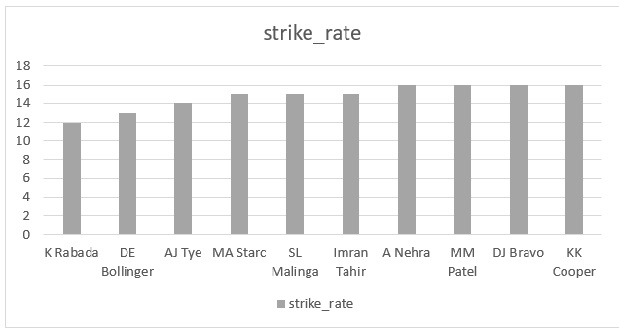
/* Now you need to get 2-3 bowlers with the best strike rate and who have bowled at least 500 balls
in IPL so far.To do that you have to make a list of 10 players you want to bid in the auction so that
when you try to grab them in auction you should not pay the amount greater than you have in the purse
for a particular player.*/
select bowler , matches_played , balls_delivered , strike_rate from bowler_stats
where balls_delivered>500 order by strike_rate limit 10;

Slide 8
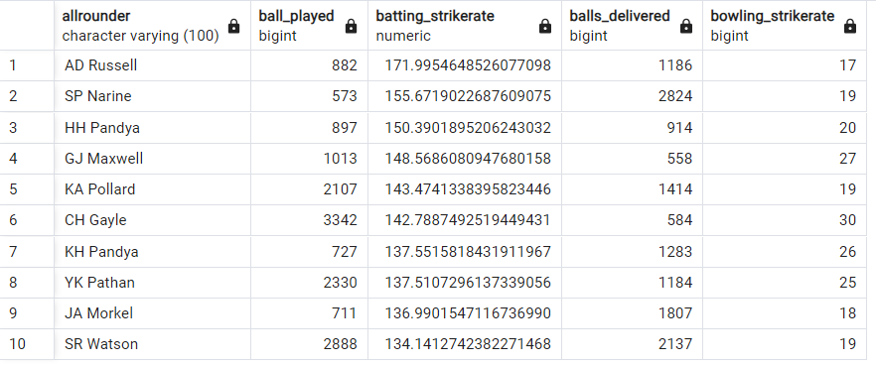
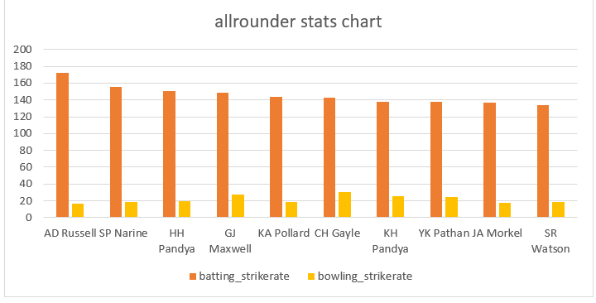
/* Now you need to get 2-3 All_rounders with the best batting as well as bowling strike rate and who have faced at least 500 balls in IPL so far and have bowled minimum 300 balls.To do that you haveto make a list of 10 players you want to bid in the auction so that when you try to grab them in auction you should not pay the amount greater than you have in the purse for a particular player.*/
--selecting allrounder for team
select allrounder , ball_played , batting_strikerate , balls_delivered, bowling_strikerate from allrounder_stats where ball_played>499 and balls_delivered>299 order by batting_strikerate desc , bowling_strikerate desc limit 10;

Slide 9
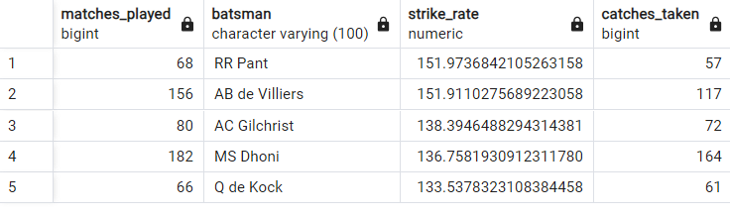
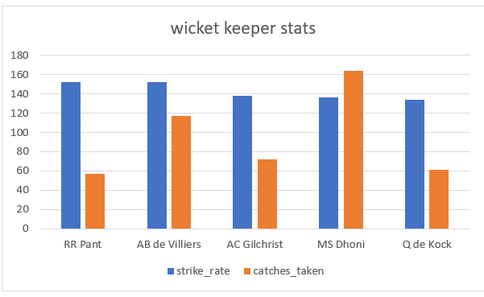
/* selecting a wicketkeeper for a team*/
Explanation - I am selecting a wicket keeper on the bases of the catches taken by a wicket keeper which is a most important factor of wicketkeeper as data given and I also used their strike rate.
So that the wicket keeper should contribute to team total runs with a good strike rate which help to score quick runs in t20 . I have taken top 30 data of catch taken and filter
Wicket keeper using wicket keeper name list and then I take the strike rate data in order to get top 5 of result for target. Luckily I have 3 of them already in target list so I mention them as Wicket keeper batsmen and remaining 2 I mentioned as wicket keeper.
select a.matches_played,a.batsman,a.strike_rate,b.catches_taken from batsmen_stats as a join (select fielder,count(dismissal_kind) as catches_taken from ipl_ball where fielder in (select distinct(fielder) from ipl_ball where dismissal_kind='caught’) group by fielder order by catches_taken desc limit 30) as b on b.fielder=a.batsman where a.batsman in ('MS Dhoni','KD Karthik','RV Uthappa','AB de Villiers','PA Patel','WP Saha','NV Ojha','AC Gilchrist','Q de Kock','RR Pant','KC Sangakkara') order by strike_rate desc limit 5;

Slide 10
■ Selected players to target in auction
Players name | Cateogery
AD Russell | Allrounder
SP Narine | Allrounder
HH Pandya | Allrounder
GJ Maxwell | Allrounder
KA Pollard | Allrounder
CH Gayle | Allrounder
Harbhajan Singh | Allrounder
SR Watson | Allrounder
DJ Bravo | Allrounder
KH Pandya | Allrounder
YK Pathan | Allrounder
JA Morkel | Allrounder
JC Buttler | Batsman
KL Rahul | Batsman
V Sehwag | Batsman
JP Duminy | Batsman
ML Hayden | Batsman
DA Warner | Batsman
LMP Simmons | Batsman
KS Williamson | Batsman
MEK Hussey | Batsman
SE Marsh | Batsman
ST Jayasuriya | Batsman
DR Smith | Batsman
CA Lynn | Batsman
Rashid Khan | Bowler
M Muralitharan | Bowler
A Kumble | Bowler
DW Steyn | Bowler
R Ashwin | Bowler
DL Vettori | Bowler
J Botha | Bowler
MA Starc | Bowler
SL Malinga | Bowler
K Rabada | Bowler
DE Bollinger | Bowler
AJ Tye | Bowler
Imran Tahir | Bowler
A Nehra | Bowler
MM Patel | Bowler
KK Cooper | Bowler
AB de Villiers | Wicket keeper and batsmen
AC Gilchrist | Wicket keeper and batsmen
RR Pant | Wicket keeper and batsmen
MS Dhoni | wicket keeper
Note*- I donated a wicket keeper and batsmen because they are already selected in team but I get them in wicket Table result also
Q de kock | wicket keeper

Slide 11
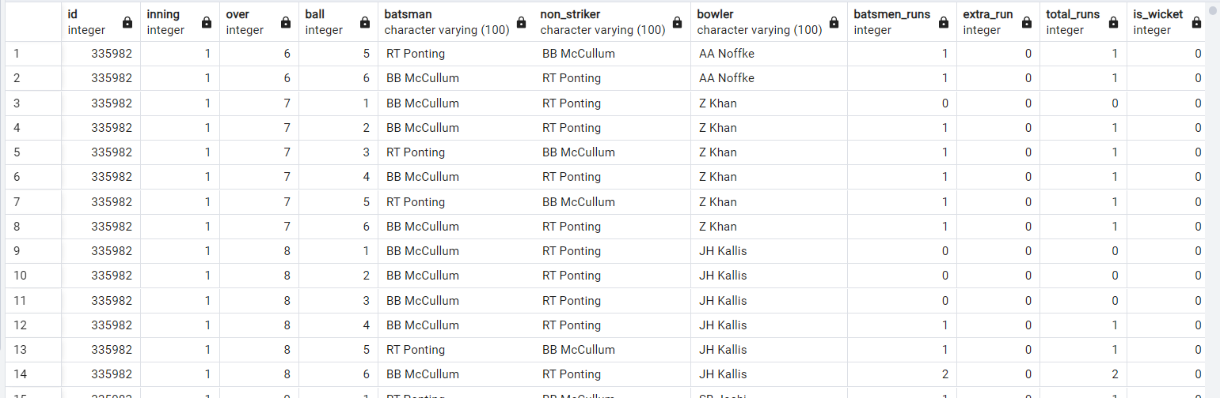
-- Additional questions
--creating table deliveries
create table deliveries (id int,inning int,over int,ball int,batsman varchar(100),non_striker varchar(100),bowler varchar(100),batsmen_runs int,extra_run int,total_runs int,is_wicket int,dismissal_kind varchar(100),pyaler_dismissal varchar(100),fielder varchar(100),extras_type varchar(100),batting_team varchar(100),bowling_team varchar(100) );
--copy data from csv in ipl ball
copy deliveries from 'C:\Program Files\PostgreSQL\16\data\copy data\IPL_Ball.csv' delimiter ',' csv header;
--showing data of deliveries
select * from deliveries;
--creating table maches
create table matches (id int,city varchar(100),date date,player_of_match varchar(100),venue varchar(200),neutral_vanue int,team1 varchar(100),team2 varchar(100),toss_winnwe varchar(100),toss_decision varchar(100),winner varchar(100),result varchar(100),result_margin int,eliminator varchar(100),method varchar(100),umpire1 varchar(100),umpire2 varchar(100));
--copy data from csv in maches
copy matches from 'C:\Program Files\PostgreSQL\16\data\copy data\IPL_matches.csv' delimiter ',' csv header;

Slide 12
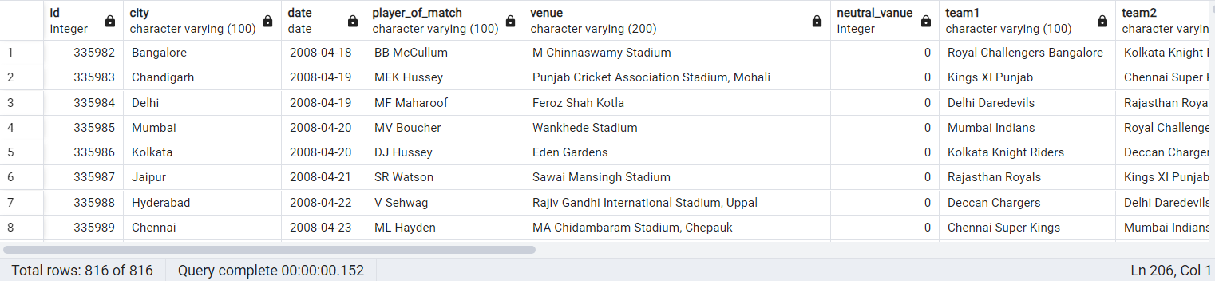
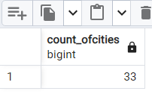
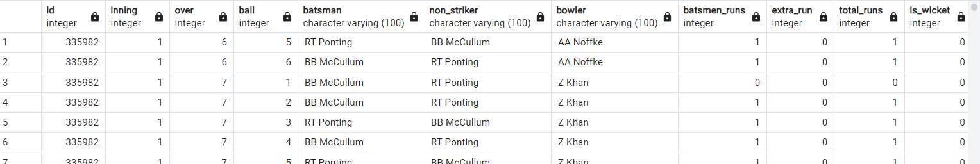
--showing data of maches
select * from matches;
Q1- Get the count of cities that have hosted an IPL match?
select count(distinct city) as count_ofcities from matches ;
Q2- Create table deliveries_v02 with all the columns of the table 'deliveries' and an additional
column ball_result containing values boundary, dot or other depending on the total_run (boundary for >= 4, dot for 0 and other for any other number)
(Hint 1 : CASE WHEN statement is used to get condition based results)
(Hint 2: To convert the output data of the select statement into a table, you can use a subquery. Create table table_name as [entire select statement].
CREATE TABLE DELIVERIES_V02 AS
SELECT id,inning,over,ball,batsman,non_striker,bowler,batsmen_runs,extra_run,total_runs,is_wicket,dismissal_kind,pyaler_dismissal as player_dismissal , fielder, extras_type , batting_team , bowling_team , CASE WHEN total_runs >= 4 THEN 'boundary' WHEN total_runs = 0 THEN 'dot' ELSE 'other' END AS ball_result FROM DELIVERIES;
--selecting deliveries v02 data
select * from DELIVERIES_V02;
note*- other columns are not able to capture in this screen shot

Slide 13

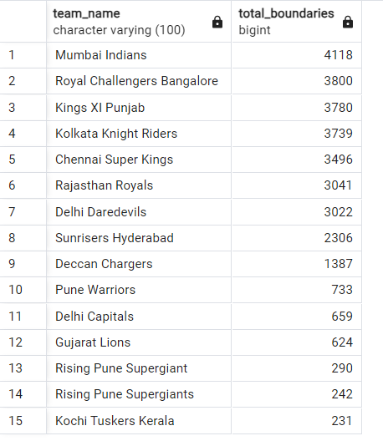
Q3- Write a query to fetch the total number of boundaries and dot balls from the deliveries v02 table
SELECT SUM(CASE WHEN ball_result = 'boundary' THEN 1 ELSE 0 END) AS total_boundaries, SUM(CASE WHEN ball_result = 'dot' THEN 1 ELSE 0 END) AS total_dot_balls FROM deliveries_v02;
Q4-Write a query to fetch the total number of boundaries scored by each team from the deliveries_v02 table and order it in descending order of the number of boundaries scored?
select distinct(batting_team) as team_name , SUM(CASE WHEN ball_result='boundary' then 1 else 0 END) as total_boundaries from DELIVERIES_V02 GROUP BY batting_team order by total_boundaries desc;

Slide 14
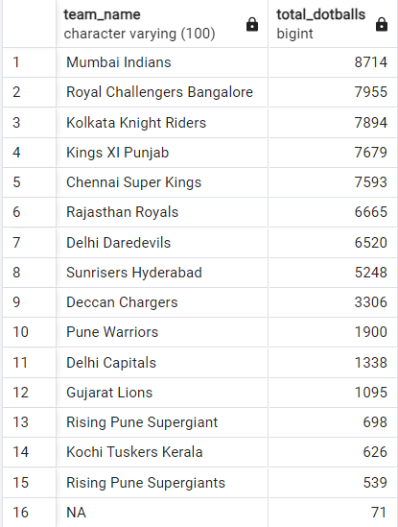
Q5 -Write a query to fetch the total number of dot balls bowled by each team and order it in
descending order of the total number of dot balls bowled.
select distinct(bowling_team) as team_name , SUM(CASE WHEN ball_result='dot' then 1 else 0 END) as total_dotballs from DELIVERIES_V02 GROUP BY bowling_team order by total_dotballs desc;

Slide 15
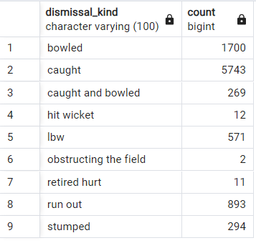
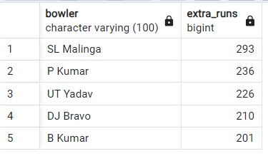
Q6-Write a query to fetch the total number of dismissals by dismissal kinds where dismissal
kind is not NA
select distinct(dismissal_kind),count(dismissal_kind) from deliveries
where NOT dismissal_kind='NA’
group by dismissal_kind;
Q7 Write a query to get the top 5 bowlers who conceded maximum extra runs from the deliveries table
select bowler,sum(extra_run) as extra_runs
from deliveries
group by bowler
order by extra_runs desc
limit 5;

Slide 16
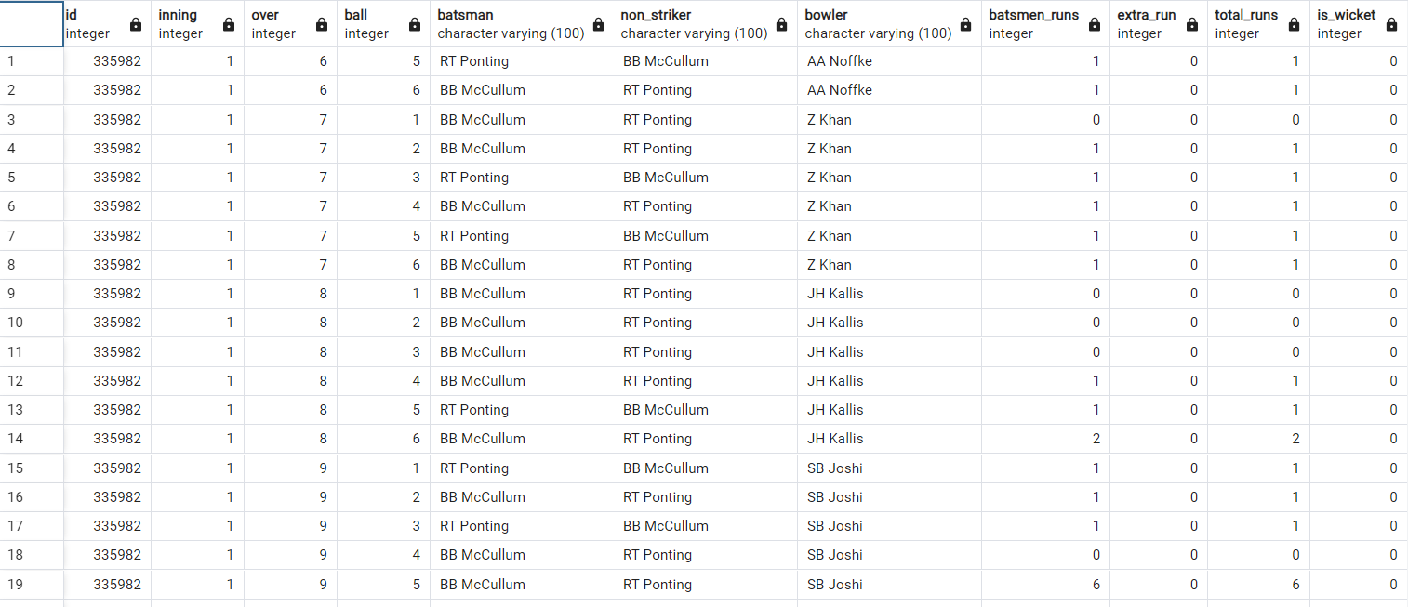
Q8- Write a query to create a table named deliveries_v03 with all the columns of deliveries_v02 table and two additional column (named venue and match_date) of venue and date from table matches
-- creating table deliveries_v03
create table deliveries_v03 as select d.*,m.venue, m.date as match_date from DELIVERIES_V02 as d join matches as m on m.id=d.id;
--showing data of deliveries_v03
select * from deliveries_v03;
note*- other columns are not able to capture in this screen shot

Slide 17
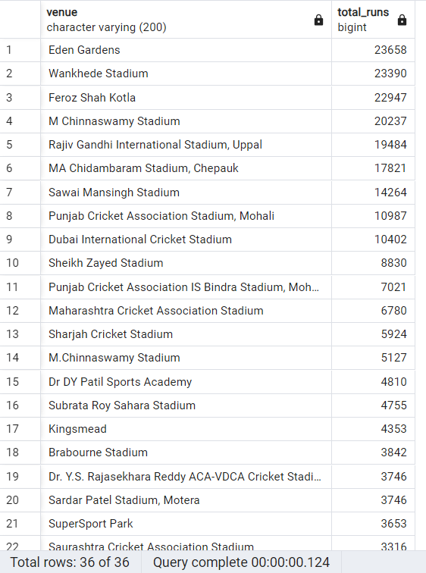
Q9-Write a query to fetch the total runs scored for each venue and order it in the descending order of total runs scored
select venue,sum(total_runs) as total_runs
from deliveries_v03
group by venue
order by total_runs desc;
note*- other columns are not able to capture in this screen shot

Slide 18
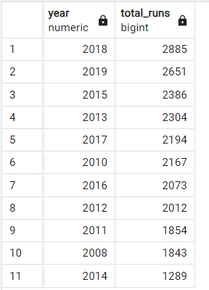
Q10. Write a query to fetch the year-wise total runs scored at Eden Gardens and order it in the descending order of total runs scored?
select extract(year from match_date) as year ,sum(total_runs) as total_runs from deliveries_v03
where venue = 'Eden Gardens’
group by extract(year from match_date)
order by total_runs desc ;

