Slide 1
Empirical Evaluation of Machine Learning Techniques for Text Classification

Slide 2

Group Members
Mythrei Nalluri (700741075)
Madhuri Gadaboina (700741049)
Sushant Ashish (700747009)
Vinay Kumar Camarushi (700740428)

Slide 3
RESPONSIBILITIES
Sushant Ashish
Worked on Dataset, Data Preprocessing, SVM, Random Forest & Documentation.
Madhuri Gadaboina
Worked on Dataset, Decision Tree and K-Nearest Neighbors.
Vinay Kumar Camarushi
Worked on Dataset, Data Visualization, Naïve Bayes and Documentation.
Mythrei Nalluri
Worked on Dataset, Logistic Regression

Slide 4
Motivation
Text classification is the process of classifying a text material into a number of predetermined categories or tags. It is a key problem in NLP and has uses in a number of areas, including topic modeling, sentiment analysis, and spam filtering.
The requirement for precise and effective text classification has expanded quickly with the growth of digital text data. Many different algorithms have been presented, and machine learning techniques have demonstrated promising results in text classification.
Yet, choosing the best method and its optimal parameters for a given problem is not an easy task. To determine the most effective method, empirical evaluation of various ML algorithms for text classification is required.

Slide 5
Objectives
Preprocessing: To eliminate clutter and unimportant data, as well as to standardize the text format, the text data needs to be preprocessed.
Feature Extraction: The text data is transformed into features[7], a numerical representation that the machine learning model can use to make predictions
Model Selection: For text categorization, a variety of machine learning models and algorithms can be employed; the optimal one should be selected depending on the problem's requirements and data characteristics
Training and Evaluation: A labeled dataset must be used to train the model, and measures like accuracy, precision, recall, and F1-score must be used to assess its performance.
Deployment: Once the model is trained and evaluated, it can be deployed in a real-world system to classify new, unseen text documents.

Slide 6
Related Work
Data Preprocessing: The 20,000 News Group dataset is a widely used benchmark dataset for text classification tasks.
Splitting of Data: To avoid overfitting, the dataset was divided into two categories: training datasets and, testing datasets, which were divided by 80 percent and 20 percent, respectively.
We removed any documents with missing or invalid content and performed tokenization to split each document into individual words. We also applied stop-word removal and stemming to reduce the dimensionality of the feature space.

Slide 7
Problem Statement
Text classification is the process of classifying a text material into a number of predetermined categories or tags. It is a key problem in NLP and has uses in a number of areas, including topic modeling, sentiment analysis, and spam filtering.
The requirement for precise and effective text classification has expanded quickly with the growth of digital text data.
Many different algorithms have been presented, and machine learning (ML) techniques have demonstrated promising results in text classification.
Yet, choosing the best method and its optimal parameters for a given problem is not an easy task.
To determine the most effective method, empirical evaluation of various ML algorithms for text classification is required

Slide 8
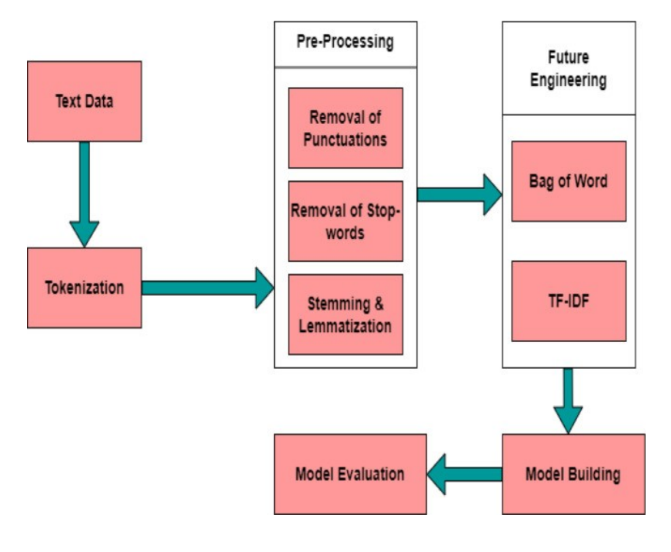
Proposed Solution

Slide 9
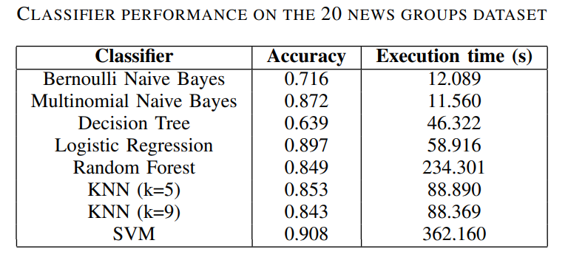
Results
Few Important Highlights from our interpretation of the results:
SVM proves to be the best classifier in terms of accuracy with 90.8%.
Surprisingly, Naïve Bayes (Multinomial) also seem to perform good, but has proved to be inconsistent based on the type of dataset used, and also different results if train-test split is changed, as it assumes the independence of features.
KNN with 5 and 9 neighbors seem to give almost similar results. As a matter of fact, k=5 gives slightly better accuracy results than k=9 with similar execution times as well.
Logistic regression seems to be the most versatile option considering the efficiency acquired in a faster execution time.
Random Forest also performs as expected, good but not the best considering both factors.
Decision Tree classifier performs the worst and should be avoided at all cost.

Slide 10
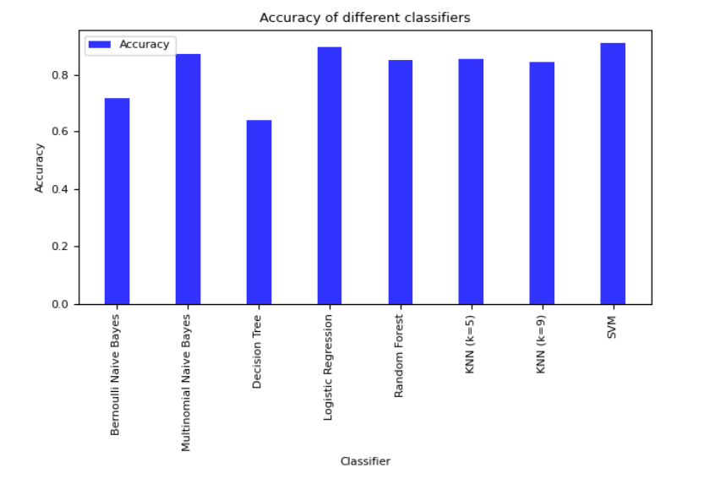
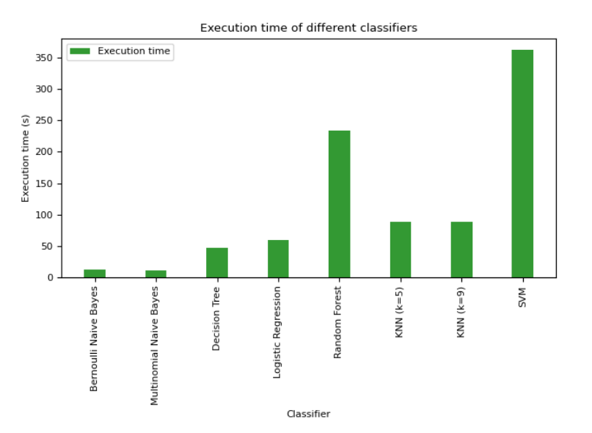

Slide 11
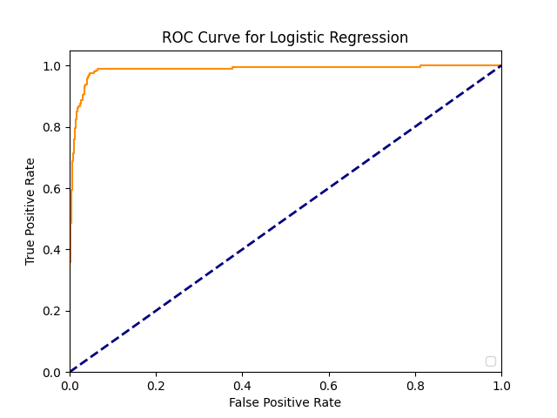
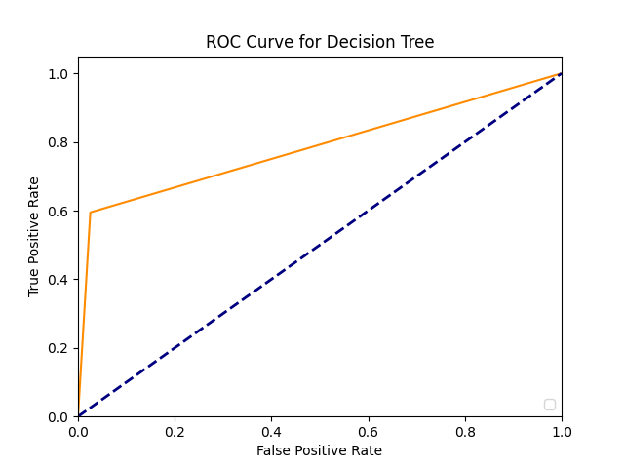
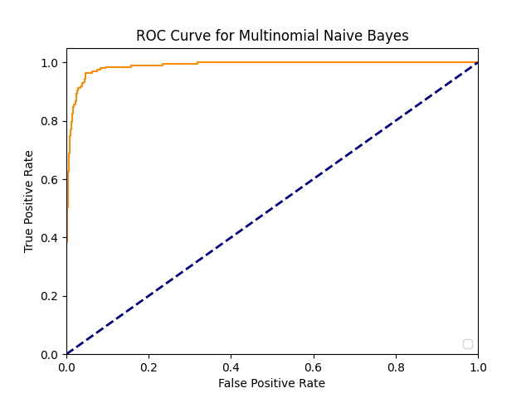
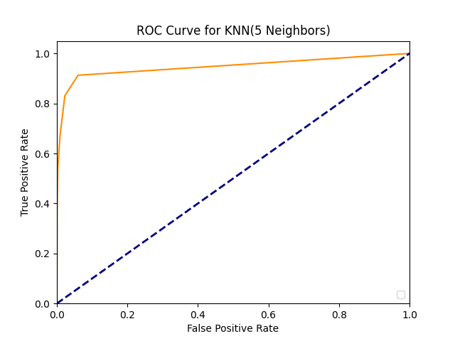

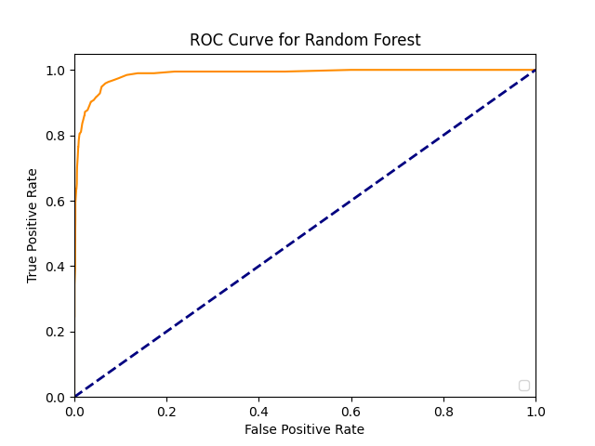

Slide 12
References
[1] Z. Xue, J. Wei and W. Guo, ”A Real-Time Naive Bayes Classifier Accelerator on FPGA,” in IEEE Access vol. 8, pp. 40755-40766, 2020.
[2] Jain, Pratyaksh, Karthik Ram Srinivas, and Abhishek Vichare. ”Depression and suicide analysis using machine learning and NLP.” Journal of Physics: Conference Series. Vol. 2161. No. 1. IOP Publishing 2022.
[3] Babu, N.V., Kanaga, E.G.M. “Sentiment Analysis in Social Media Data for Depression Detection Using Artificial Intelligence: A Review. SN COMPUT. SCI. 3, 74 (2022).
[4] Guia, M.; Silva, R. and Bernardino, J. (2019). Comparison of Na¨ıve Bayes, Support Vector Machine, Decision Trees and Random Forest on Sentiment Analysis. In Proceedings of the 11th International Joint Conference on Knowledge Discovery, Knowledge Engineering and Knowledge Management - KDIR
[5] G. Mustafa, M. Usman, M. T. Afzal, A. Shahid and A. Koubaa, ”A Comprehensive Evaluation of Metadata-Based Features to Classify Research Paper’s Topics,” in IEEE Access, vol. 9, pp. 133500-133509, 2021, doi:10.1109/ACCESS.2021.3115148
[6] Mehanna, Y.S.; Mahmuddin, M.B. A Semantic Conceptualization Using Tagged Bag-of-Concepts for Sentiment Analysis. IEEE Access 2021, 9, 118736–118756.
[7] Kabir M, Kabir MMJ, Xu S, Badhon B (2021) An empirical research on sentiment analysis using machine learning approaches. Int J Comput Appl 43(10):1011–1019.
[8] S. Chowdhury and M. P. Schoen, ”Research Paper Classification using Supervised Machine Learning Techniques,” 2020 Intermountain Engineering, Technology and Computing (IETC), Orem, UT, USA, 2020, pp. 1-6, doi: 10.1109/IETC47856.2020.9249211.
[9] Shah, K., Patel, H., Sanghvi, D. et al. A Comparative Analysis of Logistic Regression, Random Forest and KNNModels for the Text Classification. Augment Hum Res 5, 12 (2020).
[10] L. Zhang et al., ”BERT Based Sentiment Analysis in Social Media,” in IEEE Access, vol. 9, pp. 72335-72345, 2021.
[11] Y. Wang et al., ”Efficient Convolutional Neural Networks for Text Classification with Variable-Length Input,” in IEEE Transactions on Neural Networks and Learning Systems, vol. 32, pp. 320-333, 2021. [12] K. Li et al., ”Multimodal Sentiment Analysis Using Hierarchical Attention-Based Deep Neural Networks,” in IEEE Transactions on Multimedia, vol. 23, pp. 1355-1368, 2021. [13] J. Zhang et al., ”Attention-Based Deep Neural Networks for Text Classification: A Review,” in IEEE Access, vol. 8, pp. 219221-219238, 2020. [14] T. Chen et al., ”Self-Attention Based Recurrent Neural Network for Text Classification,” in IEEE Access, vol. 8, pp. 22650-22659, 2020. [15] Q. Zhang et al., ”Adaptive Deep Learning Framework for Short Text Classification,” in IEEE Access, vol. 8, pp. 186087-186099, 2020. [16] X. Ma et al., ”A Survey of Deep Learning-Based Text Classification Techniques,” in IEEE Transactions on Neural Networks and Learning Systems, vol. 32, pp. 629-647, 2021. [17] X. Zhou et al., ”Fine-Grained Multi-Label Text Classification by LabelEnhanced Embedding and Attention Network,” in IEEE Transactions on Knowledge and Data Engineering, vol. 33, pp. 400-413, 2021. [18] W. Zhang et al., ”A Novel Feature Learning Framework for Text Classification Based on Convolutional Neural Networks,” in IEEE Access, vol. 7, pp. 69000-69010, 2019. [19] X. Liu et al., ”An Attention Enhanced Multi-Channel Convolutional Neural Network for Text Classification,” in IEEE Access, vol. 7, pp. 166190-166201, 2019. [20] D. Wang, ”Learning to Respond with Deep Neural Networks for Retrieval-Based Dialog Systems,” in IEEE/ACM Transactions on Audio, Speech, and Language Processing, vol. 29, pp. 1800-1810, 2021.

Slide 13
[11] Y. Wang et al., ”Efficient Convolutional Neural Networks for Text Classification with Variable-Length Input,” in IEEE Transactions on Neural Networks and Learning Systems, vol. 32, pp. 320-333, 2021.
[12] K. Li et al., ”Multimodal Sentiment Analysis Using Hierarchical Attention-Based Deep Neural Networks,” in IEEE Transactions on Multimedia, vol. 23, pp. 1355-1368, 2021.
[13] J. Zhang et al., ”Attention-Based Deep Neural Networks for Text Classification: A Review,” in IEEE Access, vol. 8, pp. 219221-219238, 2020.
[14] T. Chen et al., ”Self-Attention Based Recurrent Neural Network for Text Classification,” in IEEE Access, vol. 8, pp. 22650-22659, 2020.
[15] Q. Zhang et al., ”Adaptive Deep Learning Framework for Short Text Classification,” in IEEE Access, vol. 8, pp. 186087-186099, 2020.
[16] X. Ma et al., ”A Survey of Deep Learning-Based Text Classification Techniques,” in IEEE Transactions on Neural Networks and Learning Systems, vol. 32, pp. 629-647, 2021.
[17] X. Zhou et al., ”Fine-Grained Multi-Label Text Classification by LabelEnhanced Embedding and Attention Network,” in IEEE Transactions on Knowledge and Data Engineering, vol. 33, pp. 400-413, 2021.
[18] W. Zhang et al., ”A Novel Feature Learning Framework for Text Classification Based on Convolutional Neural Networks,” in IEEE Access, vol. 7, pp. 69000-69010, 2019.
[19] X. Liu et al., ”An Attention Enhanced Multi-Channel Convolutional Neural Network for Text Classification,” in IEEE Access, vol. 7, pp. 166190-166201, 2019.
[20] D. Wang, ”Learning to Respond with Deep Neural Networks for Retrieval-Based Dialog Systems,” in IEEE/ACM Transactions on Audio, Speech, and Language Processing, vol. 29, pp. 1800-1810, 2021.

