Slide 1
PROJECT PRESENTATION
ContractIQ
AI Contract Intelligence & Risk Analysis
Upload a contract. Get every key clause, the exact evidence it rests on,
and a transparent risk score — entirely on your own machine.
Python 3.11
FastAPI
PyTorch · MiniLM
CUAD v1
React 19
SQLite
Local-first · No cloud · No paid APIs September 2026

Slide 2
AGENDA
What we will cover
01
The problem & the solution
why contract review breaks, and the pipeline that fixes it
02
System architecture
four layers, one direction of data flow
03
Machine learning
CUAD dataset, model choice, evidence-accurate extraction
04
Risk methodology
fifteen auditable rules behind the 0-100 score
05
Engineering
backend API, data model, security & privacy
06
Proof
199 tests, benchmarks, and a live demo on real files
Everything shown runs 100% locally — the demo at the end uses real files, not slides.

Slide 3
THE PROBLEM
Contract review is slow, manual, and easy to get wrong
6.7k
41
100%
median tokens per contract
risk-relevant clause categories
of review burden on one reader
max observed: 78.6k tokens
tracked in the CUAD v1 dataset
key clauses buried in boilerplate
Missed clauses are expensive — A missed auto-renewal, exclusivity or non-compete term binds the business for years.
Manual review doesn't scale — Reading every page to find 15 things that matter is hours of expert time per contract.
Cloud tools break confidentiality — Contracts are among the most sensitive documents a company holds; pasting them into web services is a non-starter.
Dataset facts: CUAD v1 (510 contracts, 20,910 QA pairs) — project Phase 1 dataset analysis

Slide 4
THE SOLUTION
One pipeline: from raw file to defensible analysis
1
2
3
4
5
Upload
→
Parse
→
Extract
→
Score
→
Review
PDF · DOCX · TXT,
validated & sanitized
PyMuPDF / python-docx
to exact text + offsets
MiniLM QA model fine-
tuned on CUAD
15 transparent risk
rules, 0–100 + band
Evidence-highlighted
workspace & history
100% local
Evidence-linked
Never legal advice
no cloud calls, no API keys — uploads never leave the machine
every finding stores the exact character range it came from
AI-assisted analysis; results are flagged for professional review

Slide 5
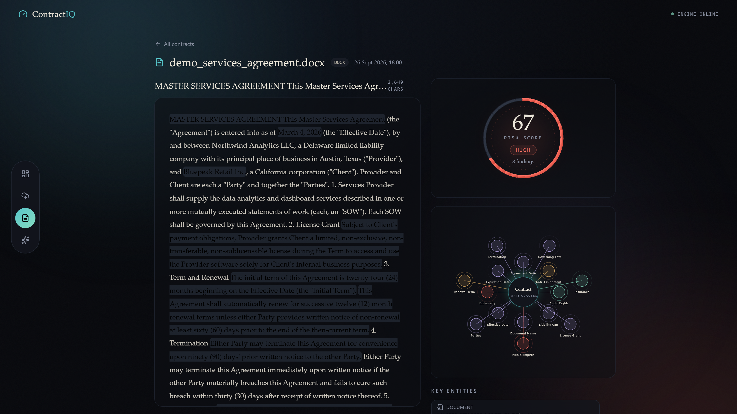
Analysis workspace — Risk Orb (67 · HIGH), Clause Intelligence Map, evidence highlighting

Slide 6
CAPABILITIES
What the engine delivers for every contract
15 clause types
Exact evidence
Transparent risk
Parties, dates, governing law, termination, non-compete, exclusivity, liability cap, insurance and more — from a 41-type CUAD registry.
Every clause maps to precise character offsets; verified at 0 mismatches across 129 checks on real analyses.
Deterministic 0–100 score from 15 readable rules in three bands — deliberately separate from AI confidence.
Robust ingestion
History & recovery
GPU or CPU
Safe handling of corrupt, encrypted, scanned and oversized files — rejected with clear errors, never fabricated text.
Searchable contract history, duplicate detection (SHA-256), crash recovery and idempotent re-analysis.
CUDA detection at startup with automatic CPU fallback — same code, no configuration.

Slide 7
SYSTEM DESIGN
Four layers, one direction of data flow
Document parser
Fine-tuned model
FastAPI (uvicorn)
PyMuPDF · python-docx
ml/models/final
33.4M params
React 19 + TypeScript
10 routes · request IDs
error envelope
upload validation
lifespan + recovery
Vite 7 · Tailwind 4
Risk Orb · Clause Map
API client w/ timeouts
ML adapter → MiniLM QA
HTTP /api
lazy-loaded singleton
SQLite
Risk engine
SQLAlchemy 2.0
storage/contractiq.db
15 deterministic rules
Design choices
Contract text is never logged; every failure maps to a typed error envelope; analysis state survives crashes; the ML layer sits behind a Protocol so models swap without touching the backend.
All state changes flow left to right — the UI never writes to the database directly.

Slide 8
MACHINE LEARNING · DATA
CUAD v1 — trained on real commercial contracts
510
41
20,910
contracts, 100+ pages average
clause categories
annotated QA pairs
US commercial agreements across 27 industries
each with a curated legal question template
span-level annotations by contract lawyers
How each clause type becomes a question
SPLIT
367
train contracts
41
validation (thresholds)
102
test — touched exactly once
"Is there a non-compete restriction?"
extracts the restriction, or answers: no
"What is the Cap on Liability?"
extracts the exact cap wording from the text
"What is the Renewal Term?"
no clause present → confident no-answer
Source: The Atticus Project, CUAD v1 (2021); project dataset integrity guarded by SHA-256 checksum

Slide 9
MACHINE LEARNING · MODEL CHOICE
Small enough for a laptop, smart enough for contracts
Candidate | Params | CPU speed (win/s) | Knows when a clause is absent | Verdict
MiniLM (SQuAD 2.0) | 33.4M | 4.43 | Yes — trained on no-answer data | SELECTED
DistilBERT (SQuAD 1.1) | 66M | 3.41 | No — always guesses an answer | Rejected
RoBERTa (SQuAD 2.0) | 125M | ~1.2 | Yes | Rejected: 3.7x compute
Why it matters the whole model is ~127 MB on disk and runs on a plain laptop CPU — the privacy promise (“never leaves your machine”) only holds if inference does not need a data-center GPU.
Trade-off we accept MiniLM trades some accuracy for a 3–4x speed edge — retrieval and windowing win it back, and the same code serves a gaming laptop (seconds per contract) and an office laptop without one.
Benchmark: project phase-3 model benchmark — batch inference on CPU, identical pre-processing

Slide 10
MACHINE LEARNING
Extractive QA, fine-tuned on legal contracts
Task formulation
Each clause type becomes a question (CUAD template) asked over the contract; the model returns the answer span — or 'no answer'.
FINE-TUNING RUN
20,420
1 epoch
838 s
train windows
batch 16 · lr 3e-5
on an RTX 2050 GPU
Sliding windows
512-token windows, stride 128, max answer 64 tokens — handles contracts far beyond the model's context.
1 epoch at batch 16, lr 3e-5, fp16, 1:3 positives-to-negatives — thresholds frozen on the 41-contract dev split before a single test run.
Base model
deepset/minilm-uncased-squad2 — 33.4M params, ~127 MB, no-answer aware; chosen over DistilBERT and RoBERTa on speed-per-accuracy.
RETRIEVAL — GOLD-ANSWER RECALL @ K=15
79.4%
91.4%
95.2%
→
→
question only
+ TF-IDF keywords
+ title boost
Sources: phase3_retrieval_recall.md · phase3_training.md (project reports)

Slide 11
MACHINE LEARNING · EXTRACTION FLOW
From a 78,000-token contract to exact evidence
Contract
Blocks
TF-IDF ranking
Windows
MiniLM QA
Evidence
up to 78.6k tokens,
far beyond the model
→
1,200 chars,
200-char overlap
→
keywords + title boost
top-15 blocks
→
512 tokens, stride 128,
max answer 64
→
best span per clause
or no-answer
→
exact character
offsets → UI highlight
Why retrieval first? running every window of a long contract on CPU would dominate the ~80 s budget; ranking first cuts the work — and measured gold-answer recall at K=15 reaches 95.2%.
95.2%
11 / 15
0
of gold answers survive into the search window (was 79.4% with questions alone)
clauses use retrieval; 4 high-value clause types scan the full document instead
offset mismatches in 129 evidence checks — spans decode back to exact character positions
Sources: phase3_retrieval_recall.md · phase8 evidence-offset verification

Slide 12
RESULTS
Measured honestly on the official CUAD test set
Clause-level F1 — best and worst of 15 (102-contract test set, run once)
60.8%
exact match (EM), overall
66.2%
token F1, overall
74.4%
no-answer accuracy — knows when a clause is absent
Parties is the known weak spot: the answer spans many entities — flagged, not hidden.
Source: phase3_test_evaluation.md — official CUAD test split, frozen thresholds, single run

Slide 13
RISK METHODOLOGY
A risk score you can audit line by line
LOW 0–30
MEDIUM 31–60
HIGH 61–100
Example rules (weight · severity)
Separation of concerns
The ML model never assigns risk. It extracts facts; rules score them.
NON_COMPETE_PRESENT
+18
HIGH
EXCLUSIVITY_PRESENT
+15
HIGH
CAP_ON_LIABILITY_ABSENT
+12
MEDIUM
Confidence gate
Rules fire only at extraction confidence ≥ 0.5 — below that the finding is marked uncertain and excluded from the score.
AUTO_RENEWAL_LANGUAGE (regex)
+10
MEDIUM
TERMINATION_CONVENIENCE_ABSENT
+10
MEDIUM
AUDIT_RIGHTS_PRESENT
+4
LOW
Weights and bands are data, not code — configurable in ml/configs/clauses.json

Slide 14
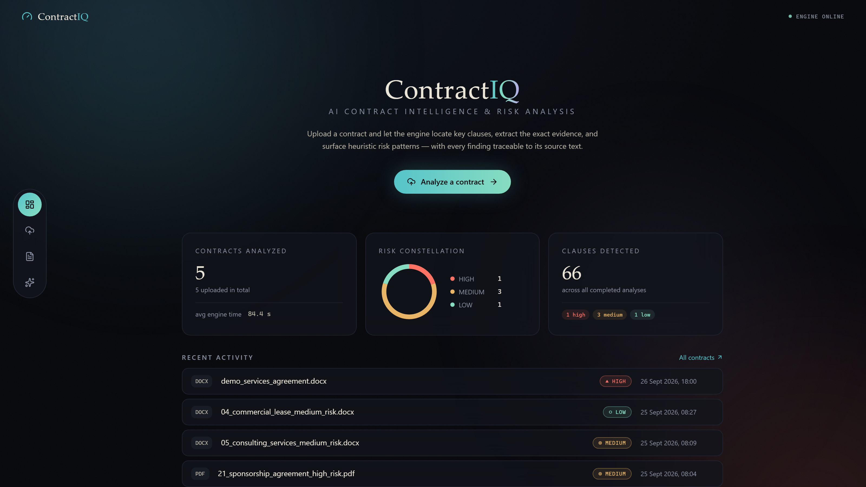
Overview dashboard — portfolio stats, risk constellation, recent activity, live engine status

Slide 15
ENGINEERING · LIFECYCLE
Every request is a small, safe state machine
1
Upload
validate (type, 20 MB cap) → store as UUID → parse to text → SHA-256 duplicate check → status READY
EVERY ERROR IS TYPED — NEVER A RAW TRACEBACK
{ "error": "OCR_REQUIRED",
"message": "The PDF has no text layer...",
"request_id": "dbb1496526d944b5" }
2
Analyze
ANALYZING → lazy-load model → extract 15 clauses with offsets → run 15 risk rules → write atomically → COMPLETED
the same request_id appears in the X-Request-ID header and in logs
3
Fail safely
corrupt / encrypted / scanned files and CUDA out-of-memory all become typed FAILED analyses — never a crashed server
Idempotent by design
Re-analyzing a contract replaces the previous result atomically — double-clicking Analyze can never corrupt data, and a 409 guards concurrent runs.
4
Recover
on startup, contracts stuck in ANALYZING from a crash are moved to a safe state automatically

Slide 16
ENGINEERING
A small, strict API over four tables
Endpoint | Purpose
POST /api/contracts/upload | validate → parse → store (201)
POST /api/contracts/{id}/analyze | run extraction + risk (idempotent)
GET /api/contracts/{id}/analysis | full analysis: clauses, evidence, findings
GET /api/contracts/{id}/text | raw text for evidence highlighting
GET /api/contracts | search · filter · sort · paginate
GET /api/stats · /api/health | dashboard stats · engine + model status
contracts
file info · status · text hash · raw text
analyses
risk score · model state · timings
clause_results
found · span offsets · confidence
risk_findings
rule · severity · weight · evidence
CONTRACT STATE MACHINE
UPLOADED
→
READY
→
ANALYZING
→
COMPLETED
→
FAILED
Stale ANALYZING rows are recovered to a safe state on restart.

Slide 17
ENGINEERING · SECURITY
Designed so the contract never leaves the machine
Uploads are untrusted input
type + 20 MB size checks; corrupt, encrypted and scanned files rejected with typed errors — content is never executed
Path safety by construction
user filenames are never used as paths; uploads stored under UUID names; traversal like ../../x is neutralized before anything touches disk
Log privacy
contract text is never written to logs — events carry IDs, codes and timings only; verified in the release secret-scan
Raw text is a switch
STORE_RAW_TEXT=true (needed for evidence highlighting) can be turned off to keep only metadata; temp files cleaned on a 24-hour policy
LAN mode is opt-in
production default binds localhost; the LAN launcher exposes the app without auth — documented, trusted-networks-only
Full review: docs/SECURITY.md · phase 8 secret-scan and evidence checks passed

Slide 18
QUALITY
Verified end to end, not just unit-tested
199
0
11.9×
135 kB
tests passing
evidence mismatches
GPU speed-up
frontend bundle
186 pytest + 13 vitest
across 129 checks, browser + DB
52.8 vs 4.43 windows/s — RTX 2050
gzipped production build
Full E2E with the real model
22-step browser run: upload → analyze → verify; 0 page errors, clean console.
Security reviewed
traversal-safe filenames, type/size validation, uploads never executed, no secrets, contract text never logged.
Failure modes designed
corrupt / encrypted / scanned files rejected with typed errors; CUDA OOM contained; stale analyses recovered.
Portable by construction
runs from any folder (spaces included); 150-file scan: no hardcoded paths.
Sources: phase8_final_qa.md · phase3_gpu_benchmark.md (project reports)

Slide 19
LIVE DEMO
Real files, real analysis — not slides
LOW
MEDIUM
HIGH
01_saas_subscription
05_consulting_services
09_franchise_agreement
friendly terms — the orb stays small; cap on liability and insurance are found, almost nothing fires
auto-renewal is flagged (+10) and the soft non-compete shows how wording rules work
non-compete, exclusivity, auto-renewal, no convenience exit — the orb climbs as rules stack
The demo folder ships with the project: demo_contracts/ — 22 agreements across SaaS, leases, franchises, joint ventures, GDPR DPAs and more, in LOW / MEDIUM / HIGH flavors, with PDF samples for the PDF pipeline. Nothing is uploaded until you drag it in.
Every number you will see is computed live on this laptop — the model, the rules and the data all stay on this machine.

Slide 20
HONEST ASSESSMENT
What it can't do yet — and what comes next
CURRENT LIMITATIONS
NEXT STEPS
Single-user, local only — no authentication
Async job queue with live progress streaming
Synchronous analysis — the UI waits (no queue)
OCR pipeline for scanned contracts (Tesseract)
Risk rules are heuristics, not learned from outcomes
Learned risk model on top of extracted clauses
Scanned PDFs need OCR — not implemented
Enable more of the 41 CUAD clause types (flag-flip)
Parties extraction is weak on multi-entity spans
Auth + multi-user mode for small teams
Every limitation above is documented in the project reports — the system never hides uncertainty.

Slide 21
THANK YOU
Every finding traceable
to its source text.
95.2%
66.2%
15
199
100%
retrieval recall
test F1
clause types
tests passing
local & private
ContractIQ — AI-assisted analysis. Results should be reviewed by a qualified professional. Not legal advice.
Questions welcome.

