Slide 1
Task 4 – Dashboard Design
Sales & Financial Performance
Elevate Labs Data Analyst Internship

Slide 2
Dashboard KPIs
Total Sales: $1,712,265
Total Profit: $340,805
Orders: 600
Profit Margin: 19.9%

Slide 3
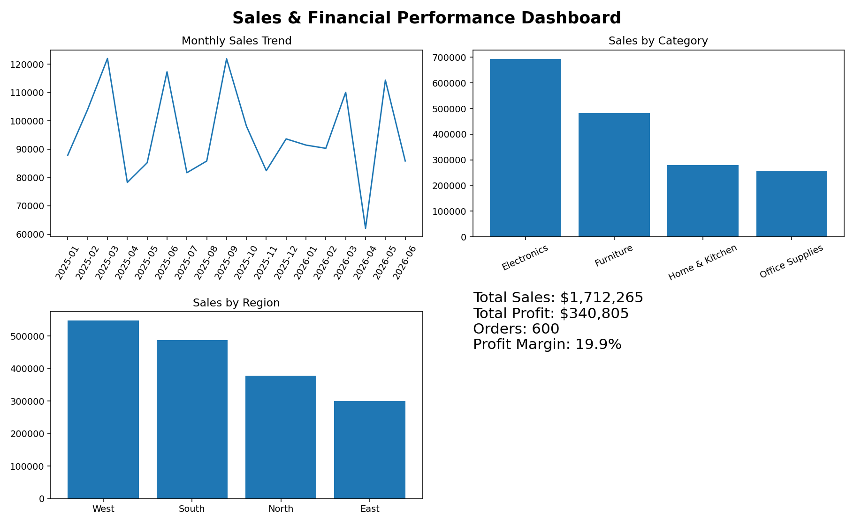
Dashboard Features
Interactive filters: Year, Region, Category, Channel
Monthly time-series analysis
Sales by Category, Region and Channel
KPI cards for executive summary

Slide 4
Business Insights & Recommendations
Electronics leads category sales.
West leads regional sales.
Office Supplies is the lowest-sales category.
Monitor profit margin alongside sales growth.
Use filters to investigate underperforming segments.

