Slide 1


SMART INDIA HACKATHON 2026
"AI-Based Early Forecasting of Bovine Mastitis in Indian Dairy Farms"
Problem Statement ID –SIH26109
Problem Statement Title-
"AI-Based Predictive Modelling for Early Forecasting of
Bovine Mastitis in Indian Dairy Farms“
Theme-Agriculture, FoodTech & Rural Development
PS Category- Hardware
Team ID-SIH26-A0H-T276
Team Name (Registered on portal)-HexaCore
1

Slide 2




MASTITIS FORECASTER
Detailed Solution
→
Sensor
EC + temp,
per quarter
Sensing — A clip-on probe measures electrical conductivity (EC) and temperature for each quarter during hand milking, using a two-electrode AC measurement system with ±3% measurement accuracy and a response time of <2 seconds per reading.
→
What makes us different
Per-cow, offline AI: Learns each cow's own EC/temperature baseline and predicts mastitis risk on-device (TinyML), with no cloud or connectivity required.
Built for hand-milking, not parlours: A ₹3,000–3,500 clip-on probe brings parlour-grade detection to small/medium Indian dairy farms at a fraction of automated-system cost.
Actionable + compliant: Alerts via buzzer/LED in local language (no smartphone needed) and auto-tracks antibiotic withdrawal windows per cow for traceability.
On Display Monitoring
Logs yield,
works offline
→
→
Predicting-Learns each cow's personal EC, yield and behaviour baseline; flags readings over 15-20% deviation. Confirmed only after 2 consecutive milkings.
Prediction Model
Per-cow
baseline check
→
→
Alert-Fires on-device as a buzzer plus red/green icon, days before any visible sign, with zero connectivity needed.
Alert
Local-language+buzzer
→
Tracking-Logs every alert and antibiotic-withdrawal window against the cow automatically.
2

Slide 3
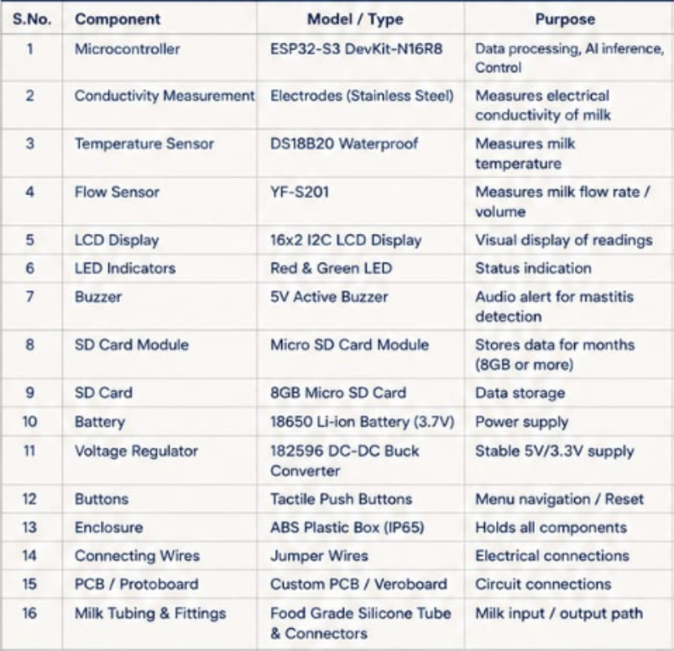
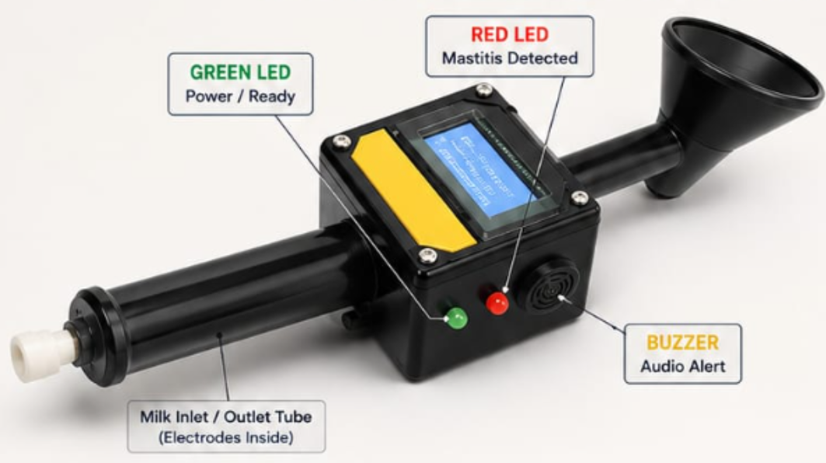
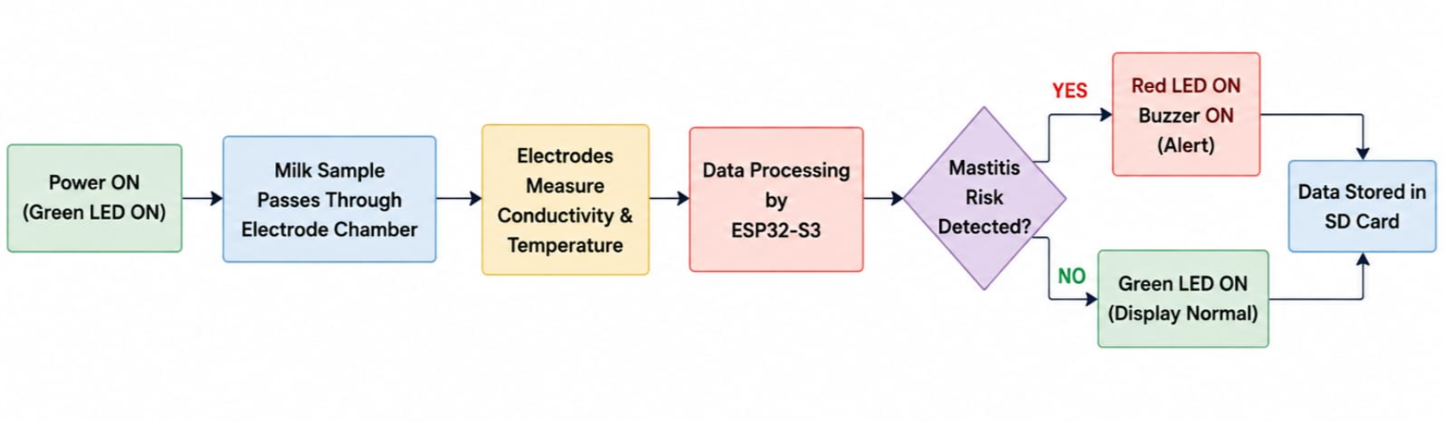
TECHNICAL APPROACH
Milk flows through the electrode chamber.
The electrodes measure the electrical conductivity of milk.
Temperature and flow are also measured.
ESP32-S3 processes the data and runs TinyML model locally.
If mastitis risk is high → Red LED & Buzzer ON.
Otherwise → Green LED ON.
All data is stored in SD card for months.
3

Slide 4
FEASIBILITY AND VIABILITY
ECONOMIC
TECHNICAL
SOCIAL
Farmers face a loss of Rs.2,500 per cow if affected,on a large scale it is high
• Total device cost (prototype): ~₹3,000 – ₹3,500
• One-time investment; no recurring subscription or cloud charges.
• A single automated milking parlour costs several lakh rupees — our device costs only a small fraction of that.
• Highly affordable and scalable for small & medium dairy farms.
• Conductivity is measured using food-grade stainless-steel electrodes placed in the milk flow path. Food-grade stainless steel is safe, corrosion-resistant, and suitable for long-term use in milk.
• Other parameters measured: temperature (DS18B20) and milk flow/quantity.
• Controlled by ESP32-S3 (N16R8) with Wi-Fi, 8MB PSRAM and 16MB Flash.
• Local AI (TinyML) analyses 14-day trends and predicts mastitis risk offline.
• Data is stored on a microSD card for months (8GB or more).
.
• Local-language display with simple alerts (Green/Red).
• LED indicators: Green (Normal) and Red (Risk Detected).
• Buzzer is mild for easy attention without causing disturbance.
• No smartphone required.
• No behaviour change beyond attaching the clip-on electrode during milking.
• Adds only a few seconds per cow.
• Helps early detection, reduces losses, and improves animal health and farmer income.
COST BREAKDOWN (Prototype)
Food-grade stainless-steel electrodes are biocompatible, safe for milk contact, and resistant to corrosion from milk and cleaning chemicals.
All components + enclosure
2,750 – 3,000
Designed for zero digital literacy: simple visual (Green/Red LED) and mild audio alerts work for farmers who cannot read or use smartphones, ensuring adoption across rural and semi-literate dairy communities.
Total Estimated Cost
3,000 – 3,500
4

Slide 5
IMPACT AND BENEFITS
IMPACT FLOW
EARLY SENSING
2.PERSONAL BASELINE
3.RISK FORECAST
4.TIMELY ACTION
5.BETTER OUTCOMES
6.DIGITAL RECORDS
Detect EC / temperature deviation
Compare against each cow's normal
Flag repeated abnormal patterns
Monitor, re-test or contact vet
Support animal health & milk quality
Build traceable herd history
KEY BENEFITS
ANIMAL HEALTH
FARMER VALUE
MILK SAFETY
RURAL INCLUSION
Earlier attention to abnormal trends and better follow-up per cow
Decision support that fits into existing hand-milking routines
Traceable alerts and treatment/ withdrawal tracking
Offline-first + local-language alerts for low-connectivity farms
Prototype success can be demonstrated through: Detection consistency • Alert usability • Offline operation • Validation against veterinary/diagnostic results
5

Slide 6
RESEARCH AND REFERENCES
Bansal, B.K. et al. (2009) — Economic analysis of bovine mastitis in India and Punjab
Epidemiology of Bovine Mastitis in Cows of Dharwad District — PMC
Sinha, M.K. et al. (2014) — Subclinical Mastitis in Dairy Animals: Incidence, Economics, Predisposing Factors
Frontiers in Veterinary Science (2025) — ML-based clinical mastitis detection using milk EC and SCC
Lazaro, A. et al. — Battery-less NFC conductivity sensor for bovine mastitis detection, Farming 4.0
AI Models-Claude and Gemini
6

