Slide 1
Machine Learning Using Python
Name Vinay K V USN1NT19EC181
Under the Guidance of
Dr. Sapna Kumari C
Assistant Professor
INTERNSHIP PRESENTATION

Slide 2
Presentation Outline
Overview of the Company
Products made by Company
Brief on the Work Carried Out/ being Carried Out

Slide 3
Overview of the Company
TAKE IT SMART PVT.LTD is an Indian based engineering and Software Company headquartered in Bangalore, Karnataka, India. It is both product and service-oriented software company.
TAKE IT SMART PVT.LTD have its own services such as,
Embedded Applications development
Web design and development
IT Service
Android app Development
Web Bases Software Solutions

Slide 4
Overview of the Company
DOMAINS
TAKE IT SMART PVT.LTD have working with several domains like-
IT
Digital marketing
Business Address: Take It Smart (OPC) Pvt.Ltd
14,SGN Arcade, 1st Floor, 2nd stage, 1st Main Rd, RPC Layout, Hoshalli Extension, Stage 1,
Vijayanagar, Bengaluru, Karnataka 560040
Mobile: +91-8050104212
Email: info@takeitsmart.in
Website: www.takeitsmart.in

Slide 5
Product Made by Company
Background Subtraction on Real time Video using OpenCV
Abstract:
Background subtraction is a way of eliminating the background from image. To achieve this we extract the moving foreground from the static background.
Background subtraction is a major pre-processing step in many vision-based applications.
Background modelling consists of two main steps:
Background Initialization;
Background Update.
In the first step, an initial model of the background is computed, while in the second step that model is updated in order to adapt to possible changes in the scene

Slide 6
Work Carried Out
INTRODUCTION
Background subtraction is a vision-based applications.
Background Subtraction has several use cases in everyday life, it is being used for object segmentation, security enhancement, pedestrian tracking, counting the number of visitors, number of vehicles in traffic etc.
Background subtraction (BS) is a common and widely used technique for generating a foreground mask by using static cameras.

Slide 7
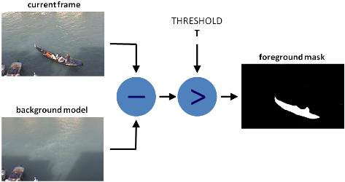
Work Carried Out
INTRODUCTION

Slide 8
Work Carried Out
Block diagram
Library OpenCV, NumPy
Input Real Time Camera
python
Output
Background Subtraction Algorithm

Slide 9
Work Carried Out
Hardware Requirements:
Computer – Processor, high speed is preferred.
RAM 4GB
Hard disk – Free space of 5GB
Laptop built-in Camera
Software’s Used
Python 3.7
Open CV tool
OS – Windows 11
Idle Software

Slide 10
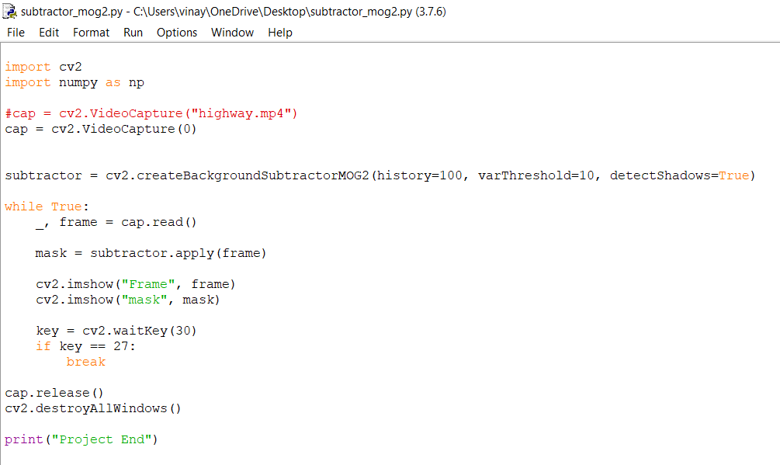
Brief on the Work Carried Out
Python Code

Slide 11
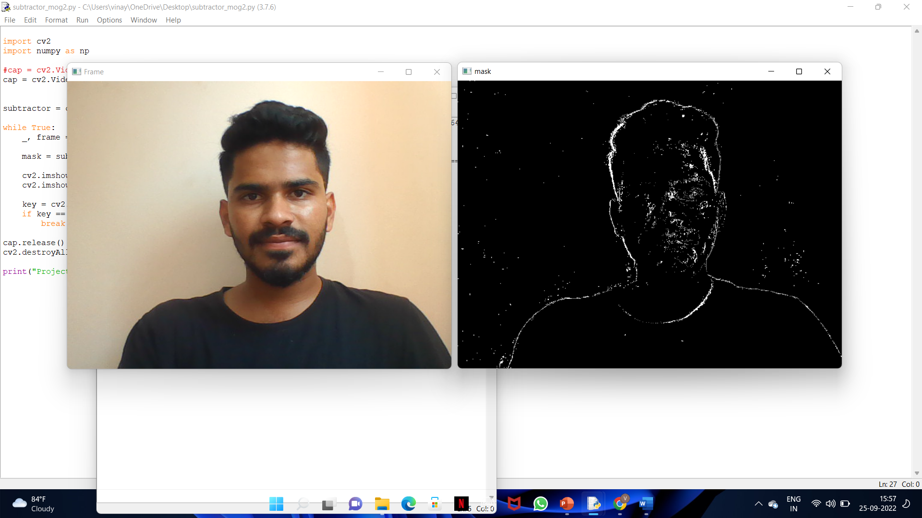
Brief on the Work Carried Out
Output

Slide 12
Brief on the Work Carried Out
Applications
Background Subtraction method can be used in Vehicle counting applications in highway.
Intruder Detection can be implemented using Background Subtraction Algorithm.
Advantages
It saves time.
Efficient and reliable process to monitor changes in privacy conditions

Slide 13
Brief on the Work Carried Out
CONCLUSION
A system for Background Subtraction on Real time Video using OpenCV can be developed.
Background subtraction is a major pre-processing step in many vision-based applications
In future, this can be taken to the product level. To make this project as user friendly and durable, we need to make it compact and cost effective

