Slide 1

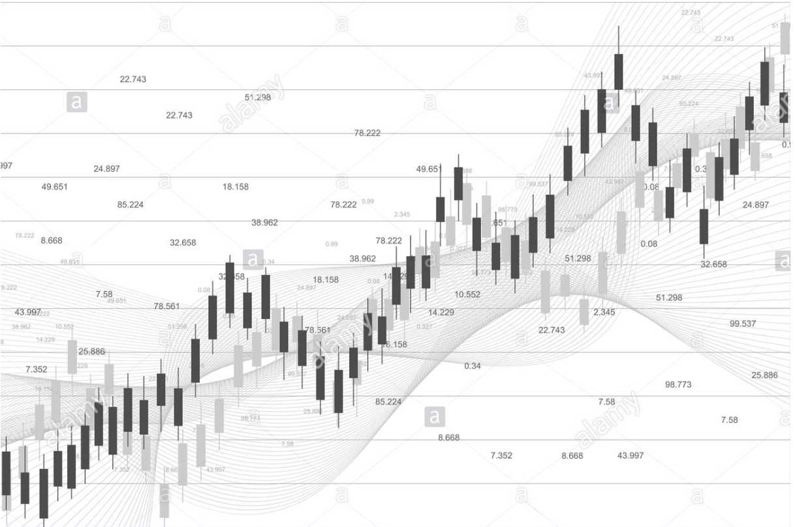
Predicting America’s Stock Market using Supervised Learning
Presented
by
Vinay Lokesh & Sacheth Reddy

Slide 2
Agenda
Introduction
Background Survey
Methodology
4. Models
5. Results
6. Milestones
7. Conclusion

Slide 3
Introduction
Stock market plays a crucial role in the growth of the industry and commerce of the country that eventually affects the economy of the country to a great extent.
It is vital to have great analytics and forecasting of stock market - key rationale for government or an industry to keep a close watch - a rise in stock market is an indication of an emerging industrial sector and a decline in stock market indicates significant loss of wealth.
The year 2020 has witnessed a dramatic decline in stock market for most industrial and government sectors due to the potential worsening of COVID-19 pandemic.
Aim: Applying supervised learning methods to predict future stock returns based on previous number data along with additional features

Slide 4
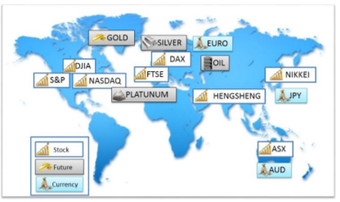
Background Survey
There are numerous stock analysis software platforms in the market. Some of them are Trading View, Stock Rover, Meta Stock
Numerous strategies such as Machine Learning, Artificial Intelligence are deployed to improve the forecasting.
Numerous stock market indices such as NASDAQ, S&P 500, DJIA are used against the algorithms to check for accuracy.

Slide 5
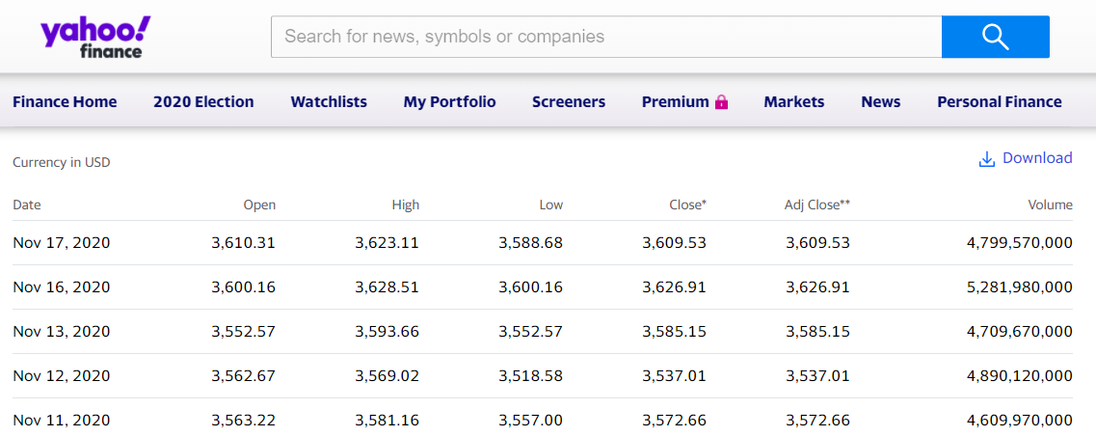
Methodology
Preprocessing and Cleaning – Combining different data sets and filling the missing values. Usage of historical data from S&P 500 - a stock market index that measures the stock performance of 500 large companies listed on stock exchanges in the United States.
Selection of parameters in the data set – considering different parameters such as high, low, close, open, investment, capital and so on

Slide 6
Methodology
Feature Selection – Prune out less useful features. Select K algorithm gives k highest values.
F Test – compares the significance of adding a variable to a model with addition of improvement of new variable
Performed in three steps:
M0 - choose a model with a variable
M1 - choose a model with an additional variable
M2 - choose a model with a new additional variable
Given all possible features, we implement a forward feature selection algorithm to select the features that contribute most to the accuracy of prediction using different machine learning algorithms.

Slide 7
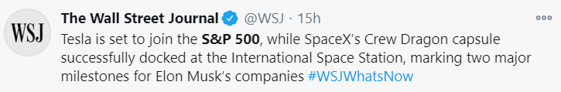


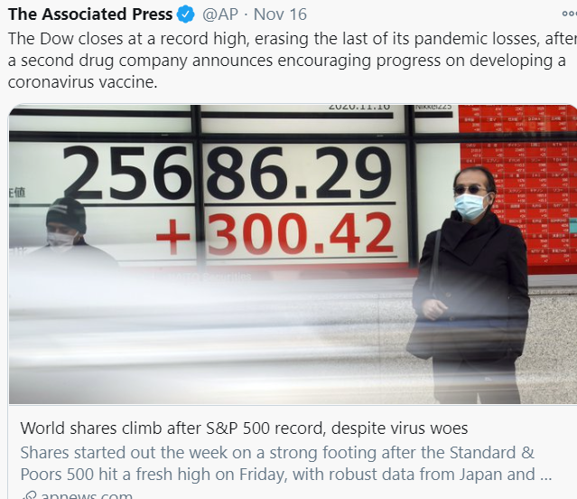
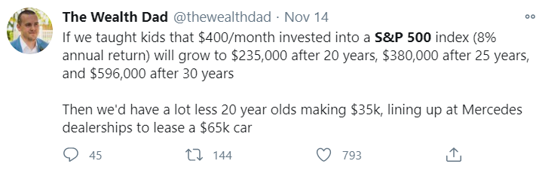

Methodology
Twitter sentiment analysis – Considering a rank value of 1 or 0 and appending it to data based on tweets related to the stock market on a particular day. Provides a better approach to go along with current trends.

Slide 8
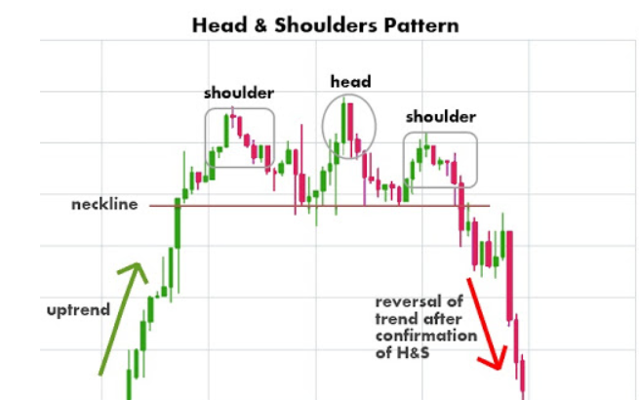
Models
Fundamentals
Technical
Classification Regression
Random Forest Random Forest
SVC SVR
Ada booster Ada Booster
K nearest K nearest

Slide 9
Models: Adaboost
.
Uses stumps to classify.
Weak learners are being used.
Drawbacks:
Sensitive to outliers
Can’t scaleup
Does overfits
M1
NEW DATA
M2
DATA
COMBINE
PREDICT
MK

Slide 10
Models: Support Vector Machine
.
Clear separation between two classes.
Uses hyperplane to draw margins.
Drawbacks:
Suitable for large data sets.
Does not perform well in noisy conditions.
Prone to overfit.
Gap
Class A
Class B

Slide 11
Models: K-nearest neighbor
w2
Works good for small data sets.
Simple and easily interpretable
No training is required.
Drawbacks:
As dimensions increases prone to error.
Slow algorithm
Cannot deal with missing values
Outlier sensitivity
.
w1
w3

Slide 12
Models: Random Forest
It can solve classification and regression.
Does not overfit.
Good for higher dimensionality
Maintain accuracy.
.
instance
Tree-1
Tree-2
Tree-n
Class A
Class B
Class B
majority
Final class

Slide 13
Models: Random Forest(cont…)
.
D1 1
Outlook | Temperature | Humidity | Wind | Play Tennis
Sunny | Hot | High | Weak | No
Sunny | Hot | High | Strong | No
Overcast | Hot | High | Weak | Yes
Rain | Mild | High | Weak | Yes
D2 1
1
D3 0

Slide 14
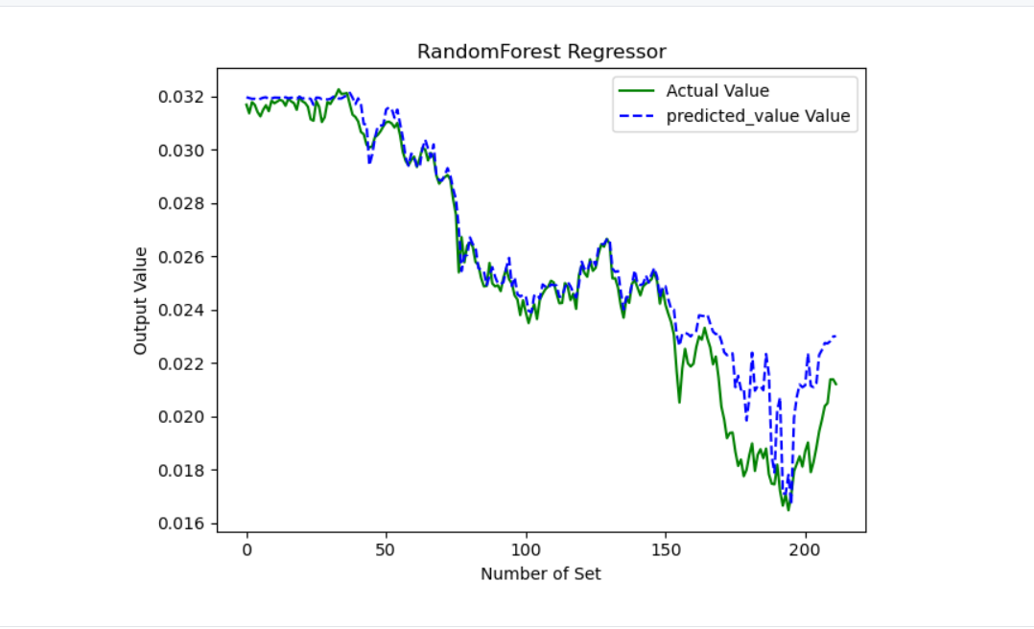
Results
.
AMG STOCKS

Slide 15
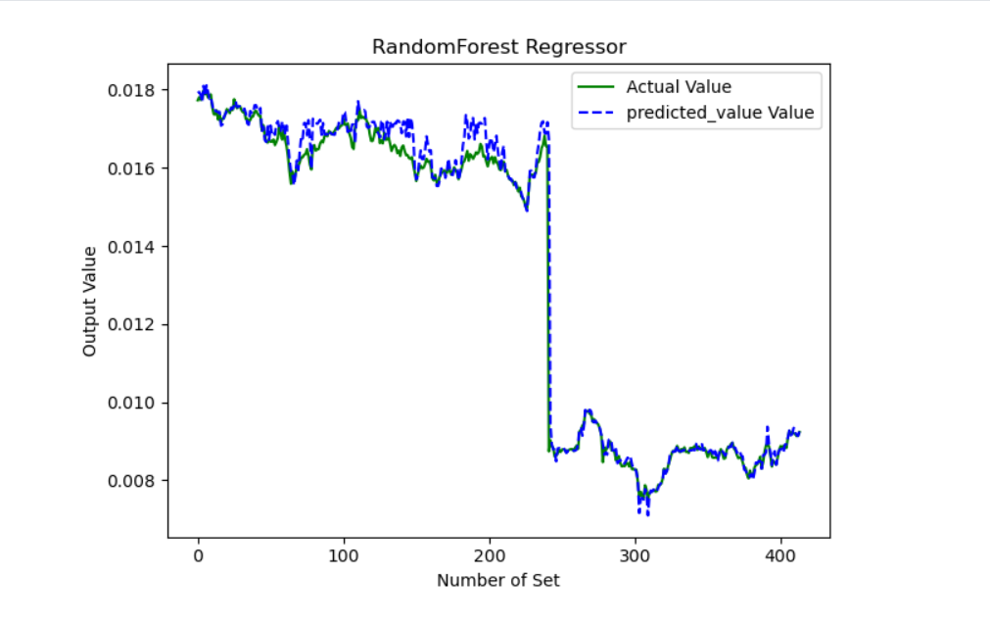
Results
.
BAX STOCKS

Slide 16
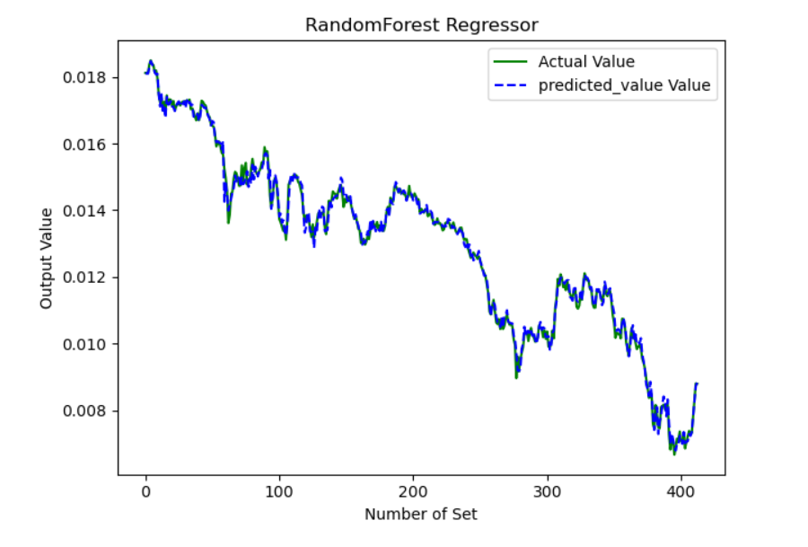
Results
.
COP STOCKS

Slide 17
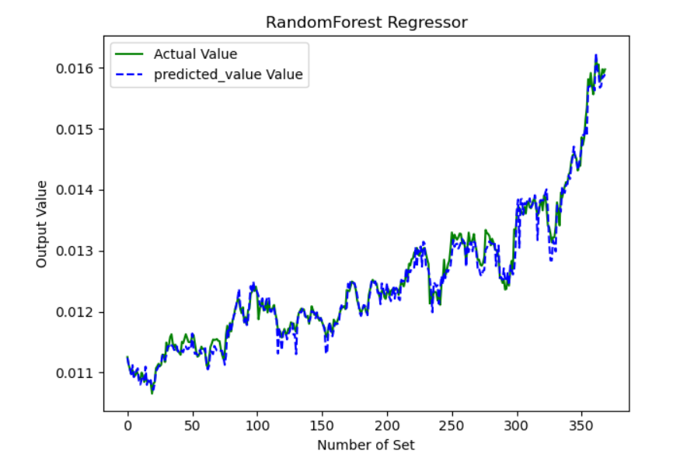
Results
.
CPB STOCKS

Slide 18
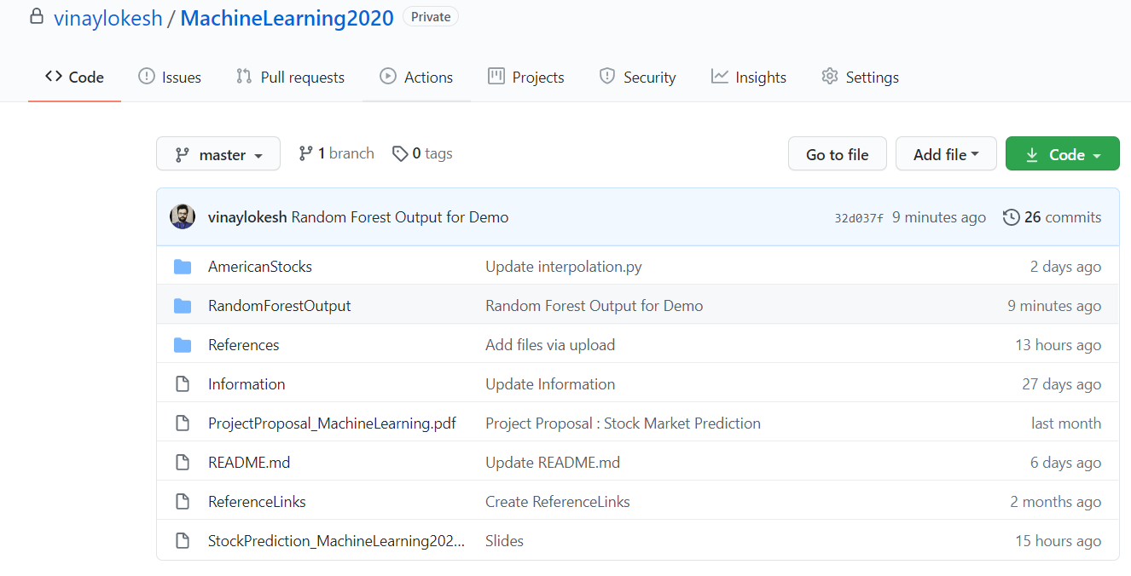
Milestones
.
Analysis
Nov 15
Implementation
Nov 8
Data Collection
Initial Decision
Sept 27
Sept 15

Slide 19
Conclusion
The project entails stock prediction based on different set of models and arrives at a conclusion that Random Forest model provides the best solution in terms of accuracy.
Base learners are generated by using original stock data with inclusion of sentiment analysis to strengthen accuracy.
Future Enhancement - inclusion of Twitter analytics based on an Artificial Intelligence and inclusion of hourly statistics instead of day wise calculation.

Slide 20
Questions?

Slide 21
Thank you

