Slide 1
Hiring Decision Analysis based on Interview Evaluation
HSN-620
Hemant Bidasaria
Shubhanshu Shukla
Vinay Joshi
Department of Humanities and Social Sciences
Indian Institute of Technology, Roorkee
HSN-620

Slide 2


Multi Dimensional Hiring Decision Analysis Model
What is the Problem
Solution…
Traditional hiring methods rely heavily on resumes, technical interviews, and gut feelings — often missing critical insights into a candidate’s emotional intelligence, communication style, and real-time interaction behavior. This leads to:
Poor cultural fit
Weak communication alignment
Underperformance despite technical competence
Comprehensive hiring model integrating:
Emotional Analysis (via facial expressions, gaze tracking, and emotional fluctuations)
Communication Analysis (including speech pace, confidence, eye contact, hesitation, and conciseness)
Transcript Analysis (using NLP to evaluate role-fit, technical depth, emotional tone, and language clarity)
Soft skills are increasingly more valued: According to LinkedIn’s 2024 Global Talent Trends, 92% of HR leaders believe soft skills matter as much or more than hard skills
Team compatibility: Matching communication and emotional patterns with company culture improves long-term retention.
Recent Companies: HireVue, Pymetrics, Entelo, Retorio
HSN-620

Slide 3
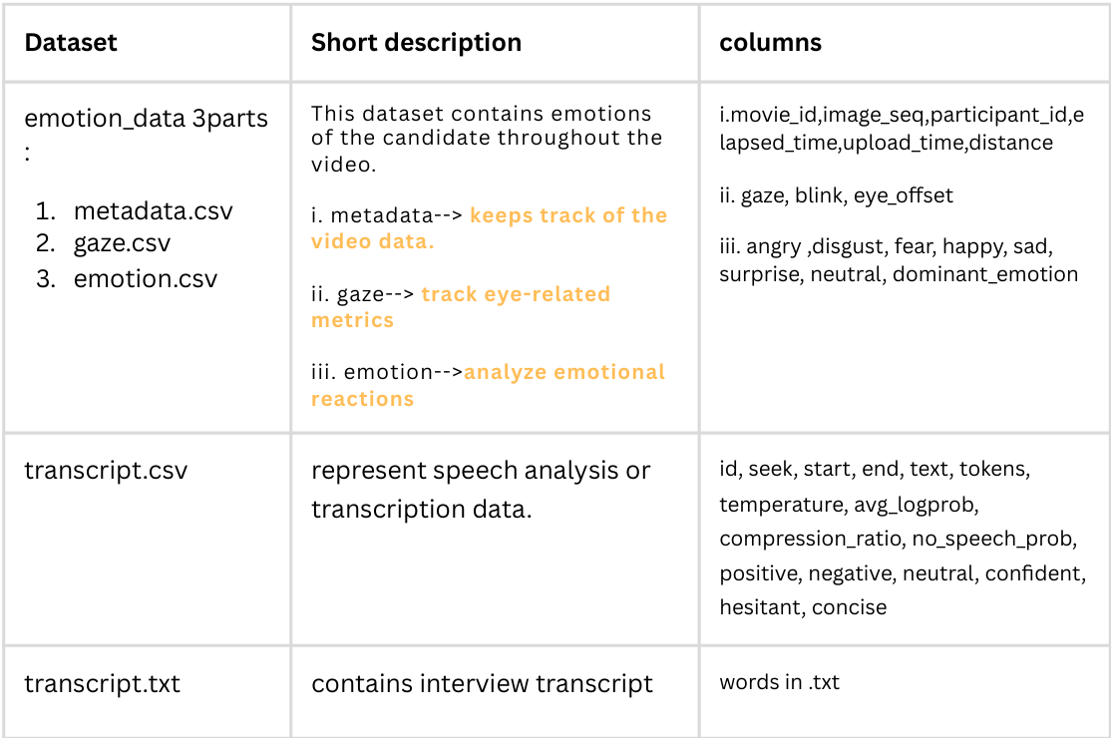
Dataset used to create a multimodal model
Dataset
Emotion Data
Transcript.csv
Transcript.txt
HSN-620

Slide 4
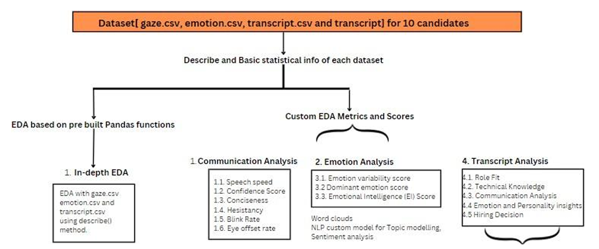
Flowchart of the model:
A basic exploratory data analysis (EDA) was conducted to understand key metrics like mean, count, standard deviation, and percentiles for each candidate's interview data.
Scores for all other parameters are calculated considering various parameters as will be discussed further.
HSN-620

Slide 5
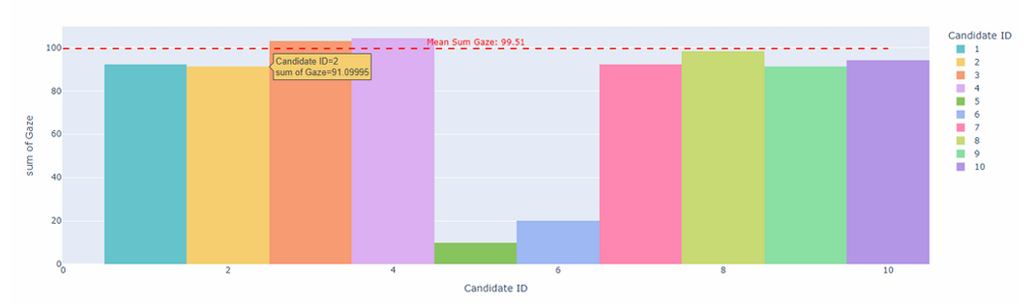
Exploratory Data Analysis and its implication on Hiring
Mean of Gaze Sum for each candidate: (EDA on Emotion combined.csv)
The plot shows the total sum of gaze, indicating how often each candidate looked at the camera during an interview.
Candidates 5 and 6 have notably lower gaze values compared to others. This suggests that these candidates might not have been focused on the camera, potentially reading from a device or paper.
Possible External Factors: Candidates with lower gaze values might have experienced distractions, technical difficulties, or external factors affecting their eye contact, which could be worth investigating.
HSN-620
Notes:
We will look at how different parameters affect the final decision. Candidate 4: This candidate has the highest gaze sum, which could indicate strong engagement and focus on the camera during the interview. 2. Even Distribution: Most candidates (except 5 and 6) have gaze sums around or above the mean, suggesting consistent engagement across the majority of candidates.

Slide 6
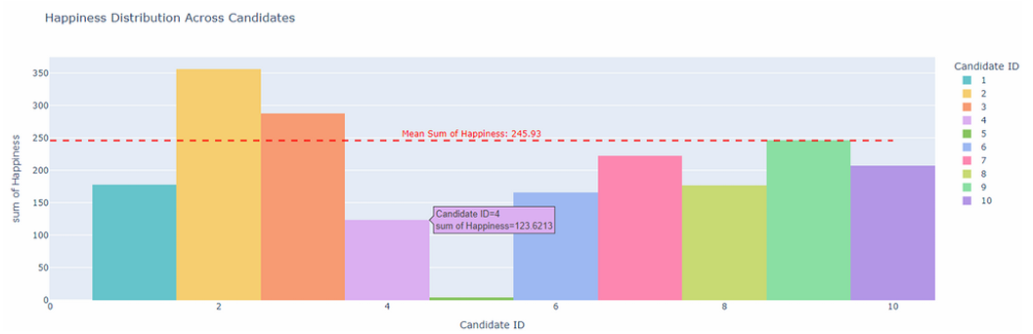
Exploratory Data Analysis and its implication on Hiring
Plot of Happiness distribution among candidates:
The plot suggests that candidates with happiness above the average line should be considered for roles that benefit from higher emotional engagement.
High levels of happiness suggests they could potentially be better suited for roles that require a positive disposition or team collaboration.
Below-Average Candidates could indicate areas for concern if happiness is an important trait for the role in question.
HSN-620
Notes:
Very much depends upon the role you are hiring, you will provide weights to such parameters

Slide 7
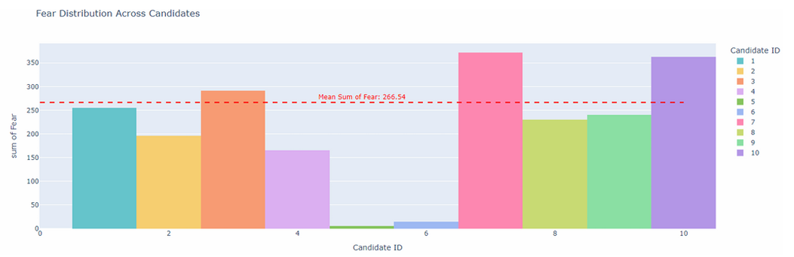
Exploratory Data Analysis and its implication on Hiring
Plot of Fear distribution among candidates:
This plot shows the fear distribution across di erent candidates, with each bar representing the sum of fear detected for each candidate
Depending on the nature of the job, moderate levels of fear could indicate a healthy awareness of challenges, while extreme levels (either high or low) might require more investigation into how the candidate deals with pressure.
Above-Average Fear Levels (Candidates 7, 10, 3, and 1): If fear is associated with stress or anxiety in a work context, these candidates may require further exploration to understand how they manage fear or stressful situations
HSN-620
Notes:
Very much depends upon the role you are hiring, you will provide weights to such parameters. Role dependent weights

Slide 8
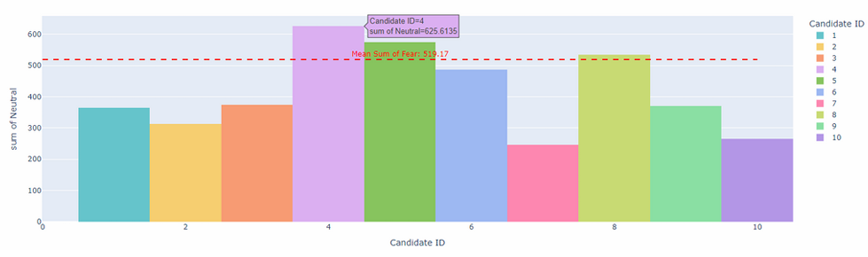
Exploratory Data Analysis and its implication on Hiring
Plot of Neutral distribution among candidates:
High Neutrality: Candidates 4, 5, and 8, with higher neutrality, might be ideal for roles requiring calmness under stress, impartial decision-making, or situations where maintaining neutrality is crucial.
Low Neutrality: Candidates who exhibit lower levels of neutrality may either be more passionate or emotionally expressive, which can be beneficial in roles that require strong emotional engagement (such as leadership or creative roles).
HSN-620
Notes:
Very much depends upon the role you are hiring, you will provide weights to such parameters. Role dependent signs of weight

Slide 9
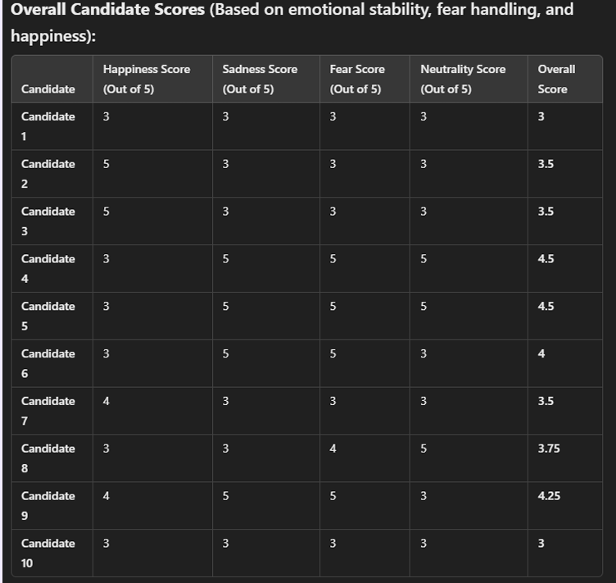
Creating Scores for candidates
Based on the job profile we can give weights to different emotional scores and calculate overall candidate score impacting its hiring.
HSN-620

Slide 10
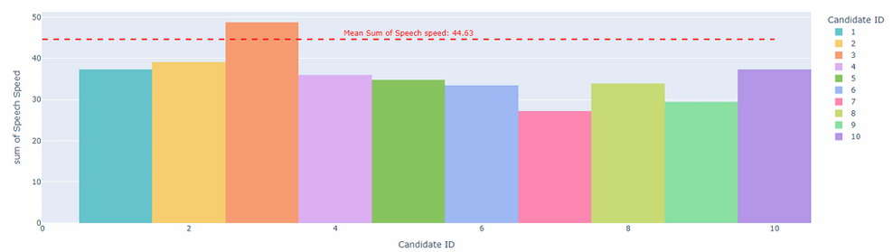
Exploratory Data Analysis and its implication on Hiring
Speech speed distribution across candidates: (EDA on Transcript combined.csv)
Above-Average Speech Speed: Excessively fast speech can sometimes be difficult to follow, particularly in roles that require clear communication.
Below-Average Speech Speed: While slow speech can be perceived as a sign of calmness and careful consideration, if it’s too slow, it may also suggest hesitation or lack of confidence, depending on the context.
Balanced Speech Speed: Candidates like 4, 5, and 6 are closer to the average, indicating a more neutral or balanced pace. This might be desirable in roles that require clear communication and an ability to articulate thoughts at a reasonable speed.
HSN-620

Slide 11
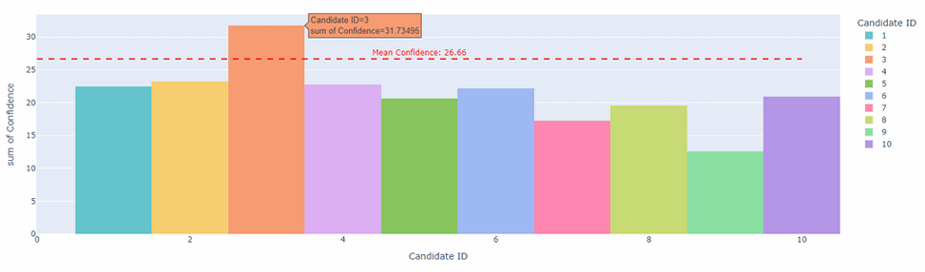
Exploratory Data Analysis and its implication on Hiring
Confidence distribution across candidates:
Above-Average Confidence: These candidates might be suitable for roles requiring leadership, decision-making, or client-facing responsibilities.
Below-Average Confidence:These candidates might be more reserved or unsure in their responses, which may suggest they are less comfortable under pressure or need more development in assertiveness for roles that demand confident communication.
Similarly for hesitant emotion, conciseness emotion, etc we can do the analysis
HSN-620
Notes:
We will look at how different parameters affect the final decision. Candidate 4: This candidate has the highest gaze sum, which could indicate strong engagement and focus on the camera during the interview. 2. Even Distribution: Most candidates (except 5 and 6) have gaze sums around or above the mean, suggesting consistent engagement across the majority of candidates.

Slide 12
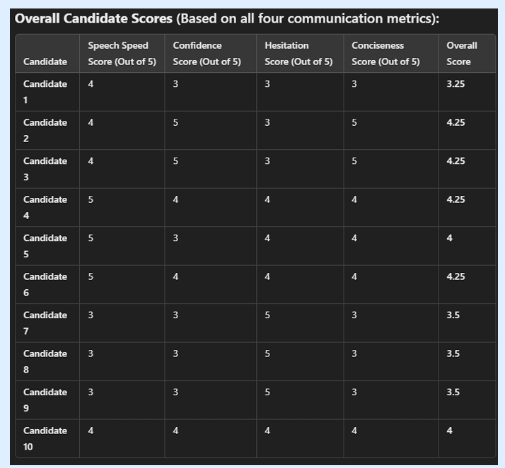
Creating Scores for candidates
Based on the job profile we can give weights to different communication metrics and calculate overall candidate score impacting its hiring.
HSN-620

Slide 13
EDA on Transcript (NLP):
Why?
Goal: systematically extract and quantify key insights from candidate interviews:
Sentiment
Communication skills
Topic relevance
Technical competencies
Method: using natural language processing (NLP) + AI tools.
Enables objective, data-driven, and efficient evaluation of candidates, helping organizations identify top talent, ensure fair and unbiased assessments, and make well-informed hiring decisions that align with role requirements and organizational goals
Why This Matters:
Reduces bias by converting subjective interviews to quantifiable metrics.
63% faster candidate screening vs. manual methods (LinkedIn’s 2024 Global Talent Trends)
HSN-620

Slide 14

EDA on Transcript (NLP):
Transcript Analysis Workflow for Hiring Decisions
Raw Transcript
Text Processing
Sentiment Analysis
Topic Modelling
Insights
Summarization
NER & Skills Extraction
HSN-620

Slide 15
EDA on Transcript (NLP):
Transcript Analysis Workflow for Hiring Decisions
Raw Transcript
Text Processing
Sentiment Analysis
Topic Modelling
Insights
Summarization
NER & Skills Extraction
1. Text Processing
Tokenization: Splits text into words/sentences (word_tokenize)
Stopword Removal: Filters out 120+ non-essential words (e.g., "the", "is")
Lemmatization: Converts "running" → "run" using SpaCy's linguistic database
Why It Matters:
Reduces data noise by 40-60%, and standardizes responses for accurate NLP model input
Candidate 1 Output:
['hello', 'jeffrey', 'pursue', 'management', 'iim', ...]
Interpretation: Cleaned data reveals focus areas like "management" and academic background ("IIM")
HSN-620
Notes:
Text Preprocessing: Tokenization: Break down the transcript into sentences or words to analyze individual parts of speech or phrases. Stopword Removal: Remove common words like “the,” “is,” etc., which do not contribute to understanding the candidate’s traits. Lemmatization/Stemming: Convert words to their root form (e.g., “running” becomes “run”) to reduce redundancy and improve analysis accuracy.
Sentiment Analysis: Purpose: Understand the emotional tone of the interview responses, such as whether the candidate is confident, enthusiastic, or doubtful. Tool: Use libraries like VADER or TextBlob to perform sentiment analysis on the transcripts. Application: Higher positivity in sentiment could suggest enthusiasm, while a mix of neutral and negative sentiment could indicate hesitation or uncertainty.
Topic Modeling: Purpose: Discover the key topics or themes each candidate discussed during the interview. Technique: Use Latent Dirichlet Allocation (LDA) to identify themes in the text. Application: This will help you understand which candidates discussed more relevant topics related to their role or showcase expertise in particular areas.
Named Entity Recognition (NER): Purpose: Identify specific entities such as skills, job titles, organizations, etc., mentioned in the transcript. Tool: Use models like SpaCy for NER to detect important terms. Application: You can map out the candidate's experience, capabilities, and role fit based on the entities they mention (e.g., "Python" for a developer role, "team management" for a leadership role).
Skills Extraction: Purpose: Automatically extract mentions of technical or soft skills. Technique: Use keyword extraction methods (TF-IDF or RAKE) or specific pre-built models like SkillNER to detect competencies. Application: This will help match each candidate’s skill set to the requirements of different roles.
Text Summarization: Purpose: Summarize the transcript for a high-level overview of the candidate’s strengths and responses. Technique: Use extractive or abstractive summarization algorithms (e.g., Hugging Face transformers) to generate summaries of each interview. Application: These summaries can give you quick insights into each candidate’s performance without going through the full transcript.
Personality Insights: Purpose: Derive personality traits of candidates based on their responses. Tool: Use a tool like IBM Watson Personality Insights or LIWC (Linguistic Inquiry and Word Count) to analyze traits such as openness, agreeableness, conscientiousness, etc. Application: This can help you match candidates to roles where certain personality traits are essential (e.g., leadership roles for highly extroverted or assertive candidates).

Slide 16
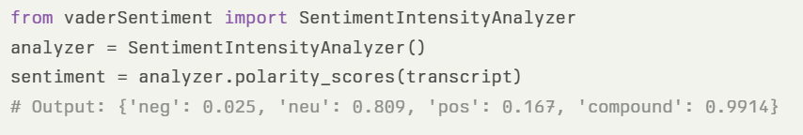
EDA on Transcript (NLP):
Transcript Analysis Workflow for Hiring Decisions
Raw Transcript
Text Processing
Sentiment Analysis
Topic Modelling
Insights
Summarization
NER & Skills Extraction
Why VADER?
Optimized for conversational text (social media/transcripts)
Captures intensity via capitalization/punctuation ("GREAT!!" → +0.8 vs "good." → +0.3)
Processes 10K+ words/sec vs ML models (critical for bulk interviews)
How it works and Key Metrics:
Metric | Range | Candidate 1 Score | Interpretation
Compound | [-1,1] | 0.9914 | Strong positivity
Positivity Ratio | % | 16.7% | Moderate enthusiasm
Neutrality | % | 80.9% | Balanced responses
HSN-620

Slide 17
EDA on Transcript (NLP):
Transcript Analysis Workflow for Hiring Decisions
Raw Transcript
Text Processing
Sentiment Analysis
Topic Modelling
Insights
Summarization
NER & Skills Extraction
Interpretation Framework
High compound (>0.5): Confident speakers (e.g., Candidate 1: 0.99 → Pharma client roles)
Low compound (<-0.1): Flag for HR review (potential hesitation/uncertainty)
Neutral dominance (>70%): Technical roles over sales
Why not others?
Handles interview-specific constructs: "Not bad" → +0.35 (TextBlob: -0.3)
Tool | Limitation | Hiring Context Impact | Tool
TextBlob | Misses modifiers ("extremely good") | Underestimates candidate enthusiasm | TextBlob
BERT/LLMs | Slow (3 mins/transcript) | Impractical for 1000+ applicants | BERT/LLMs
Custom ML | Requires labeled interview data | High setup cost for SMEs | Custom ML
HSN-620

Slide 18
EDA on Transcript (NLP):
Transcript Analysis Workflow for Hiring Decisions
Raw Transcript
Text Processing
Sentiment Analysis
Topic Modelling
Insights
Summarization
NER & Skills Extraction
What is Topic Modeling?
Topic modeling is an unsupervised machine learning technique that automatically discovers the main themes or “topics” present within a large collection of unstructured text, such as interview transcripts.
Each topic is represented by a cluster of keywords that frequently co-occur, helping to summarize and interpret the content of documents at scale
Why Use Topic Modeling in Hiring Analysis?
Extracts Key Themes
Objective Comparison
Role Fit Assessment
Scalable Insight
HSN-620

Slide 19
EDA on Transcript (NLP):
Transcript Analysis Workflow for Hiring Decisions
Raw Transcript
Text Processing
Sentiment Analysis
Topic Modelling
Insights
Summarization
NER & Skills Extraction
How it works?
Document-Term Matrix: A matrix is created to represent word frequencies across all transcripts.
Model Fitting: LDA is applied. LDA assumes each document (transcript) is a mixture of topics, and each topic is a distribution over words.
Topic Extraction: The model outputs topics as sets of keywords, along with the proportion of each topic present in each transcript
HSN-620

Slide 20
EDA on Transcript (NLP):
Transcript Analysis Workflow for Hiring Decisions
Raw Transcript
Text Processing
Sentiment Analysis
Topic Modelling
Insights
Summarization
NER & Skills Extraction
What is LDA (Latent Dirichlet Allocation)?
Initialization: Decide on the number of topics you want the model to find (e.g., 3–5 topics). Randomly assign each word in each document to one of the topics.
Iterative Topic Assignment: For each word in each document:
Reassign the word to a topic based on: How often the word appears in each topic across all documents. How often topics appear in the current document. Repeat this process for many iterations so that word-topic assignments stabilize.
Topic Formation: After enough iterations, each topic becomes a distribution of words (keywords with high probability in that topic). Each document becomes a mixture of topics (e.g., 60% Topic A, 30% Topic B, 10% Topic C).
Output: For each topic, a List of top keywords that define it. For each document: Proportion of each topic present.
HSN-620
Notes:
Latent Dirichlet Allocation (LDA) is a probabilistic model used for topic modeling, a technique that discovers hidden themes or topics within a collection of documents. It assumes each document is a mixture of various topics, and each topic is a distribution of words. LDA identifies these latent topics by analyzing word co-occurrence patterns within the documents.
Here's a more detailed breakdown:
How LDA Works:
1. Generative Model:
LDA assumes a generative process where documents are created by drawing topics from a distribution and then drawing words from the chosen topic's word distribution.
2. Hierarchical Structure:
It's a three-level hierarchical model:Document Level: Each document is composed of a mixture of topics.
Topic Level: Each topic is a distribution over words.
Word Level: Each word's presence in a document is influenced by the underlying topic distribution.
3. Iterative Process:
LDA typically uses methods like Gibbs sampling to iteratively refine the topic assignments to words and documents.
4. Uncovering Latent Topics:
By analyzing word co-occurrence and document-topic relationships, LDA can identify the underlying topics that explain the patterns in the data.
Key Concepts:
Topic:
A collection of words that tend to appear together, representing a specific theme or subject.
Document:
A text document in the corpus.
Latent:
Refers to hidden or underlying features that are not directly observed but are inferred from the data.
Dirichlet Distribution:
A probability distribution over a simplex, used to model the distribution of topics in documents and words in topics

Slide 21
EDA on Transcript (NLP):
Transcript Analysis Workflow for Hiring Decisions
Raw Transcript
Text Processing
Sentiment Analysis
Topic Modelling
Insights
Summarization
NER & Skills Extraction
Example Output (from Candidate 1):
Topic 1 (18%): “experience”, “work”, “management”, “detail”
Topic 2 (13%): “professional”, “career”, “attention”
Topic 3 (9%): “biotechnology”, “research”, “kharagpur”
Interpretation: This candidate’s transcript focuses on work experience, attention to detail, and technical research, indicating a strong fit for technical or management roles.
HSN-620

Slide 22
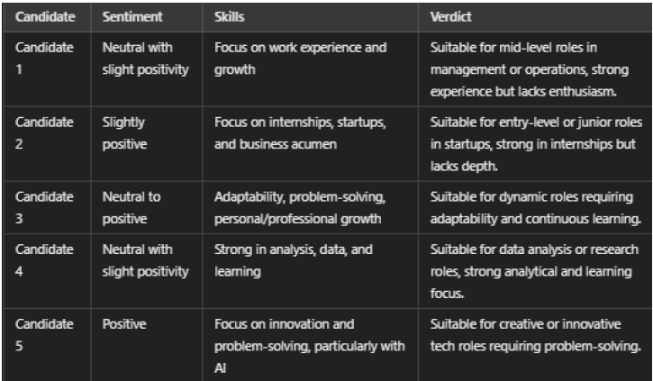
EDA on Transcript (NLP):
Transcript Analysis Workflow for Hiring Decisions
Raw Transcript
Text Processing
Sentiment Analysis
Topic Modelling
Insights
Summarization
NER & Skills Extraction
Named Entity Recognition: Identified key entities such as technologies, companies, and skills from the text.
Skill Extraction: Extracted relevant skills from the transcripts using keyword matching and NLP techniques.
HSN-620

Slide 23
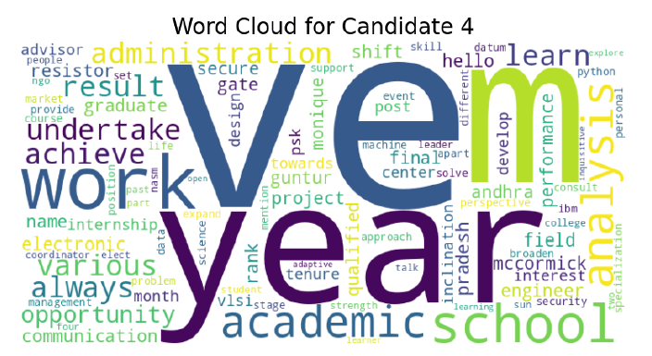
EDA on Transcript (NLP):
Transcript Analysis Workflow for Hiring Decisions
Raw Transcript
Text Processing
Sentiment Analysis
Topic Modelling
Insights
Summarization
NER & Skills Extraction
Candidate 4: strong focus on their academic background, work experience, and project involvement. They appear to have a technical or engineering-related profile. This profile suggests that the candidate might be well-suited for technical roles or positions requiring analytical and project management skills.
HSN-620

Slide 24
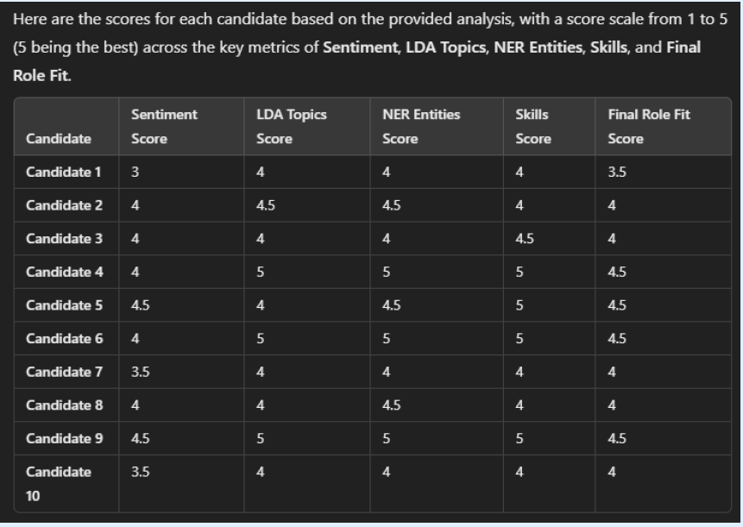
EDA on Transcript (NLP):
Feedforwarding results to AI
HSN-620

Slide 25
Communication Skills Score
Objective: To measure communication effectiveness using behavioral indicators like confidence, speech, eye movement, and hesitation.
Scoring Method:
combined_conf_score = w1*avg_confidence_score -
w2*(std_confidence_score/avg_confidence_score)
HSN-620

Slide 26
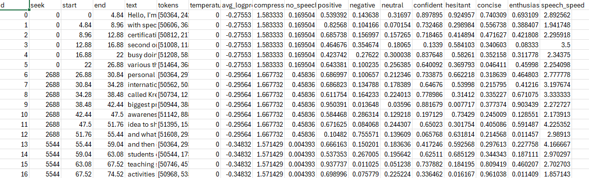
Communication Skills Score
data.head()
HSN-620

Slide 27
Communication Skills Score
Key Metrics:
Confidence Score: Measures consistency of confidence in speech
Blink Rate: Should be moderate — too high signals nervousness
Eye Offset Score: Consistent eye alignment indicates focus
Speech Speed: Should be neither too fast nor too slow
Conciseness: Encourages brief and meaningful communication
Hesitancy: Moderate pauses imply thoughtful, structured speech
HSN-620

Slide 28
Communication Skills Score
Interpretation:​
High average values → Good performance​
Low variability → Consistency and stability​
Penalizes erratic or inconsistent behavior​
Confidence Score Average:
Generally, a confidence score above 0.7 suggests that the candidate is performing well and making predictions with reasonable certainty.
Confidence Score Variance:
A low variance (like 0.0434) indicates that the confidence scores are relatively consistent. This means the model is not fluctuating wildly in how confident it is in its predictions, which is a good sign of stability
HSN-620

Slide 29
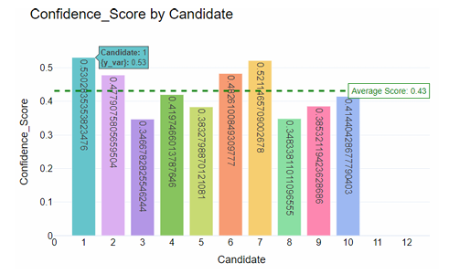
Communication Skills Score
The combined confidence scores reflect communication e ectiveness. Candidates 3, 5, 8, and 9 show lower confidence levels.
HSN-620

Slide 30
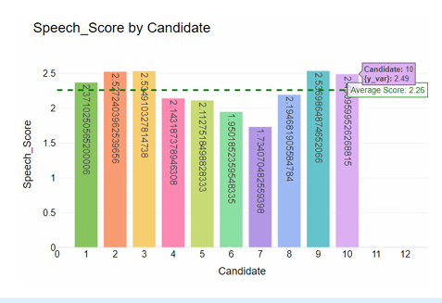
Communication Skills Score
combined_speech_score=w1*avg_speech_speed-w2*std_speech_speed
Candidates 3, 2, and 10 should be considered for roles that require strong communication, as they performed well in this area. Conversely, Candidates 7 and 6 may need improvement in speech clarity and should be considered for roles where communication is less critical.
HSN-620

Slide 31
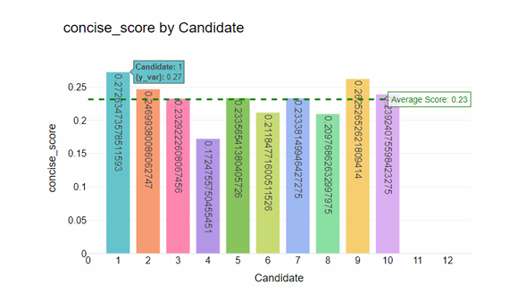
Communication Skills Score
Concise comm---> a good communicater
Conciseness is a key metric for evaluating communication skills. However, candidates 4, 6, and 8 performed below others in this area.
HSN-620

Slide 32
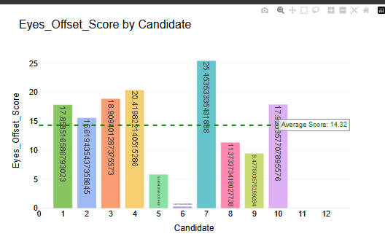
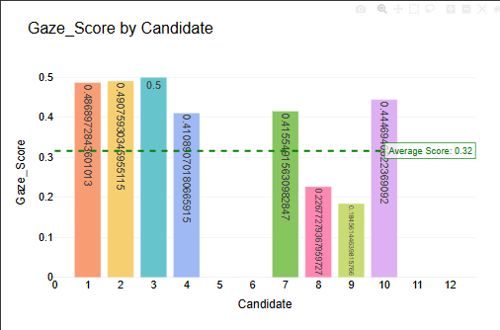
Communication Skills Score
Eye offset indidcates the deviation the candidate is looking away from the camera and this along with the Graze score confirms that Candidate 7 has both below average graze score and is looking away from the camera
HSN-620

Slide 33
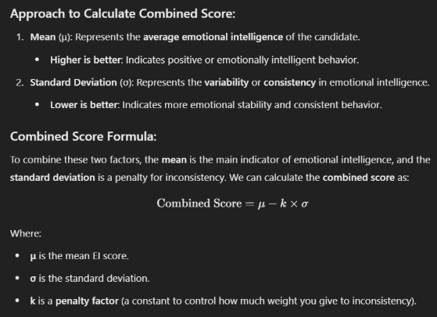
Emotional Intellegence Score
We assigned emotional weights to each emotion and summed them across the video to track emotional fluctuations and assess the candidate's emotional intelligence.
HSN-620

Slide 34
Emotional Intellegence Score
def calculate_ei(row):
# Assign weights to emotions
emotion_weights = {
'angry': -2, # Negative influence
'disgust': -2, # Negative influence
'fear': -1, # Negative but less intense
'happy': 2, # Positive
'sad': -2, # Strong negative
'surprise': 0, # Neutral
'neutral': 1 # Moderate positive
# Calculate score based on emotions and intensity
emotional_score = sum(row[emotion] * weight for emotion, weight in emotion_weights.items()
Emotional weights were assigned to each emotion and they were cumulatively summed over the entire duration of the video. This made us understand how emotions of the candidate fluctuated
HSN-620

Slide 35
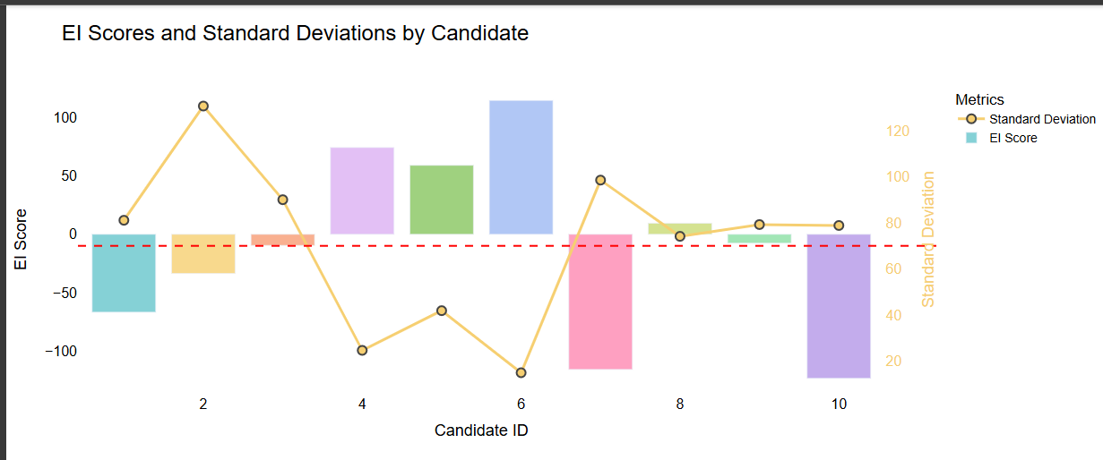
Emotional Intellegence Score
EI Score (bar chart): Reflects each candidate’s emotional intelligence based on their emotional perception, regulation, expression, and dominant emotions during the interview. Standard Deviation (line with dots): Shows the volatility or consistency in a candidate’s emotional intelligence across the interview.
A lower standard deviation indicates emotional stability, while a higher standard deviation points to emotional volatility or inconsistency
HSN-620

Slide 36
Conclusion/ Results
The final decision of comprehensive hiring would include scores from all the steps:
Prebuilt in Function EDA
Communication Analysis Score
Emotional Intelligence Score
Transcript Analysis Score
The scores obtained in each of the metrics are very much dependent upon the weights we put in each subpart, that depends on how much that metrics essence is needed in the job role for which the hiring is being made.
Also, a cumulative score combing the four above metrics is also based on role, thereby creating a formula to get the final score according to the role fit.
Instead of keeping a threshold based on value we can keep it on the basis of requirement for the company and industry standards.
HSN-620

Slide 37
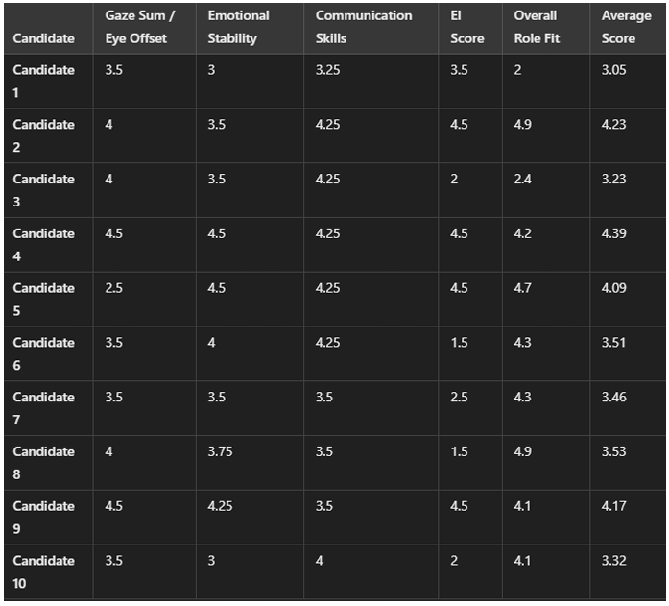
Conclusion/ Results

Slide 38
Thank You!! We are open to questions.

