Slide 1
Book Recommendation System
Group 2:
Date:01/08/2023 +
Ms. Anusree Raghunath
Ms. Vaishnavi Sanjay Nikhare
Mr. Pranav Ashok Dharpure
Mr. Nikhit Manoharrao Chokhandre
Ms. Vinaya Bhat
Mr. Vinay N. Gangammanavar
Mr. Sandipan Biswas

Slide 2
PROBLEM STATEMENT
The main objective of our project is to create book recommendation systems for users according to the features.

Slide 3
Project Flow-
Defining Project objective
Data collection
EDA-Exploring and Visualize the data.
Recommendation system
Deployment

Slide 4
DATA DESCRIPTION
There are three datasets
Books
Users
Ratings
Based on this data we have to build a book recommendation system for users.

Slide 5
Books Dataset
No of books : 271360
Columns : ISBN, Book-Title, Author name ,Year of publication, Image URL
Users Dataset
No of Users/Readers : 278858
Columns : User-ID, Location, Age
Ratings Dataset
No of Ratings : 1149780
Columns : User-ID, ISBN, Book_Ratings

Slide 6
EDA(Exploratory Data Analysis)

Slide 7
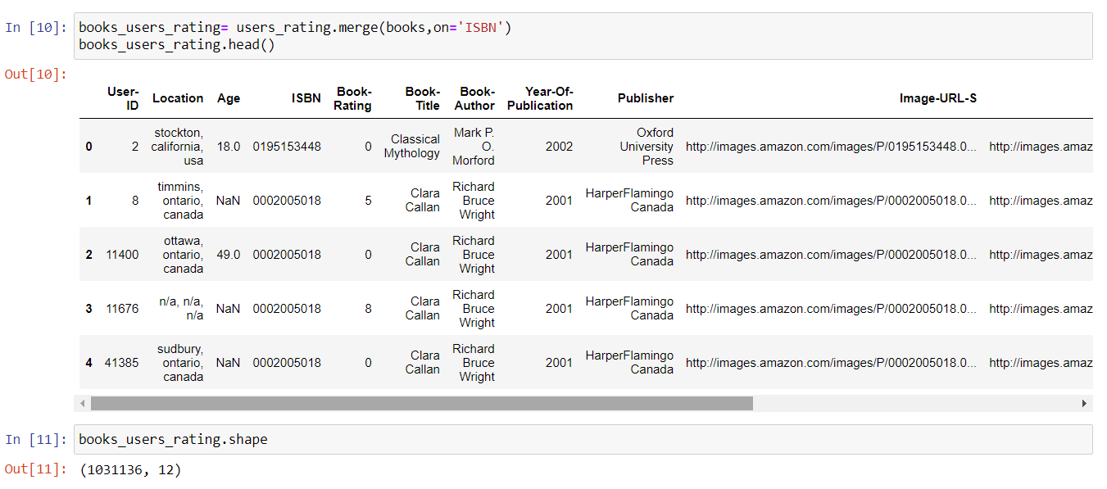
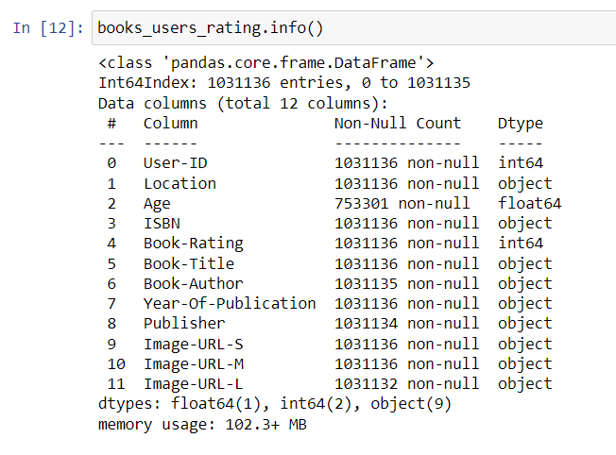
Merging all three datasets
There are 1031136 rows and 12 columns after merging the three datasets. We call this data as books_users_ratings.

Slide 8
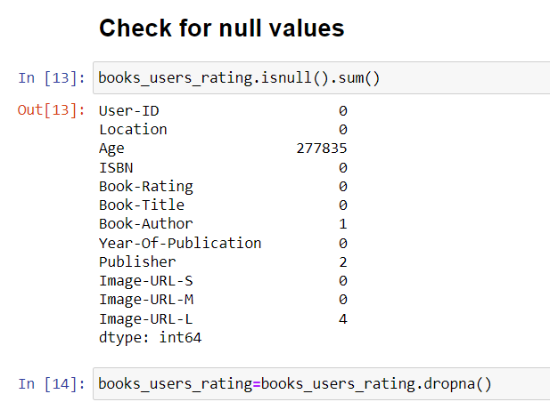
Checking for null values and treatment
Age column has 277835 null values , we just drop them instead of replacing them as the age plays an important role in recommendation of books.
After dropping we have 753296 rows and 12 columns.

Slide 9
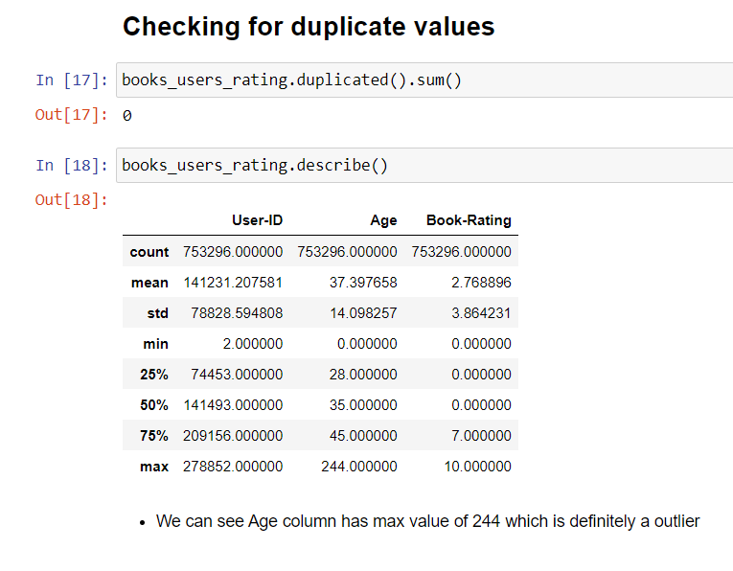
Checking for Duplicate values and Description of Age and Rating columns
There are no Duplicate values.
The age column has max value as 244 which is definitely a outlier.

Slide 10
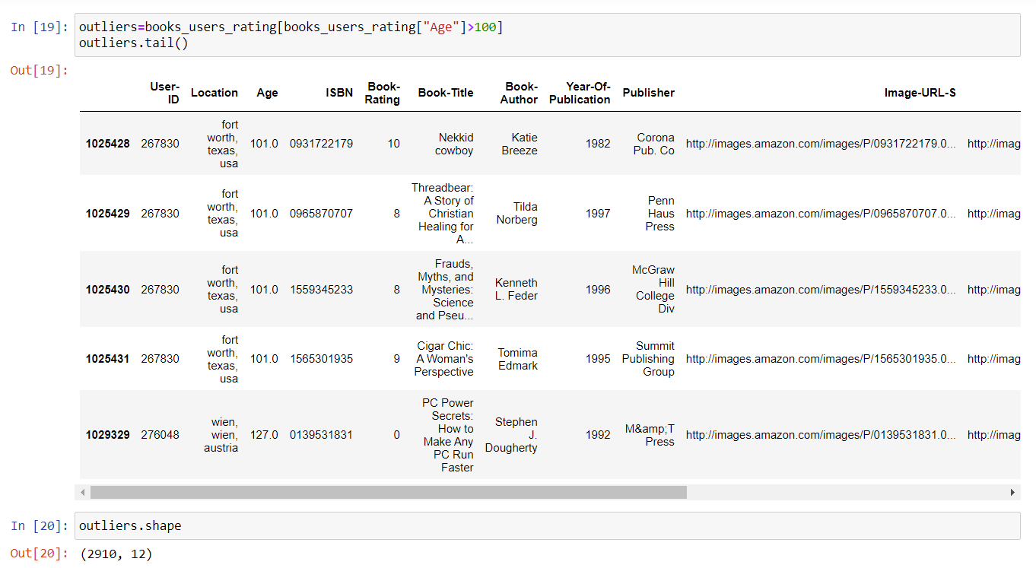
Outlier detection and treatment
We set the age criteria as 100 and anything more than 100 is treated as outlier.
There are total 2910 rows who's values of age >100. we treat the outliers by dropping them.

Slide 11
Data pre-processing

Slide 12
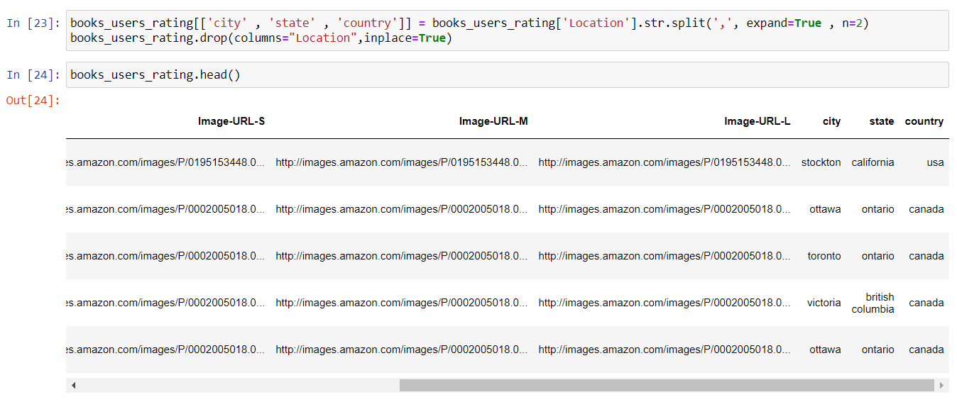
Creating new columns from the Location data
The location column has 3 values separated by comma.
We use .split() method to create new columns city, state, country.

Slide 13
Visualization

Slide 14
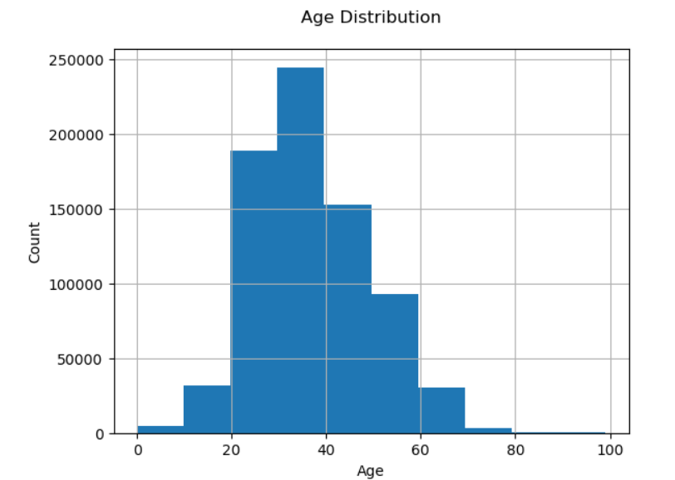
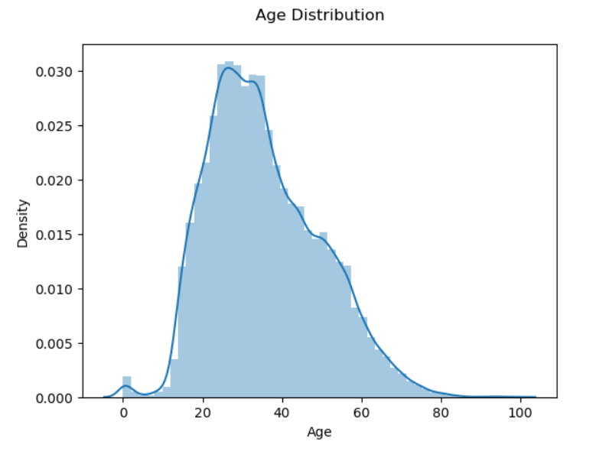
Age distribution of users
The majority of readers are between the ages of 25 and 40.
Readers who are 80 to 100 years old make up a tiny minority.

Slide 15
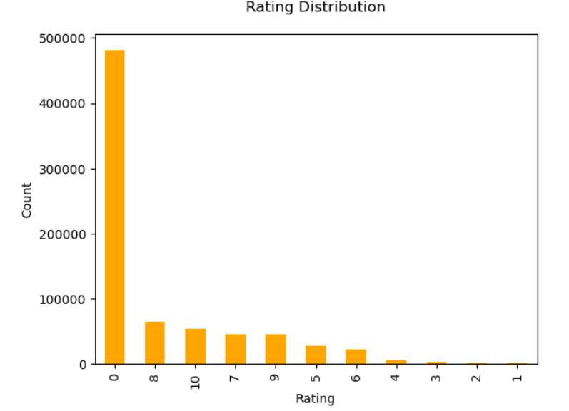
Rating Distribution
There are nearly 480000 books that have zero ratings

Slide 16
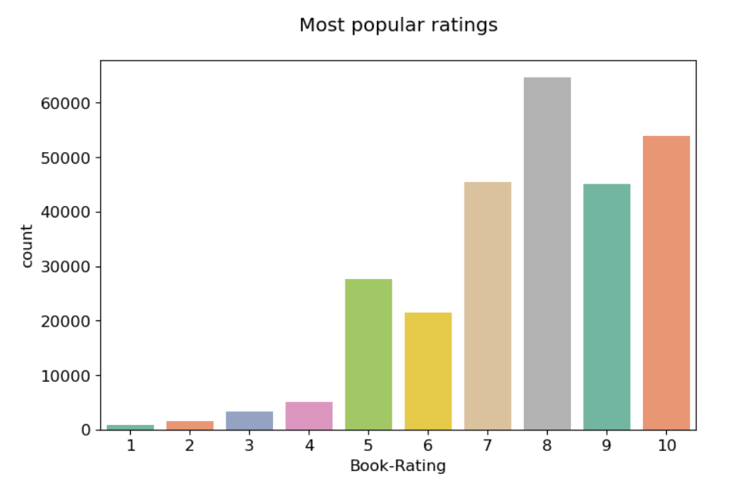
Non Zero/Most Popular Rating
Most of users have given above 4 ratings to books
8 is the most common rating given by users

Slide 17
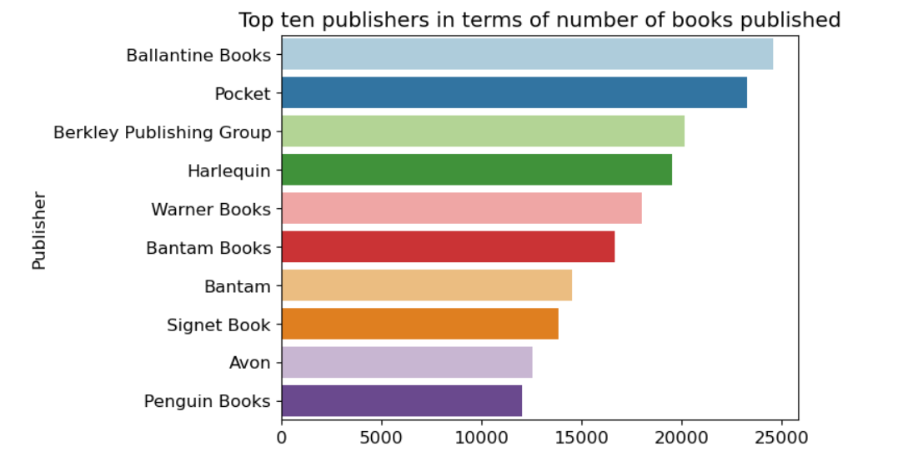
Publisher with most books
Ballantine Books is most popular publisher based on the number of users who have rated their books

Slide 18
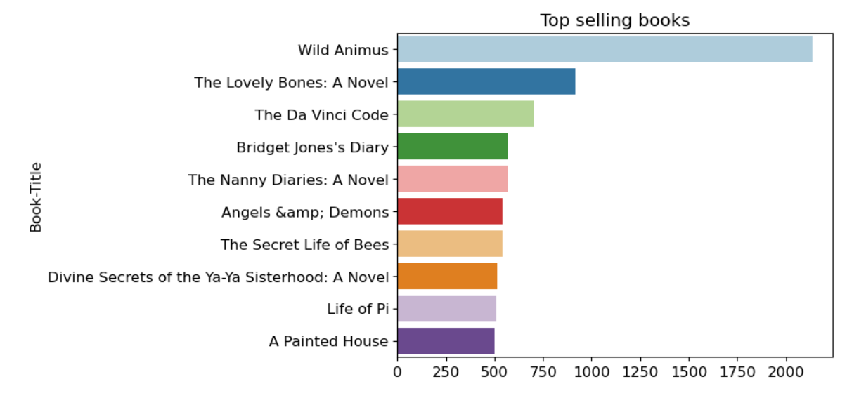
Top Selling Books
Wild Animus is the highest selling book followed by The lovely Bones: A Novel.

Slide 19
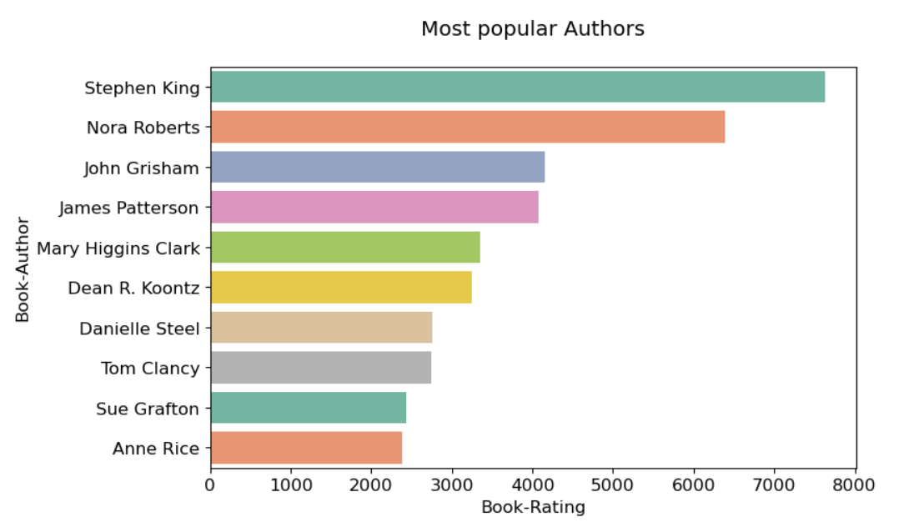
Most Popular Author
Most popular book author with respect to the number of ratings is Stephen King.

Slide 20
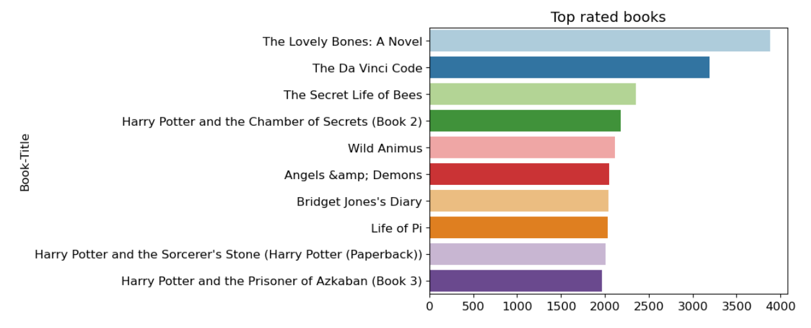
Top Rated Book

Slide 21
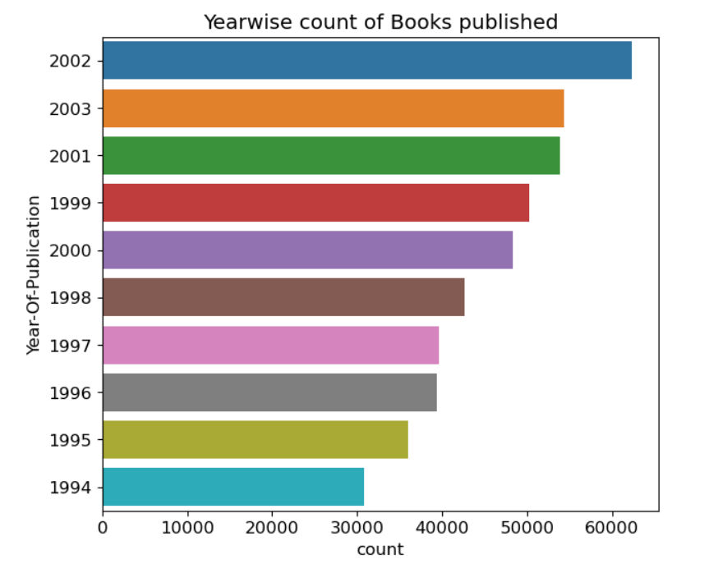
Year wise count of book published
In 2002 more than 60000 books were published .

Slide 22
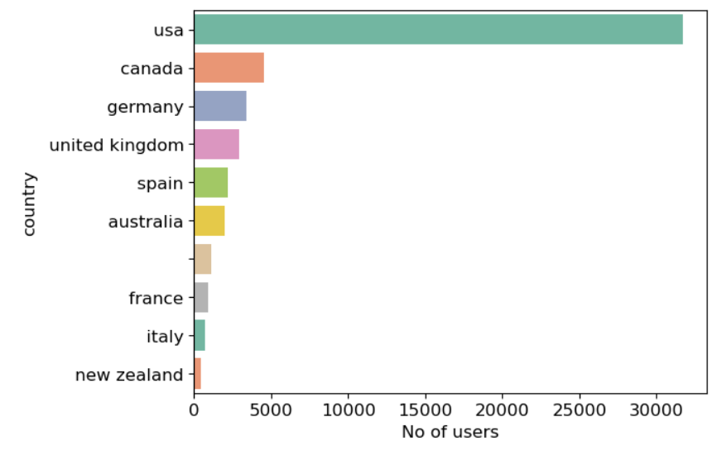
Countries with most readers
Most of the readers are from the United States.

Slide 23
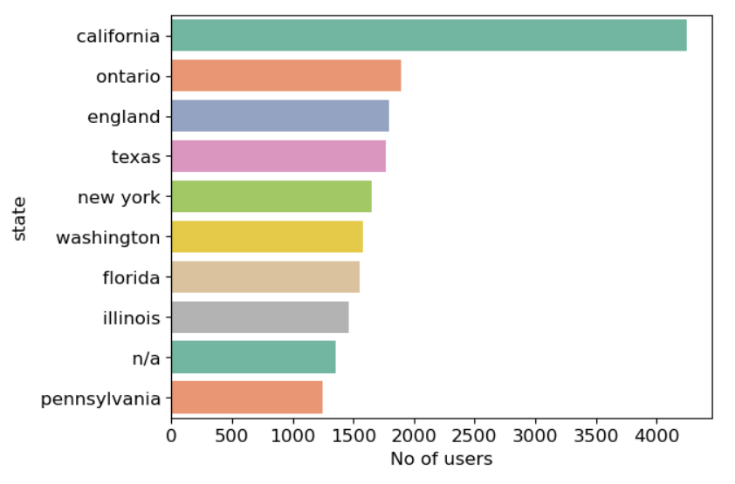
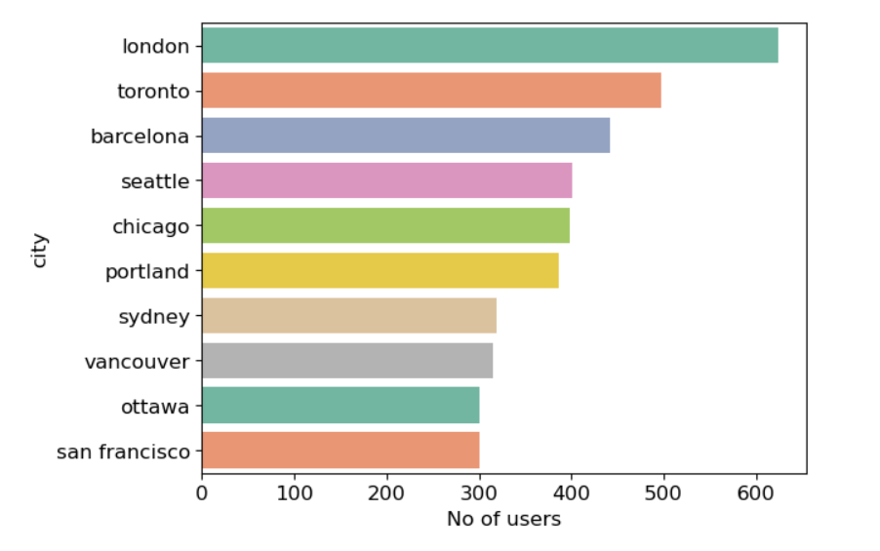
State and City wise most readers
In state California has most readers and in city London has the most readers.

Slide 24
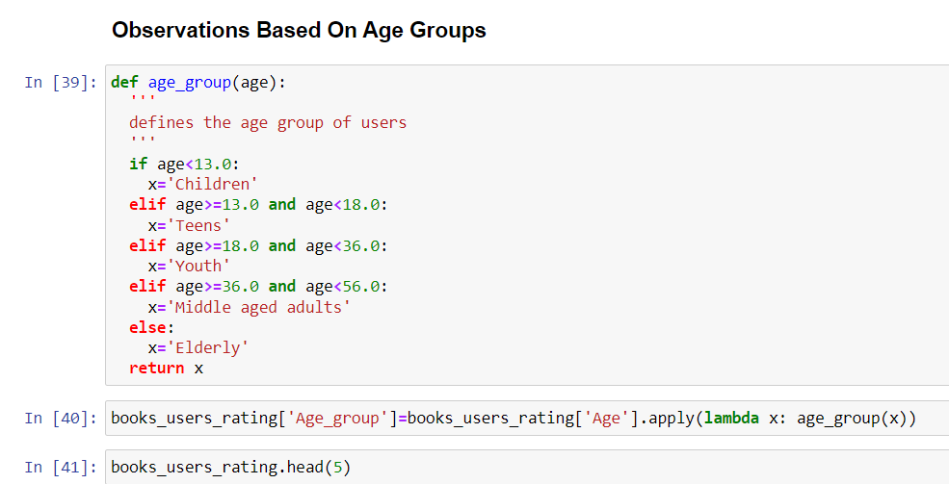
Creating new column Age_group
Age_group has been created based on age categories of various readers namely children, Teens, Youth, Middle aged adults and Elderly.

Slide 25
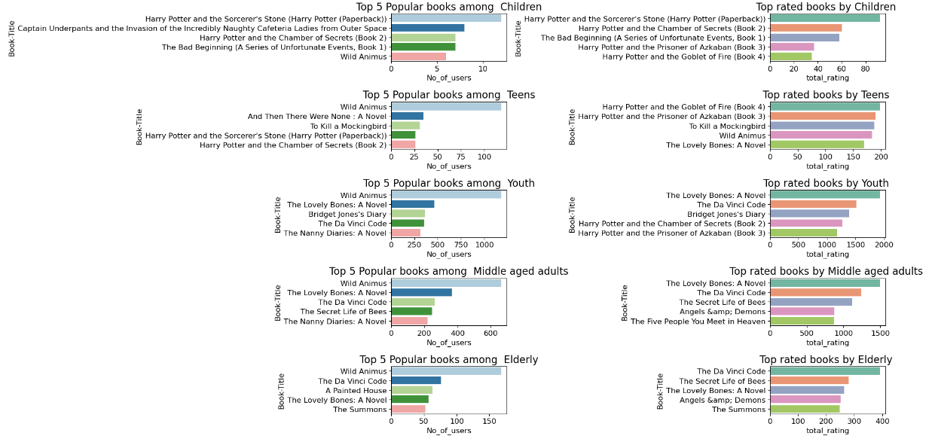
Age wise plotting

Slide 26
EDA conclusions
Wild Animus is the most read book among all age groups.
Most popular book author based on the number of ratings is Stephen King .
Ballantine Books and Pocket are the top publishers based on the number of ratings that their books have received.
The majority of readers are between the ages of 25 and 40.
The majority of readers who have given the books ratings are from the United States and Canada.
The Lovely Bones is the top rated book among Youth & Middle-aged Adults.

