Slide 1

BIG MART SALES PREDICTION USING MACHINE LEARNING
Artificial Intelligence Internship Project Presentation
Presented By: Vinay Kumar Ogre
Organisation: Naviotech Solution • 2026

Slide 2
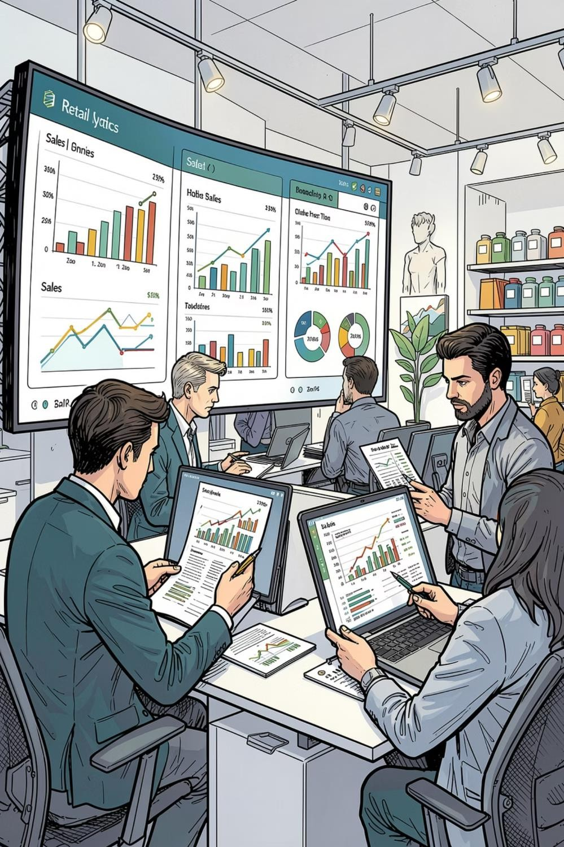
Introduction
Sales prediction is the process of estimating future product sales using historical data, market trends, and statistical models. It empowers retailers to anticipate demand and align supply accordingly.
Machine learning brings precision to business analytics by uncovering hidden patterns within large datasets — enabling proactive, data-driven decision-making across the retail value chain.
Predictive analytics has become indispensable in the retail industry, where accurate forecasts directly influence profitability, customer satisfaction, and competitive advantage.
Demand Estimation
Forecasting future product demand with statistical modelling
Inventory
Optimisation
Aligning stock levels with predicted consumer demand
Strategic Planning
Supporting pricing, promotion, and supply chain decisions

Slide 3
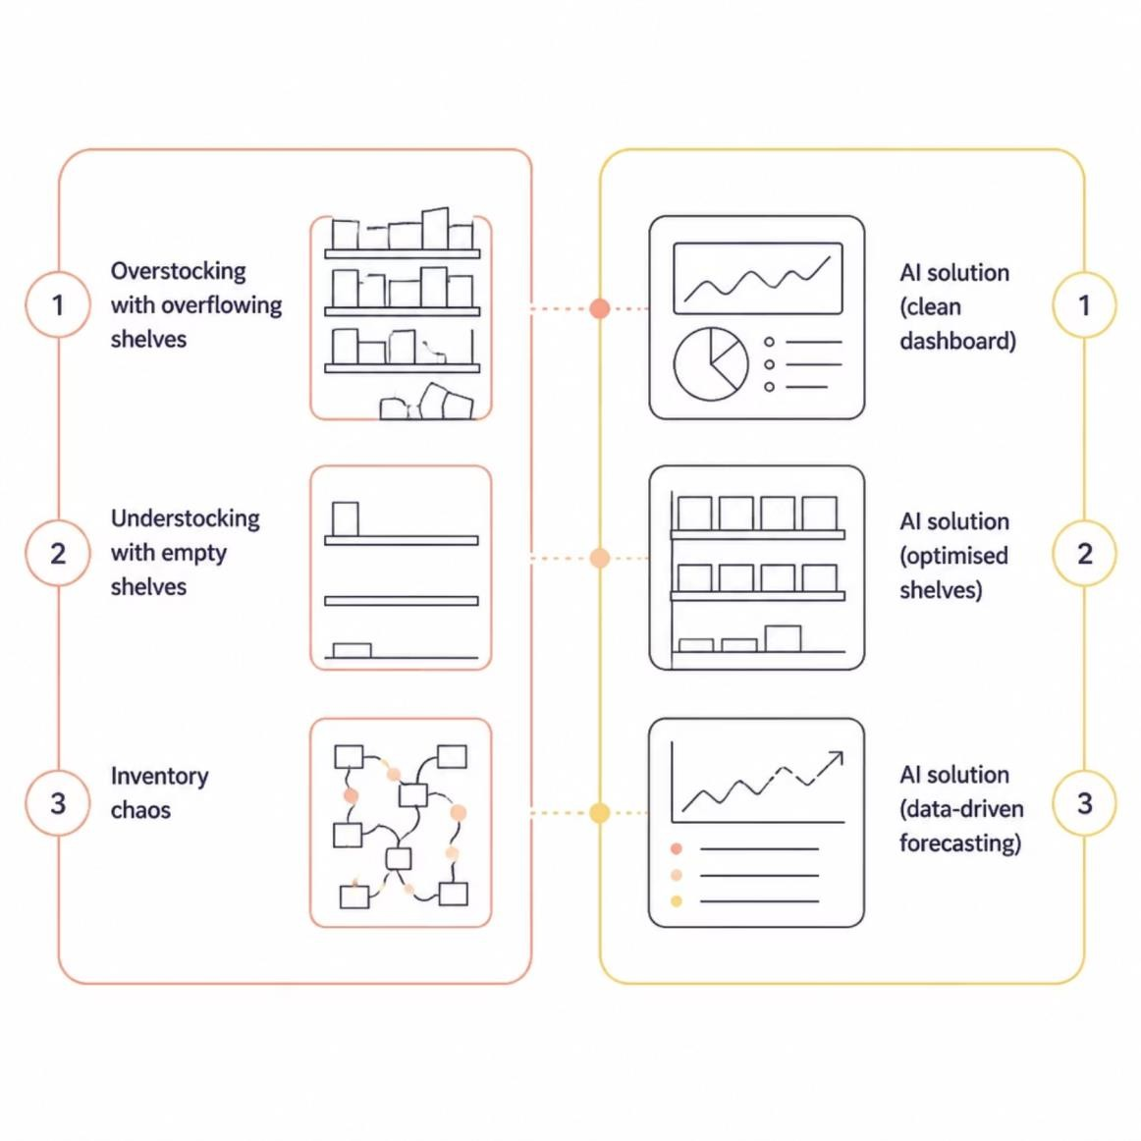
The Problem Statement
Retailers face persistent challenges in inventory management that erode margins and customer trust. Two issues
dominate:
Overstocking — Excess inventory ties up capital, increases warehousing costs, and leads to spoilage or
obsolescence.
Understocking — Insufficient stock triggers lost sales, customer dissatisfaction, and brand erosion.
Traditional forecasting methods rely on intuition and historical averages — approaches that fail to capture the
complexity of modern retail dynamics.

Slide 4



Project Objectives
Predict Product Sales
Build an accurate ML model to forecast outlet-level sales for diverse products.
Improve Inventory Planning
Enable data-backed stock decisions that reduce waste and prevent shortages.
Support Business Decisions
Deliver actionable insights for pricing, promotions, and supply chain strategy.
Apply ML Techniques
Leverage supervised learning and feature engineering on real-world retail data.
Analyse Retail Data
Explore and interpret Big Mart's historical sales dataset to extract meaningful patterns.

Slide 5
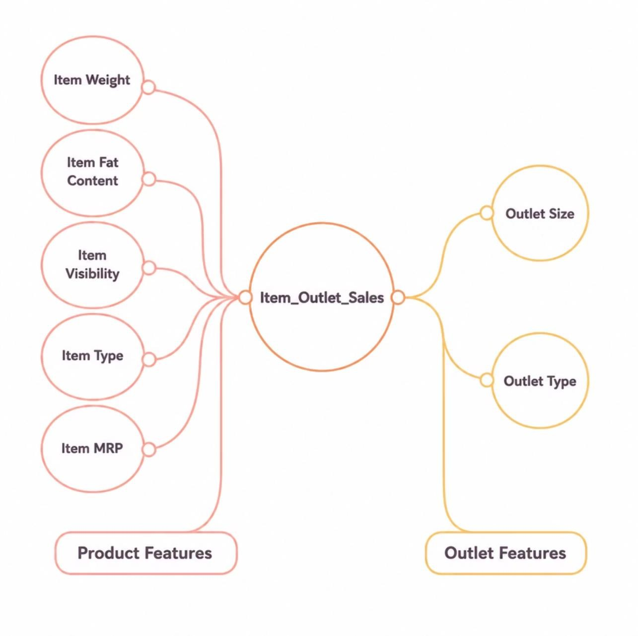
Dataset Description
The Big Mart dataset comprises 8,523 product records across 1,559 products and 10 retail outlets. It is split into
two files for model training and evaluation.
Target Variable:
Item_Outlet_Sales — the continuous value our model le arns to predict.

Slide 6





Technology Stack
A robust Python-centric ecosystem powering the end-to-end machine learning pipeline — from data wrangling to model deployment.
Python
Core programming language for the entire ML workflow
Pandas
Data manipulation and structured analysis
NumPy
Numerical computing and array operations
Matplotlib
Data visualisation and exploratory plotting
Seaborn
Statistical graphics and correlation heatmaps
Scikit-Learn
Preprocessing, model selection, and evaluation
XGBoost
Gradient-boosted regression model for prediction
Google Colab
Cloud-based notebook development environment

Slide 7

Data Preprocessing Pipeline
Raw data is rarely model-ready. A structured preprocessing pipeline ensures data quality, consistency, and predictive power before training begins.
Data Loading
Data Cleaning
Missing Handling
Label Encoding
Feature Eng.
Each stage transforms raw retail records into a clean, encoded, and feature-rich dataset ready for supervised learning.

Slide 8
System Architecture
The end-to-end architecture follows a linear data-to-insight pipeline — from raw Big Mart records through preprocessing and modelling to actionable sales predictions.
01 02
Dataset
Load Train.csv and Test.csv into Pandas DataFrames for processing
Data Preprocessing
Clean, transform, and engineer features from raw retail data
03
04
Missing Value Handling
Impute gaps using median and mode strategies for robustness
Label Encoding
Convert categorical features into numeric representations
05
06
Train-Test Split
Partition the training data for model validation
XGBoost Regressor
Train the gradient-boosted ensemble on processed features
07
08
Prediction
Generate sales forecasts for the test dataset
Performance Evaluation
Assess accuracy using R² score and residual analysis

Slide 9

XGBoost Regressor
XGBoost (eXtreme Gradient Boosting) is an optimised distributed gradient-boosting library designed for speed and performance. It builds an ensemble of weak learners sequentially, each correcting errors from its predecessor.
Why XGBoost? It consistently outperforms other regression algorithms on tabular data, making it the natural choice for Big Mart's structured dataset.
High Accuracy
Ensemble learning captures
complex non-linear patterns
1
Efficient Training
Parallelised tree construction enables rapid convergence
2
Built-in Regularisation
L1 and L2 penalties prevent
overfitting on training data
3
Handling Missing Data
Natively learns default
directions for sparse features
4

Slide 10
Implementation Workflow
Load Dataset
Import Big Mart CSV files
into Pandas
Handle Missing Values
Impute Item_Weight and Outlet_Size gaps
Train XGBoost
Fit the regressor on the
training split
Evaluate Results
Measure performance
with R² and RMSE
Explore Data
Uncover distributions,
correlations, and outliers
Label Encoding
Convert all categorical
columns to numeric
Generate Predictions
Forecast sales for the
test dataset
Each stage was executed iteratively in Google Colab, with visual validation at every checkpoint to ensure pipeline integrity.

Slide 11

Big Mart Sales Prediction Using Machine Learning
AI INTERNSHIP PROJECT NAVIOTECH SOLUTION
A Machine Learning-driven approach to retail sales forecasting using the XGBoost Regressor, presented as part of the Artificial Intelligence Internship Programme at Naviotech Solution.
Presenter
Vinay Kumar OGRE
Organisation
Naviotech Solution
Year
2026

Slide 12
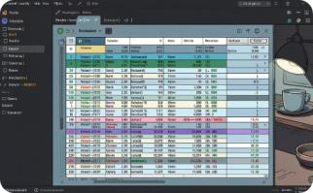
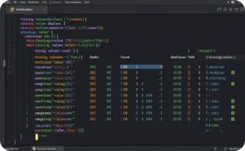
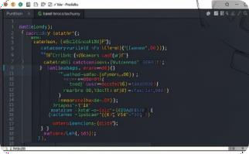
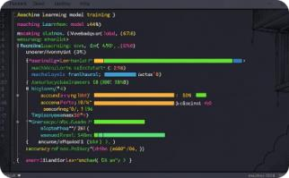
Output Screenshots
Key stages of the model pipeline captured as dashboard outputs, illustrating data ingestion, preprocessing, encoding, and
model training.
Dataset Loading Output
The Big Mart dataset is loaded into a structured DataFrame, displaying product and outlet-level features across 8,523 records.
Missing Values Output
Null value analysis identifies gaps in Item_Weight and Outlet_Size, guiding the imputation strategy for data integrity.
Label Encoding Output
Categorical variables such as Item_Fat_Content and Outlet_Type are encoded into numerical labels for model compatibility.
Model Training Output
The XGBoost Regressor is trained on processed features, with iterative boosting rounds converging towards optimal performance.

Slide 13

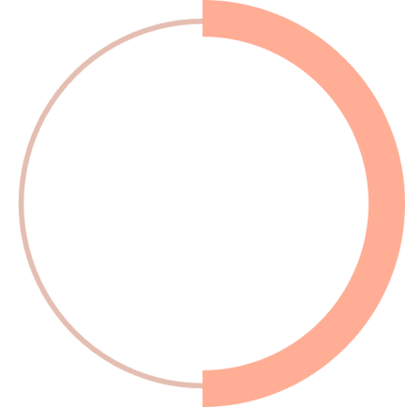
Model Performance & Results
The XGBoost Regressor was evaluated on both training and testing datasets to assess generalisation capability and predictive accuracy.
88%
50%
Training R² Score
0.8762
Testing R² Score
0.5017
The model achieves a strong training R² score of 0.8762, indicating it learned the training patterns well. The testing R² score of 0.5017 reflects moderate generalisation to
unseen data.
Training Accuracy
High fit on training data with R² = 0.8762, capturing complex nonlinear relationships.
Testing Accuracy
Test R² = 0.5017 suggests potential overfitting, indicating room for regularisation
tuning.

Slide 14

Advantages & Future Scope
Web Application Deployment
Deploy as an interactive web app using Flask or
Streamlit for stakeholder access.
1
Better Sales Forecasting
Accurate predictions of product-level sales across retail outlets.
2
Cloud Integration
Scale the model on AWS or Azure with serverless inference endpoints.
Improved Inventory Management
Optimised stock levels reduce wastage and shortage risks.
Real-Time Prediction
Stream live sales data for instant forecasting and dynamic pricing.
3
4
Advanced AI
Models
Explore deep learning ensembles and hyperparameter tuning for higher accuracy.
Business Growth
Data-backed insights unlock expansion and profitability.

Slide 15

Conclusion & Thank You
The Big Mart Sales Prediction project successfully demonstrates the application of Machine Learning for retail sales forecasting. The XGBoost Regressor model delivered a training R² score of 0.8762, capturing complex relationships across product and outlet features, while the testing R² of 0.5017 highlighted areas for further regularisation and feature engineering.
This project establishes a scalable foundation for data-driven retail decision-making, inventory optimisation, and business intelligence.
Thank You
Questions & Answers

