Slide 1
“Animal Detection and Community Alert System”
By,
Vinay Kumar Pandey

Slide 2
Animal Detection and Community Alert System
A step towards safety.

Slide 3
Problem Statement:
To develop an automated system that detects wild animals like lions, tigers, and leopards entering residential areas, confirms their presence through human validation, and triggers an alarm to warn the local population.

Slide 4
Existing System:
Overview: Previous systems primarily focused on theoretical studies and simulations, employing machine learning techniques such as Support Vector Machines (SVM) and Convolutional Neural Networks (CNN) for animal detection.
Approach: Utilized camera traps, video surveillance, and basic detection algorithms like SVM, which provided only limited success in monitoring wildlife without practical real-world application in stopping them from attacking humans.

Slide 5
System Architecture:
Existing System
Input Data
Preprocessing Unit
Output Display
Animal Detection Model
Convolutional Neural Networks (CNN): Used for feature extraction from images.
Depth-wise Separable Convolution Layer: Enhances efficiency by breaking down convolution into point-wise and depth-wise operations.
Classification Layer: Identifies the animal species based on the extracted features.

Slide 6
Proposed System:
Our Unique Contribution:
Unlike previous systems, our project not only builds on the theoretical models but also implements the detection system using IoT to create a practical, real-life solution.
We introduce two additional layers of confirmation and security:
Manual Verification by the Forest Department: Adds a critical layer of human validation to confirm the presence of wild animals and reduce false positives.
IoT Integration: An Arduino-based siren system provides an immediate alert, ensuring the public is warned in real time about potential wildlife threats.

Slide 7
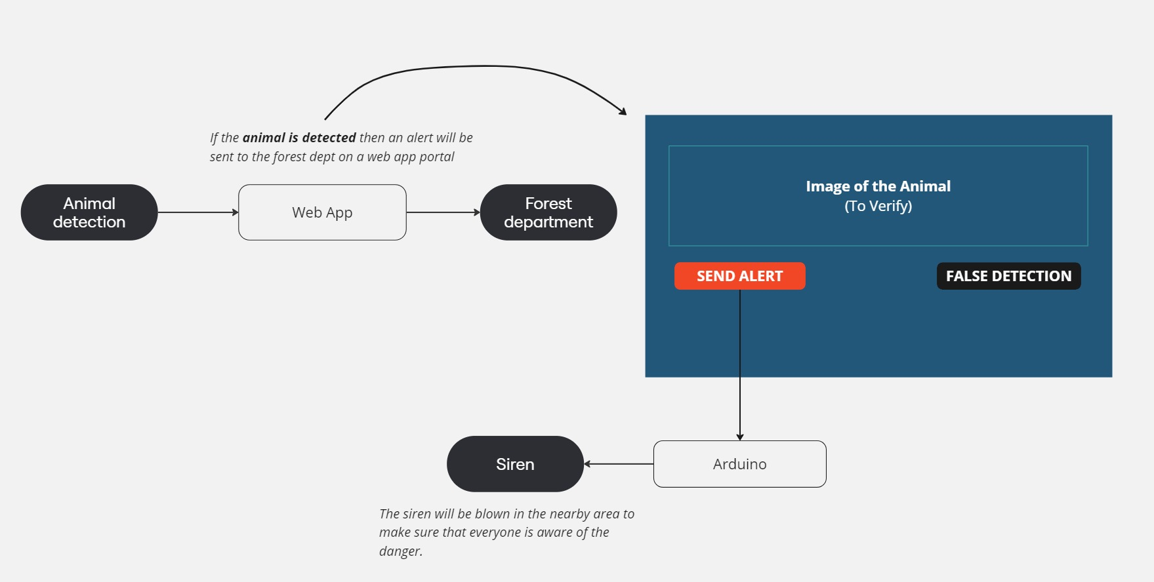
System Architecture:

Slide 8
Literature Survey:
Sr. No. | Paper Name | Year | Authors | Description
1. | Wild Animal Detection using Deep Learning | 2022 | Sreedevi K L , Dr Anitha Edison | Efficient observation of wild animals is crucial. Cost-effective techniques for observing the behaviour of wild animals are needed for both wildlife conservation and for reducing human-wildlife conflicts.
2. | Animal Detection Alert System. | 2022 | S Meera, R Sharmikha sree, K Priyadharshini, P.V. Varshitha, R. SaiCharitha | This paper proposes an Animal detection system using a deep neural networks algorithm. The proposed system is used for detecting the creatures veritably directly.

Slide 9
Literature Survey:
Sr. No. | Paper Name | Year | Authors | Description
3. | Animals Image Classification Method Based on Improved Convolutional Neural Network | 2022 | Zihang Song, Wenkang Gong, Chenxi Li, Teoh Teik Toe | This paper attempts to apply neural networks to classify images of 10 different animals.

Slide 10
Motivation:
Frequent incidents of human-animal conflict, such as:
Wild elephants destroying crops in rural India.
Leopards entering villages and attacking livestock.

Slide 11
Objectives:
Following are the objectives behind the idea of the project:
1. Develop a reliable animal detection system using AI.
2. Send real-time alerts to nearby communities.
3. Reduce crop and livestock damage in rural areas.
4. Increase community safety.

Slide 12
Scope:
1.
Wildlife conservation parks
2.
Agricultural
farmlands
3.
Rural villages near forest areas
4.
Urban wildlife management systems

Slide 13
Hardware & Software Essentials:
Hardware:
Software:
Arduino Kit
Camera
Siren / Speakers
Python 3.11
Python libraries

Slide 14
UML Diagrams:
System
Animal’s Photo
Alert
The system will recognize the wild animals.
Local community will be alerted using a siren sound in the area.
DFD Level 0

Slide 15
Design:
System
Animal’s Photo
The system will recognize the wild animal and send an update to the forest dept.
Forest Dept. will verify it manually and trigger an alert if detection was true.
If it was a false detection then declare it false alert.
Forest Department
Alert
Local community will be alerted using a siren sound in the area.
DFD Level 1

Slide 16
Design:
Camera
System
The system will recognize the wild animal and send an update to the forest dept.
Animal’s Photo
Photo of the animal will be captured using camera.
Forest Dept. will verify it manually & trigger an alert if detection was true.
If it was a false detection then declare it false alert.
YOLO Algorithm
Forest Department
Alert
Local community will be alerted using a siren sound in the area.
DFD Level 2

Slide 17
UML Diagrams:
Animal’s Photo
Image Classification
Forest Department’s verification
Public Alert
Siren
Photo of the animal will be classified to find out the animal.
If the animal is a threat Forest Department will be alerted.
They will verify the alert manually.
Siren will be triggered to alert the locals.
Sequence Diagram

Slide 18
Design:
Activity Diagram
Animal’s Image
Check if wild
Send Alert to Forest Department.
Verify the alert
Triger Siren

Slide 19

UML Diagrams:
Wild Animal Detection
Verification of the Alert generated by the detection.
Declaring the alert.
Animal
System
Forest Department
Use Case Diagram

Slide 20
Class Diagram:
Camera
Animal Detection Model
Animal
Camera_Id
Location
Status
CaptureImage()
SendImage()
Model_type
Accuracy
Result
detectAnimal(image)
classifySpecies(image)
species
Location_detail
identifySpecies()
getDeatails()
Alert
IoT Siren
Alert_Id
Status
Timestamp
triggerAlert()
logAlert()
Siren_Id
Location
Volume
Activatesiren()
DeactivateSiren()
Class Diagram

Slide 21
Object Diagram:
Camera 1
Animal Detection Model
Animal
Camera_Id: 1
Location: Zone 1
Status : Active
CaptureImage()
SendImage()
Accuracy: 95%
Result: leopard
detectAnimal(image)
classifySpecies(image)
Species: Leopard
Location_detail: Zone 1
identifySpecies()
getDeatails()
Alert
IoT Siren
Alert_Id: 101
Status: Active
Timestamp: 2024-10-27 10:15
triggerAlert()
logAlert()
Siren_Id: 01
Location: Zone1
Volume: High
Activatesiren()
DeactivateSiren()
Object Diagram

Slide 22
Own Contribution:
Our contribution involves the development of an animal detection algorithm that
provides accurate and reliable real-time alerts to communities, reducing human-animal
conflict.
The system leverages modern AI techniques for animal classification, allows the Forest
department to actually verify the alert and then uses IoT for community alert
notifications.

Slide 23
Conclusion:
Our system combines real-time animal detection with IoT alerts to enhance public safety from wildlife threats. Using YOLO for accurate detection and manual verification by the forest department, it ensures reliable alerts, reducing false positives and making communities safer.

Slide 24
References:
“Wild Animal Detection using Deep Learning” in 2022 by Sreedevi K L , Dr Anitha Edison.
“Animal Detection Alert System” in 2022 S Meera, R Sharmikhasree, K Priyadharshini, P.V. Varshitha, R. SaiCharitha.
“Animals Image Classification Method Based on Improved Convolutional Neural Network” in 2022 by Zihang Song, Wenkang Gong, Chenxi Li, Teoh Teik Toe.

Slide 25
Thank You

