Slide 1
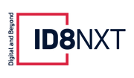
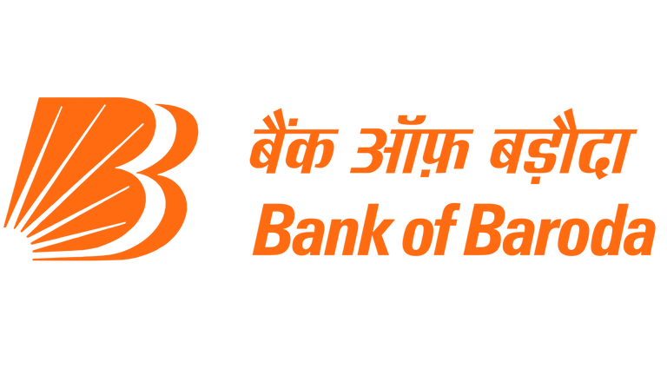

FinBuddy
Bank of Baroda Hackathon 2024
Your Team Name : Hackers
Your team bio : Your Financial Buddy
Date : 30th June 2024

Slide 2
Problem Statement?
Our aim is to revolutionize financial advisory services by leveraging generative AI to provide personalized, data-driven financial advice to customers.
Analyze customer financial data and market trends to generate tailored investment strategies.
Offer real-time advisory services that adapt to changing financial conditions and customer goals.
Ensure transparency and explainability in the AI-driven advisory process to build customer trust and confidence.

Slide 3
Pre-Requisite
Currently, most existing chatbots in the financial advisory sector are not truly conversational; they rely on keyword-based or QnA interactions.
While there are a few conversational chatbots like BloomingPT, they are not available for public use. Additionally, there are intermediaries such as stock market brokers and financial consultants (CAs).
However, this approach is often chaotic and burdensome, as hiring a CA can be financially taxing and the manual process takes a significant amount of time to resolve queries.

Slide 4
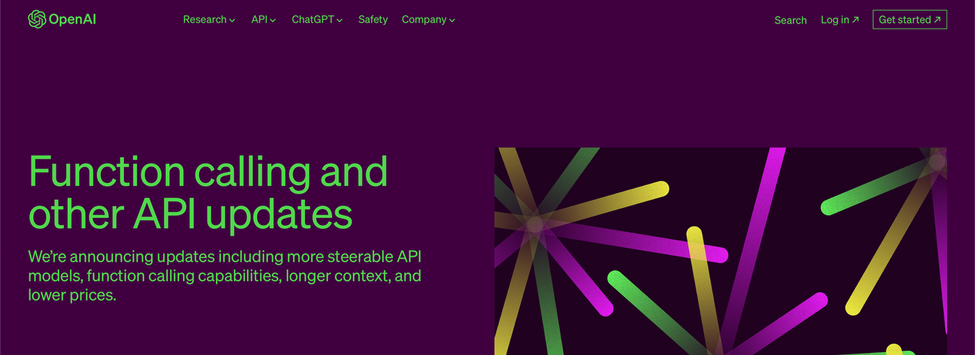
Tools or resources
Natural Language Processing (NLP) Libraries:
SpaCy: For text processing and entity recognition.
NLTK (Natural Language Toolkit): For text analysis and preprocessing.
Hugging Face Transformers: For implementing the Retrieval-Augmented Generation (RAG) model.
2. Machine Learning Frameworks:
TensorFlow: For training and deploying AI models.
PyTorch: For developing and fine-tuning the chatbot's underlying model
3. APIs and Data Sources:
Financial Market APIs (e.g., Alpha Vantage, IEX Cloud): For retrieving real-time market data and financial information.
Bank and SEBI Guidelines Databases: For ensuring compliance with regulatory standards.
4. Cloud Computing Platforms:
Microsoft Azure: For integrating AI services and deploying the chatbot.

Slide 5
5. Security and Privacy Tools:
Encryption Libraries (e.g., PyCryptodome): For ensuring data security and privacy.
GDPR Compliance Tools: To ensure the chatbot adheres to privacy regulations and standards.
6. Development and Collaboration Tools:
GitHub: For version control and collaborative development.
Jupyter Notebooks: For experimentation and prototyping.
Microsoft Teams: For team communication and project management.
7. Customer Feedback and Testing Tools:
SurveyMonkey: For gathering user feedback and improving the chatbot.
UserTesting: For conducting usability tests and ensuring a seamless user experience.

Slide 6
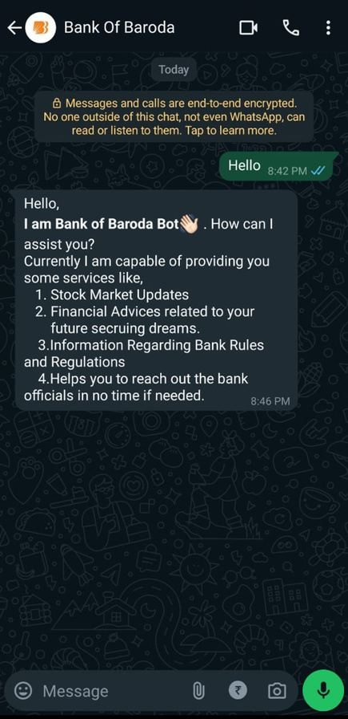
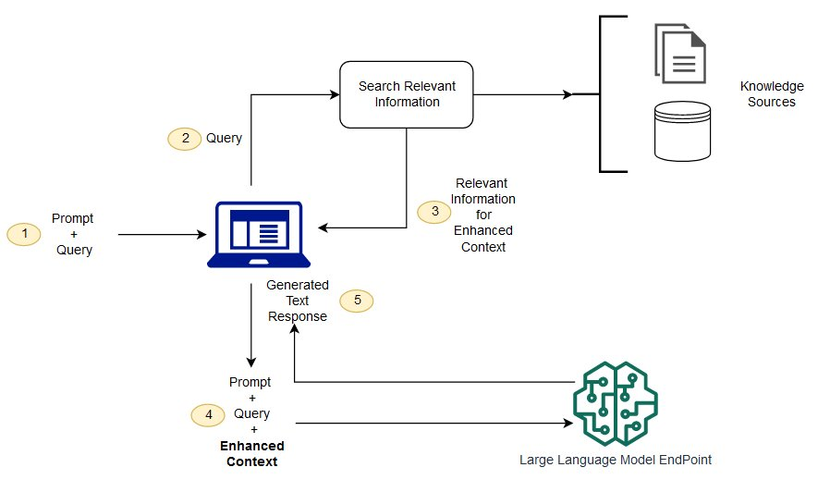
Any Supporting Functional Documents
Present your solution, talk about methodology, architecture & scalability
(Retrieval Augmented Generation)
Our Solution :

Slide 7
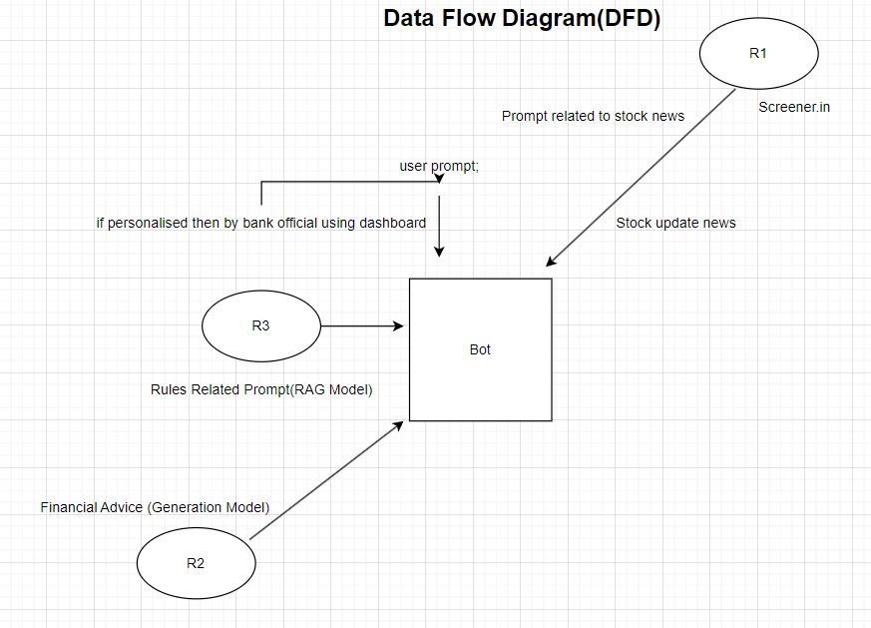
Any Supporting Functional Documents
Methodology (Data Flow Diagram)

Slide 8
Key Differentiators & Adoption Plan
Unlike traditional keyword-based chatbots, our RAG-based chatbot provides personalized recommendations that adapt to changing market dynamics and individual customer goals. This ensures that the advice is always relevant and tailored to the specific needs of each user.
Our chatbot's output suggestions adhere strictly to bank and SEBI (Securities and Exchange Board of India) guidelines. This ensures that the financial advice provided is not only accurate but also compliant with regulatory standards, which enhances trust and reliability for the users.
To maintain user privacy, our solution offers generalized financial recommendations without requiring access to the customer's transaction history. This approach ensures that sensitive financial data remains secure, addressing privacy concerns while still delivering valuable and actionable advice.

Slide 9
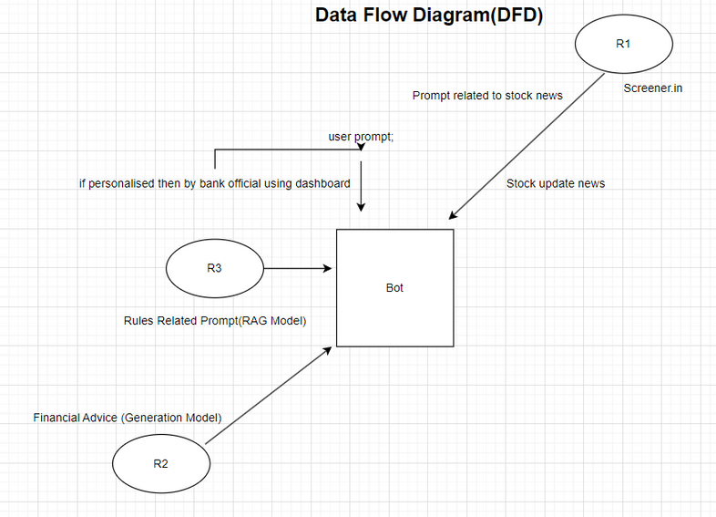
GitHub Repository Link & supporting diagrams, screenshots, if any
Github Repo Link : https://github.com/vinayparjapati5/FinBuddy
https://www.bankofbaroda.in/banking-mantra/recent-trends-in-banking/articles/new-guidelines-on-digital-lending-issued-by-rbi
https://investor.sebi.gov.in/Investor-charter.html

Slide 10
Business Potential and Relevance
1.Personal Financial Advisory Services: Integrates into financial institutions to provide real-time, personalized investment advice.
2.Customer Support in Financial Institutions: Handles customer inquiries, enhancing experience and satisfaction.
3. Robo-Advisory Platforms: Forms the core of automated financial planning services.
4. Wealth Management: Offers tailored investment strategies in compliance with regulatory standards.
5. Retail Banking: Assists with investment queries, account management, and financial planning.
6. Financial Education: Provides insights and explanations about financial concepts and market trends.

Slide 11
Uniqueness of Approach and Solution
Unique Aspects:
1. Dynamic Personalization:
Our RAG-based chatbot offers personalized recommendations that adapt to changing market dynamics and individual customer goals. This ensures that users receive timely and relevant advice tailored specifically to their financial needs and circumstances.
2. Regulatory Compliance:
The output suggestions provided by our chatbot adhere strictly to bank and SEBI (Securities and Exchange Board of India) guidelines. This compliance with regulatory standards ensures that the advice is not only accurate but also trustworthy and reliable.
3. Privacy Protection:
To maintain user privacy, our solution delivers generalized financial recommendations without accessing the customer's transaction history. This approach safeguards sensitive financial data, addressing privacy concerns while still offering valuable and actionable advice.
4.Deployment on Whatsapp(Ease of Access):
We are focusing on ease of access by providing our bot on WhatsApp.

Slide 12
User Experience
Our RAG-based chatbot will enhance the user experience in the following ways:
1. Real-Time Market Analysis:
Our chatbot provides investment suggestions based on real-time market conditions and individual customer goals. This ensures that users receive timely and relevant advice, helping them make informed financial decisions that reflect the current market environment.
2. Transparency and Explainability:
We ensure transparency and explainability in the AI-driven advisory process. By clearly communicating how recommendations are generated, we build customer trust and confidence in the advice provided, making the financial advisory process more accessible and understandable for users.

Slide 13
Scalability
Model Optimization
Fine-tuning machine learning models to enhance performance by adjusting hyperparameters, selecting effective algorithms, and preventing overfitting, resulting in more accurate predictions.
Customer Real-Data-Based Investment Suggestions Without Hindering Their Security
Using real customer data for personalized investment advice while ensuring data privacy and security through anonymization, encryption, and compliance with regulations.
Infrastructure Scaling
Expanding IT infrastructure in response to demand using vertical and horizontal scaling, cloud services, and automation tools to maintain performance and reliability.

Slide 14
Ease of Deployment and Maintenance
1. Scalable Infrastructure and Efficient Deployment
- Use Azure Resource Manager (ARM) Templates and Azure Kubernetes Service (AKS) for consistent and scalable deployment.
- Utilize Azure Machine Learning and Azure Functions for seamless model training, deployment, and serverless processing.
2. Comprehensive Monitoring and Security
- Leverage Azure Monitor and Azure Log Analytics for real-time monitoring and deep log analysis.
- Ensure robust security management with Azure Security Center and secure sensitive data using Azure Key Vault.
3. Cost Management and User Experience Optimization
- Monitor and control spending with Azure Cost Management and Billing, and optimize costs with Azure Reserved Instances.

Slide 15
Thank You
Team member names :
Vinay Kumar
Manav Malhotra
Akshay Pratap Singh
Harshit Dubey

