Slide 1


HEART DISEASE DIAGNOSTIC ANALYSIS
DETAILED PORJECT REPORT
VINAY PRITWANI

Slide 2
PROJECT DETAILS
PROJECT TITLE | Heart Disease Diagnostic – Analysis
TECHNOLOGY | Business Intelligence
DOMAIN | Healthcare
PROJECT DIFFICULTY LEVEL | Advanced
PROGRAMNING LANGUAGE USED | Python
TOOLS USED | Jupyter Notebook, MS-Excel, MS- Power BI

Slide 3
OBJECTIVE
The objective of this project is to analyze how likely the people in different ages are prone or likely to suffer from cardiovascular diseases (CVD’s) or heart disease based on the combination of some features that are the attributes of heart disease.

Slide 4
PROBLEM STATEMENT
Health is the real wealth in pandemic time we all realized the brute effects of covid-19 on all irrespective of status. You are require to analyze this health and medical data for better future preparations.
A dataset is formed by taking into consideration the data of 303 individuals.

Slide 5

ARCHITECTURE
Raw Data Collection
Importing Libraries in Jupyter Notebook
Load Dataset
Missing Value Imputations
Low Level
Design Document
High-Level
Design Document
  Architecture Document
Wireframe Document
Handling Outliers
Data Pre- Processing
Deployment
Reporting
Insights
Data Cleaning
Insights
Power BI
Modeling
Exploratory Data Analysis

Slide 6
DATASET INFORMATION
age: The person's age in years
sex: The person's sex (1 = male, 0 = female)
cp: The chest pain experienced (Value 1: typical angina, Value 2: atypical angina, Value 3: non-anginal pain, Value 4: asymptomatic)
trestbps: The person's resting blood pressure (mm Hg on admission to the hospital)
chol: The person's cholesterol measurement in mg/dl
fbs: The person's fasting blood sugar (> 120 mg/dl, 1 = true; 0 = false)
restecg: Resting electrocardiographic measurement (0 = normal, 1 = having ST-T wave abnormality, 2 = showing probable or definite left ventricular hypertrophy by Estes' criteria)
thalach: The person's maximum heart rate achieved
exang: Exercise induced angina (1 = yes; 0 = no)
oldpeak: ST depression induced by exercise relative to rest
slope: the slope of the peak exercise ST segment (Value 1: upsloping, Value 2: flat, Value 3: downsloping)
ca: The number of major vessels (0-3)
thal: A blood disorder called thalassemia (3 = normal; 6 = fixed defect; 7 = reversable defect)
num: Heart disease (0 = no, 1 = yes)

Slide 7
IMPORTANCE OF PARAMETERS
Resting Blood Pressure :- High blood pressure can damage the arteries of the heart, it can increase the risk of CVD’s if the person is already suffering from obesity, high cholesterol, diabetes or any heart condition.
Fasting Blood Sugar :- if the body is unable to produce enough hormone secreted by pancreas (insulin) or not responding to insulin properly causes your body sugar level to rise, hence increasing your risk of heart disease.
Cholesterol :- there are two types of cholesterol HDL (high-density-lipoprotein) and LDL (low-density-lipoprotein), HDL is considered good cholesterol which reduces the risk of heart disease and LDL is bad cholesterol which increase the risk of heart disease.
Sex :- Gender of the person is the significant factor contributing to person’s overall health, it is observed that men are more prone to heart disease then pre-menopausal women but after menopause both men and women are at equal risk of heart disease as per WHO.
Age :- With the increase in person’s age it is observed that the risk of CVD’s also increases rapidly, for instance coronary fatty streaks can begin to form in adolescence, 82% of people who are above 65 or elder die from coronary heart disease, simultaneously the risk of stroke also doubles every decade after age 55.

Slide 8
IMPORTANCE OF PARAMETERS
Resting ECG :- ECG refers to a non-invasive test that can detect abnormalities along with arrhythmias, evidence of CVD’s, left ventricular hypertrophy and bundle branch blocks, resting ECG is also used to assess known cardiovascular diseases, to detect previously undiagnosed CVD’s, and to provide a baseline standard against which to measure changes in the postoperative period.
Max Heart Rate Achieved :- it has been observed that increase in heart rate by 10 beats per minute was linked to increase in risk of cardiac arrest by at least 20%, the increase in risk of CVD’s associated with the acceleration of heart rate was comparable with the increase in risk observed with high blood pressure.
ST depression :- An ST depression is a result that may appear in a person’s electrocardiogram (ECG) results. It is linked with health problems like hypokalemia and myocardial ischemia. Certain medications may also cause an ST depression, such as digitalis, ECG results appear in a graph of spikes and valleys and the points on this graph represent different waves of electrical activity.

Slide 9
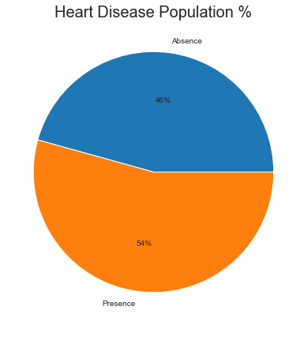
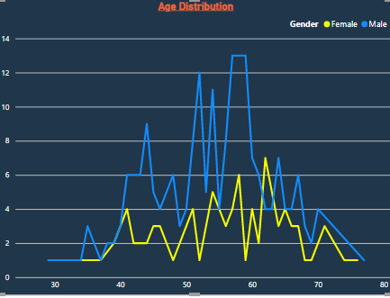
INSIGHTS
Type of population
54% of the total population are suffering from heart disease
More men are from age category below 50 and women below 55 years of age

Slide 10
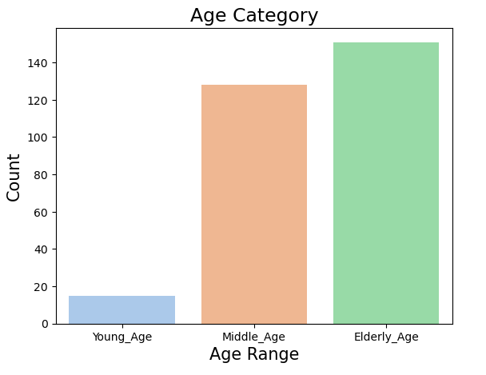
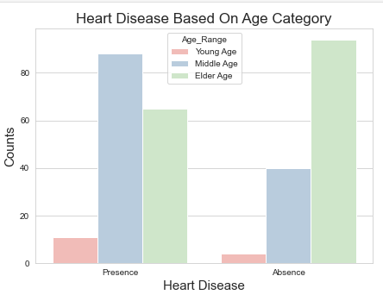
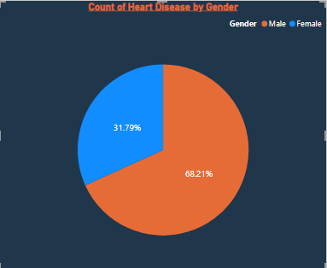
WHO SUFFER FROM HEART DISEASE
There are more elderly people in the sample
Elderly people are prone to heart disease
Males are more likely to suffer from heart disease

Slide 11
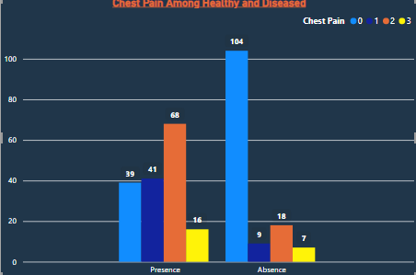
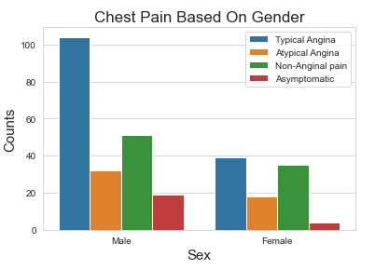
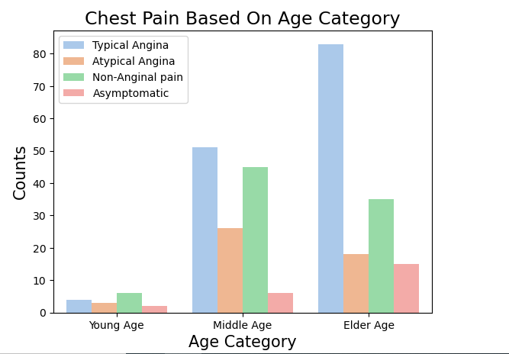
CHEST PAIN EXPERIENCED BY PEOPLE
It can be observed that those having asymptomatic chest pain are prone to heart disease
We can see that a people that are suffering from Asymptomatic type of Chest Pain are mostly men.
There is very high number of Asymptomatic Pain in Elderly age Category

Slide 12
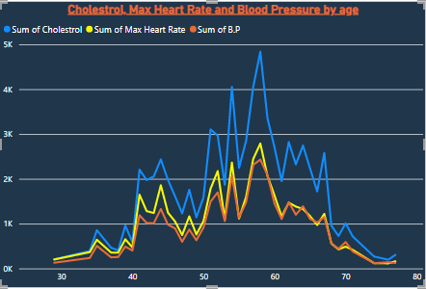
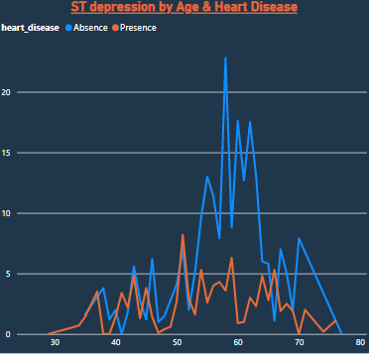
It can be observed that cholesterol, maximum heart rate and blood pressure increase between 50-65 years of age then dips at around 70-80 years of age
In this graph ST depression occurs from 30 years of age and it gradually increases.
It is highest between 50-70 and then starts to drop.

Slide 13
K.P.I (KEY PERFORMANCE INIDCATOR)
Percentage of people suffering from CVD’s or heart disease.
Age distribution as per the gender.
Gender distribution based on the heart disease.
Chest pain experienced by people having heart disease.
Blood pressure, Cholesterol level and Maximum heart rate of people as per their age and heart condition.
ST depression of people as per their age and heart condition.

Slide 14
CONCLUSION
54% of the total population are suffering from heart disease.
More men are from age category below 50 and women below 55 years of age.
Elderly people are prone to heart disease.
Males are more likely to suffer from heart disease.
It can be observed that those having asymptomatic chest pain are prone to heart disease.
It can be observed that cholesterol, maximum heart rate and blood pressure increase between 50-65 years of age then dips at around 70-80 years of age.
ST depression is highest between 50-70 and then starts to drop.

Slide 15
Q&A
Q1) What’s the source of data?
  The dataset id taken from I Neuron’s provided project document.
  Q 2) What was the type of data?
  The data was the combination of numerical and Categorical values.
  Q 3) What’s the complete flow you followed in this Project?
  Refer slide 5th for better Understanding
Q 4) What techniques were you using for data pre-processing?
  Removing unwanted attributes
  Visualizing relation of independent variables with each other and output variables
  Checking and changing Distribution of continuous values
  Removing outliers
  Cleaning data and imputing if null values are present.
  Converting numerical data into categorical values
  Q 5) What are the libraries that you used in python?
  Numpy, Pandas, Seaborn, Matplotlib

Slide 16
THANK YOU!!

