Slide 1
FACIAL IMAGE RECONSTRUCTION USING ELLIPTICAL APPROXIMATION AND CONVEX HULL
JITCSISPRO001
Under the guidance
of
Harsha.S
(ASSISTANT PROFESSOR DEPT.INFORMATION SCIENCE ENGINEERING)
B R Vinayraaj 1JT13CS014
Sanjay G.M 1JT13CS041
Krishna N.B 1JT13CS024

Slide 2
Introduction
Problem Statement :
Given set of images, to identify it as a face and extract face images from it.
Generating the 3D model for the image of the face and dividing it in to plurality of segments.
Reconstruction of the missing segments of the face with face image database.

Slide 3
Why this project ?
computer Vision along with Image processing is one of the most interesting and rapidly developing fields in computer science. It has many applications like face detection and recognition, character recognition, finger print matching, body imaging etc. One of the main application areas in image processing methods is to extract the pictorial information for human body interpretation.
Other than that it has numerous applications in real world.
Namely human-system interactions, security application, virtual scenario recreation, etc.

Slide 4
Milestones and Challenges in this project.!!
Faces are complex, multidimensional and meaningful visual stimuli.
Face Recognition is difficult.
Face and background in the image are similar in overall configuration.
Identifying the golden ratio proportions in the face and mark the silhouette of the face proportions.
Conversion of the 2D face image to a 3D model, where grouping the segments of the image to create perfect full face model is challenge.
Reconstruction for the segment that cant be retrieved from the 2D face image with at most accuracy is the major milestone of the application.

Slide 5
Approach
As, mentioned before database of images of the subject has to be created
and images of the subject has to be compared and a silhouette of the
segments of the face has to be marked. And convert the 2D image into
3D image and reconstruct the dormant side of the face missing in the image.
Algorithm or concepts that we encounter.!!
PCA(Principal component analysis)
LDA(Linear discriminant analysis)
Eigen Space & Eigen face
Elliptical Approximation
Convex Hull
Languages or platform suitable for implementation for this algorithms
are to be chosen by trial of these algorithms in each of them platform
to get most accurate result for the problem.

Slide 6
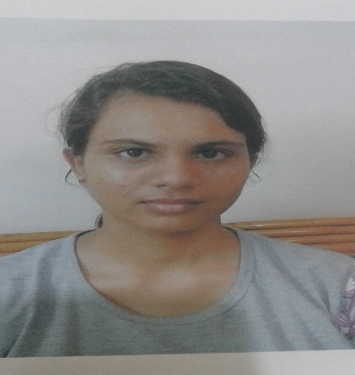
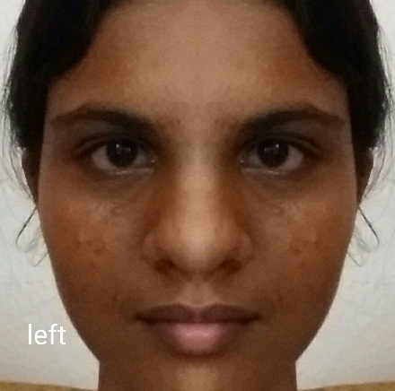
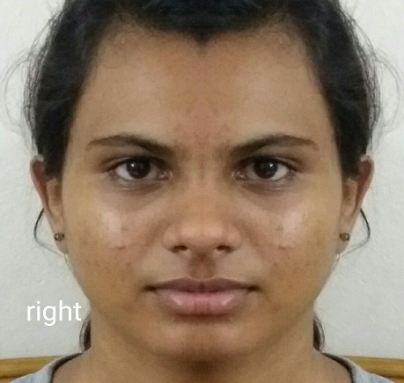
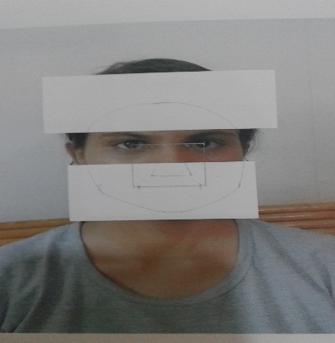
Expected Outcome Of This System..!!
Original in Left Right Occluded Image
Database Optimization Optimization

Slide 7
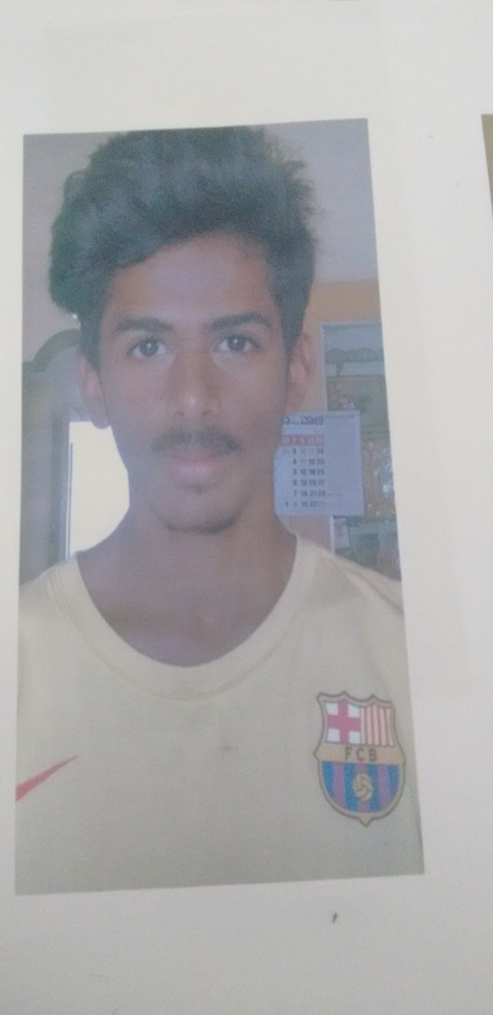
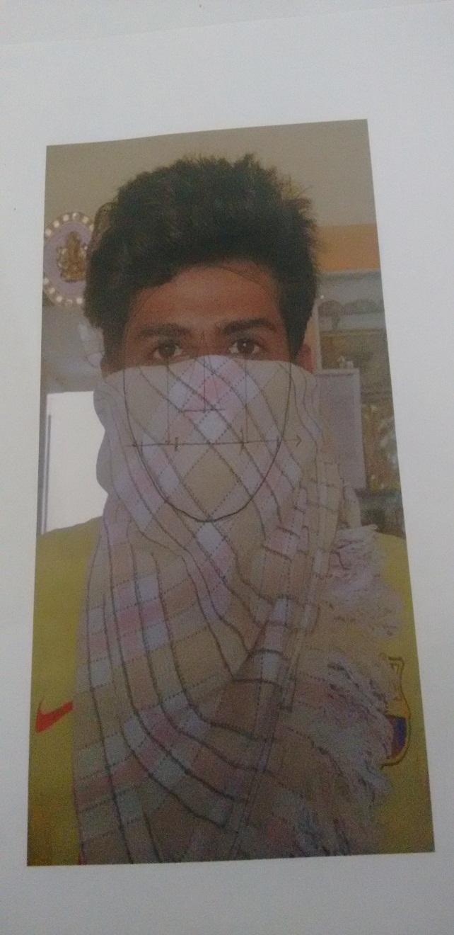
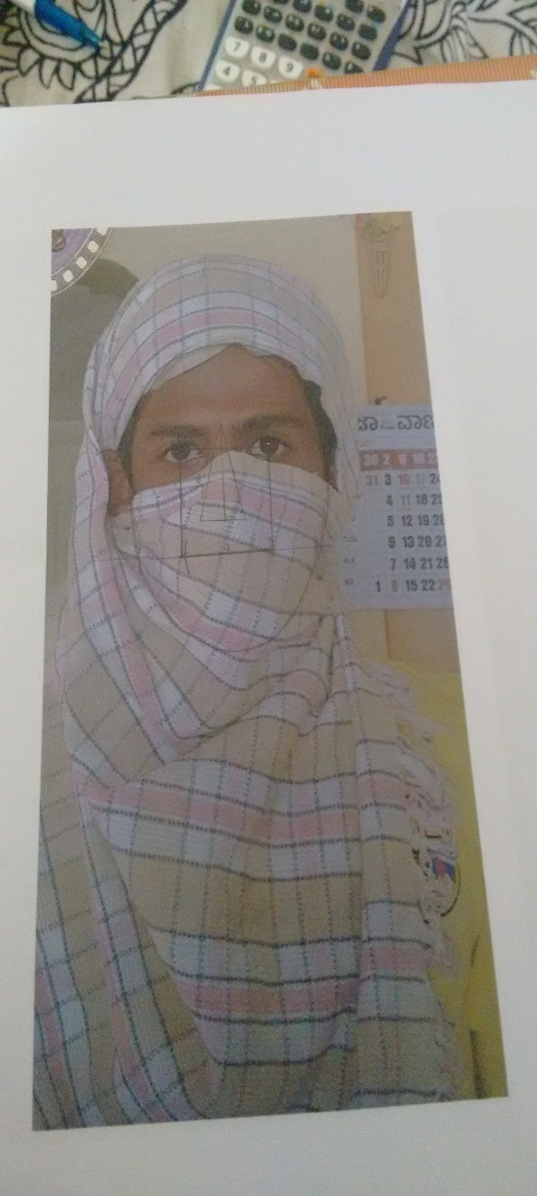
SILLHOUETTE DRAWING

Slide 8
References
Navarrete P. and Ruiz-del-Solar J. (2002), “Interactive Face Retrieval using Self-Organizing Maps”, 2002 Int. Joint Conf. on Neural Networks – IJCNN 2002, May 12-17, Honolulu, USA.
“A tutorial on Principal Components Analysis”, By Lindsay I Smith.
“Eigenfaces for Recognition”, Turk, M. and Pentland A., (1991)
Journal of Cognitive Neuroscience, Vol. 3, No. 1, pp. 71-86.
Ruiz-del-Solar, J., and Navarrete, P. (2002). “Towards a Generalized Eigenspace-based Face Recognition Framework”, 4th Int. Workshop on Statistical Techniques in Pattern Recognition, August 6-9, Windsor, Canada.
Simulating Neural Networks by James A. Freeman.
Artificial Intelligence by Neil J. Nielsson.

Slide 9
THANK YOU

