Slide 1


“Advanced C Programming”
eDiploma-2021

Slide 2
Preprocessor

Slide 3
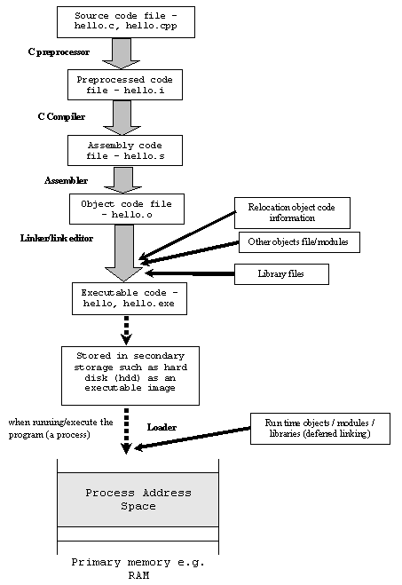
Compilation Phases 1.preprocessing: gcc –E code.c 2.assembly code generation: gcc -S code.c 3.obj file generation: gcc –c code.c 4.executable generation: gcc code.c [gcc code.c –o myexe] from obj files: gcc -o myexe code.o

Slide 4
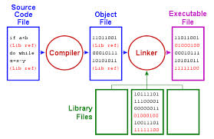
Compilation Phases

Slide 5
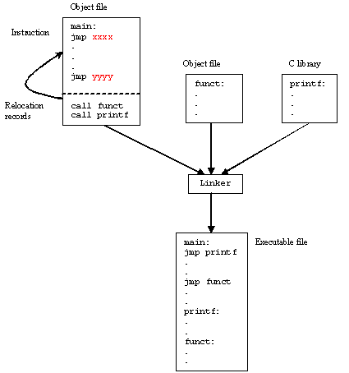
Compiling and running C programs

Slide 6
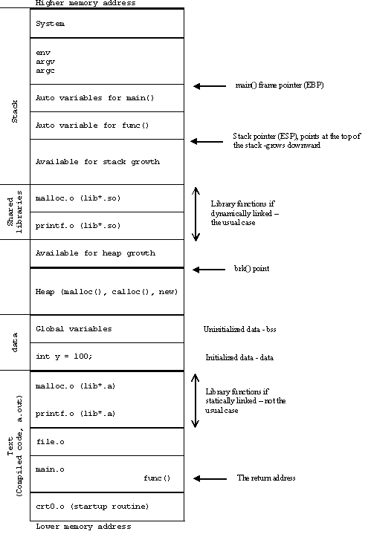

Slide 7
Introduction
Definition and Features:
Pre-processing is conceptually a separate first step in the compilation. It performs the following actions before the compilation process:
Inclusion of other files
Definition of symbolic constants and macros
Conditional compilation of program code
Conditional execution of preprocessor directives
Operators: Two operators are available in standard C
# - Used to replace the text token to a string surrounded by quotes
## - Used to concatenate two tokens (Token Pasting)

Slide 8
File Inclusion (#include)
The #include Preprocessor Directive
Used to include the copy of a specified file in place of the directive
Syntax:
Type 1: #include <filename>
It searches standard library for the file
Use for standard library files
Type 2: #include "filename"
First, It searches the current directory for the file, if not found, then it searches the standard library
Used for user-defined files

Slide 9
File Inclusion (#include)…
The #include Preprocessor Directive
Uses
Loading header files
#include<stdio.h>
Programs with multiple source files to be compiled together
Header file - has common declarations and definitions (Structures, Unions, function prototypes)

Slide 10
Symbolic Constants (#define)
The #define Preprocessor Directive
Preprocessor directive used to create symbolic constants and macros. When program compiled, all occurrences of symbolic constant replaced with replacement text. (Also called as Object-Like Macros)
Syntax:
#define identifier replacement-text
Example:
#define PI 3.14159
Every thing written right side of the identifier will be replaced.
Cannot redefine symbolic constants with more #define statements

Slide 11
Macros (#define)
Macros: The #define Preprocessor Directive
A macro is a fragment of code which has been given a name. Whenever the name is used, it is replaced by the contents of the macro. (GNU C Definition)
By convention, macro names are written in uppercase to increase the readability. People can differentiate between a normal variable and a symbolic constant.
Types of Macros:
Object like macros (Symbolic Constants)
Function like macros
Notes:
http://gcc.gnu.org/onlinedocs/cpp/Object-like-Macros.html#Object-like-Macros

Slide 12
a) Object like Macros
Object like macros – Macros without arguments are treated like Symbolic Constants and called as object like macros
Examples:
#define BUFFER_SIZE 1024
foo = (char *) malloc (BUFFER_SIZE);
Notes:
http://gcc.gnu.org/onlinedocs/cpp/Object-like-Macros.html#Object-like-Macros

Slide 13
Symbolic Constants (#define)
The #define Preprocessor Directive
#include<stdio.h>
#define UPPER 25
void main( )
{
int i ;
for ( i = 1 ; i <= UPPER ; i++ )
printf( "%d\n",i);
}
#include <stdio.h>
#define PI 3.1415
int main(){
int radius;
float area;
printf("Enter the radius: ");
scanf("%d",&radius);
area=PI*radius*radius;
printf("Area=%.2f",area);
return 0;
}

Slide 14
b) Function like Macros
Function like macros – To define a function like macro, use the same directive “#define”, but put a pair of parentheses immediately after the macro name.
Examples:
#define PI 3.14159
#define CIRCLE_AREA( x ) ( PI * ( x ) * ( x ) )
area = CIRCLE_AREA(4);
area = ( 3.14159 * ( 4 ) * ( 4 ) );
A function like macro is only expanded if its name appears with a pair of parentheses after it.
Before
preprocessing
After
preprocessing
Notes:
http://gcc.gnu.org/onlinedocs/cpp/Object-like-Macros.html#Object-like-Macros

Slide 15
b) Function like Macros…
Without parentheses – Incorrect expansion
#define CIRCLE_AREA( x ) PI * x * x
area = CIRCLE_AREA( c + 2 );
area = 3.14159 * c + 2 * c + 2;
Multiple arguments
#define RECTANGLE_AREA( x, y ) ( ( x ) * ( y ) )
rectArea = RECTANGLE_AREA( a + 4, b + 7 );
rectArea = ( ( a + 4 ) * ( b + 7 ) );
Before
preprocessing
After
preprocessing
Before
preprocessing
After
preprocessing

Slide 16
Macros
#include <stdio.h>
#define MAX(x,y) ((x) > (y) ? (x) : (y))
int main(void)
{
printf("Max between 10 and 20 is %d\n", MAX(10, 20));
return 0;
}

Slide 17
Macros
#define MUL(X,Y) X*Y
void main()
{
printf("value %d",MUL(3,4));
printf("value %d",MUL(3+2,4+2));
}

Slide 18
Macros - Exercise
Write a program to compute the area of a rectangle using macros

Slide 19
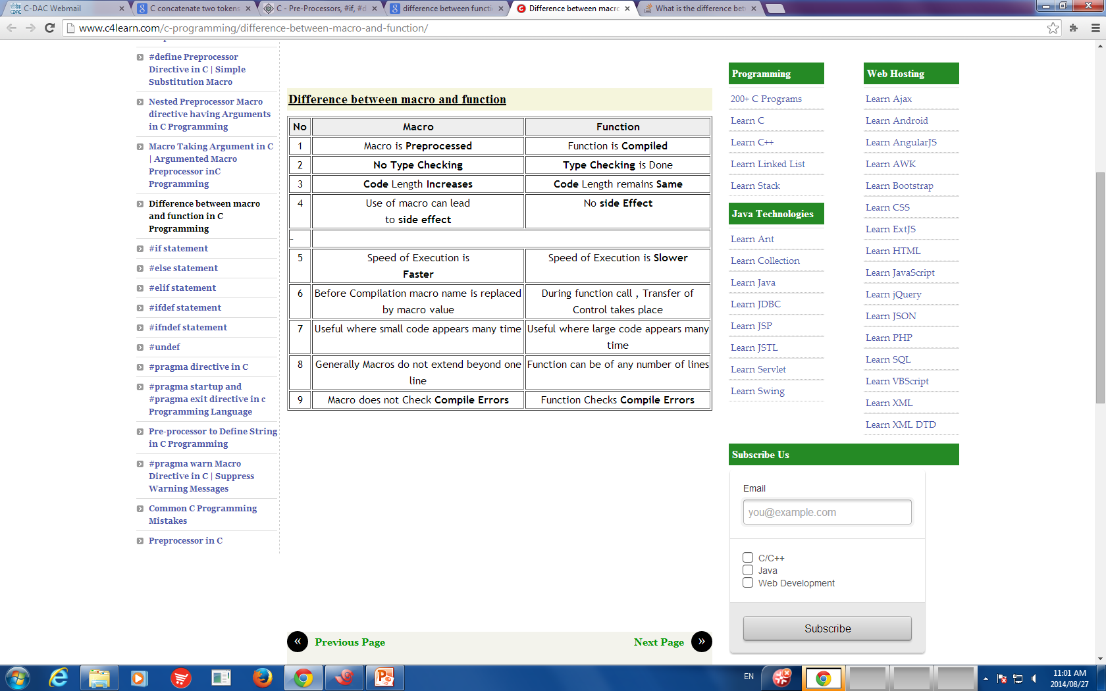
Function .vs. Macro

Slide 20
Macros - #undef
#undef
Undefines a symbolic constant or macro, which can later be redefined
#include <stdio.h>
#define MAX(x,y) ((x) > (y) ? (x) : (y))
int main(void)
{
printf("Max between 10 and 20 is %d\n", MAX(10, 20));
return 0;
}

Slide 21
Conditional Compilation
We can, if we want, have the compiler skip over part of a source code by inserting the preprocessing commands #ifdef and #endif,which have the general form:
#ifdef macroname
statement 1 ;
statement 2 ;
statement 3 ;
#endif
If macroname has been #defined, the block of code will be processed as usual; otherwise not.

Slide 22
#ifdef Directives
#include <stdio.h>
#define RAJU 100
int main()
{
#ifdef RAJU
printf("RAJU is defined. So, this line will be added in " \
"this C file\n");
#else
printf("RAJU is not defined\n");
#endif
return 0;
}
Compilation options: defining RAJU from outside of code
gcc ifdef.c -D RAJU=100 -o ifdef

Slide 23
#ifdef Directives
#include <stdio.h>
int main()
{
#define C “C Programming"
#ifdef C
printf(C);
#endif
return 0;
}

Slide 24
#ifndef Directives
#ifndef exactly acts as reverse as #ifdef directive. If particular macro is not defined, “If” clause statements are included in source file.
Otherwise, else clause statements are included in source file for compilation and execution.

Slide 25
#ifndef Directives
#include <stdio.h>
#define RAJU 100
int main()
{
#ifndef SELVA
{
printf("SELVA is not defined. So, now we are going to define here\n");
#define SELVA 300
}
#else
printf("SELVA is already defined in the program");
#endif
return 0;
}

Slide 26
#undef Directives
#include <stdio.h>
#define height 100
void main()
{
printf("First defined value for height : %d\n",height);
#undef height // undefining variable
#define height 600 // redefining the same for new value
printf("value of height after undef redefine:%d",height);
}

Slide 27
Conditional Compilation
Conditional compilation
Control preprocessor directives and compilation
Note: Cast expressions, sizeof, enumeration constants cannot be evaluated
Structure is similar to “if” control structure
#if !defined( NULL ) #define NULL 0 #endif
Determines if symbolic constant NULL defined
If NULL is defined, defined(NULL) evaluates to 1
If NULL not defined, defines NULL as 0
Every #if ends with #endif
#ifdef is the short form for #if defined(name)
#ifndef is the short from for #if !defined(name)

Slide 28
Conditional Compilation…
Other statements
#elif - equivalent of else if in an if structure
#else - equivalent of else in an if structure
"Comment out" code
Cannot use /* ... */
Use
#if 0
code commented out
#endif
To enable the code, change 0 to 1

Slide 29
Conditional Compilation…
#include <stdio.h>
#define IOS 1
#define ANDROID 2
#define OS IOS
int main()
{
#if OS == IOS
printf("this is ios device.\n");
#elif OS == ANDROID
printf("this is android device.\n");
#endif
return 0;
}

Slide 30
Conditional Compilation…
Debugging
#define DEBUG 1
#ifdef DEBUG printf("Variable x = %d“, x); #endif
Defining DEBUG enables code
After code corrected, remove #define statement
Debugging statements are now ignored

Slide 31
## Operator - Concatenation
## - It concatenates two tokens
Example:
#define TOKENCONCAT( x, y ) x ## y
TOKENCONCAT( O, K ) becomes OK
#include<stdio.h>
#define CAT(a, b) a##b
void main() {
printf("%d", CAT(10, 20));
}

Slide 32
Thank You

