Slide 1
Strings Basics

Slide 2
Strings

Slide 3
Strings
a one-dimensional array of characters which is terminated by a null character '\0'.
Thus a null-terminated string contains the characters that comprise the string followed by a null.
To hold the null character at the end of the array, the size of the character array containing the string is one more than the number of characters in the word "Hello.“
char greeting[6] = {'H', 'e', 'l', 'l', 'o', '\0'};
char greeting[] = "Hello";

Slide 4
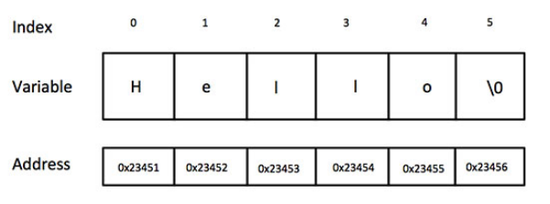
Strings
char greeting[6] = {'H', 'e', 'l', 'l', 'o', '\0'};
char greeting[] = "Hello";

Slide 5
Strings: what is output of the program
#include <stdio.h>
int main ()
{
char greeting[6] = {'H', 'e', 'l', 'l', 'o', '\0'};
printf("Greeting message: %s\n", greeting );
return 0;
}

Slide 6
Strings: what is output of the program
#include <stdio.h>
int main ()
{
char name[6] = {'A', 'C', '\0', 'T', 'S', '\0'};
printf("message: %s\n", name );
return 0;
}

Slide 7
Strings
strcpy(s1, s2) Copies string s2 into string s1.
strcat(s1, s2); Concatenates string s2 onto the end of string s1.
strlen(s1); Returns the length of string s1.
strcmp(s1, s2) Returns 0 if s1 and s2 are the same; less than 0 if s1<s2; greater than 0 if s1>s2.

Slide 8
Strings
strchr(s1, ch) Returns a pointer to the first occurrence of character ch in string s1.
strstr(s1, s2); Returns a pointer to the first occurrence of string s2 in string s1.

Slide 9
Strings operations
#include <stdio.h>
#include <string.h>
void main ()
{
char str1[12] = "Hello";
char str2[12] = "World";
char str3[12];
int len ;
strcpy(str3, str1);
printf("strcpy( str3, str1) : %s\n", str3 );
strcat( str1, str2);
printf("strcat( str1, str2): %s\n", str1 );
len = strlen(str1);
printf("strlen(str1) : %d\n", len );
}
strcpy( str3, str1) : Hello
strcat( str1, str2): HelloWorld
strlen(str1) : 10

Slide 10
Reading from standard input
#include <stdio.h>
#include <string.h>
void main ()
{
char str1[12] ;
printf("enter a string....\n" );
scanf("%s",&str1);
printf("entered string....is %s \n",str1);
}

Slide 11
Reading from standard input
#include <stdio.h>
#include <string.h>
void main ()
{
char str1[12] ;
printf("enter a string....\n" );
scanf("%s",str1);
printf("entered string....is %s \n",str1);
}

