Slide 1

“ C Programming”
By
C.Mahesh

Slide 2

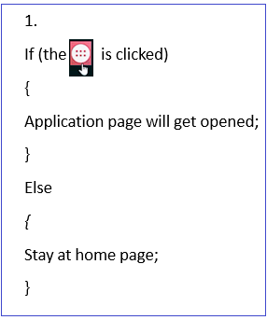
If-else

Slide 3
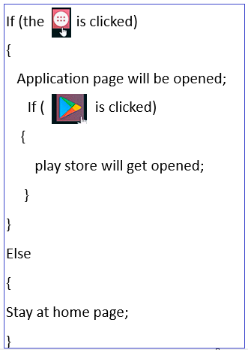
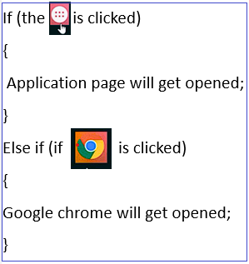
Nested if:(if inside if)
Else IF (no dependency)

Slide 4
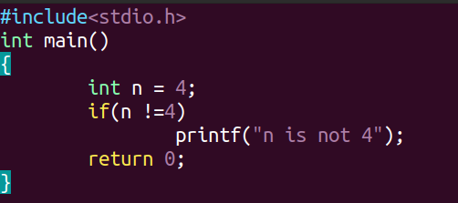
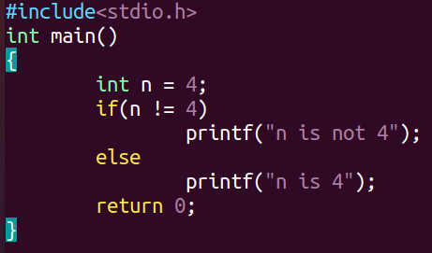
Is It necessary to put the ELSE Part? Ans: yes & no
Ex 1:
Ex 2:

Slide 5
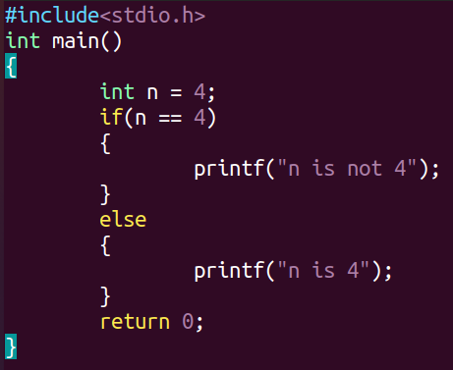
What is difference between Ex 2 vs below program ?

Slide 6
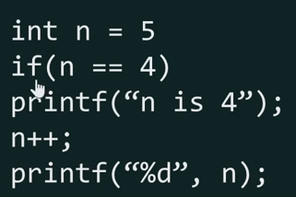
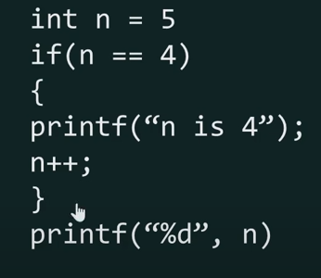
Why Curly braces required ?
Output: ?
Output: ?

Slide 7
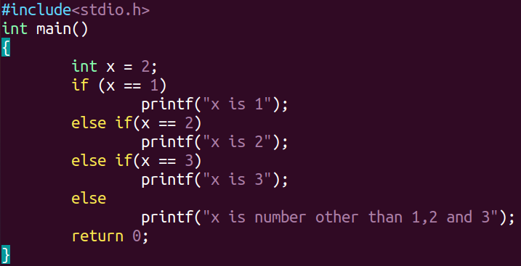
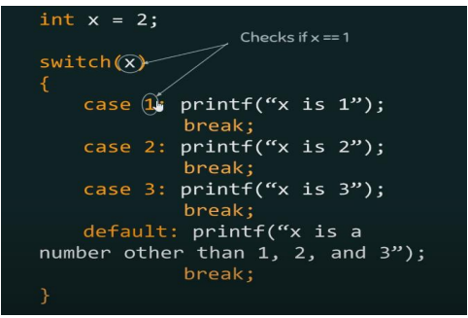
SWITCH ? Switch is a great replacement to long else if constructs.
Ex1:
Replacement long else if using switch construct

Slide 8
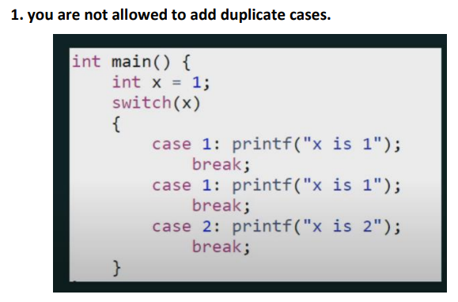
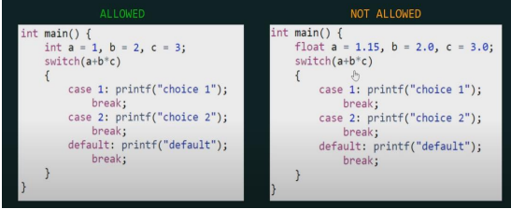
Facts related to switch:
2.Only those expressions are allowed in switch which results in an integral constant value

Slide 9
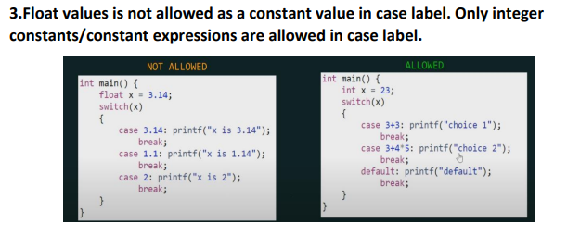
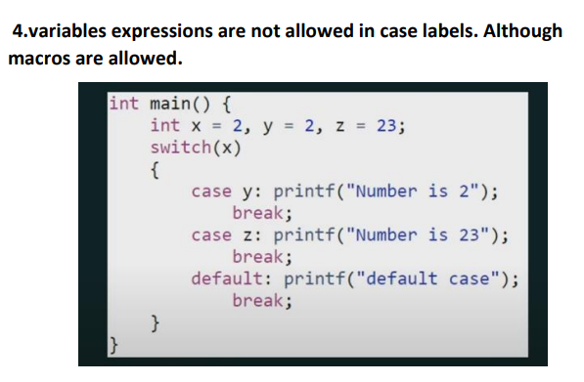

Slide 10
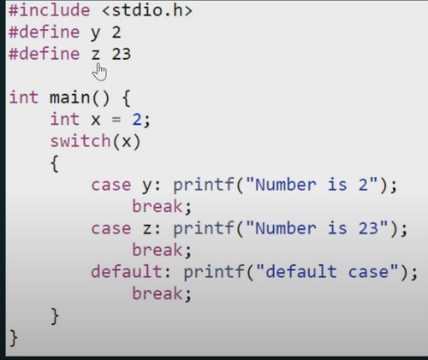

Slide 11
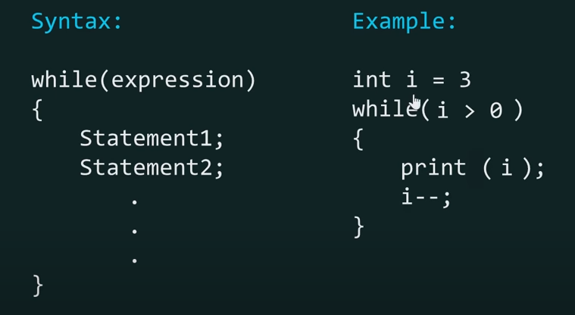
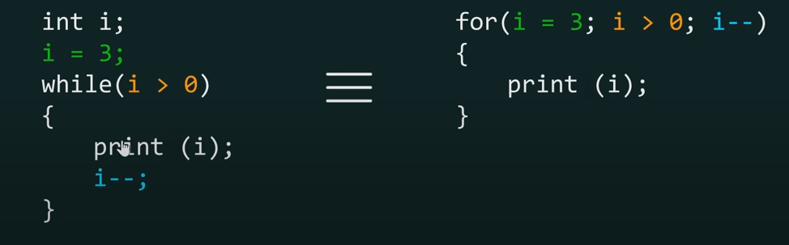
While loop & For loop:

Slide 12
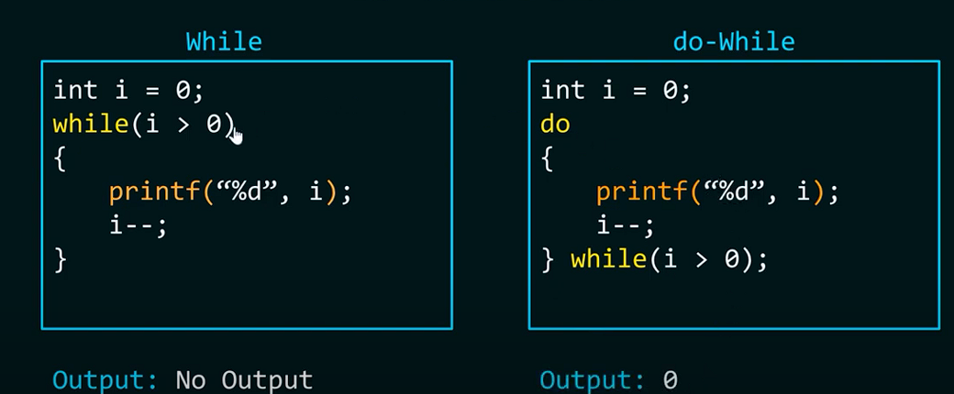
Difference between while loop vs do-while loop

Slide 13
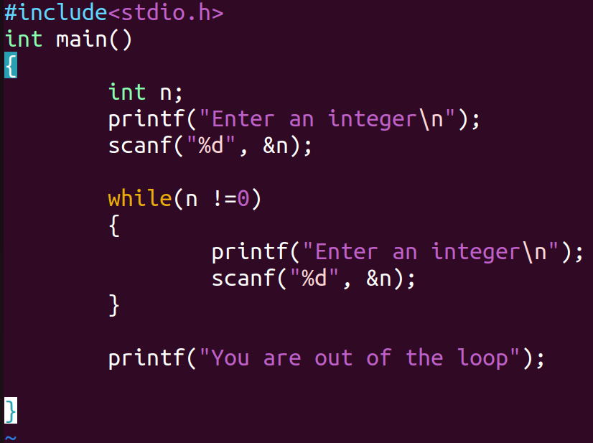
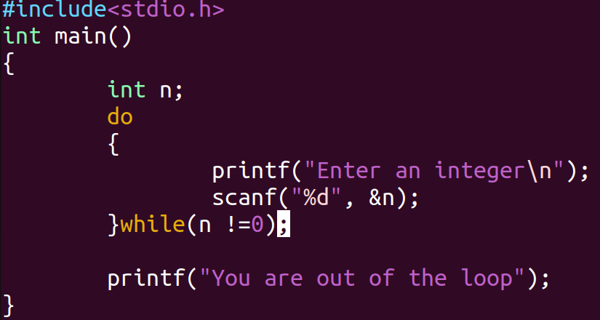
Why should prefer do-while instead of while? Pro: W.a.p which allow user to enter an integer until he/she enters a value zero?
While loop:
Do-while loop:
Ex:

Slide 14
Break & Continue:
Break : used to terminate from the loop
Continue: Similarly to break but instead of terminating from the loop, it forces to execute the next iteration of the loop.

Slide 15
Forever loop : Special form of the while loop is the forever loop. This is a loop that never ends. It’s just run forever.
Ex:
int main(void)
{
While(1)
{
Printf(“cdac hyderbad”);
}

