Slide 1
C Programming

Slide 2
Arrays

Slide 3
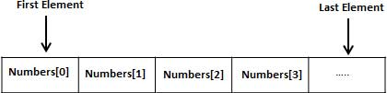
Arrays - Introduction
Definition: Array is a derived data type. Array is a collections of variables of same type.
Fixed size, size defines the number of elements in the array
Stored in contiguous memory locations
Array element is accessed by its index value

Slide 4
Declaring & Initializing Array
Declaration: type Array_Name [array size]
Example: 5 element array of integer type
int arr [5];
int arr[ ] = {1,2,3,4,5};
Initialization:
for(j=0;j<5;,j++)
arr [ j ]=j+1;

Slide 5
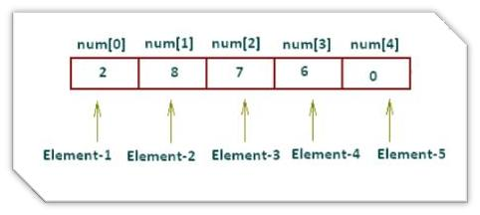
Declaring & Initializing Array
Array Size specified Directly:
int num[5] = {2,8,7,6,0};
Array Size specified In-Directly:
int num[] = {2,8,7,6,0};

Slide 6
Visualizing 1-D Arrays
Representing a single dimension Array
int A[10];
[0] | [1] | [2] | [3] | [4] | [5] | [6] | [7] | [8] | [9]
Base +0 +4 +8 +12 +16 etc.
Address
Notes:
a-spec
Is an optional array specification, enclosed in parentheses. If POINTER or ALLOCATABLE is specified, the array is deferred shape; otherwise, it is explicit shape. In an explicit-shape specification, each bound must be a constant scalar integer expression.

Slide 7
Accessing Arrays & Operations
Individual element can be accessed using Index
Example:
Int arr [10];
Int value = arr[0];
NOTE:
Don't try to access an element that is not in the array such as the eleventh element of a ten element array.
Case of “ out of bounds”
Attempting to access a value past the end of an array will either crash your program or worse retrieve garbage data without telling you that an error occurred.
Examples:
int arr [10];
int i=0;
Int value = arr[i];

Slide 8
Example of 1-D Array
int iarr[3] = {2, 3, 4};
char carr[20] = “ACTS" ;
float farr[3] = {12.5,13.5,14.5} ;
Notes:
a-spec
Is an optional array specification, enclosed in parentheses. If POINTER or ALLOCATABLE is specified, the array is deferred shape; otherwise, it is explicit shape. In an explicit-shape specification, each bound must be a constant scalar integer expression.

Slide 9
program on 1-D Array
#include <stdio.h>
int main()
{
int num[] = {21,18,57,45,50};
int i;
for(i=0;i<5;i++)
{
printf("\n Integer Array Element num[%d] : %d",i+1,num[i]);
}
return 0;
}
Notes:
a-spec
Is an optional array specification, enclosed in parentheses. If POINTER or ALLOCATABLE is specified, the array is deferred shape; otherwise, it is explicit shape. In an explicit-shape specification, each bound must be a constant scalar integer expression.

Slide 10
Example 1: Average of n numbers
#include <stdio.h>
int main(){
int n, i;
float num[10], sum=0.0, average;
printf("Enter the number of data elements: ");
scanf("%d",&n);
for(i=0; i<n; ++i)
{
printf("%d. Enter number: ",i+1);
scanf("%f",&num[i]);
sum+=num[i];
}
average=sum/n;
printf("Average = %f",average);
return 0;
}

Slide 11
Example 2: Largest of n numbers
#include <stdio.h>
int main(){
int i,n;
int arr[10];
printf("Enter total number of elements(1 to 10): ");
scanf("%d",&n);
printf("\n");
// Read n numbers
for(i=0;i<n;++i) /* Stores number entered by user. */
{
printf("Enter Number %d: ",i+1);
scanf("%d",&arr[i]);
}
// Find the largest number
for(i=1;i<n;++i)
{
if(arr[0]<arr[i])
arr[0]=arr[i];
}
printf("Largest element = %d\n",arr[0]);
return 0;
}

Slide 12
1-D Array
1-D Array Program
Write a C Program to display one dimensional array elements with addresses
Write a C Program to Calculate Addition of All Elements in one dimensional array
Write a C Program to Find Greatest Element in Array in one dimensional array
Write a C Program to Reversing the 1-D Array Elements
Write a C Program to Search an element in 1-D Array
Write a C Program to sort elements in 1-D Array
Notes:
a-spec
Is an optional array specification, enclosed in parentheses. If POINTER or ALLOCATABLE is specified, the array is deferred shape; otherwise, it is explicit shape. In an explicit-shape specification, each bound must be a constant scalar integer expression.

Slide 13
Multidimensional Arrays

Slide 14
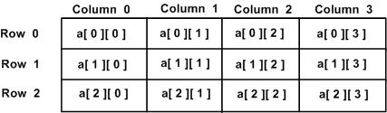
Multidimensional Arrays
Arrays with more than one dimension
2D Arrays : grid of rows and columns
GCC allows arrays of up to 29 dimensions (source:linuxtopia.com)
Using an array of more than three dimensions is very rare
Representing a double dimension Array
integer a[3] [4] ;

Slide 15
Multidimensional Arrays
Representing a double dimension Array
integer B[6] [3] ;
2nd Subscript
B(0,0) | B(0,1) | B(0,2)
B(1,0)
B(2,0)
B(3,0)
B(4,0)
B(5,0)
1st Subscript
Row major order

Slide 16
Memory Representation – 2D Arrays
0x1014
mat[1][2]
0x1010
mat[1][1]
int mat[2][3];
mat[1][0] = 17;
0x100C
mat[1][0]
0x1008
mat[0][2]
0x1004
mat[0][1]
Valid Initialization
0x1000
mat[0][0]
What happens when you initialize
mat[0][3] = 20;
No bounds checking…causes no error

Slide 17
Multidimensional Arrays - Initialization
int disp[2][4] = {
{10, 11, 12, 13},
{14, 15, 16, 17}
};
int disp[2][4] = { {10, 11, 12, 13}, {14, 15, 16, 17} };
int disp[2][4] = { 10, 11, 12, 13, 14, 15, 16, 17 };
int arr[2][2] = {1, 2, 3 ,4 } /* Valid declaration*/
int arr[][2] = {1, 2, 3 ,4 } /* Valid declaration*/
int arr[][] = {1, 2, 3 ,4 } /* Invalid declaration – must specify second dimension*/
int arr[2][] = {1, 2, 3 ,4 } /* Invalid because of the same reason mentioned above*/

Slide 18
Accessing Array Elements & Operations
Single operations which involves entire array are not allowed.
Must be done element by element
Individual element can be accessed using Index
Examples:
int a[10] [10], b[10][10], c[10][10];
a = b + c; // Not allowed
/*Element by element*/
for(i=0; i<=9; i++)
{
for(j=0; j<=9; j++)
{
c[ i ] = a[ i ] + b[ i ] ;
}
}

Slide 19
2-D Arrays and Functions
We can pass 2-D arrays to functions
An array will be passed to a function using its name (base address)
We should pass the length of each dimension of the array.
Examples: Passing Array
int a[m][n], b[m][n];
print( a, b, m, n);
Examples: Receiving an Array
print(int a[ ] [n], int b[ ] [n], m, n)
{
--function body--
}
Examples: Function prototype
print( int [ ][n], int b[ ] [n] , int, int);

Slide 20
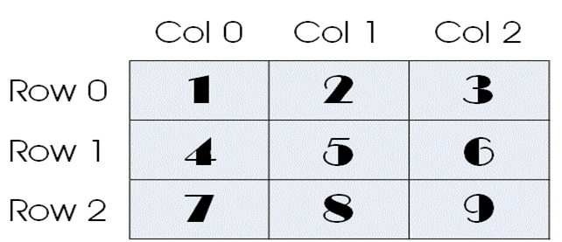
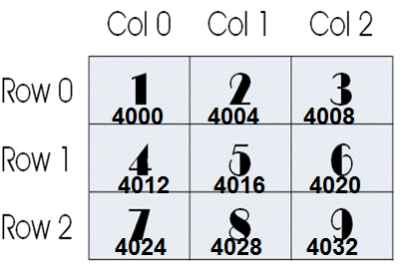
2D Arrays
A[3][3]={1,2,3,4,5,6,7,8,9};
A[3][3]={ {1,2,3},{4,5,6},{7,8,9} }; // array of 1D array
a[0][1] = a[0][0] + Size of Data Type
[0][0] | [0][1] | [0][2] | [1][0] | [1][1] | [1][2] | [2][0] | [2][1] | [2][2]
Base +0 +4 +8 +12 +16 etc.
Address

Slide 21
Initializing 2D Arrays
#include<stdio.h>
int main()
{
int i, j;
int a[3][2] = {
{ 1, 4 },
{ 5, 2 },
{ 6, 5 }
};
for (i = 0; i < 3; i++)
{
for (j = 0; j < 2; j++)
{
printf("%d ", a[i][j]);
}
printf("\n");
}
return 0;
}
1 4
5 2
6 5

Slide 22
Initializing 2D Arrays
#include<stdio.h>
int main()
{
int i, j;
int a[3][2] = { 1, 4, 5, 2, 6, 5 };
for (i = 0; i < 3; i++)
{
for (j = 0; j < 2; j++)
{
printf("%d ", a[i][j]);
}
printf("\n");
}
return 0;
}
1 4
5 2
6 5

Slide 23
Initializing 2D Arrays
#include<stdio.h>
int main()
{
int i, j;
int a[3][2] = {
{ 1 },
{ 5 , 2 },
{ 6 }
};
for (i = 0; i < 3; i++)
{
for (j = 0; j < 2; j++)
{
printf("%d ", a[i][j]);
}
printf("\n");
}
return 0;
}
1 0
5 2
6 0

Slide 24
3D array – array of 2D Arrays
#include<stdio.h>
int main()
{
int i, j,k;
int a[2][3][4] = {
{ {1, 2, 3, 4}, {5, 6, 7, 8}, {9, 10, 11, 12} },
{ {13,14, 15, 16}, {17, 18, 19, 20}, {21, 22, 23, 24} }
};
for (i = 0; i < 2; i++)
{
for (j = 0; j < 3; j++)
{
for (k = 0; k < 4; k++)
{
printf("%d ", a[i][j][k]);
}
printf("\n");
}
printf("\n");
}
return 0;
}

