Slide 1


“Advanced C Programming”
eDESD - 2021

Slide 2
Day 1
Introduction to Linux , vi editor and C
Data Types & Operators in C

Slide 3
1. Introduction to Linux, Vi and C

Slide 4
Introduction to Linux - Outline
What is Unix?
What is Linux?
Linux Distributions
Linux File System
Shell and Basic Commands
vim (vi improved) Editor (vi – visual interactive)

Slide 5
What is Unix?
Initially, Named as “UNiplexed Information Computing System (UNICS)”
Changed the name to “UNIX”
Developed in 1969 at AT&T’s Bell Labs by
Ken Thompson - UNIX
Dennis Ritchie - C Language
Douglas Mcllroy - Pipes
A multi-tasking and multi-user Operating System
You can have many users logged into a system simultaneously, each running many programs.
00:00:00 Hours, Jan 1, 1970 is time zero for UNIX. It is also called as epoch.
Reference: http://en.wikipedia.org/wiki/History_of_Unix
Notes:
You can have many users logged into a system simultaneously, each running many programs.

Slide 6


UNIX
Ken Thompson (Sitting) and Dennis Ritchie (Standing) working together at a PDP-11
Ken Thompson and Dennis Ritchie
Reference: http://en.wikipedia.org/wiki/History_of_Unix

Slide 7
What is Linux?
A clone of UNIX, Developed in 1991 by Linus Torvalds, a Finnish graduate student (It was his personal project)
Inspired by and replacement of “Minix (Mini Unix by Tanenbaum for education)”
Linus + Minix → Linux
First kernel (v1.0) was released in 1994 (Under GNU general public license)
Consist of
Linux Kernel
GNU (GNU is Not Unix) Software
Software Package management & Others
Notes:
UNIX .vs. Linux
Most of you might have wondered what the difference between UNIX and Linux is. Here is some of the information I found out while googling. UNIX Vs Linux. 1. Most common difference: UNIX is propriety system while Linux is an Open Source system. 2. Technical a) In UNIX ‘Development’ is targeted toward specific audience and platform. Linux development is diverse. Linux standard base was formed to alleviate this problem but it wasn’t of much help. b) UNIX maintains consistency b/w different versions. Have a published standard that they follow for their customer. Linux have inconsistencies b/w versions and no strict standards for tools, environment and functionality. c) In UNIX developers are bounded by standard while in Linux developers are free and have no restriction. d) In UNIX commands, tool and utilities etc are rarely changed over versions. Hence it is easy to for administrator to update their skills. Moreover tools and application can be used on new edition of OS without a large body of testing. In Linux commands, tools and utilities may change over time. 3. Hardware a) UNIX was coded for small handful h/w platform/architecture. Linux was designed to be as compatible as possible. Runs on dozens of Architecture and support numerous I/O devices & other external devices. Supported devices are limitless. b) Commercial UNIX is usually custom written for each system, making the original cost quite high, but having the benefit of being exactly what you need. e.g. HP-UX => PA-RISC & Itanium m/c Solaris=> SPARC and x86 AIX=> Power Processor Linux has base packages that are required, then you install more to get the system you need. (In this respect, Linux is closer in model to windows than a commercial UNIX OS is.) 4. Kernel a) UNIX kernel is not freely available. Linux kernel is freely available. b) UNIX patches available are highly tested. Linux patches are not highly tested as UNIX patches. 5. Updates and Bugs a) Every OS, including UNIX and Linux, suffers from vulnerabilities and bugs that have to be patched, fixed and updated. But Linux enjoys a clear advantage over its elder sibling in this department. Linux bugs tend to die an early death, because the OS undergoes an incredible amount of scrutiny in the global open-source community b) Constant peer review, proponents claim, allows one developer to leverage the experience and knowledge of all other developers around the globe; As a result, the software develops faster and becomes more robust over time. This process has made Linux an incredibly stable OS.

Slide 8




Linux is everywhere
Originally developed for X86-32 Bit
Internet was built around UNIX
Android & MAC OS are developed based on Linux kernel
Ported to other architectures.
IBM PowerPC
Mobile Phones -Nokia N810, Google Nexus (Ubuntu), etc.
Routers, GPS
Robo
Check www.top500.org to know the power of Linux

Slide 9
Why Linux is everywhere?
Open, Free or Cheap
Scalable and Portable
Scalable – In terms of processor count, Number of users, Memory size, I/O, Resource management etc..
Portable – It can work efficiently on anything from wristwatch to World’s fastest Supercomputer
Multiuser and multitasking
Robust – A cluster or a Server can run for years without rebooting → Reliable

Slide 10
Linux Distributions
600+ Linux Distributions
RHEL (Commercial Support)
Fedora (Free, Majorly used for Desktop)
Ubuntu (Free, Majorly used for Desktop, From South Africa)
Slackware (One of the oldest, simple and stable)
CentOS (free RHEL, From England)
SuSe (Free and Commercial, From Germany)
Knoppix (first LiveCD distribution)
Notes:
Live CD distribution – Distribution that can operate from a CD or DVD

Slide 11
Which Linux Distribution…?
Depends on user requirements
Slackware
Ubuntu
Fedora
RHEL
CentOS

Slide 12
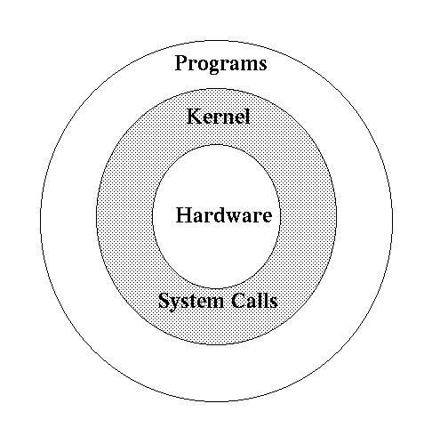
UNIX/Linux Structure

Slide 13
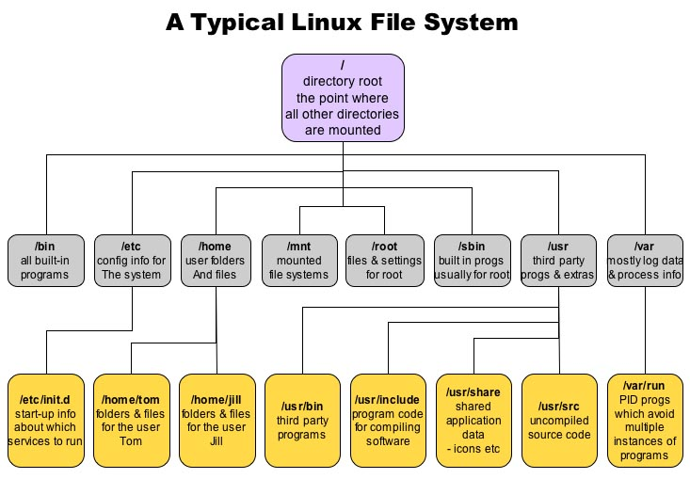
Linux File System
Notes:
Bin – most of the Linux commands will be present in this dir.
Etc – Configuration files such as /etc/profile
Mnt – it shows the mounted file systems such as pendrives, CDs, Mobile Data storage etc..
Root – all the files and settings related to root will be present in this
Sbin – built in commands/programs for root user - /sbin/ifconfig
Usr – third party softwares – you can install java here
Var – mostly it will have logs

Slide 14
Details of File System
/ → root directory
/boot → files for booting system
/etc → configuration files
/bin → important system binaries
/sbin → contains system admin programs(super user)
/usr → user applications
/lib → dynamic libraries
/home → user home directories
/root → super user home dir
/var → contains variable data constantly generated when system is running
/dev → device files

Slide 15
Files, Directories and Inodes
File: A file represents a sequence of bytes.
Each file will have a name
Special characters are allowed but need to be used carefully
Directory: A directory represents a list of files.
A directory is also a file which contains the list of files containing in it.
Every directory and file will be listed in its parent directory
Inode: An inode (Index Node) contains information about a file (metadata) – File permissions, UID, GID, Size, Time Stamp etc.
The information about all the files will be maintained in a table called “Inode Table”

Slide 16
Users and Groups
Users: Users can be either people or accounts which exist to use specific applications of Linux.
Each user will be given a unique user ID (UID).
A root user will also be present and he has all the administrave privileges.
Groups: Users can be tied together into groups for a common purpose.
Example: climate, ssdh, acts
Each group is associated with a group ID (GID).

Slide 17
Access Permissions
File Permissions: There are 3 permissions for any file → r, w, x.
Read (r) - Indicates that a given category of user can read a file.
Write (w) - Indicates that a given category of user can write to a file.
Execute (x)- Indicates that a given category of user can execute the file.
Directory permissions:
Read (r) - The direcotry can be read.
Write (w) - The directory can be updated, renamed or deleted.
Execute (x)- Operations can be perfomred on the files of the directories. This bit is also called as search bit, it indicates whether you are permitted to search files under that directory
Categories of users: All of these three permissions are assigned to three categories of users – User (U), Group(G), Others(O)

Slide 18
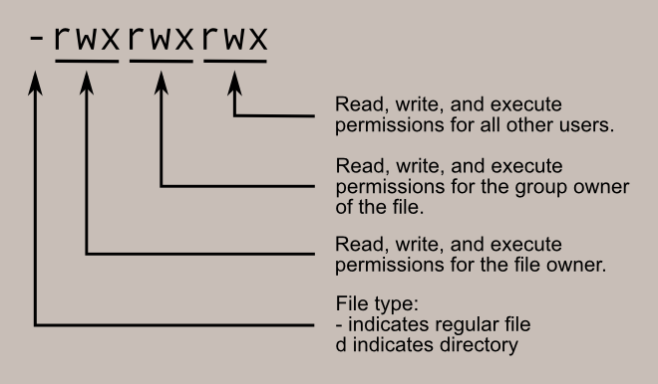
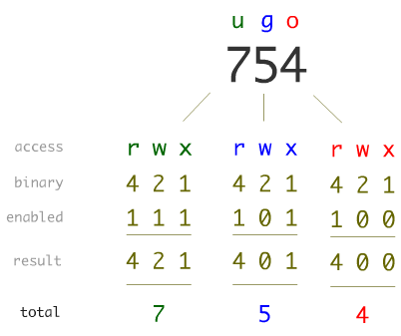
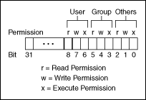
Access Permissions…

Slide 19
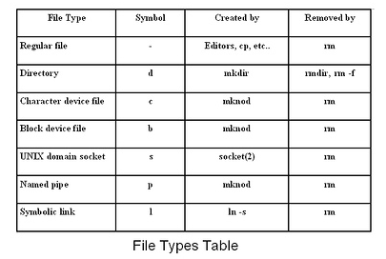
File Types
Notes:
These both files are related to writing data and reading data from one place to other place. But the difference between them is how they read/write data.
character file: A char file is a hardware file which reads/write data in character by character fashion. Some classic examples are keyboard, mouse, serial printer. If a user use a char file for writing data no other user can use same char file to write data which blocks access to other user. Character files uses synchronise Technic to write data. Of you observe char files are used for communication purpose and they can not be mounted.
Example character files: /dev/autofs, /dev/console, /dev/crash, /dev/lp0, /dev/null, /dev/ppp, /dev/random, /dev/tty etc
ls -l output for a char file:
[root@yumserver dev]# ls -l tty0 crw–w—- 1 root root 4, 0 Dec 31 11:45 tty0 [root@yumserver dev]#
Block file: A block file is a hardware file which read/write data in blocks instead of character by character. This type of files are very much useful when we want to write/read data in bulk fashion. All our disks such are HDD, USB and CDROMs are block devices. This is the reason when we are formatting we consider block size. The write of data is done in asynchronous fashion and it is CPU intensive activity. These devices files are used to store data on real hardware and can be mounted so that we can access the data we written. Have a look at our other post on getting block size of a device.
Block file examples:/dev/loop0, /dev/ram0, /dev/sda1, /dev/sr0.
A socket is a special file used for inter-process communication. These allow communication between two processes. In addition to sending data, processes can send file descriptors across a Unix domain socket connection using the sendmsg() and recvmsg() system calls.
Unlike named pipes sockets are fully duplex-capable.
A socket is marked with an s as the first letter of the mode string, e.g.
srwxrwxrwx ... /tmp/.X11-unix/X0
Named Pipes
One of the strengths of Unix has always been inter-process communication. Amongst the facilities provided by the OS are pipes. These pipes connect the output of one process to the input of another. This is fine if both processes are living in the same parent process space, started by the same user. There are however circumstances where the communicating processes must use named pipes. One such circumstance is that the processes have to be executed under different user names and permissions.
These named pipes are special files that can exist anywhere in the file system. These named pipe special files are made with the commandmkfifo as in mkfifo mypipe.
A named pipe is marked with a p as the first letter of the mode string, e.g.
prw-rw---- ... mypipe
A symbolic link is a reference to another file. This special file is stored as a textual representation of the referenced file's path (which means the destination may be a relative path, or may not exist at all).
A symbolic link is marked with an l (lower case L) as the first letter of the mode string, e.g.
lrwxrwxrwx ... termcap -> /usr/share/misc/termcap lrwxrwxrwx ... S03xinetd -> ../init.d/xinetd

Slide 20
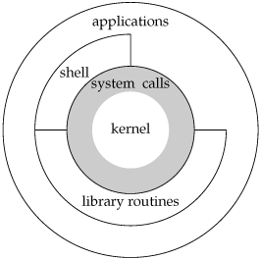
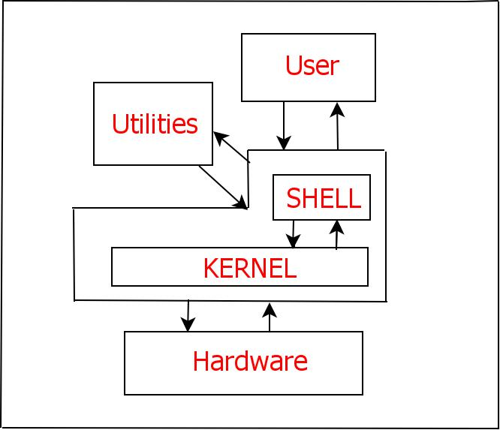
What is Linux Shell?
The kernel sits on top of the hardware and is the core of the OS; it receives tasks from the shell and performs them
The shell is the command line interface through which the user interacts with the OS. Most commonly used shell is “bash”
Linux has a kernel and one or more shells – bash, csh, ksh etc.
When you login to the system the default shell will be given to the user. Bash is the default shell for Linux (We can change the default shell)
GUI of Linux is in fact an application program works on the shell.

Slide 21
Shell commands
Shell Command - A command is a program which interacts with the kernel to provide the environment and perform the functions called by the user.
A command can be: a built-in shell command; an executable shell file, known as a shell script; or a source compiled, object code file.
Examples: ls, mkdir, pwd, cd
Command Structure:
$ command <options> <arguments>
Multiple commands can be executed one by one using a single line by separating them with semicolon.
$ ls; mkdir my_dir; ls

Slide 22
Shell Programming
Shell Script - A series of commands can be written into a text file and execute that file. This is called as shell script.
The first line of a shell script must be “#!/bin/Shell-Name”
In order to execute a shell script we need to give execute permission (x) to that file using “chmod” comand.
chmod +x users.sh
Example:
#!/bin/bash
date
who
ps -ax

Slide 23
How to explore?
Man pages
Manpage
$ man ls
$ man 2 mkdir
$ man man

Slide 24
How to explore…?
Man page sections
User-level commands and apps - /bin/mkdir
System calls - int mkdir(const char *, …);
Library calls - int printf(const char *, …);
Device drivers and network protocols - /dev/tty
Standard file formats - /etc/hosts
Games and demos - /usr/games/fortune
Misc. files and docs - man 7 locale
System admin. commands - /sbin/reboot

Slide 25
Shell commands
File management
System information
Process and Job management
Network
Searching
System start and stop
Compression and decompression
Miscellaneous

Slide 26
Shell commands…
1. File management
ls - directory listing ( ex: ls a* , ls *.c )
ls -al - formatted listing with hidden files
cd dir - change directory to dir
cd - change to home
pwd - show current directory
mkdir dir - create a directory dir
rm file - delete file
rm -r dir - delete directory dir
rm -f file - force remove file
rm -rf dir - force remove directory dir *
cp file1 file2 - copy file1 to file2
cp -r dir1 dir2 - copy dir1 to dir2; create dir2 if it doesn't exist

Slide 27
Shell commands…
1. File management …
mv file1 file2 - rename or move file1 to file2. If file2 is an existing dir, moves file1 into directory file2
touch file - create or update file
cat > file - places standard input into file
more file - output the contents of file
head file - output the first 10 lines of file
tail file - output the last 10 lines of file
tail -f file - output the contents of file as it grows, starting with the last 10 lines
ls > dir-file-list.txt - redirecting the command output into file

Slide 28
Shell commands…
1. File management …
The single most useful command…….
$ man man
Who am I?
$ whoami
Where am I?
$ cd
$ pwd

Slide 29
Shell commands…
1. File management …
What is here?
$ ls
That’s all? Or still more files??
$ ls -a
A file or a directory?
$ ls -F
Want to see the details of all the files/dirs?
$ ls -l

Slide 30
Shell commands…
1. File management …
Want to go to a different directory?
$ cd path_of_dest_dir
Want to go to your parent dir?
$ cd ..
Want to jump into your home?
$ cd
Want to go to root of entire machine?
$ cd /

Slide 31
Shell commands…
1. File management …
Want to create a new directory?
$ mkdir dir_name
Want to create a directory tree (In the current directory)?
$ mkdir -p eDESD/c/day1/linux
Want to copy the contents of one file to another file?
$ cp file1 file2
Want to copy a directory to another directory?
$ cp –r dir1 dir2

Slide 32
Shell commands…
1. File management …
chmod octal file – change the permissions of file to octal, which can be found separately for user, group, and world by adding:
● 4 – read (r)
● 2 – write (w)
● 1 – execute (x)
Examples:
chmod 777 – read, write, execute for all
chmod 755 – rwx for owner, rx for group and world
For more options, see man chmod.

Slide 33
Shell commands…
2. System Information
date – Show the current date and time
cal – Show this month's calendar
uptime – Show current uptime
w – Display who is online
whoami – Who you are logged in as
finger user – Display information about user
uname -a – Show kernel information
cat /proc/cpuinfo – CPU information
cat /proc/meminfo – Memory information
df – Show disk usage
du – Show directory space usage
free – Show memory and swap usage

Slide 34
Shell commands…
3. Process and Job management
ps – Display your currently active processes top – Display all running processes kill pid – Kill process id pid killall proc – Kill all processes named proc (use with extreme caution) bg – Lists stopped or background jobs; resume a stopped job in the background fg – Brings the most recent job to foreground

Slide 35
Shell commands…
4. Network commands
ifconfig – List IP addresses for all devices on the local machine ping host – Ping host and output results wget file – Download file wget -c file – Continue a stopped download

Slide 36
Shell commands…
5. Searching
grep pattern files – Search for pattern in files grep -r pattern dir – Search recursively for pattern in dir command | grep pattern – Search for pattern in the output of command locate file – Find all instances of file find / -name filename – Starting with the root directory, look for the file called filename locate filename – Find a file called filename
which filename – Show the subdirectory containing the executable file called filename grep TextStringToFind /dir – Starting with the directory called dir, look for and list all files containing TextStringToFind

Slide 37
Shell commands…
6. System stop and start
shutdown -h now – Shutdown the system now and do not reboot shutdown -r 5 – Shutdown the system in 5 minutes and reboot shutdown -r now – Shutdown the system now and reboot reboot – Stop all processes and then reboot - same as above

Slide 38
Shell commands…
7. Compression and uncompression
tar cf file.tar files – Create a tar named file.tar containing files tar xf file.tar – Extract the files from file.tar
tar czf file.tar.gz files – Create a tar with Gzip compression tar xzf file.tar.gz – Extract a tar using Gzip
tar cjf file.tar.bz2 – Create a tar with Bzip2 compression tar xjf file.tar.bz2 – Extract a tar using Bzip2
gzip file – Compresses file and renames it to file.gz gzip -d file.gz – Decompresses file.gz back to file

Slide 39
Shell commands…
8. Miscellaneous
adduser accountname – Create a new user call accountname passwd accountname – Give accountname a new password su – Log in as superuser from current login exit – Stop being superuser and revert to normal user

Slide 40
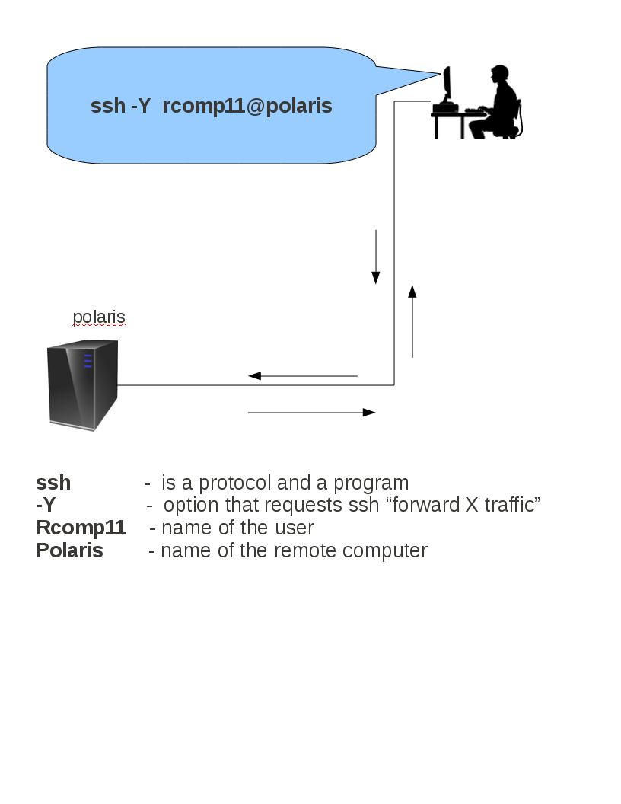
How to connect to Linux system?

Slide 41
Quiz - 1
List the hidden files in the current directory.
Search for a string “DESD” in a file “desd.c”.
Display disk usage statistics in GBs.
Which command is used to change the file permissions of a file?

Slide 42
Vi editor
The VI editor is the most popular and classic text editor in the Linux family. Below, are some reasons which make it a widely used editor –
1) It is available in almost all Linux Distributions
2) It works the same across different platforms and Distributions
vi Command mode:
The vi editor opens in this mode, and it only understands commands
In this mode, you can, move the cursor and cut, copy, paste the text
This mode also saves the changes you have made to the file
Commands are case sensitive. You should use the right letter case
Reference: https://www.guru99.com/the-vi-editor.html)
Notes:
Latest ISO C document at ISO site: 683 pages
http://www.iso.org/iso/home/store/catalogue_tc/catalogue_detail.htm?csnumber=57853
http://www.open-std.org/JTC1/sc22/wg14/www/standards.html

Slide 43
Vi editor
vi Editor Insert mode:
This mode is for inserting text in the file.
You can switch to the Insert mode from the command mode by pressing 'i' on the keyboard
Once you are in Insert mode, any key would be taken as an input for the file on which you are currently working.
To return to the command mode and save the changes you have made you need to press the Esc key
How to use vi editor
To launch the VI Editor -Open the Terminal (CLI) and type
vi <filename_NEW> or <filename_EXISTING>
And if you specify an existing file, then the editor would open it for you to edit. Else, you can create a new file.
Reference: https://www.guru99.com/the-vi-editor.html)
Notes:
Latest ISO C document at ISO site: 683 pages
http://www.iso.org/iso/home/store/catalogue_tc/catalogue_detail.htm?csnumber=57853
http://www.open-std.org/JTC1/sc22/wg14/www/standards.html

Slide 44
Vi editing basic commands
i - Insert at cursor (goes into insert mode)
a - Write after cursor (goes into insert mode)
A - Write at the end of line (goes into insert mode)
ESC - Terminate insert mode
u - Undo last change
U - Undo all changes to the entire line
dd - Delete line
3dd - Delete 3 lines.
cw - Change word
x - Delete character at the cursor
r - Replace character
Saving and Closing the file
Shift+zz - Save the file and quit
:w - Save the file but keep it open
:q - Quit without saving
:wq - Save the file and quit
Reference: https://www.guru99.com/the-vi-editor.html)
Notes:
Latest ISO C document at ISO site: 683 pages
http://www.iso.org/iso/home/store/catalogue_tc/catalogue_detail.htm?csnumber=57853
http://www.open-std.org/JTC1/sc22/wg14/www/standards.html

Slide 45
Overview of C
C is a general-purpose, procedural, computer programming language developed in between 1969 and 1973 by Dennis M. Ritchie at the Bell Telephone Laboratories to develop the UNIX operating system
UNIX OS, C compiler have been written in C
C standards
1989 - ANSI C (C89)
1990 - C90 (Same as C89, but approved by ISO)
1999 - C99
2011 - C11 (Approved in Dec-2011)
New features in C11 – Type generic macros, Anonymous structures, Atomic operations, Bounds-Checked functions etc.
Latest
Reference: http://en.wikipedia.org/wiki/C_(programming_language)
Notes:
Latest ISO C document at ISO site: 683 pages
http://www.iso.org/iso/home/store/catalogue_tc/catalogue_detail.htm?csnumber=57853
http://www.open-std.org/JTC1/sc22/wg14/www/standards.html

Slide 46
Applications of “C”
Operating Systems
Language Compilers
Assemblers
Text Editors
Device Drivers
Modern Programs
Databases
Lang. Interpreters
Utilities
Libraries
Applications developed using C
Google Chrome, Firefox browsers
Unix/Linux
MySQL
MS Office
Mozilla Thunderbird (Mail client)
Winamp
VC++ Compiler
JVM
And many more……
Most widely used & popular system programming Language

Slide 47
Start Working with C
Requirements:
Editor: vi (or) vim (or) gedit
Compiler: gcc or icc
OS: Linux
Run Time Environment
Syntax of C
Notes:
What is RTE?
Stands for "Runtime Environment." As soon as a software program is executed, it is in a runtime state. In this state, the program can send instructions to the computer's processor and access the computer's memory (RAM) and other system resources.
Distinguish this from Development Environments and Build Environments.
You will tend to find a hierarchy here.
Run - Everything you need to execute a program, but no tools to change it.
Build - Given some code written by someone eveything you need to compile or otherwise prepare an executable that you put into a Run environment. Build environments are pretty useless unless you can tets what you built, so they often include Run too. In Build you can't actually modify the code.
Develop - Everything you need to write code, build it and test it. Code Editors and other such tools. Typically also includes Build and Run.

Slide 48
Components of a C Program
Preprocessor
#include <stdio.h>
int main()
{
/*My first program in C */
int i,j ;
printf("Hello, World! \n");
i=2;
j=i+5;
return 0;
}
Functions
Comments
Variables
Semicolon
Statements
Expressions
Whitespaces
Notes:
C is a programming language. So. It is a language. Every language has some constructs to build the useful components using that.
We combine several constructs i.e building blocks and make a complete program.
Start writing a block. It should start with a curly brace and with another curly brace. We need to write all the statements in that block. Block should be given a name, if it is a function then we should give the name of the fucntion.
Each C program should have a main function. So, we can name our first block as “main”. We learn more about functions later. This block can be empty.
What is include statement? Why do we need it?
We are using a function printf which prints “hello world”. It is a fucntion..i.e. a block of statements which are not written by us. It is not part of C language. It is a function defined in C library. We should tel that the prototype of this fucntion is in stdio.h.
What is stdio.h?
It is a header file contains the definitions/prototypes of standard IO functions and other symbolic constants.

Slide 49
Compiling and running C programs
Source Files: hello.c
Executables: hello
gcc hello.c -o hello
Execution:
./hello
Source Files: main.c hello.c
Executables: main
gcc main.c hello.c -o main
Execution:
./main

Slide 50
Thank You

