Slide 1


“Advanced C Programming”
eDESD-2021

Slide 2
3. Control Statements

Slide 3
Control Statements
Definition: The control-flow of a language specify the order in which computations are performed.
Types:
Decision Making (Branching)
if else statement, if..else..if.. Statement (Multi-way decision making)
Nested if statement
Switch statement
Loops
For Loop
While Loop
Do while Loop

Slide 4
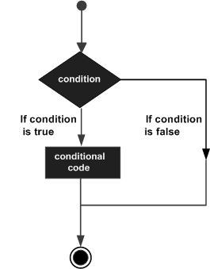
if..else
Definition: The if-else statement is used to express decisions.
The else part is optional.
Syntax:
If (expression)
set of statements;
else
set of statements;
Example :
If(a>b)
print( “ a is greater\n);
else
print(“ b is greater\n”);

Slide 5
if..else
Example : Write a C program to check given number is odd or even?
#include <stdio.h>
int main()
{
int num;
printf("Enter a number to check.\n");
scanf("%d",&num);
if(num%2 == 0)
{
printf(“ Number %d is even\n",num);
}
else
printf(“ Number %d is odd\n",num);
return 0;
}

Slide 6
If..else..if..
Multi Way decision making: If any expression is true, the corresponding statement is executes and chain terminates
Last “else” part handles “none of the above”
Syntax:
If (expression)
statement 1;
else if (expression)
statement 2;
else if (expression)
statement 3;
else
statement 4;
Example :
If(a>b)
print( “ a is greater\n);
else if (b>a)
print(“ b is greater\n”);
else
printf(“ a & b are equal”);

Slide 7
Nested if
Nested if: You can use one if or else if statement inside another if or else if statement(s).
Syntax:
If (expression)
statement 1;
if (expression)
statement 2;
else
statement 4;
Example :
if( a == 100 )
{
if( b == 200 )
{
printf("Value of a is 100\n””;
printf(“Value of b is 200\n" );
}
else
printf("Value of a is 100\n”);
}

Slide 8
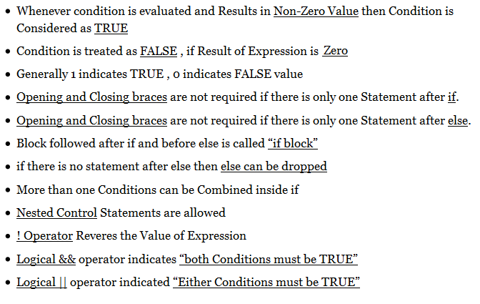
If statement

Slide 9
Class Room Work
Write a program to find out the smallest and the largest of three integers using
Only if
Only if else
Nested if

Slide 10
Class Room Work
Write logical expressions that tests whether a given character is
• lower case letter
• upper case letter
• digit
• white space (includes space, tab,new line)

Slide 11
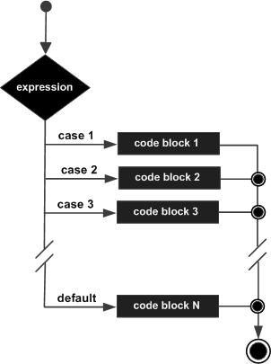
Switch
Definition: The switch statement is a multi-way decision that tests whether an expression matches one of a number of constant integer values, and branches accordingly.
Syntax:
Switch(expression)
{
case const-expr :
statements;
break;
case const-expr :
statements;
break;
……………
……………
default :
statements;
}

Slide 12
Switch - Rules
Rules:
The expression used in a switch statement must have an integral or enumerated type.
When the variable being switched on is equal to a case, the statements following that case will execute until a break statement is reached.
Break statement terminates the switch.
You can have any number of case statements within a switch.
A switch statement can have an optional default case. We should have only one default case.
Default case can be kept any where in the switch.
Not every case needs to contain a break.

Slide 13
Switch – rules..
Case label must be unique.
Empty Switch case is allowed.
Case label must be a constant or constant expression
case 1+1:
case 'A‘ :
case 67:
Case label must be an integer or character, cannot be float
case 10.12:
case 7.5:
Two or more cases can share a single break.
Nesting of switch statements is allowed.
Macro Identifier (Symbolic constant) is allowed as Switch Case Label.

Slide 14
Switch – rules..
Case labels must be of integral type (integer,character)
case 10:
case 20+20:
case 'A':
case 'a’:
Variable not allowed in switch case labels
case var :
case num1 :
case n1+n2 :

Slide 15
Switch – Example1
Example1: /* Simple Calculator – Add, Sub, Mul, Div */
# include <stdio.h>
int main()
{
char op;
float num1, num2;
printf("Select an operator either + or - or * or / \n");
scanf("%c",&o);
printf("Enter two operands: ");
scanf("%f%f",&num1,&num2);
switch(op)
{
case '+':
printf("%f + %f = %f",num1, num2, num1+num2);
break;

Slide 16
Switch – Example1…
Example1: /* Simple Calculator – Add, Sub, Mul, Div */
case '-':
printf("%f - %f = %f",num1, num2, num1-num2);
break;
case '*':
printf("%f * %f = %f",num1, num2, num1*num2);
break;
case '/':
printf("%f / %f = %f",num1, num2, num1/num2);
break;
default:
/* If operator is other than +, -, * or /, error message */
printf("Error! operator is not correct");
break;
}
return 0;
}

Slide 17
Switch…QUIZ
#include <stdio.h>
int main () { int value = 3; switch(value) { case 1: printf(“Value is 1 \n” ); break; case 2: printf(“Value is 2 \n” ); break; case 3: printf(“Value is 3 \n” ); break; case 4: printf(“Value is 4 \n” ); break;
default : printf(“Value is other than 1,2,3,4 \n” );
}//end of switch
return 0; }//end of main
Output:
Value is 3

Slide 18
More on switch
# include <stdio.h>
int main() {
int id=3;
switch(id)
{
case 1:
printf("C Programming Language");
break;
case 2:
printf("C++ Programming Language");
break;
case 2:
printf("Web Technology");
break;
default :
printf("No student found");
break;
}
return 0;
}
Case Label must be unique

Slide 19
Switch case with 2 defaults?
# include <stdio.h>
int main() {
int id=3;
switch(id)
{
case 1:
printf("C Programming Language");
break;
case 2:
printf("C++ Programming Language");
break;
case 3:
printf("Web Technology");
break;
default :
printf("No student found");
break;
default :
printf("No student found");
break;
}
return 0;
}
~
Switch case should have atmost one default label

Slide 20
Default can be anywhere in the switch ?
# include <stdio.h>
int main() {
int id=3;
switch(id)
{
case 1:
printf("C Programming Language");
break;
default :
printf("No student found");
break;
case 2:
printf("C++ Programming Language");
break;
case 3:
printf("Web Technology");
break;
}
return 0;
}
Yes, Default can be anywhere in the switch

Slide 21
More on switch
# include <stdio.h>
int main() {
int id=1;
switch(id)
{
case 1:
printf("C Programming Language");
case 2:
printf("C++ Programming Language");
case 3:
printf("Web Technology");
break;
default :
printf("No student found");
break;
}
return 0;
}
~
Break statement takes control out of switch
2 or more case may share one break statement

Slide 22
More on switch
# include <stdio.h>
#define NUM 1
int main() {
int id=1;
switch(id)
{
case NUM:
printf("C Programming Language");
break;
case 2:
printf("C++ Programming Language");
break;
case 3:
printf("Web Technology");
break;
default :
printf("No student found");
break;
}
return 0;
}
Macro identifiers are allowed as switch case labels

Slide 23
If else .vs. Switch
The functioning of if-else and switch is more or less same
If..else
switch

Slide 24
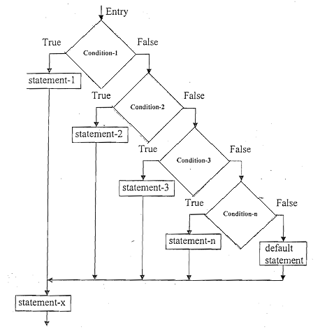
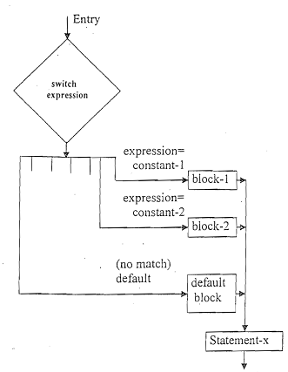
If else .vs. Switch
In another form:
If..else…if…
switch

Slide 25
If else .vs. Switch
else if Ladder | Switch
In else if ladder, the control goes through the every else if statement until it finds true value of the statement or it comes to the end of the else if ladder. | In case of switch case, as per the value of the switch, the control jumps to the corresponding case.
Less compact, Not readable | More compact than lot of nested else if. More readable.
Less efficient (slow), if the size of the ladder is big | More efficient (Fast) – Jump Table or Branch Table (Because compiler generates a jump table for a switch during compilation. Consequently, during execution, instead of checking which case is satisfied, it only decides which case has to be executed.)
Can use float expressions | Cannot use float expressions

Slide 26
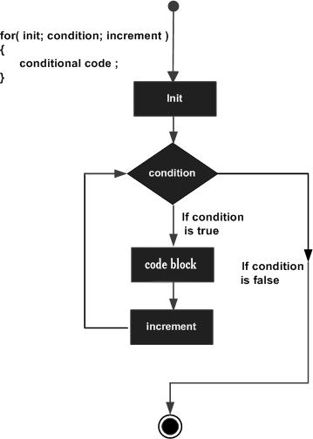
Loops – for loop
A for loop is a repetition control structure that allows you to write a loop that needs to execute a specific number of times.
Syntax:
for (expr1; expr2 ; expr 3)
{
statement(s);
}

Slide 27
Loops – for loop
A for loop is a repetition control structure that allows you to write a loop that needs to execute a specific number of times.
#include <stdio.h>
int main()
{
int i;
for(i=0;i<10;i++)
{
printf("%d ",i);
}
}
Output:
0 1 2 3 4 5 6 7 8 9

Slide 28
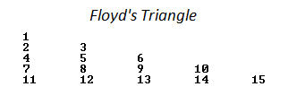
Nested For loop - Example
Example: /* Print Floid Triangle */
#include <stdio.h>
int main()
{
int n, i, c, a = 1;
printf("Enter the number of rows of Floyd's triangle to print\n");
scanf("%d", &n);
for (i = 1; i <= n; i++)
{
for (c = 1; c <= i; c++)
{
printf("%d ",a);
a++;
}
printf("\n");
}
return 0;
}

Slide 29
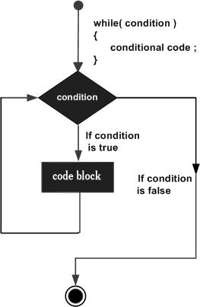
While loop
A while loop is a repetition control structure that allows you to execute a block of statements as long as a given condition is true.
When we do not know the number of iterations in advance.
Syntax:
while (expression)
{
statement(s);
}

Slide 30
While loop
A while loop is a repetition control structure that allows you to execute a block of statements as long as a given condition is true.
When we do not know the number of iterations in advance.
#include <stdio.h>
int main()
{
int i=3;
while(i<10)
{
printf("%d\n",i);
i++;
}
}
Output:
3 4 5 6 7 8 9

Slide 31
Loops… example
#include <stdio.h>
int main()
{
int n, reverse = 0;
printf("Enter a number to reverse\n");
scanf("%d", &n);
while (n != 0)
{
reverse = reverse * 10;
reverse = reverse + n%10;
n = n/10;
}
printf("Reverse of entered number is = %d\n", reverse);
return 0;
}

Slide 32
while loop - Example
Example: /* Print Floid Triangle */
#include <stdio.h>
int main()
{
int n, i, c, a = 1;
printf("Enter the number of rows of Floyd's triangle to print\n");
scanf("%d", &n);
while (expr)
{
--Class Room Exercise--
< Write the code >
}
return 0;
}

Slide 33
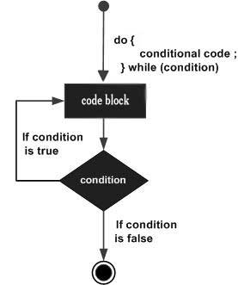
do..While loop
A do-while loop executes a block of statements at least once.
The remaining behavior is same as while loop.
Syntax:
do
{
statement(s);
} while(expression)

Slide 34
do..While loop
A do-while loop executes a block of statements at least once.
The remaining behavior is same as while loop.
#include <stdio.h>
int main()
{
int i=1;
do
{
printf("Value of i is %d\n",i);
i++;
}
while(i<=4 && i>=2);
}
Output:
Value of i is 1 Value of i is 2 Value of i is 3 Value of i is 4

Slide 35
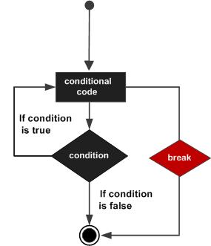
break
A break statement is used for early exit from a loop.
It can be used to terminate a case in the switch statement
If you are using nested loops then the break statement will stop the execution of the innermost loop and start executing the next line of code after the block.
Syntax: break;
while( a < 20 )
{
printf("value of a: %d\n", a);
a++;
if( a > 15)
{
break;
}
}

Slide 36
break
#include <stdio.h>
int main() { int i;
for(i=0;i<10;i++) { if(i==5) { printf(“\nComing out of for loop when i = 5″); break; } printf(“%d “,i); } }
Output:
0 1 2 3 4 Coming out of for loop when i = 5

Slide 37
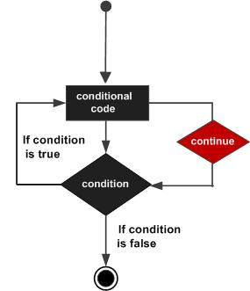
continue
A continue statement executes the next iteration of the loop, skipping the remaining code in a block.
Syntax: continue;
int a = 1;
do
{
if( a == 3)
{
/* skip the iteration */
a = a + 1;
continue;
}
printf("value of a: %d\n", a);
a++;
}while( a < 6 );
Output : 1 2 4 5

Slide 38
Continue
#include <stdio.h>
void
main ()
{
int i;
for (i = 0; i < 10; i++)
{
if (i == 5 || i == 6)
{
printf ("\nSkipping %d from display using continue statement \n",i);
continue;
}
printf ("%d ", i);
}
}
Output:
0 1 2 3 4
Skipping 5 from display using continue statement Skipping 6 from display using continue statement 7 8 9

Slide 39
goto
A goto statement causes an unconditional jump from the goto to a labeled statement in the same function.
Used to break the loops that are deeply nested, break works for only for a single level of loop
Deprecated – Not recommended to use
Syntax:
goto label;
…..
Label : statement;

Slide 40
goto - Example
Example:
#include <stdio.h>
int main ()
{
int a = 10;
LOOP: do
{
if( a == 15)
{
/* skip the iteration */
a = a + 1;
goto LOOP;
}
printf("value of a: %d\n", a);
a++;
}while( a < 20 );
return 0;
}

Slide 41
Quiz 5
How can you make the loops to run infinite number of time ?
How do you come out of infinite loops?
What is the difference between while loop and do-while loop?

Slide 42
Class Room Work
Write a program to print the multiplication table of a given number (upto 10) using for loop.
Write a program to find the number of digits in a given integer number. Use While loop or Do While loop.

Slide 43
Class Room Work
Solution: /* Multiplication Table */
/* C program to find multiplication table up to 10. */
#include <stdio.h>
int main()
{
int n, i;
printf("Enter an integer to find multiplication table: ");
scanf("%d",&n);
for(i=1;i<=10;++i)
{
printf("%d * %d = %d\n", n, i, n*i);
}
return 0;
}

Slide 44
Class Room Work
Solution: /* Number of digits */
#include <stdio.h>
int main()
{
int n,count=0;
printf("Enter an integer: ");
scanf("%d", &n);
while(n!=0)
{
n/=10; /* n=n/10 */
++count;
}
printf("Number of digits: %d",count);
}

Slide 45
Thank You

