Slide 1

SMART METAL DETECTION SYSTEM
Presented By
Bheemsen Baharti 230950330005
Buragadda Lokesh 230950330006
Burra Vinay Kumar 230950330007
C Aparna Abhishree 230950330008

Slide 2
TABLE OF CONTENTS
Introduction
Hall Effect
HALL Effect Sensors
Equipment Required
ThingSpeak
Block Diagram
Circuit setup
Where to use it?
Conclusion

Slide 3
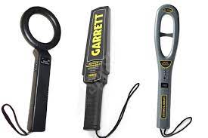
INTRODUCTION
A metal detection system is a device or technology designed to identify the presence of metallic objects within a specified area.
These systems typically operate on the principles of electromagnetic induction or pulse induction.
In electromagnetic induction-based systems, a coil generates an alternating magnetic field, and when a conductive metal object enters this field, it induces an electrical current in the object, which in turn generates a secondary magnetic field.
This change in the magnetic field is detected by the system, triggering an alert or signal to indicate the presence of metal.
In our project we use hall magnetic sensor to detect the metal (ferrous) and then send the data to the cloud.
Why do we need metal detection?
Safety and Security
Quality control in manufacturing
Archeological and Historical Preservation

Slide 4
HALL EFFECT
The Hall Effect describes the creation of a voltage difference across a conductor or semiconductor when subjected to a perpendicular magnetic field and a current flow.
It was discovered by Edwin Hall in 1879.
This effect forms the basis of Hall sensors, which detect magnetic fields with high sensitivity and accuracy.

Slide 5
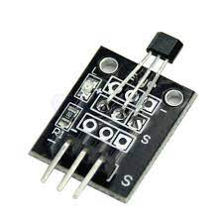
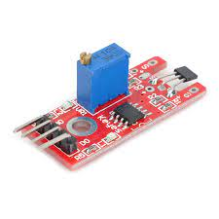
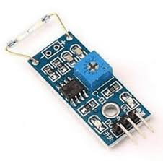
HALL EFFECT SENSORS
Hall sensors, utilizing the Hall Effect, detect magnetic fields via semiconductor technology.
They serve various industries like automotive, consumer electronics, and industrial sectors.
Types include digital switches, latches, analog, and linear sensors, each tailored to specific applications.
Their compact size, low cost, and reliability make them ideal for integration into electronic systems.
Types of HALL sensors available in kit are:
HALL magnetic sensors
Analog Hall sensor
Reed Switch

Slide 6
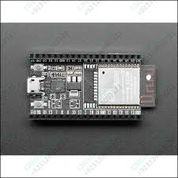
EQUIPMENT REQUIRED
ESP32 WROOM 32D:
The ESP32 WROOM 32D is a powerful microcontroller module featuring an Espressif ESP32 dual-core processor with Wi-Fi and Bluetooth connectivity capabilities.
It integrates a wide range of peripherals, including GPIO pins, SPI, I2C, UART interfaces, ADC, DAC, and PWM channels, offering extensive flexibility for IoT and embedded projects.
The module also includes built-in security features such as secure boot, cryptographic accelerators, and hardware-based AES encryption.
Its low-power modes, including deep sleep and power management functions, optimize energy efficiency for battery-powered applications.
The ESP32 WROOM 32D module typically operates with a clock frequency of up to 240 MHz

Slide 7
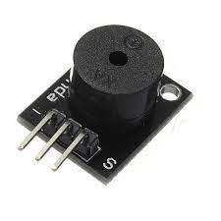
EQUIPMENT REQUIRED
Hall magnetic sensor ky-003:
The KY-003 Hall magnetic sensor module is a simple and compact device that can detect the presence of magnetic fields.
It consists of a Hall Effect sensor and a potentiometer for sensitivity adjustment.
Ky003 Hall Effect/Magnetic Sensor module consists 3144EUA-S hall effect sensor
Buzzer:
Buzzer generates sound when we provide apply voltage.
It is used to indicate the presence of metal in the project.

Slide 8
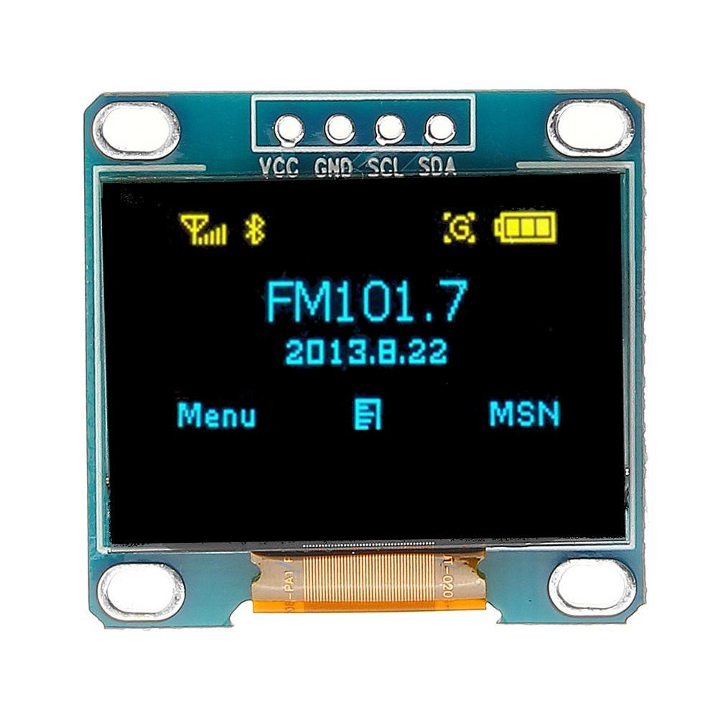
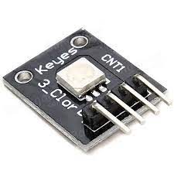
EQUIPMENT REQUIRED
SSD 1306 OLED Display:
OLED works on I2C protocol.
In the project we see the result of the metal being detected or not on the OLED screen.
3.3V is preferable to connect the OLED.
Since we have learnt about the OLED , we thought of using OLED into the project .
SMD RGB LED:
SMD LED allows efficient control and management of LED lighting, enabling features such as remote dimming, color changing, and scheduling via IoT platforms or mobile applications.
It utilizes Pulse Width Modulation (PWM) which controls the intensity of each LED color.

Slide 9

THINGSPEAK
ThingSpeak is an Internet of Things (IoT) platform that enables users to collect, analyze, and visualize data from sensors and devices in real-time.

Slide 10
BLOCK DIAGRAM
THINGSPEAK
BUZZER
KY-003 HALL
ESP32 WROOM 32D uc
OLED
SMD

Slide 11
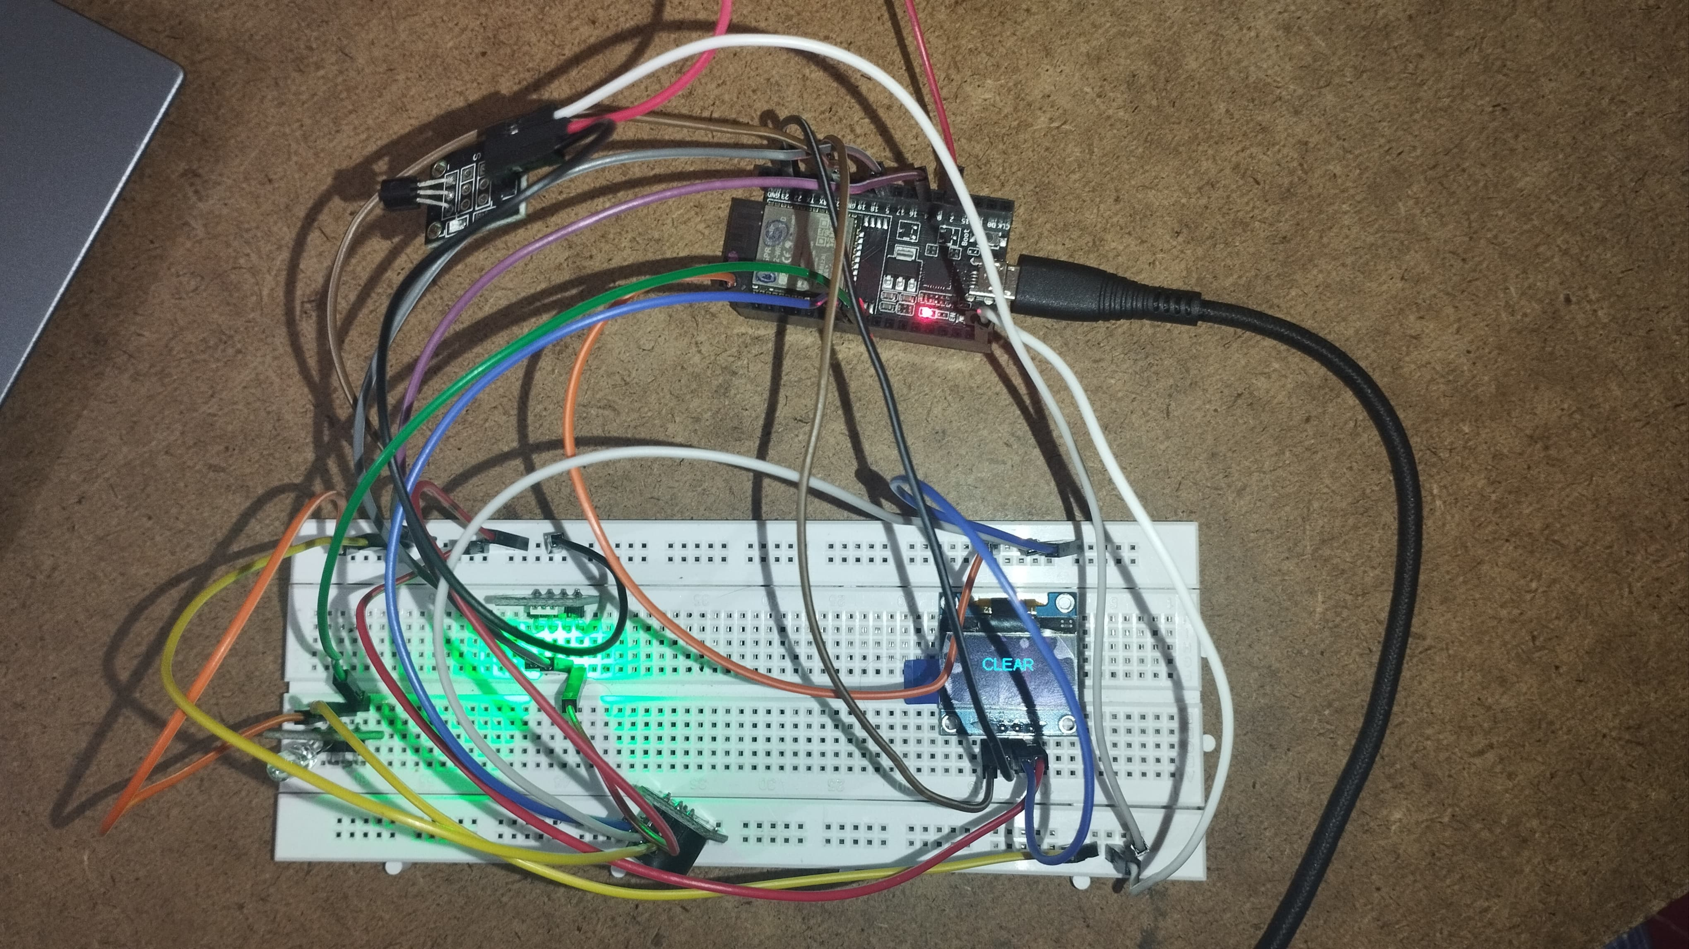
CIRCUIT SETUP

Slide 12

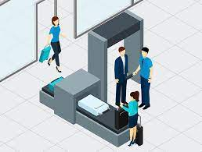
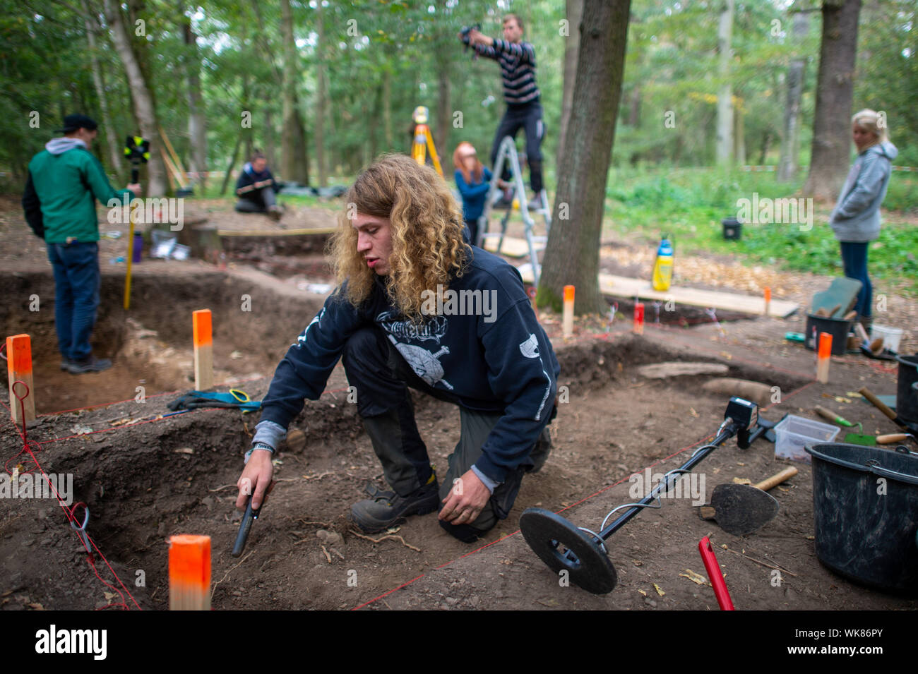

Where to use it?
Security Screening
Industrial Quality Control
Archaeological Excavations
Environmental Cleanup
Construction and Demolition

Slide 13
CONCLUSION
We have successfully implemented the smart metal detection.
Our model could detect metal at a very short distance and prints on OLED whether the access is restricted or not.

Slide 14
THANK YOU

