Slide 1


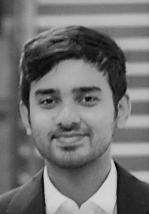
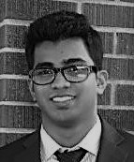
Title
DSC RE-ACTIVATION CAMPAIGN
“Our donors, closer than ever”
MVS
Consulting
Maria Arques
Swasthik Vellingiri
Vinay Rajagopalan
Notes:
Add pictures

Slide 2


Key issue
DSC is having loses, they are not able to identify potential donors
1
Take advantage of all the given information: donors, campaign and gifts
Identification
Model creation
Strategy
2
What are the characteristics of the future potential donors?
9.573,32$ profit
7 countries
20 M users
3
23.56% profit improvement
Impact
Main goal
Maximize DSC profit by identifying potential donors

Slide 3

Information used to make predictions
Amount of Historical Data Used: Random 132 Campaigns
Donors personal information
(gender, region, age…)
Donation information
(amount donated for each campaign by donor)
Campaign Information
(Donors who received the letters during the previous campaigns)

Slide 4
2- DONORS PROFILE
Potential donor
Non-potential donor
Female (they contribute more than the double as opposed to men)
Male
Age range (from 40-70 years old)
*specially the ones from 47 to 55 years
Young people (less than 40 years)
Elderly people (more than 70 years)
Old contributors
Days since last contribution:
-People that donated 11 years ago
-People that donated 13.5 years ago
Recent contributors
People that contributed to less than 5 campaigns
Multiple campaign participation (>5)

Slide 5
4 Steps to tune up the numbers
STEP 1
Historical Data Gathering and Cleaning
STEP 2
Creating New features and Feature Engineering
STEP 3
Building a Model and Finding potential Donors
Sending Letters only to potential Donors
STEP 4
OUTCOME: Lower expense and Increased Revenue
Notes:
Swasthik

Slide 6
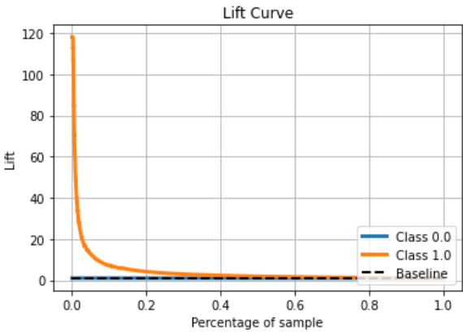
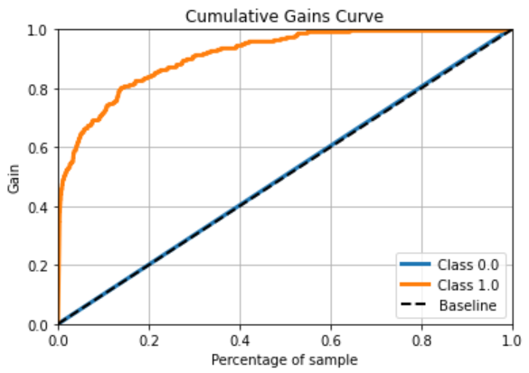
3- MODEL PERFORMANCE
For the first 5% of the “best” Donors we will reach 120 more donors than if we were contacting random Donors.
Reach more than 80% of the potential Donors by just contacting 20% of all the Donors.
Notes:
swasthik

Slide 7
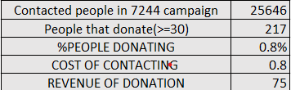
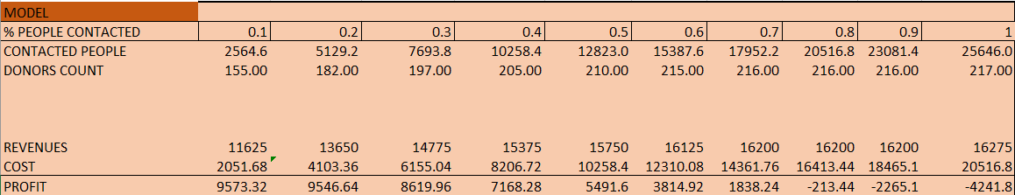
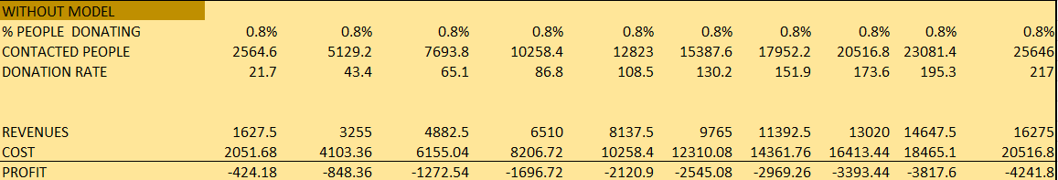
4- BUSINESS MODEL

Slide 8
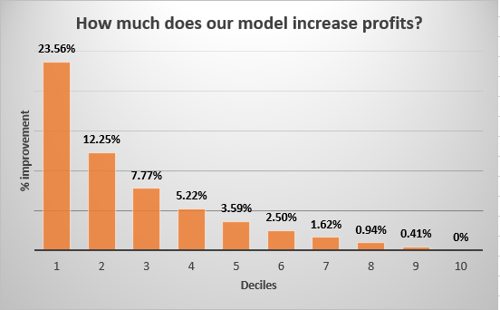
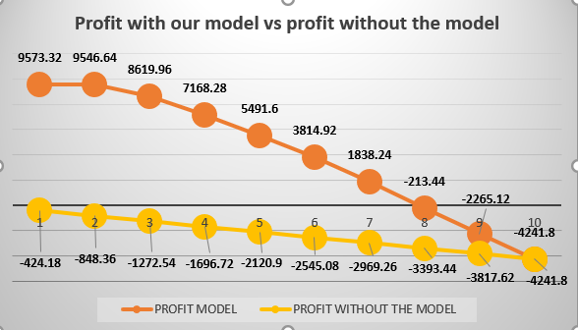




Financial results
23.56% profit increase
48.000$ after running 5 campaigns
Profit maximization when contacting 10% of the possible donors→ EFFICIENCY
6% donation rate vs 0.8% donation rate

Slide 9
THANK YOU

Slide 10
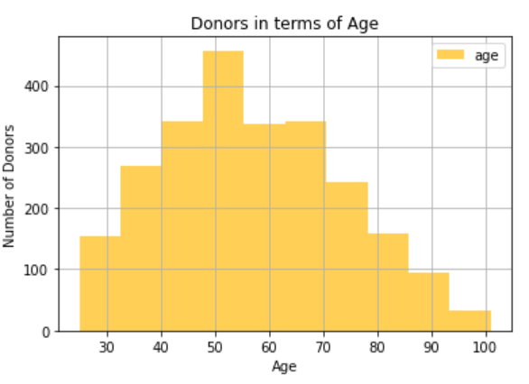
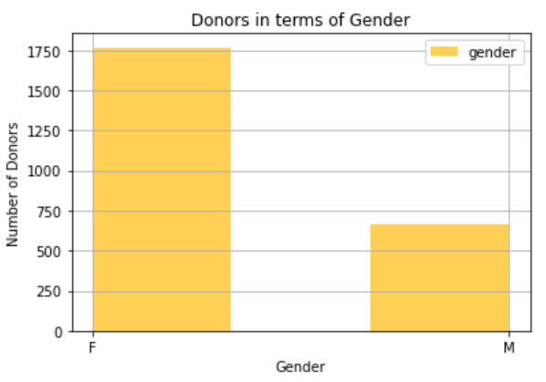
APPENDIX GRAPHS 1 -CLIENT PROFILE

Slide 11
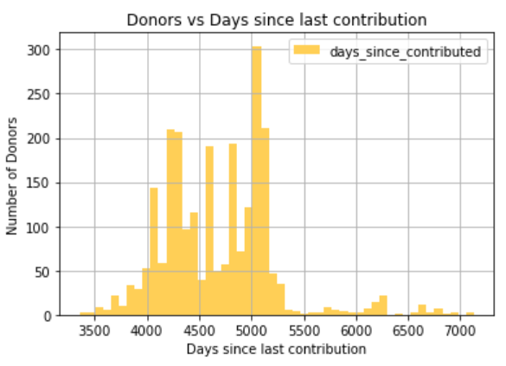
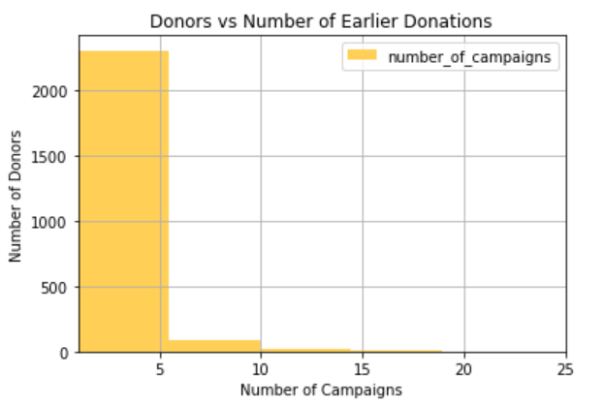
APPENDIX GRAPHS 2 -CLIENT PROFILE

