Slide 1
Task 4: Dashboard Design
Name: Vinay Raj
Tool: Power BI

Slide 2
Objective
Designed an interactive dashboard using Power BI
Analyzed sales data from Superstore dataset
Identified business insights using KPIs and charts
Created an interactive and user-friendly dashboard for business decision-making

Slide 3
Key Performance Indicators (KPIs)
Total Sales: 2.23M
Total Profit: 283.14K
Total Orders: 4898
Profit Margin: 12.70%

Slide 4
Visualizations Used
Bar Chart – Sales by Category
Pie Chart – Sales by Segment
Line Chart – Sales by Year
Filters – Region, Category, Date

Slide 5
Business Insights
West region has highest sales
Technology category performs best
Sales increased over the years
Profit margin is around 12.7%

Slide 6
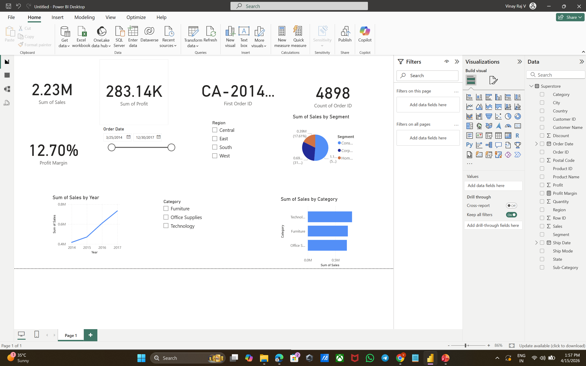
Dashboard Preview

Slide 7
Conclusion
Dashboard helps track business performance easily
Provides insights for better decision-making
Useful for stakeholders and management

