Slide 1
Data exploration and modelling project
S3344545 Gauravdeep Rana
S3737886 Vinay Nagamangala Rame Gowda

Slide 2
Data preparation steps
Data collection – through UCI machine learning repository
Data exploration – choosing columns with most significance
Data formatting – changing the columns to categories for visual representation and to integers for machine learning
Data quality – checking for data for any anomalies
Feature Engineering – converting raw data into more useful form
Data splitting – splitting the data into training and evaluation sets

Slide 3
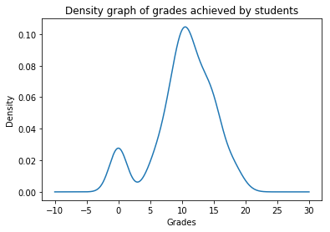
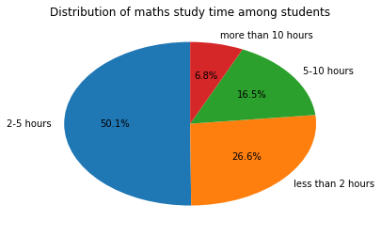
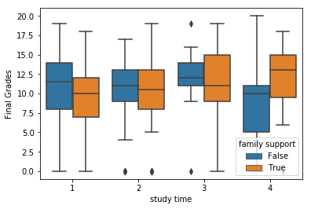
Data Set – factors effecting student’s maths grades
→ Main factors taken into consideration –
# Parent’s education and quality of family relations
# Access to internet, school and family support
# Past failures, absenteeism and willingness
# extra curricular activities and study time

Slide 4
Observations and results
Hypothesis
Study time, family/school support, extra curricular activities, internet access and parents education have positive impact on final results.
Alcohol consumption, staying in rural area, separated parents, past failures and absenteeism have negative impact on final results
Results
Most families have good relations but bad relation is more prevalent in urban areas.
More study time and family support result in better grades.
Extra paid classes result in less failures
Extra curricular activities result in less absenteeism.
Fathers with no education have kids with highest grades, closely followed by those who have higher education. While mothers with higher education have kids with highest grades

