Slide 1
SUMMER INTERNSHIP
AWS
-Vinay Rana
19CSU345

Slide 2
AWS ACADEMY CLOUD
FOUNDATIONS
Introduction
AWS Academy Cloud Foundations gives basic knowledge of cloud computing concepts. It discuss various cloud concepts, AWS core services, databases, security, architecture.
Concepts like cloud billing , cloud security, scaling and monitoring
Practical Labs
Quizzes

Slide 3
ABOUT MODULES :
MODULE 1 : Cloud Concepts Overview
Introduction to cloud computing and AWS and advantages of the cloud and how it is easy to use, has no capacity limits, provides speed and agility, is very secure and reliable.
MODULE 2 : Cloud Economics and Billing
About AWS Organizations that lets you consolidate multiple AWS accounts into an organization that you create and centrally manage. AWS Billing and Cost Management is the service that you use to pay your AWS bill, monitor your usage, and analyse and control your costs.

Slide 4
MODULE 3 : AWS Global Infrastructure Overview
AWS Service Catalog provides the following benefits like Standardization, Self-service discovery and launch, Fine-grain access control, Extensibility and version control and how AWS became a global infrastructure.
MODULE 4 : AWS Cloud Security
Security and Compliance is a shared responsibility between AWS and the customer. AWS responsibility “Security of the Cloud” and Customer responsibility “Security in the Cloud”.
AWS Identity and Access Management (IAM) enables you to manage access to AWS services and resources securely.

Slide 5
MODULE 5 : Networking and Content Deliver
It provides the broadest and deepest set of networking services with the highest reliability, most security features, and highest performance in the world. Major benefits includes most secure, highest network availability, consistent high performance, Broadest global coverage.
Amazon Cloud-Front is a fast content delivery network (CDN) service that securely delivers data, videos, applications, and APIs to customers globally with low latency, high transfer speeds, all within a developer-friendly environment.
MODULE 6 : Compute
AWS Lambda is a server-less compute service that lets you run code without provisioning or managing servers, creating workload-aware cluster scaling logic, maintaining event integrations, or managing runtimes

Slide 6
MODULE 7 : Storage
Amazon Elastic File System (EFS) automatically grows and shrinks as you add and remove files with no need for management or provisioning.
MODULE 8 : Database
Amazon Relational Database Service (Amazon RDS) makes it easy to set up, operate, and scale a relational database in the cloud.

Slide 7
MODULE 9 : CLOUD ARCHITECTURE
About cloud architecture and framework how it is operational excellent, reliable, secured and also performance and cost efficient.
MODULE 10 : Auto Scaling and Monitoring
Amazon CloudWatch is a monitoring and observability service built for DevOps engineers, developers, site reliability engineers (SREs), and IT managers.

Slide 8
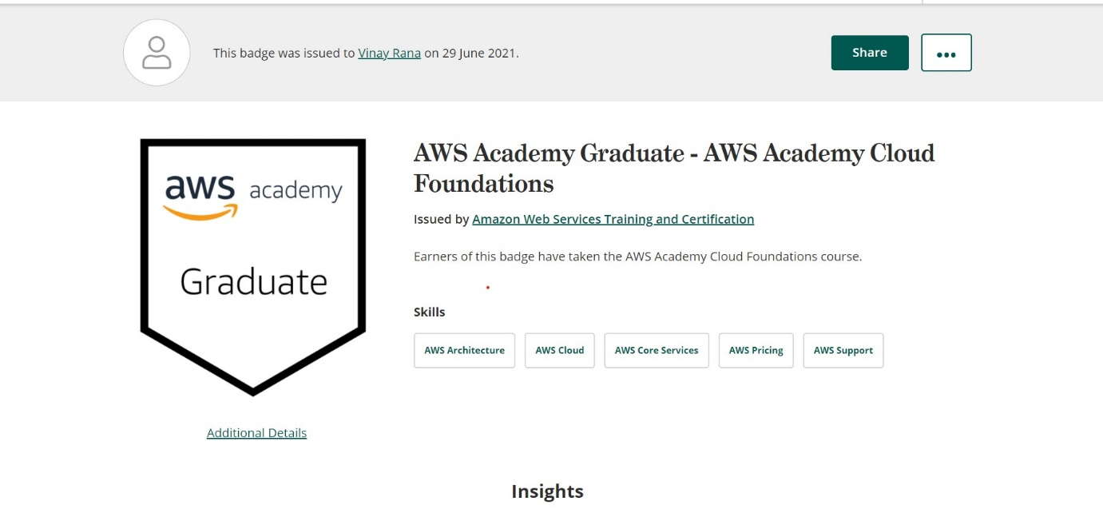
CERTIFICATE

Slide 9
THANK YOU

