Slide 1
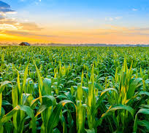

AgerAmicus
AI-Powered Sustainable Farming Assistant
AZURE AI Developer Hackathon Submission
By: Vinay Reddy & Snigdha Reddy

Slide 2
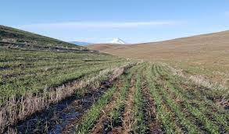
Problem Statement
Many farmers lack intelligent, accessible tools for disease detection and Q&A.
Lack of timely and localized agricultural assistance leads to crop loss.
Need for an integrated assistant using AI for guidance and plant health analysis.

Slide 3
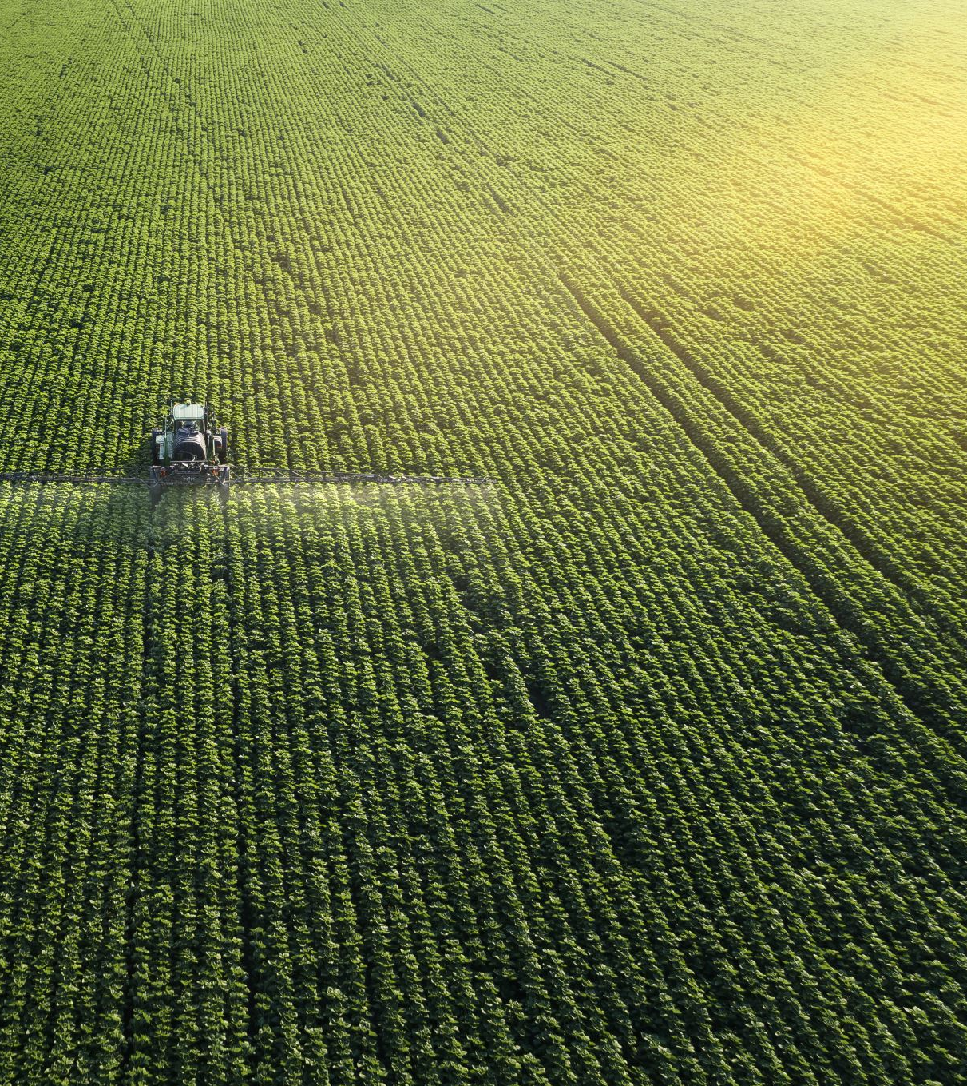
Solution Overview
AgerAmicus is an intelligent assistant for farmers.
Features:
– Plant Disease Detection from Images
– AI Chatbot for agricultural Q&A
• Combines custom-trained CNN with Azure OpenAI (GPT-3.5 Turbo)

Slide 4

Tech Stack
Python, TensorFlow, Keras, FastAPI
Azure OpenAI (gpt-35-turbo deployment)
VS Code for development

Slide 5
Features Implemented
Image-based Disease Prediction using CNN model
FastAPI backend with /analyze-image route
Azure OpenAI deployment attempted
chat route defined and tested with POSTMAN

Slide 6
Architecture
• Frontend - FastAPI backend
/analyze-image - loads CNN model and returns prediction
/chat - interacts with Azure OpenAI GPT model
• Deployed locally using Uvicorn

Slide 7
Challenges & Learnings
• Faced delays in Azure resource deployment & key configuration
• FastAPI integration issues with OpenAI SDK
• Learned to rapidly build and debug backend endpoints
• Gained experience deploying CNN models

Slide 8
Next Steps
• Build frontend UI with image upload + chat window
• Add recommendation engine for fertilizers and yield prediction
• Deploy on Azure App Service or Stream lit
• Finalize MVP with CNN-based image analysis and chatbot API definitions

