Slide 1
HR ANALYTICS
EMPLOYEE ATTRITION ANALYSIS
Project Presentation

Slide 2
TEAM MEMBERS
➤ Mudavath Rasagnya Nayak
➤ Kalyani Rajesh Yamunabade
➤ Nisha Suresh Manuskare
➤ Shweta Bharat Patil
➤ Pragallapati Venkata Manindra Guptha
➤ Venkat Sai Kishan Parida
➤ VEMURU VINAY KUMAR REDDY

Slide 3
CONTENTS
➤ Objective
➤ Introduction
➤ Business Overview
➤ Project Scope
➤ Data Model Challenges
➤ Dashboard Summary
➤ KPI Detailed Explanation
➤ Recommendations
➤ Conclusion

Slide 4
OBJECTIVE
➤ Analyze HR employee demographic and tenure data points.
➤ Identify key behavioral and financial drivers of attrition.
➤ Correlate income vs. role satisfaction across the organization.
➤ Measure work-life balance effectiveness in high-demand roles.
➤ Provide executive-ready recommendations for workforce retention.

Slide 5
INTRODUCTION
➤ HR Analytics uses data to drive human capital strategies.
➤ Reducing attrition is critical for maintaining project knowledge and reducing costs.
➤ Analysis covers 50,000+ records with 30+ distinct employee variables.
➤ Integrated approach using SQL (MySQL), Excel, and BI (Tableau/Power BI).

Slide 6
BUSINESS OVERVIEW
➤ Workforce retention directly impacts the bottom line.
➤ Employee loyalty involves a balance of Pay, Growth, and Life-Balance.
➤ Certain high-skill roles (Research, Sales) require localized retention models.
➤ Data-backed policies are essential for mid and long-term scaling.

Slide 7
PROJECT SCOPE
➤ Integration of HR_1 (Demographics) and HR_2 (Tenure/Finance).
➤ Join operation resulted in 50,000 verified data matches.
➤ Development of 6 Strategic KPIs across 4 major analytical tools.
➤ Correlation mapping of tenure vs. promotional history.

Slide 8
DATA MODEL CHALLENGES
➤ Managing large-scale data joins with varying primary key headers.
➤ Cleaning and imputing missing promotion and tenure values.
➤ Standardizing salary groups for equitable role comparison.
➤ Validating cross-tool consistency between SQL, Excel, and BI Dashboards.

Slide 9
DASHBOARD & SQL Queries

Slide 10
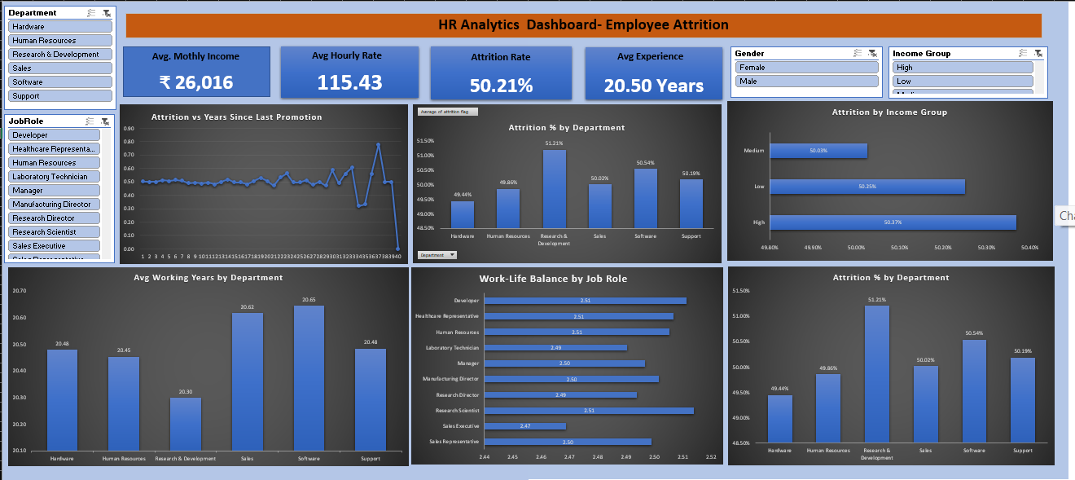
EXCEL DASHBOARD

Slide 11
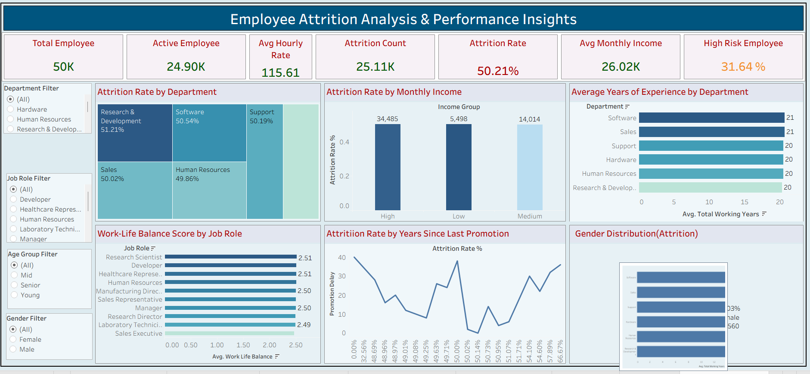
TABLEAU DASHBOARD

Slide 12
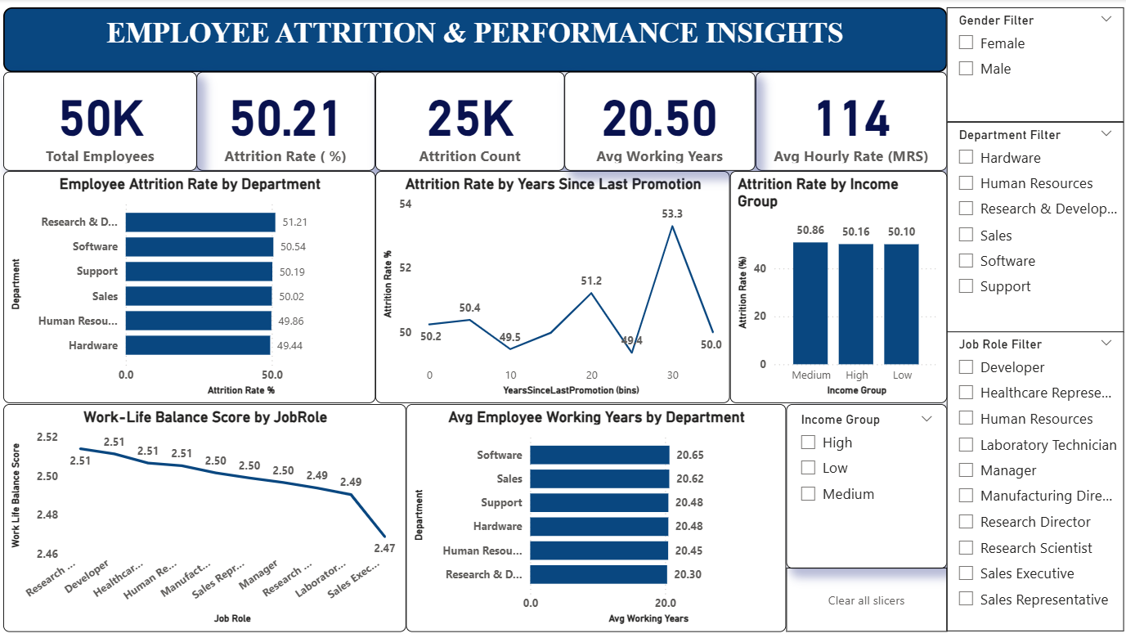
POWER BI DASHBOARD

Slide 13
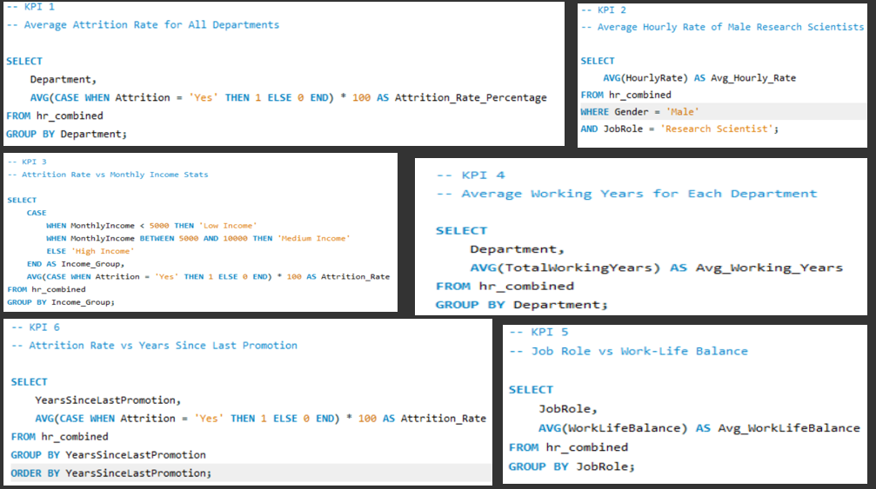
SQL LOGIC & QUERIES

Slide 14
KPI STRATEGIC EXPLANATION

Slide 15
KPI 1: ATTRITION BY DEPARTMENT
This metric evaluates employee turnover at a departmental level. Our analysis identifies a uniform attrition rate of approximately 50% across all sectors. This suggests attrition is driven by organization-wide culture or policy rather than isolated departmental management.

Slide 16
KPI 2: MALE RESEARCH SCIENTIST RATES
Focused on high-value roles, we found that Male Research Scientists receive a premium hourly rate ($114.45). This indicates high organizational value for the role, though compensation alone is failing to curb the 50% attrition trend seen globally.

Slide 17
KPI 3: INCOME VS ATTRITION CORRELATION
This KPI tests if higher pay equals higher retention. The data shows attrition remains high even in top income brackets. This critical finding proves that financial incentives are not the root trigger for exits; environmental and growth factors must be addressed.

Slide 18
KPI 4: WORKING YEARS BY DEPARTMENT
We tracked the average tenure (experience) within divisions. Surprisingly, the workforce is highly seasoned, with an average of 20 working years across the board. The risk is high-loyalty veterans leaving due to stagnation, taking decades of expertise with them.

Slide 19
KPI 5: ROLE-BASED WORK-LIFE BALANCE
Comparing 'Job Role' vs 'Balance Rating' (1-4). Sales Executive roles report the lowest satisfaction scores. High-stress roles require immediate wellness and flexibility interventions to prevent burnout-driven turnover.

Slide 20
KPI 6: PROMOTION-RETENTION
RELATION
This is the project's most vital insight. Attrition risk spikes sharply for employees who have not been promoted for 20+ years. Long-term loyalty without growth pathways is the single biggest predictor of turnover for senior staff.

Slide 21
RECOMMENDATIONS
➤ Implement mid-career promotion pathways for employees with 15+ years tenure.
➤ Focus wellness programs on Sales roles to improve Work-Life balance.
➤ Investigate the ~50% attrition benchmark to find root organizational causes.
➤ Use high income as a baseline, but focus on cultural/growth incentives.
➤ Monitor promotion cycles more closely to prevent stagnation-driven exits.

Slide 22
CONCLUSION
➤ SQL and BI analysis revealed critical attrition hotspots
➤ Stagnant promotions are the biggest single predictor of exit for long-term staff
➤ Departmental tenure is high, showing a strong potential for internal mentorship
➤ A multi-tooled approach (Excel/SQL/Tableau) ensures data accuracy and clarity
➤ Insights support a more personalized retention strategy for HR teams

Slide 23
THANK YOU

