Slide 1
Zomato Data Analysis
By: Vinay
Course: Data Analytics Project

Slide 2
Project Objective
Analyze restaurant data
Find factors affecting ratings
Study cost vs rating
Find popular cuisines & locations

Slide 3
Dataset
Zomato Bangalore Dataset
Source: Kaggle
Features: Name, Location, Rating, Cost, Cuisines

Slide 4
Tools Used
Python
Pandas, NumPy
Matplotlib, Seaborn
Power BI

Slide 5
Data Cleaning
Handled missing values
Converted ratings
Cleaned cost column

Slide 6
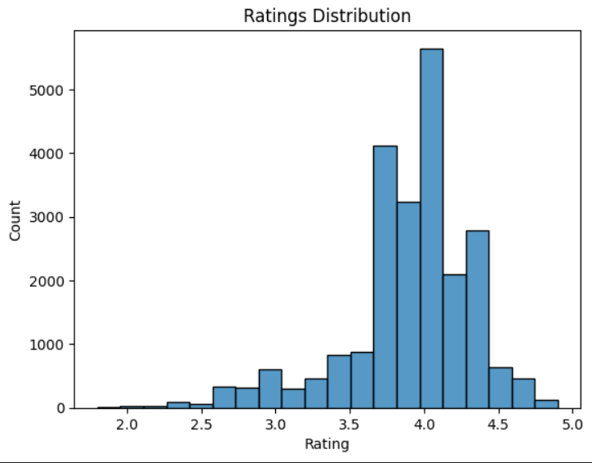
Ratings Analysis
Most ratings between 3.5–4.5
Indicates good satisfaction

Slide 7
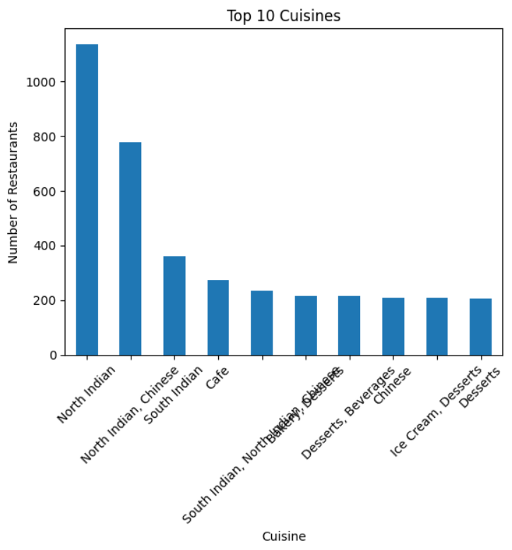
Top Cuisines
Some cuisines dominate
Shows customer preferences

Slide 8
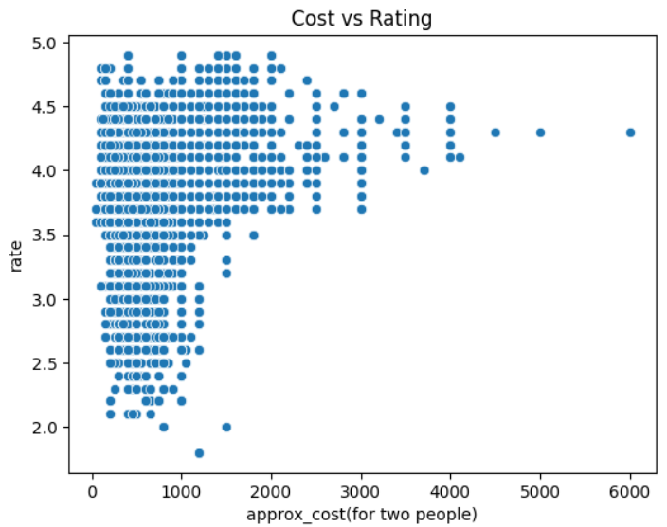
Cost vs Rating
High cost ≠ high rating
Affordable places also good

Slide 9
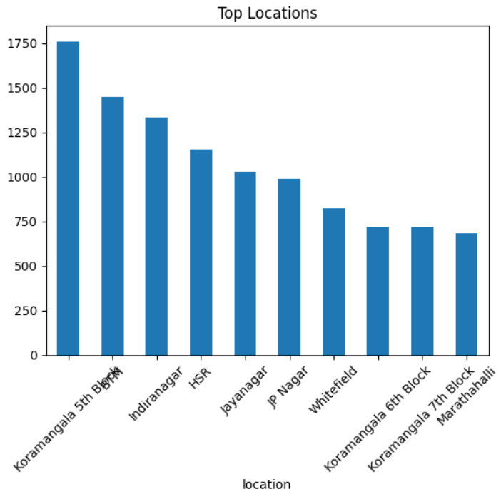
Location Analysis
Certain areas have more restaurants
Food hubs identified

Slide 10
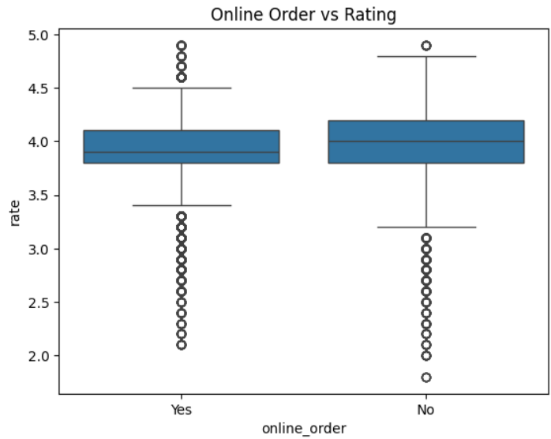
Online Order Impact
Online ordering slightly improves ratings

Slide 11
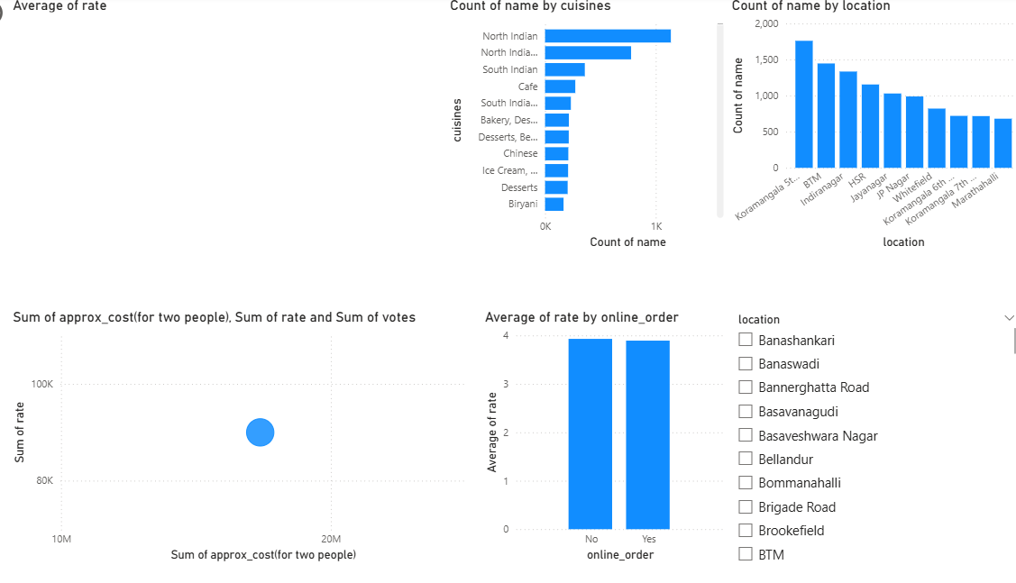
Dashboard
Interactive Power BI dashboard created

Slide 12
Conclusion
Cost not main factor
Cuisine & location matter
Data helps decisions

Slide 13
Future Scope
Sentiment analysis
Recommendation system
ML prediction

Slide 14
Thank You
Thank You!

