Slide 1
Grocery Store Billing\nManagement System
Database Design • Billing • Inventory • Sales Reporting
Project presentation | MySQL 8.0.16+
Schema, ER model, automation, and reporting capabilities
Presented by : Vinay Sambana
CGVI-PFS-VSP-007
GROCERY STORE BILLING MANAGEMENT SYSTEM
1

Slide 2
Project at a glance
A relational database foundation for grocery store transactions and inventory.
7
4
3
4
Core business tables
Reporting views
Stored procedures
Triggers
Core workflow
Catalog
›
Source
›
Checkout
›
Transaction
›
Insights
Categories + Products
Suppliers
Customers + Employees
Bills + Bill_Items
Views + query bank
GROCERY STORE BILLING MANAGEMENT SYSTEM
2

Slide 3
Database structure
Seven operational tables support the core store workflow.
Categories
category_id (PK), category_name, description
Employees
employee_id (PK), name, role, hire_date, salary
Suppliers
supplier_id (PK), name, phone, email, city
Bills
bill_id (PK), customer_id (FK, nullable), employee_id (FK), payment and totals
Products
product_id (PK), category_id (FK), supplier_id (FK), prices, stock, expiry
Bill_Items
item_id (PK), bill_id (FK), product_id (FK), quantity, unit_price, line_total
Customers
customer_id (PK), contact details, loyalty_points
price_audit
audit_id (PK), product_id, action type, old/new price, timestamp
Note: price_audit is an auxiliary audit table; product_id is not declared as a foreign key in the supplied SQL.
GROCERY STORE BILLING MANAGEMENT SYSTEM
3

Slide 4
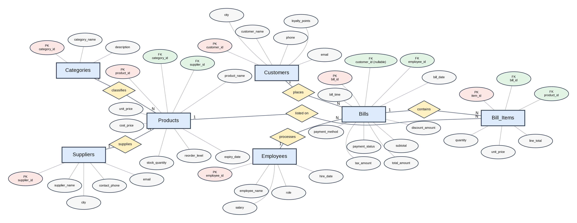
Entity–Relationship Diagram
Rectangles = entities • Diamonds = relationships • Ovals = attributes • PK/FK labels identify keys
Relationships shown are 1:N. The schema does not define a 1:1 relationship.
GROCERY STORE BILLING MANAGEMENT SYSTEM
4

Slide 5
Relationship rules
Foreign keys implement the one-to-many links.
Categories → Products
1:N
Products.category_id references Categories.category_id
Suppliers → Products
1:N
Products.supplier_id references Suppliers.supplier_id
Customers → Bills
1:N, optional
Bills.customer_id is nullable for walk-in sales
Employees → Bills
1:N
Bills.employee_id references Employees.employee_id
Bills → Bill_Items
1:N
Every bill item belongs to one bill
Products → Bill_Items
1:N
Every bill item references one product
GROCERY STORE BILLING MANAGEMENT SYSTEM
5

Slide 6
Integrity and automation
The schema includes constraints and server-side logic for safer transaction handling.
Data integrity
Automation
Primary keys on all tables
Foreign keys enforce product/category/supplier and billing links
CHECK constraints validate non-negative prices/totals and positive item quantity
Unique category names and customer phone numbers
Bill-item trigger validates quantity and available stock
After-insert trigger reduces product stock
Product insert/update/delete triggers record price audit events
Stored procedure adds bill items and recalculates bill totals
GROCERY STORE BILLING MANAGEMENT SYSTEM
6

Slide 7
Reporting and analysis
Views and query examples turn transactional data into store insights.
view_bill_overview
Bill date/time, customer or walk-in, cashier, payment, totals
view_sales_details
Bill line items joined to products and categories
view_product_stock_status
Stock/reorder status and expiry status
view_category_sales_summary
Units sold and revenue by category
Query bank covers payment trends, top-selling products, discounts/tax, pending bills, margins, city sales, and low-stock items.
GROCERY STORE BILLING MANAGEMENT SYSTEM
7

Slide 8
Setup and next steps
Environment
Before production use
MySQL Server 8.0.16+
Run the supplied SQL script in a test database
Script creates schema, sample data, indexes, views, procedures, and triggers
Review sample data and billing calculations
Test trigger-driven stock updates on a clean database
Add transaction handling, access controls, backups, and application layer as required
Thank you
GROCERY STORE BILLING MANAGEMENT SYSTEM
8

