Slide 1


Department of Artificial Intelligence and Data Science
Academic year: 2025-26
Cyber-Bullying Detection in Social Media Platform
By:
Chethangiri K(1DB22AD013)
Dhanush A B(1DB22AD017)
Kushal H K (1DB22AD023)
Vinay (1DB22AD060)
GUIDE:
Dr. Nandini K S
Associate Professor
Department of AI and DS, DBIT, Bengaluru

Slide 2
CONTENTS
Abstract
Introduction
Literature Survey
Objectives
System Model
Methodology
Software & Hardware requirements
Result and Discussion
Conclusion & Future scope
References

Slide 3
ABSTRACT
The project develops an automated cyberbullying detection system using Deep Learning (DL) to address the growing mental health impact of online harassment, particularly among adolescents.
Data from eight Kaggle datasets is preprocessed through tokenization, stop-word removal, followed by text feature extraction and classification using a Bidirectional LSTM (BiLSTM) model.
The model demonstrates high performance in accuracy, precision, recall, and F1 score, effectively detecting offensive or bullying content and contributing to safer digital communication environments.

Slide 4
INTRODUCTION
The internet and platforms like Facebook, Twitter, and YouTube have revolutionized global communication, engaging over 5 billion active users as of January 2024.
Despite their benefits, social media platforms have become hotspots for cyberbullying—intentional and repetitive online harassment causing severe psychological effects such as anxiety, depression, and suicidal thoughts.
Detecting cyberbullying is difficult due to the evolving nature of online language, including slang, sarcasm, and cultural nuances, making traditional moderation methods slow and ineffective.

Slide 5
LITERATURE SURVEY
Sl.No. | Title | Author | Year | Publication | Methodology | Advantages | Limitations
1. | Effective Automatic Cyberbullying Detection Using a Hybrid Approach SVM And NLP | J. Sathya , F. Mary Harin Fernandez | 2024 | 2024 International Conference on Advances in Data Engineering and Intelligent Computing Systems (ADICS) | A hybrid model using Support Vector Machine (SVM), NLP, TF-IDF, and the LIWC2 tool to classify text as cyberbullying or non-cyberbullying. | Achieved high accuracy of 93.15% on the test data. Outperformed other NLP methods like Naive Bayes and logistic regression. | Not explicitly stated in the provided text.
2. | Advanced Cyberbullying Detection: A Hybrid Model Integrated with Naïve Bayes | M. Priyadharshini , B.Nithya , Hemagowri J , Srinidhi K , A. Faritha Banu , V.Murugesh | 2024 | 2024 Third International Conference on Electrical, Electronics, Information and Communication Technologies (ICEEICT) | Uses TF-IDF and Naive Bayes for text analysis. The methodology section also details a Logistic Regression model for text classification. | The combination of TF-IDF and Naive Bayes is noted to increase precision. The model (Logistic Regression) achieved 80% accuracy and precision. | The model's recall score was low (approx. 0.6), meaning it failed to identify 40% of actual cyberbullying incidents. Future work indicates a need to handle multiple languages and improve real-time detection.

Slide 6
Sl. No . | Title | Author | Year | Publication | Methodology | Advantages | Limitations
3. | Integrating Link Prediction and Comment Analysis for Enhanced Cyberbullying Detection in Online Social Interactions | Vishav Bharat Pal , Pushparaj Shetty D | 2024 | 2024 IEEE International Conference on Electronics, Computing and Communication Technologies (CONECCT) | A framework that integrates Link Prediction with a cyberbullying detection model It introduces a 'Connection Probability (CP)' to assess user relationships and uses Comment Analysis for posts. | Provides a comprehensive solution that considers the relationship between users. Can be used to optimize friend recommendation systems. | Assumptions about user relationships are a simplification and could be refined. Future work suggests exploring more advanced models for higher accuracy.
4. | Detection of Cyberbullying in Online Comments Latest Advances and Challenges | Lina Feriel Benassou, Safa Bendaouia, Osman Salem, Ahmed Mehaoua | 2023 | 2023 IEEE International Conference on E-health Networking, Application & Services (Healthcom) | Uses TF-IDF for word embedding. Employs a Stacked Model that combines three base models: Random Forest, Gradient Boosting , and Support Vector Machine. Logistic Regression is used as the final estimator to combine the predictions. | The Stacked Model achieved a high accuracy of 98%. It outperformed other individual models like Extra Trees, Ada Boost, and Decision Tree. | The model cannot eliminate the risk of false positives and false negatives. Struggles with subtleties in language like sarcasm and metaphors. Needs to be adapted for multilingual datasets.
5. | Analysis of Tweets for Cyberbullying Detection | Shipra Anil Mathur , Bhuvaneswar Dharmasivam , Shivam Isarka , Jaidhar C. D. | 2023 | 2023 Third International Conference on Secure Cyber Computing and Communication (ICSCCC) | A real-time system using Selenium to scrape tweets. It uses TF-IDF and compares ML models ,finding Tuned Random Forest to be the best. Also uses an image captioning model to filter spam by comparing captions. | The Tuned Random Forest model achieved the highest accuracy at 94.06%. The system operates in real-time on Twitter data. Includes a novel method to filter spam tweets using image caption analysis. | The conclusion implies it struggles with subtle forms of cyberbullying, such as sarcasm and irony.

Slide 7
OBJECTIVES
Multi-Level Toxicity Classification: Implement a classification framework capable of identifying three distinct levels of toxicity—low, medium, and intensive—to provide a detailed understanding of the severity and nature of abusive content.
Dynamic User Reputation Scoring: Implement an adaptive reputation score system that adjusts based on the detected level of toxicity, reflecting user behavior trends and accountability over time.
Automated Preventive Mechanism: Introduce an automated blocking or restriction system that takes action against users whose reputation score falls below a specific threshold, reducing recurring instances of cyberbullying.

Slide 8
SYSTEM MODEL
Data Collection: The system extracts textual content from popular social media platforms to capture diverse forms of communication.
Input Categorization and Preprocessing: Text undergoes standard cleaning, tokenization, stop-word removal.
Feature Extraction and Selection: A feature selection process filters out the most relevant data for classification.
Deep Learning-Based Classification: A custom Bi-LSTM model analyzes text features and cyberbullying-related keywords to detect harmful or abusive content accurately.
Three-Level Toxicity Output: The system classifies each post into Low(reputation score: -0.5), Medium (reputation score: -1.0), or Intensive (reputation score: -2.0) toxicity levels, reflecting the severity of bullying behavior.

Slide 9
Bi-Directional LSTM Algorithm
Input Sequence Processing: The text is converted into numerical form (tokens → padded sequences) so that the model can read it.
Forward LSTM Pass: One LSTM reads the sequence from left to right and learns context from the past words.
Backward LSTM Pass: Another LSTM reads the sequence from right to left and learns context from future words.
Combine Both Directions: The outputs of the forward and backward LSTMs are merged (concatenated) to capture complete bidirectional context.
Classification Layer: The combined features are passed through Dense layers for the final prediction (e.g., toxic vs. non-toxic, positive vs. negative).

Slide 10
METHODOLOGY
Low toxicity
Yes
Bulling
Medium toxicity
Data Preprocessing include tokenization, padding
Decision
Model training using BiLSTM
Intensive toxicity
Data from different sources
Data Cleaning
Non-Bulling
No
Fig1. Data Flow Diagram for Cyber-bullying detection

Slide 11
Data Sources: Data from Kaggle(8datasets) aggression_parsed.csv, attack_parsed.csv, kaggle_parsed.csv , toxicity_parsed.csv, twitter_parsed.csv, twitter_racism_parsed.csv, twitter_sexism_parsed.csv, youtube_parsed.csv, genz_cyberbullying_parsed.csv.
Data Cleaning: Removing the unwanted characters from like !, @, #, etc. , removing stopping word and stemming.
Feature Engineering and feature selection: Feature engineering includes Label encoding and feature selection includes features like Text and label(0 or 1).
Model training: Training model on 8 dataset using Bi-directional LSTM(Long-Short Term Memory).

Slide 12
SOFTWARE & HARDWARE REQUIREMENTS
Hardware requirements:
Laptop with Operating System: Windows 11, macOS, or Linux
Processor: Intel Core i5/i7 (or AMD equivalent) or higher.
RAM: Minimum 8GB.
Storage: SSD with at least 256GB.
Software requirements:
Coding Language : Python
Development tools & libraries:
  Deep Learning Frameworks: TensorFlow 2.x, Keras, Bidirectional LSTM
  Machine Learning Libraries: Scikit-learn
  Data Processing & Visualization: Pandas, NumPy, Matplotlib, Seaborn

Slide 13
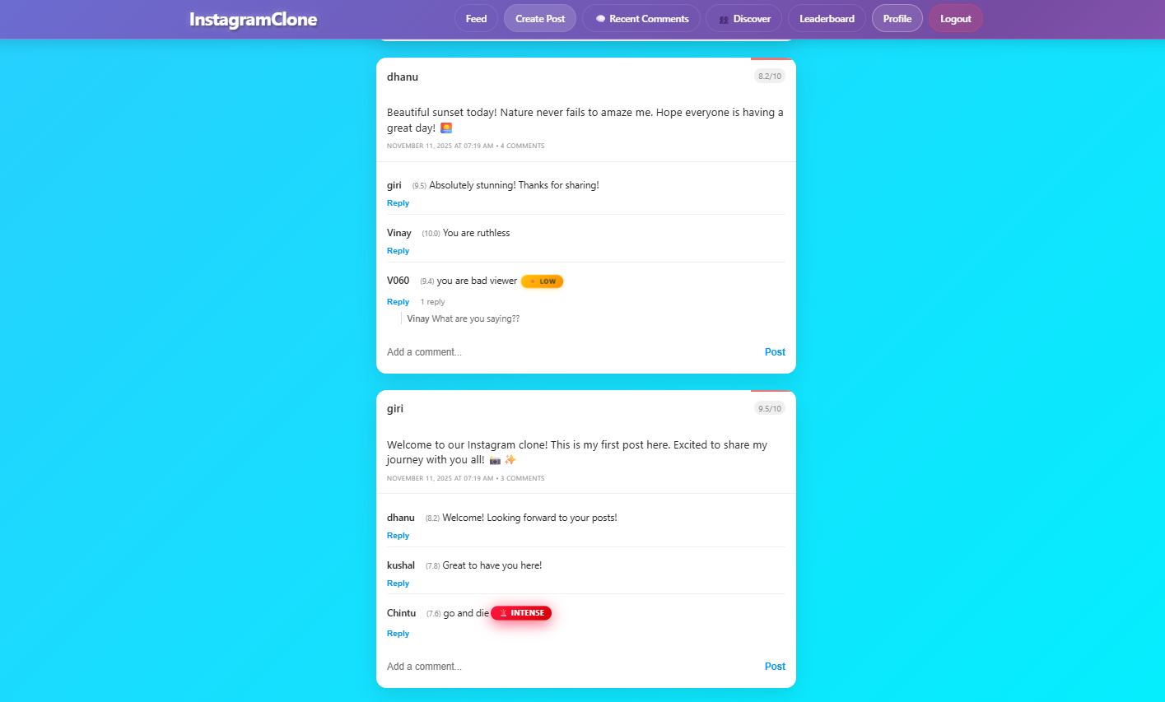
RESULT AND DISCUSSION

Slide 14
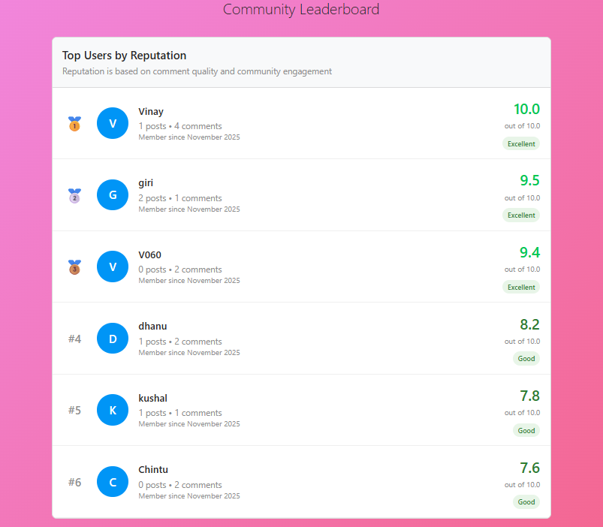

Slide 15
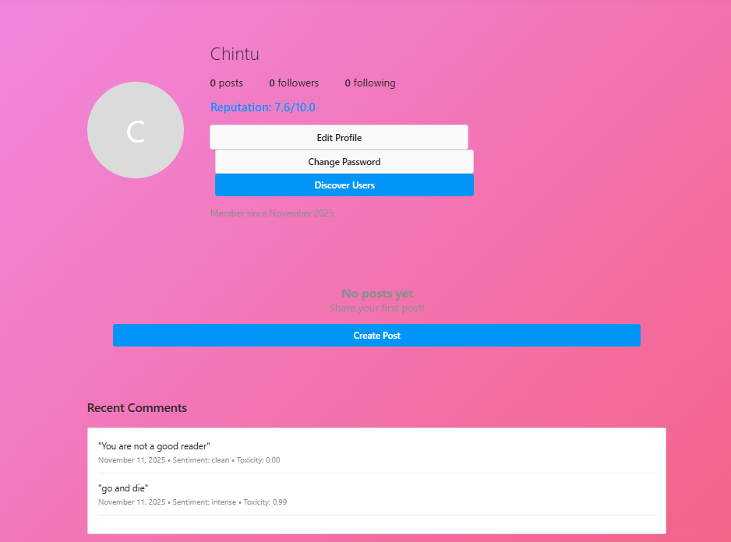

Slide 16
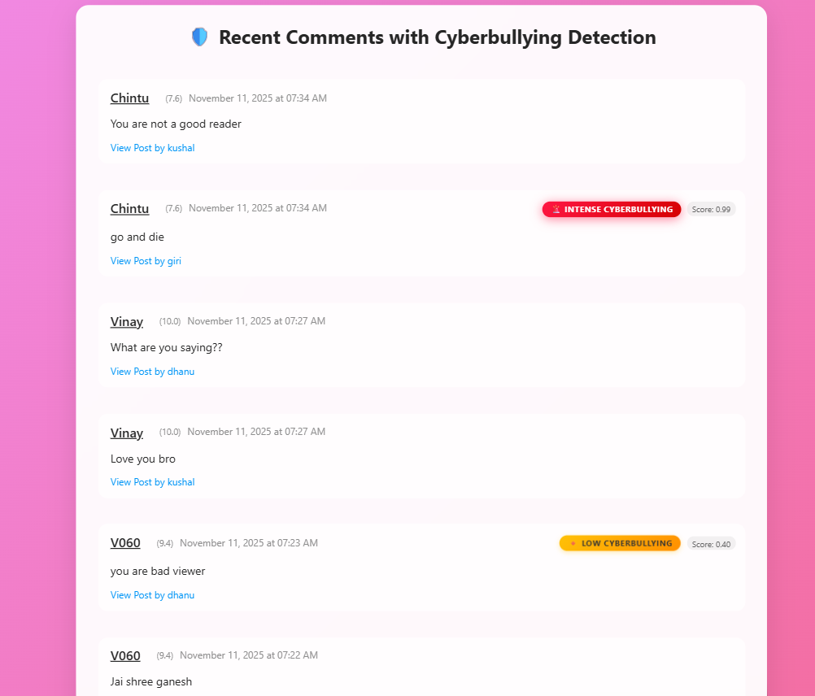

Slide 17
CONCLUSION
The system successfully enhances cyberbullying detection by introducing multi-level toxicity classification, enabling clearer differentiation between low, medium, and highly aggressive abusive content.
A dynamic user reputation scoring mechanism ensures continuous monitoring of user behavior, promoting accountability while adapting scores based on the severity of detected toxicity.
The system’s automated preventive mechanism proactively restricts or blocks users whose reputation score drops below a defined threshold, reducing repeated harmful actions.
Overall, the integrated framework ensures a more accurate, context-aware, and preventive cyberbullying detection system, contributing to a safer and more responsible online environment.

Slide 18
FUTURE SCOPE
Future research can focus on developing a multi-modal system by integrating text, image, and audio analysis for broader cyberbullying detection. Additionally, incorporating user relationship data and multi-lingual or sarcasm-specific datasets can enhance contextual understanding and global applicability.

Slide 19
REFERENCES
[1]. J. Sathya and F. M. H. Fernandez, "Effective Automatic Cyberbullying Detection Using a Hybrid Approach SVM And NLP," in 2024 International Conference on Advances in Data Engineering and Intelligent Computing Systems (ADICS), 2024.
[2]. M. Priyadharshini, B. Nithya, Hemagowri J, Srinidhi K, A. F. Banu, and V. Murugesh, "Advanced Cyberbullying Detection: A Hybrid Model Integrated with Naïve Bayes," in 2024 Third International Conference on Electrical, Electronics, Information and Communication Technologies (ICEEICT), 2024 .
[3]. V. B. Pal and P. S. D., "Integrating Link Prediction and Comment Analysis for Enhanced Cyberbullying Detection in Online Social Interactions," in 2024 IEEE International Conference on Electronics, Computing and Communication Technologies (CONECCT), 2024.
[4] L. F. Benassou, S. Bendaouia, O. Salem, and A. Mehaoua, "Detection of Cyberbullying in Online Comments Latest Advances and Challenges," in 2023 IEEE International Conference on E-health Networking, Application & Services (Healthcom), 2023.
[5]. S. A. Mathur, B. Dharmasivam, S. Isarka, and J. C. D., "Analysis of Tweets for Cyberbullying Detection," in 2023 Third International Conference on Secure Cyber Computing and Communication (ICSCCC), 2023.

Slide 20
Thank You

