Slide 1
Lending Club Case Study Submission
Group Members:
Vinay Shivaram
Rajashekar E

Slide 2
Lending Club Case Study
Company
Lending Club consumer finance company which specializes in lending various types of loans to urban customers.
The company receives a loan application, the company must decide for loan approval based on the applicant’s profile.
Business Objective
Lending Club company is the largest online loan marketplace, facilitating personal loans, business loans, and financing of medical procedures.
Borrowers can easily access lower interest rate loans through a fast online interface.
Business Strategy
Lending Club wants to understand the driving factors behind loan default. the driver variables which are strong indicators of default. Analyze to make investments with the strategy to invest where most other investors are investing.
The company can utilize this knowledge for its portfolio and risk assessment.
Goals of Data Analysis
Investment type analysis As a data scientist working for Lending Club analyze the dataset containing information about past loan applicants using EDA to understand how consumer attributes and loan attributes influence the tendency of default

Slide 3
Analysis Approach
Drop columns with null values, all random values or single category value
Convert values to proper int, float, date representations
Analyze variables against segments of other variables
Create derived variables
Publish insights and observations
Data Clean
Univariate
Analysis
Segmented
Univariate
Analysis
Bivariate
Analysis
Summarize
Results
Check distributions and frequencies of various numerical and categorical variables
Create derived variables
Do correlation analysis Check how two variables affect each other or a third variable
Analyze joint distributions

Slide 4
Data Cleaning Steps
Delete columns: Delete unnecessary columns.
Remove outliers: Remove high and low values that would disproportionately affect the results of your analysis.
Missing values: Treat missing values with appropriate approach.
Duplicate data: Remove identical rows, remove rows where some columns are identical.
Filter rows: Filter by segment, filter by date period to get only the rows relevant to the analysis

Slide 5
Analysis
The essence of the whole project is to analyze and understand how consumer attributes and loan attributes are influencing the tendency of defaulting.
We performed data cleaning and preparation on the Loan dataset:
Imputed the NA values for all the variables
Created two new columns:
Profit and Loss column
Ratio of funded amount and annual income
During univariate analysis we have created:
Histograms and Bar charts to check out the distribution of all the driver variables
Box plots to detect the Outliers
Performed the Multivariate analysis to understand how different variables interact with each other.

Slide 6
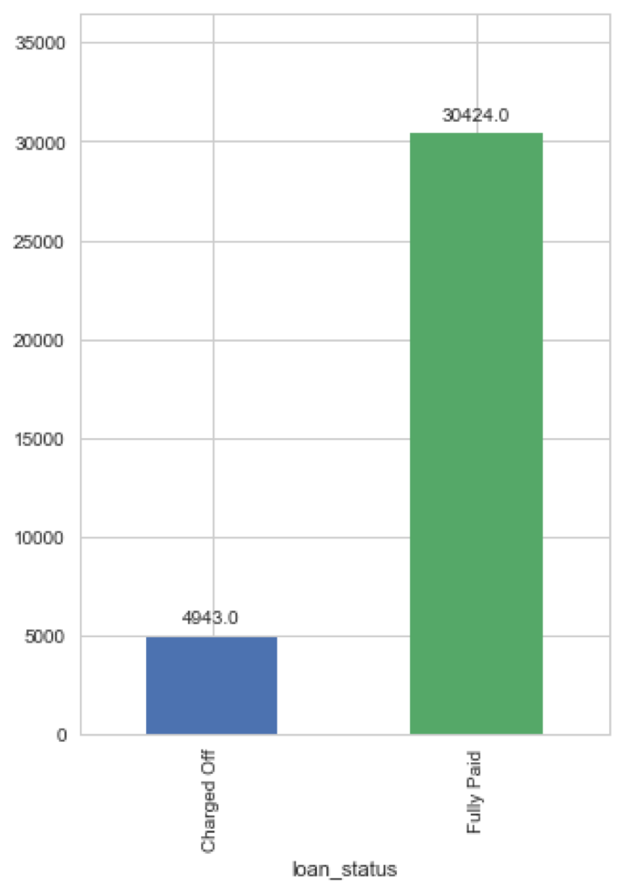
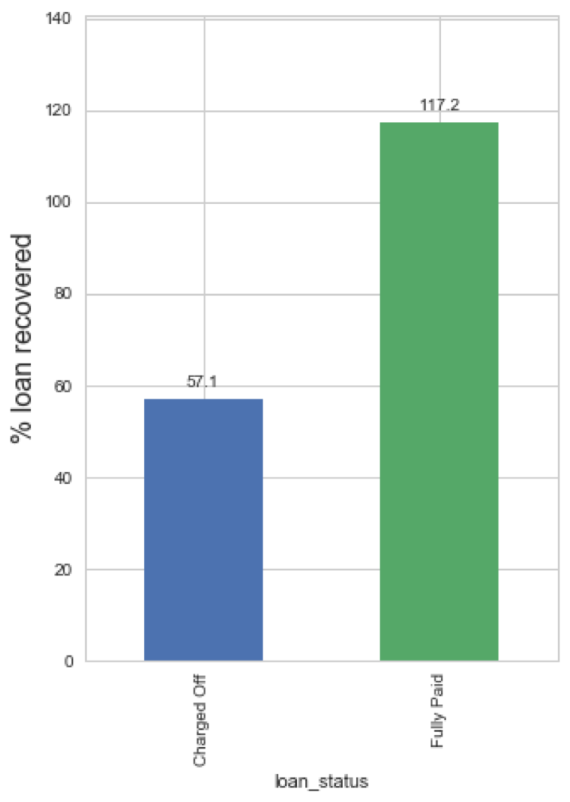
Analysis - Overall Loan Status
Total Loans
Total Money Earned
Approximately
Lending Club only
14% of loans
recovers 57% of the
are defaulted
loan amount when loans are defaulted.
Any variable that increases percentage of default to higher than 16.5% should be considered a business risk.
On fully paid up loans, the company makes 17% profit.

Slide 7
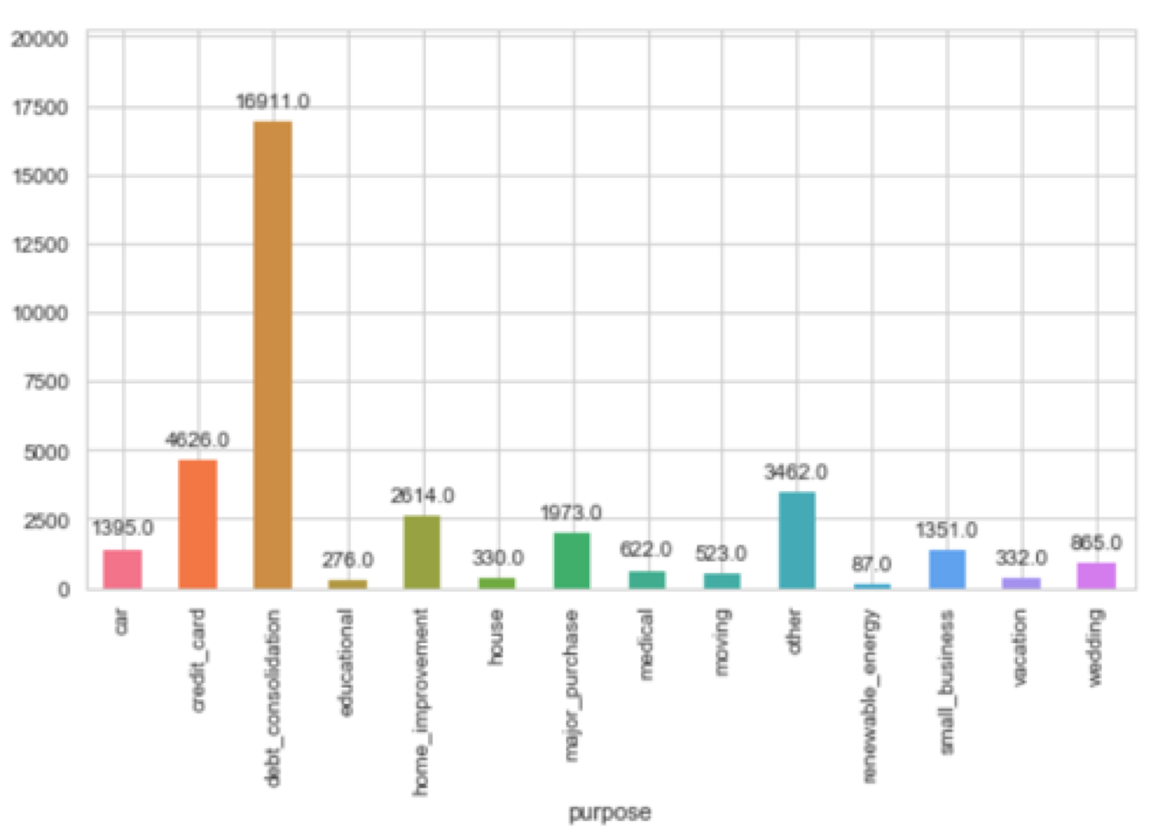
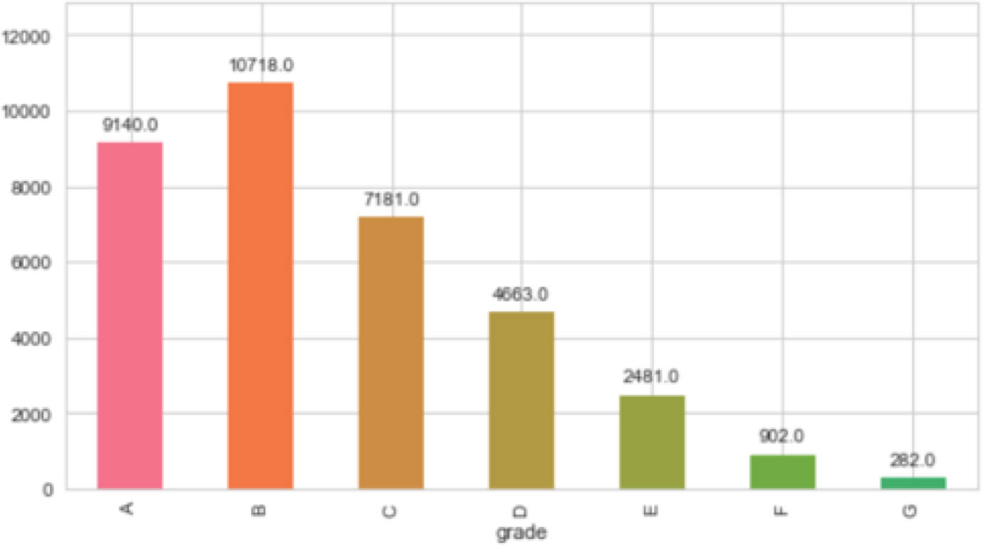
Analysis - Understanding Loans
Most loans are high quality, with a grade of A or B
Maximum number of loans are for debt consolidation, followed by credit card

Slide 8
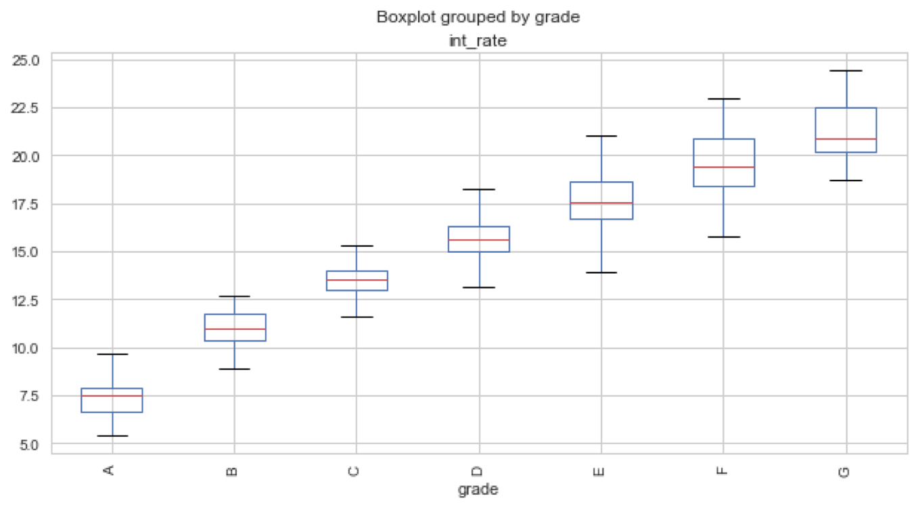
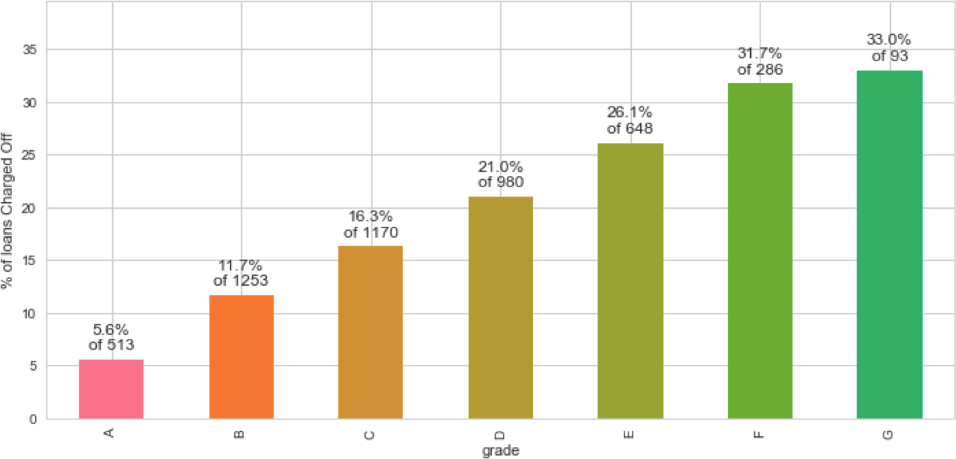
Analysis - Understanding Loans Continued
Lower grades have higher incidence of defaults on loans. The grading system is working!
Lending Club charges higher interest rates as the grade of loan becomes worse.
However, as we will see on next slide - the driving variable for defaults is the higher interest rate.

Slide 9
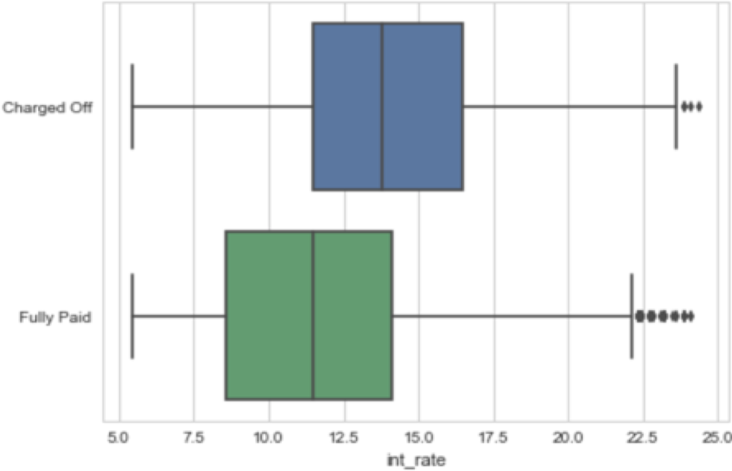
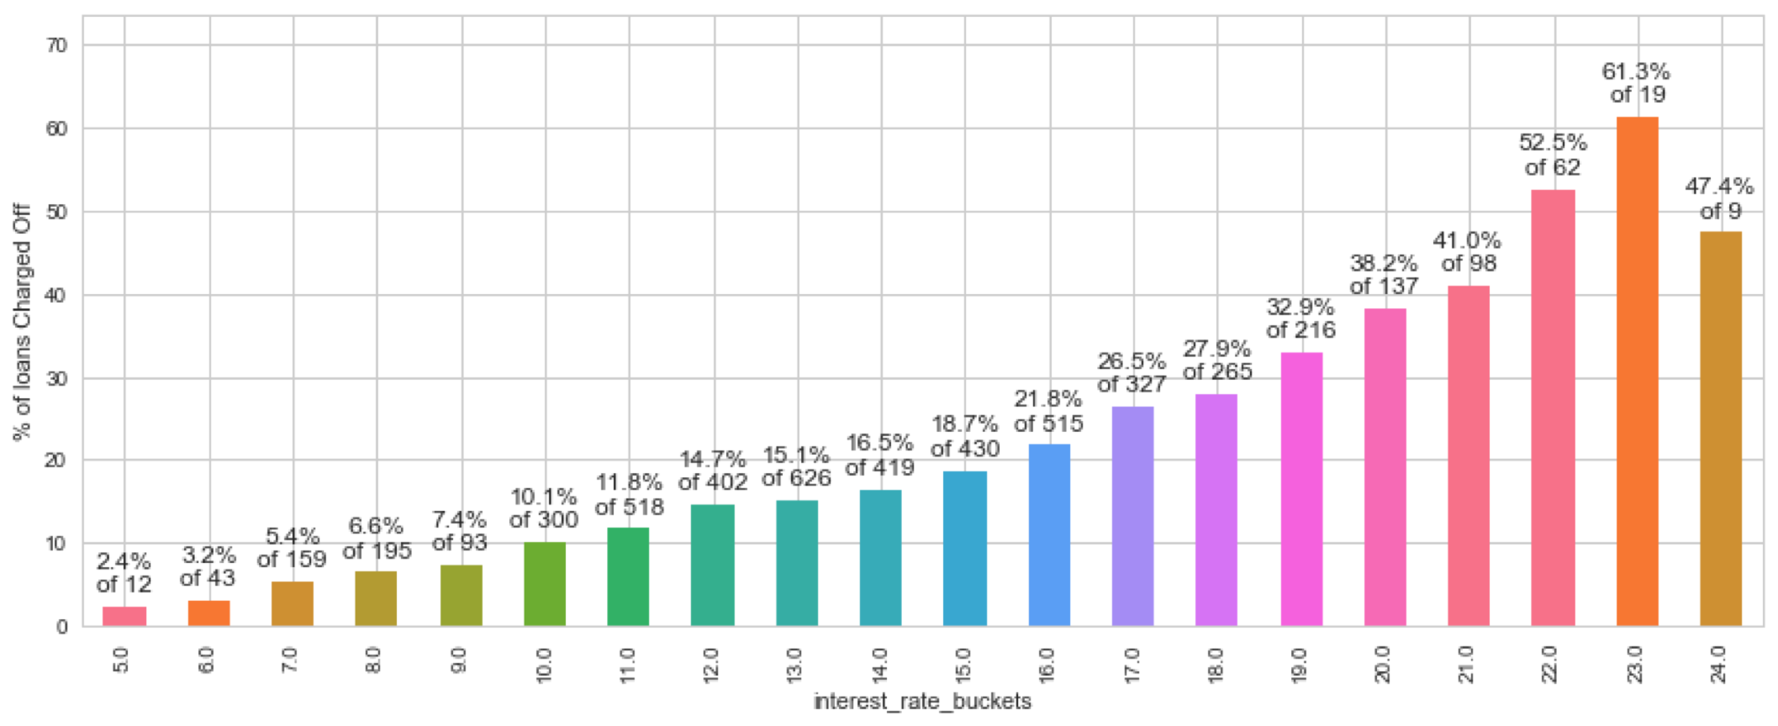
Analysis - Defaults by Interest Rate
Percentage of Defaults increases monotonically with higher interest rates. At rates of 19% and above, more than 33% of loans are Charged Off.

Slide 10
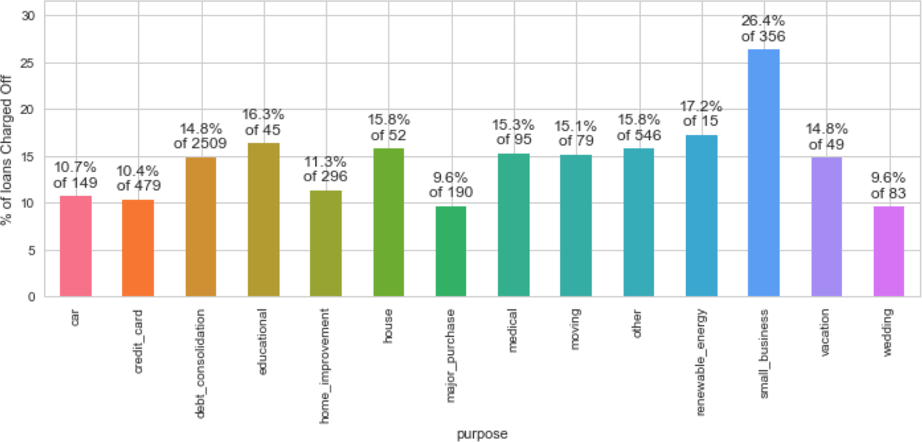
Analysis - Defaults by Loan Purpose
More than a quarter of loans taken for the purpose of running a small business see defaults.

Slide 11
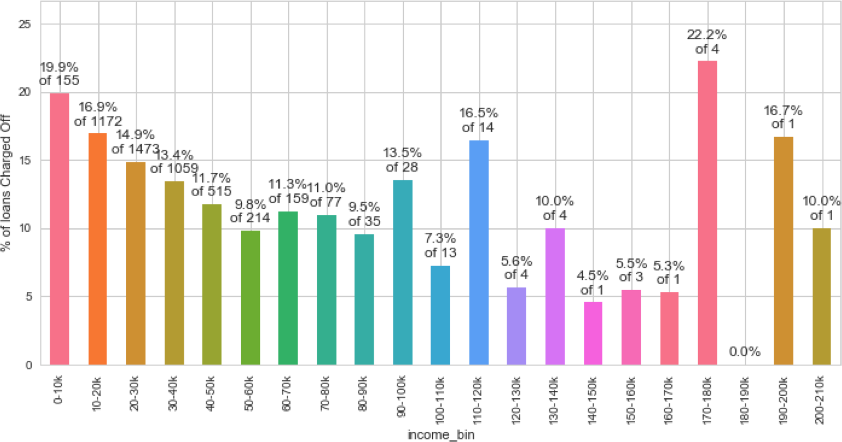
Analysis - Defaults by Borrower’s Income
Borrowers having annual income less than 20000 default on their loans at much higher rates. Loan default decreases with higher annual income.
As we will see on next slide – the ratio of amount to income is more important.

Slide 12
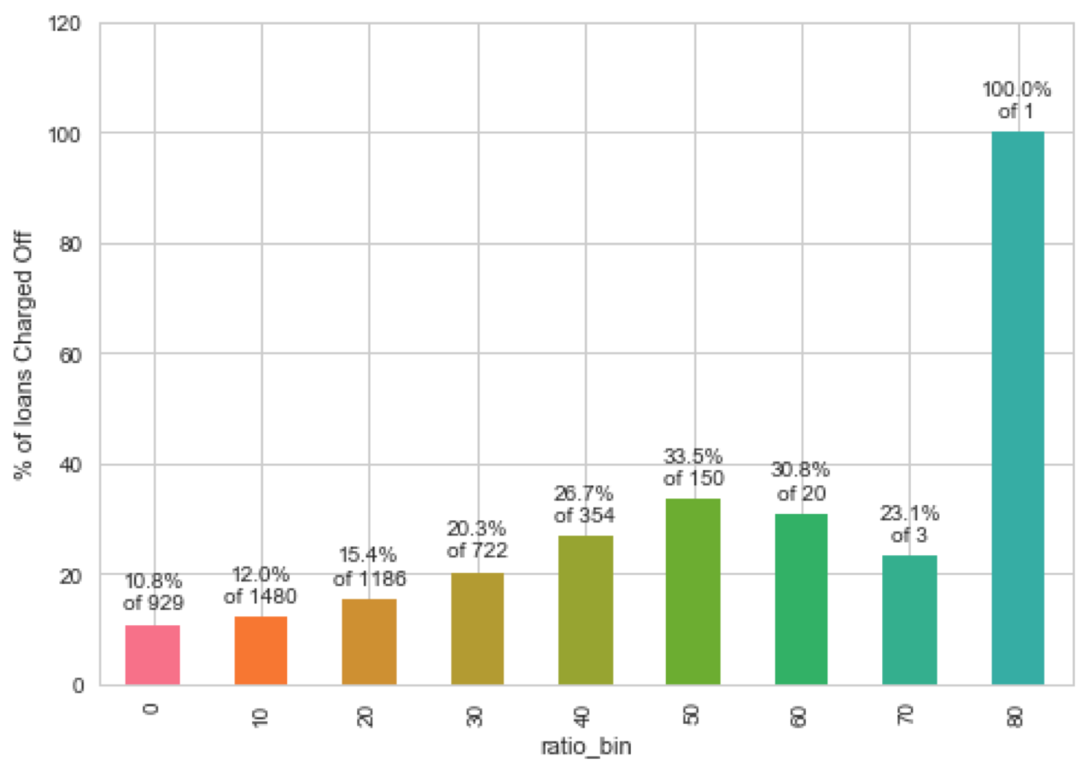
Analysis - Defaults by ratio of amount to income
As long as loan amount is less than 20% of annual income, defaults are low.
Loan amounts of 30% of annual
income or higher see a high rate of
default.
X-axis is the % of loan amount versus annual income

Slide 13
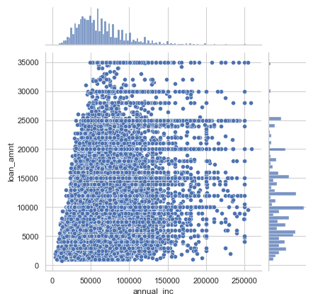
Analysis - Defaults by ratio Continued
We see here that Lending Club has extended high-value loans to people with low income.
There are many cases of people with income 50000 or less getting loans of 25000 or more.
This practice should be curtailed.

Slide 14
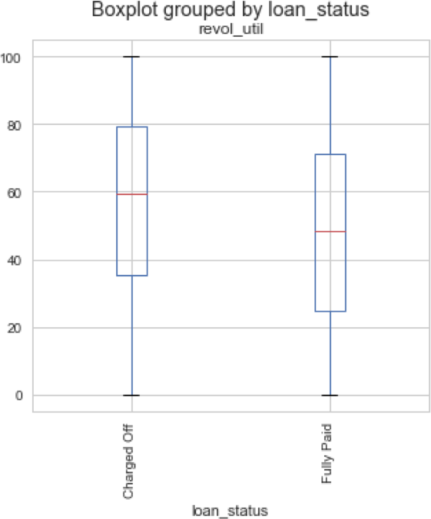
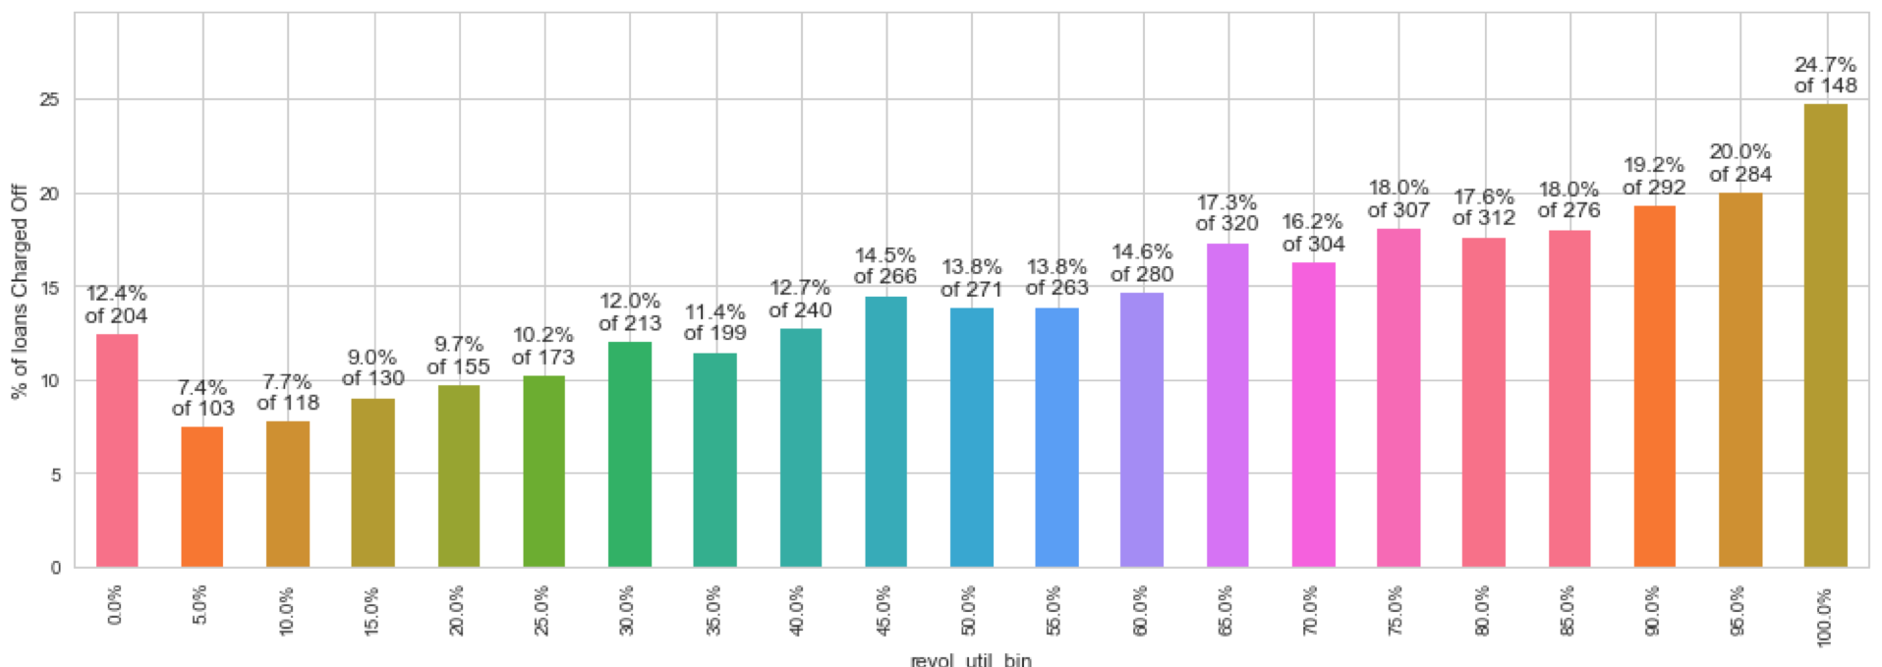
Analysis - Defaults by Revolving Line Util Rate
People with high utilization of Revolving Line of Credit at the time of taking loan default more.
Loans with utilization > 75% are risky.

Slide 15
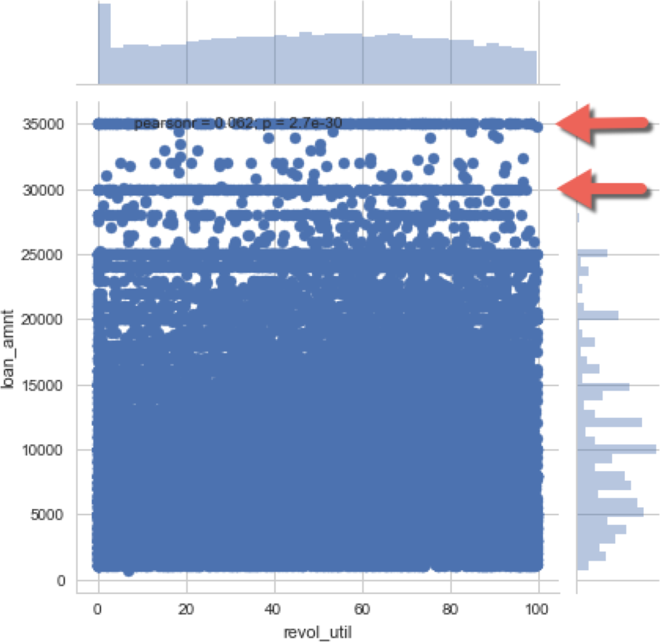
Analysis - Defaults by Rev Util Continued
There have been some high value loans extended to borrowers with revolving line utilization rate of higher than 75%.
This practice should be stopped.
Density of low value loans is also high. They should be approved less often.

Slide 16
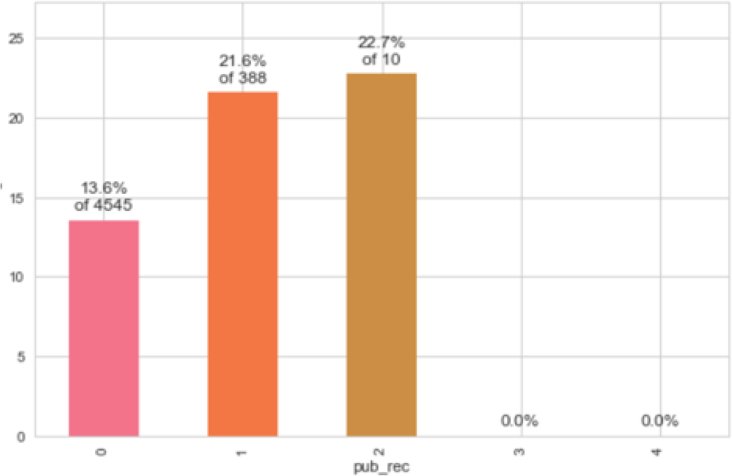
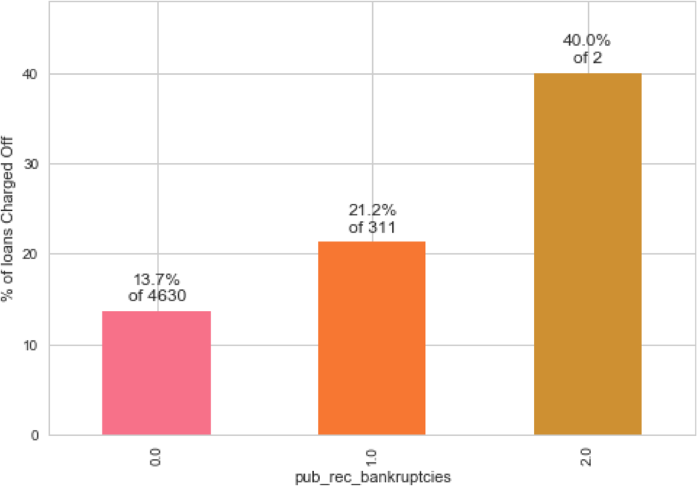
Analysis - Defaults by prior bad record
96% have no bankruptcy record.
Having even 1 bankruptcy record
increases the chances of Charge Off significantly.
Public Derogatory Record and Public Bankruptcy records have 83% correlation. We can use any one.
94% have no Public derogatory records.
Having even 1 derogatory record increases the chances of Charge Off significantly.

Slide 17
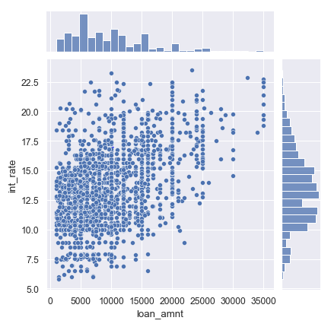
Analysis by prior bad record - Continued
High value loans, as well as low interest loans have been extended to those with prior public derogatory records.
This practice can be stopped to improve business metrics.
Data of people with >0 bad records

Slide 18
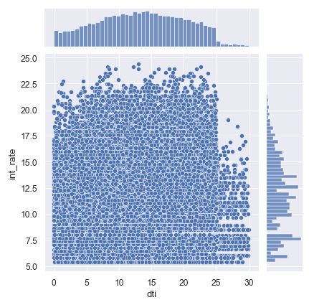
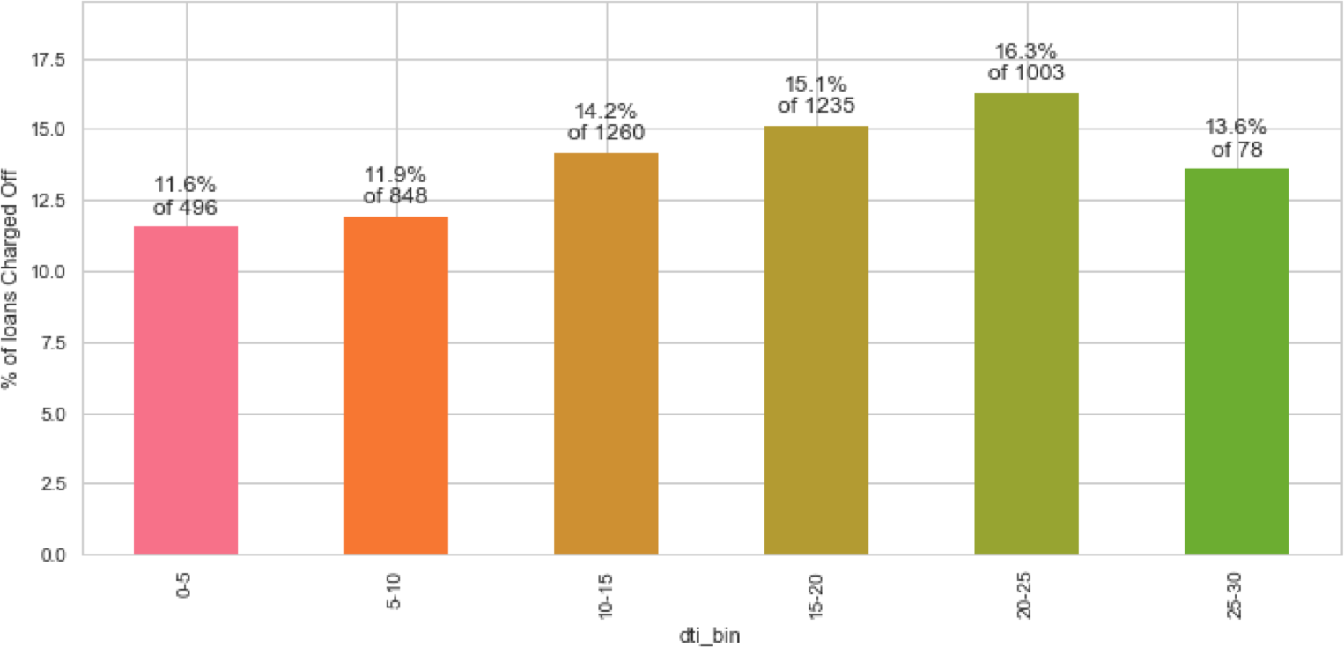
Analysis – Defaults by Debt to Income Ratio
Higher interest rates should be
Percentage of default rises with dti ratio.
charged for higher dti, but we see spread across all values
As the dti ratio rises above 20, the loans become risky.

Slide 19
Recommendations
Better Quality Borrowers
Stop – approving loans where amount/income is higher than 30%
Reduce – number of approvals where purpose is small business
Stop – approving high-value loans when revolving line utilization rate greater than 75%
Stop – approving loans to people with prior bad record. Or at least stop approving high-value loans
Start – charging higher interest rates for loans with dti greater than 20

Slide 20
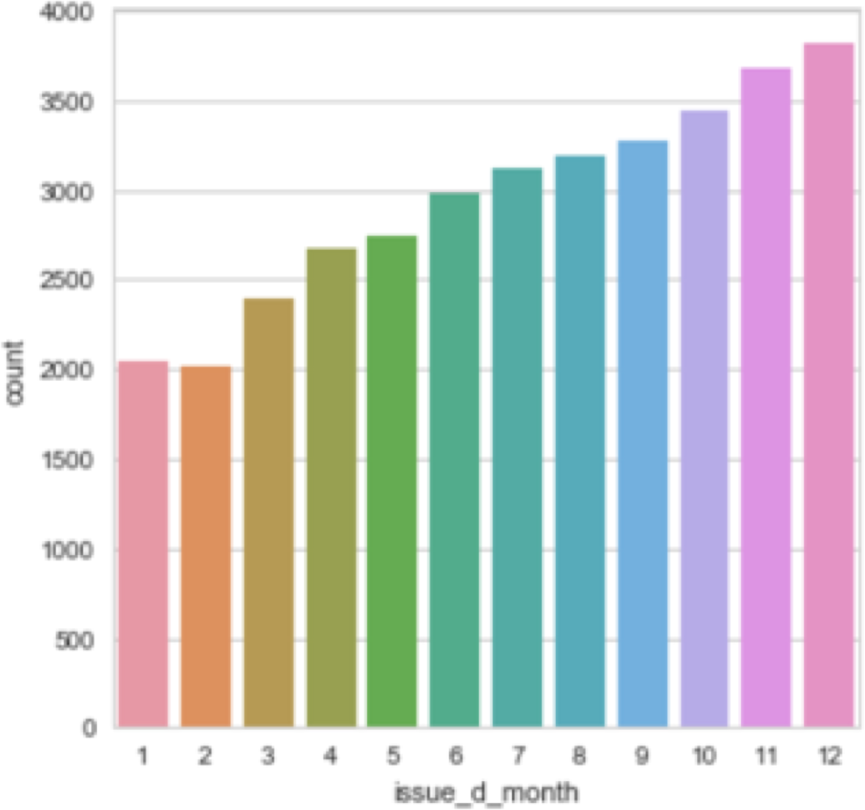
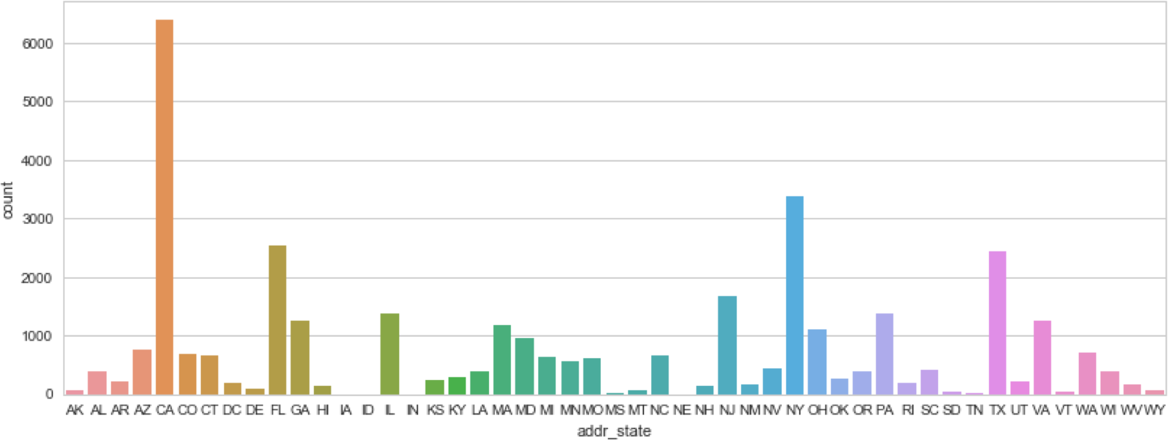
Appendix: Interesting tidbits
Loan numbers increase as months get closer to year-end. Are people trying to meet targets?
Maximum loans are in populous states, California, New York, Florida and Texas

Slide 21
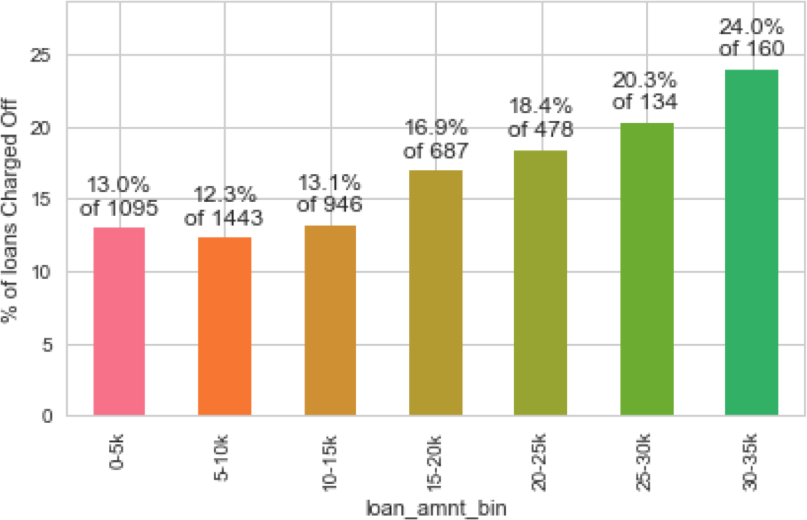
Appendix: Interesting tidbits
As the loan amount increases, the chance of default also increases.
High value loans are being extended to questionable quality borrowers?

Slide 22
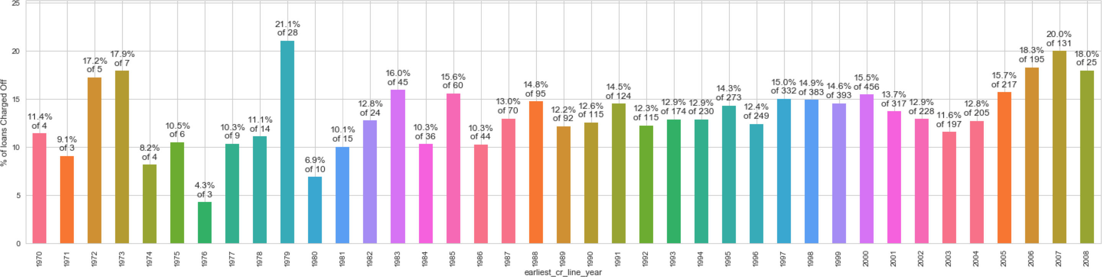
Appendix: Interesting tidbits
People who took their first loans just before an economic crisis, like the one in 1980 and the subprime crisis in 2008, have higher rates of default.
Presumably, these are young people who were affected by the economic conditions of their early career.

Slide 23
Results
Low grade loans have high tendency to default.
Grading system is working as expected.
Loans having higher interest rate have more defaulters. Check the background of applicant thoroughly if interest rate is high.
Extra scrutiny must be done for the applicants belonging to CA state, as tendency to default is high.
When the purpose is debt consolidation check applicant thoroughly as it has high tendency to default.
Conclusion

