Slide 1

Crime Analysis in Louisville, KY
VINAY KUMAR REDDY ALETI
This Photo by Unknown author is licensed under CC BY-SA.

Slide 2

Key Topics
Data Cleaning,
Data Transformation,
Data Modelling,
Data Integration
EDA
Random Forest Regression
Time Series Analysis

Slide 3
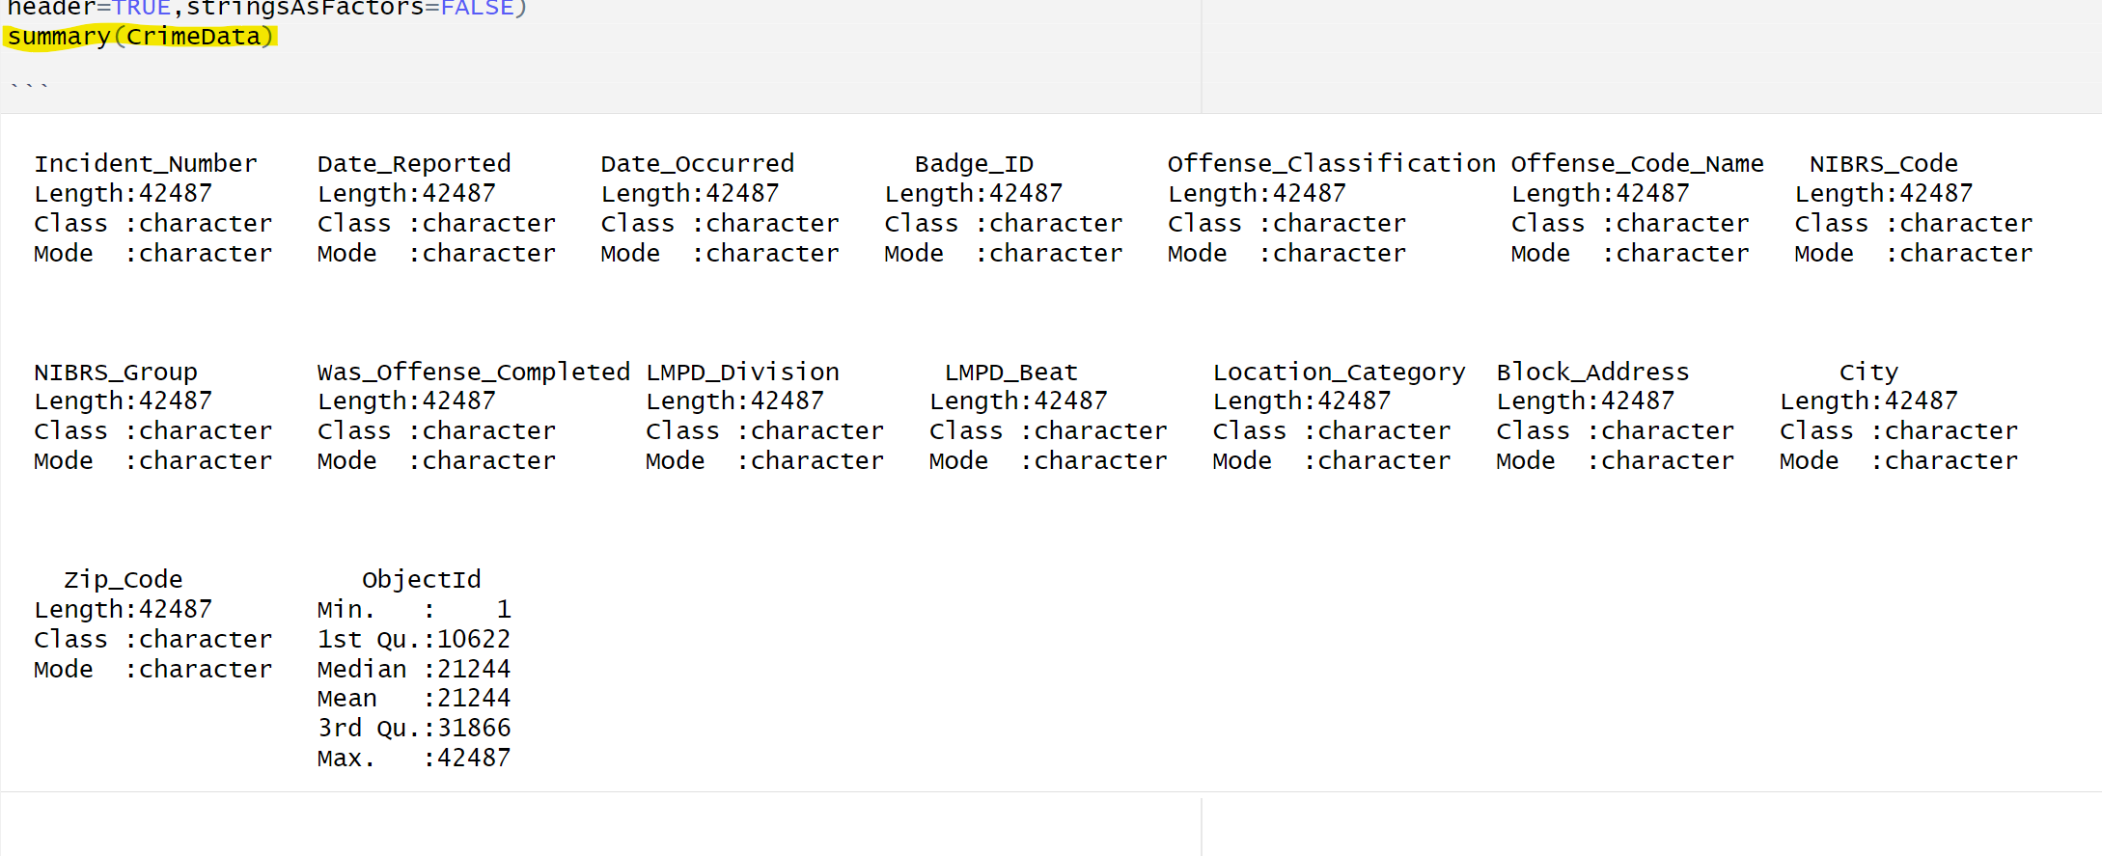
Data Exploration
Variables in Crime Dataset

Slide 4
Data Cleaning
Eliminated null values for data completeness.
Separated offense classifications and occurrence dates for better analysis.
Focused on crimes in Louisville for targeted insights.
Cleaned ZIP codes for data consistency.
Explored unique NIBRS codes for Crime Classification.

Slide 5

Understanding Crime Types
Explanation of Serious Crimes and Violent Crimes
Classification and identification of crime types
Examples of Serious and Violent Crimes

Slide 6
Violent Crime
Offense Category | Offense Code | Crime Against
Violent Crimes
Homicide Offenses |  | Person (Violent Crime)
- Murder & Nonnegligent Manslaughter | 09A | Person (Violent Crime)
- Negligent Manslaughter | 09B | Person (Violent Crime)
- Justifiable Homicide | 09C | Person (Violent Crime)
Kidnapping/Abduction (Person) | 100 | Person (Violent Crime)
Robbery (Property) | 120 | Property
Simple Assault (Person) | 13B,13A | Person (Violent Crime)
Intimidation (Person) | 13C | Person (Violent Crime)
Sex Offenses, Forcible |  | Person (Violent Crime)
- Forcible Rape | 11A | Person (Violent Crime)
- Forcible Sodomy | 11B | Person (Violent Crime)
- Sexual Assault With An Object | 11C | Person (Violent Crime)
- Forcible Fondling | 11D | Person (Violent Crime)
Sex Offenses, Nonforcible |  | Person
- Incest | 36A | Person
- Statutory Rape | 36B | Person
Stolen Property Offenses (Property) | 280 | Property
Weapon Law Violations (Society) | 520 | Society
Violent Crime: Violent crimes are a subset of serious crimes that specifically involve the use of force or the threat of force against another person, resulting in physical harm or the fear of harm. Examples of violent crimes include assault, battery, homicide, domestic violence, and sexual assault.

Slide 7
Serious Crime
Offense Category | Offense Code | Crime Against
Serious Crimes
Counterfeiting/Forgery (Property) | 250 | Property
Destruction/Damage/Vandalism... | 290 | Property
Drug/Narcotic Violations (Society) | 35A | Society
Drug Equipment Violations (Society) | 35B | Society
Embezzlement (Property) | 270 | Property
Extortion/Blackmail (Property) | 210 | Property
Fraud Offenses |  | Property
- False Pretenses/Swindle... | 26A | Property
- Credit Card/Automated... | 26B | Property
- Impersonation | 26C | Property
- Welfare Fraud | 26D | Property
- Wire Fraud | 26E | Property
Gambling Offenses (Society) | 39A, 39B, 39C, 39D | Society
Larceny/Theft Offenses |  | Property
- Pocket-picking | 23A | Property
- Purse-snatching | 23B | Property
- Shoplifting | 23C | Property
- Theft From Building | 23D | Property
- Theft From Coin-Operated... | 23E | Property
- Theft From Motor Vehicle | 23F | Property
- Theft of Motor Vehicle Parts... | 23G | Property
- All Other Larceny | 23H | Property
Motor Vehicle Theft (Property) | 240 | Property
Pornography/Obscene Material (Society) | 370 | Society
Prostitution Offenses (Society) | 40A, 40B | Society
Robbery (Property) | 120 | Property
Serious Crime: Serious crimes typically refer to offenses that are considered more severe or significant in terms of their potential impact on individuals and society. They often result in more severe legal consequences. Serious crimes can include both violent and non-violent offenses, such as murder, robbery, sexual assault, burglary, arson, kidnapping, and terrorism.

Slide 8
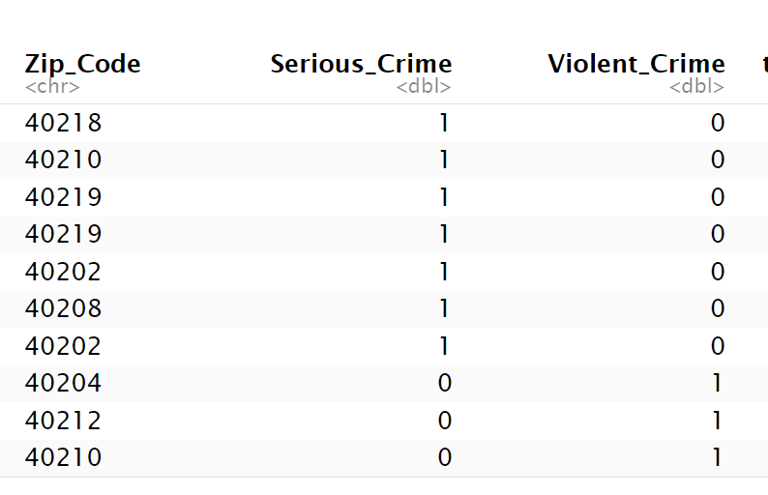
Modeling Crime
Modeling serious Crime and violent crime based on the offense classification

Slide 9
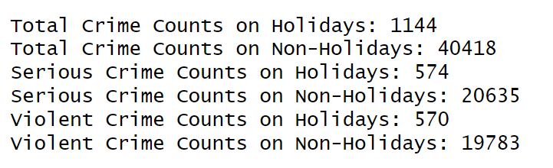
Incorporating Holidays Feature

Slide 10
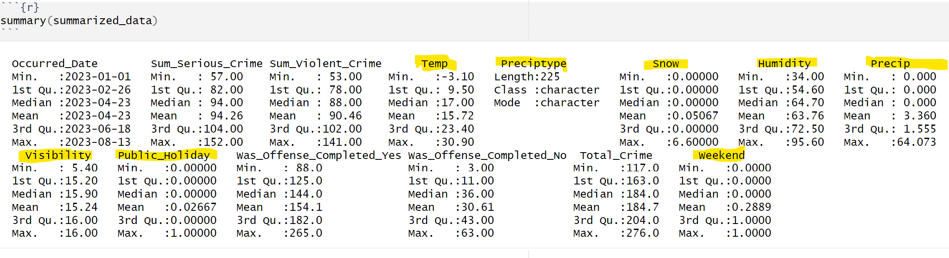
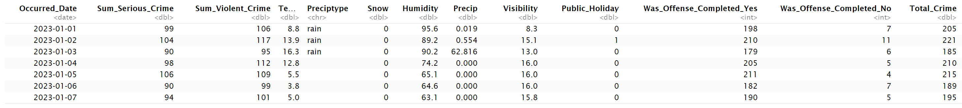
Data Integration

Slide 11
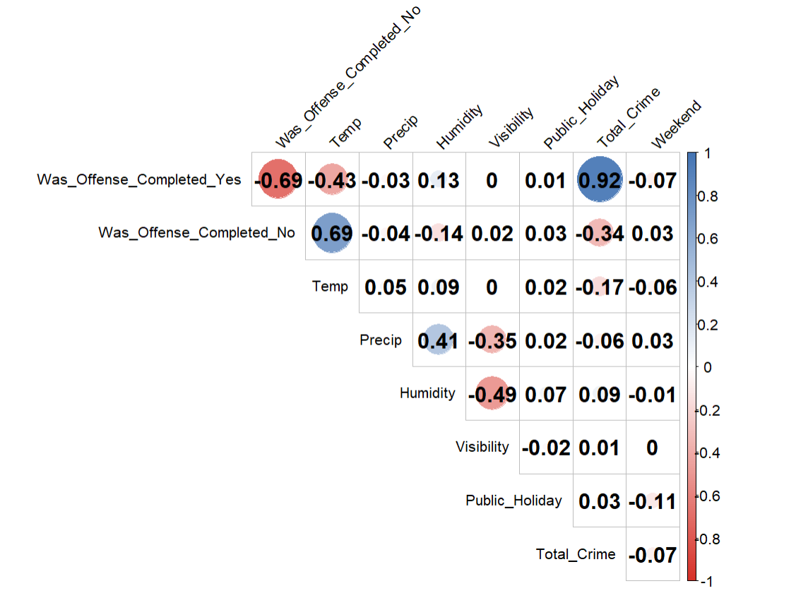
Correlation matrix

Slide 12
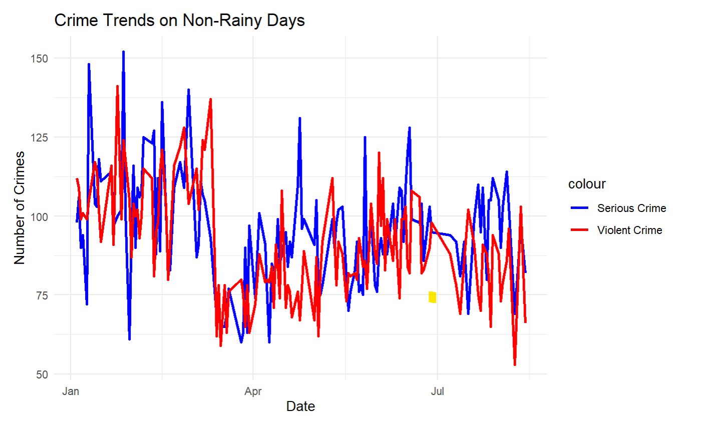
EDA (Exploratory Data Analysis)

Slide 13
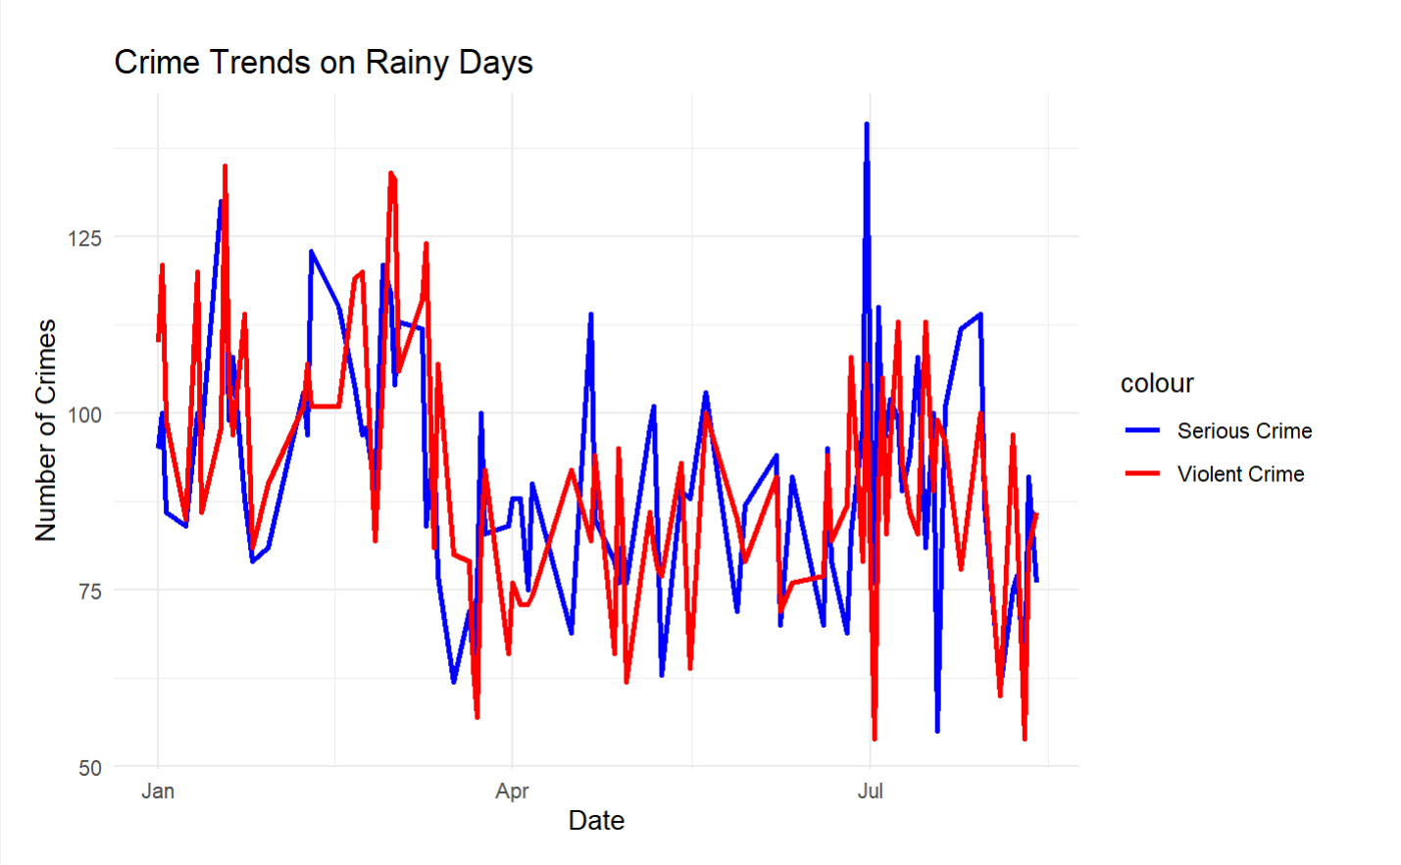
EDA (Exploratory Data Analysis)​

Slide 14
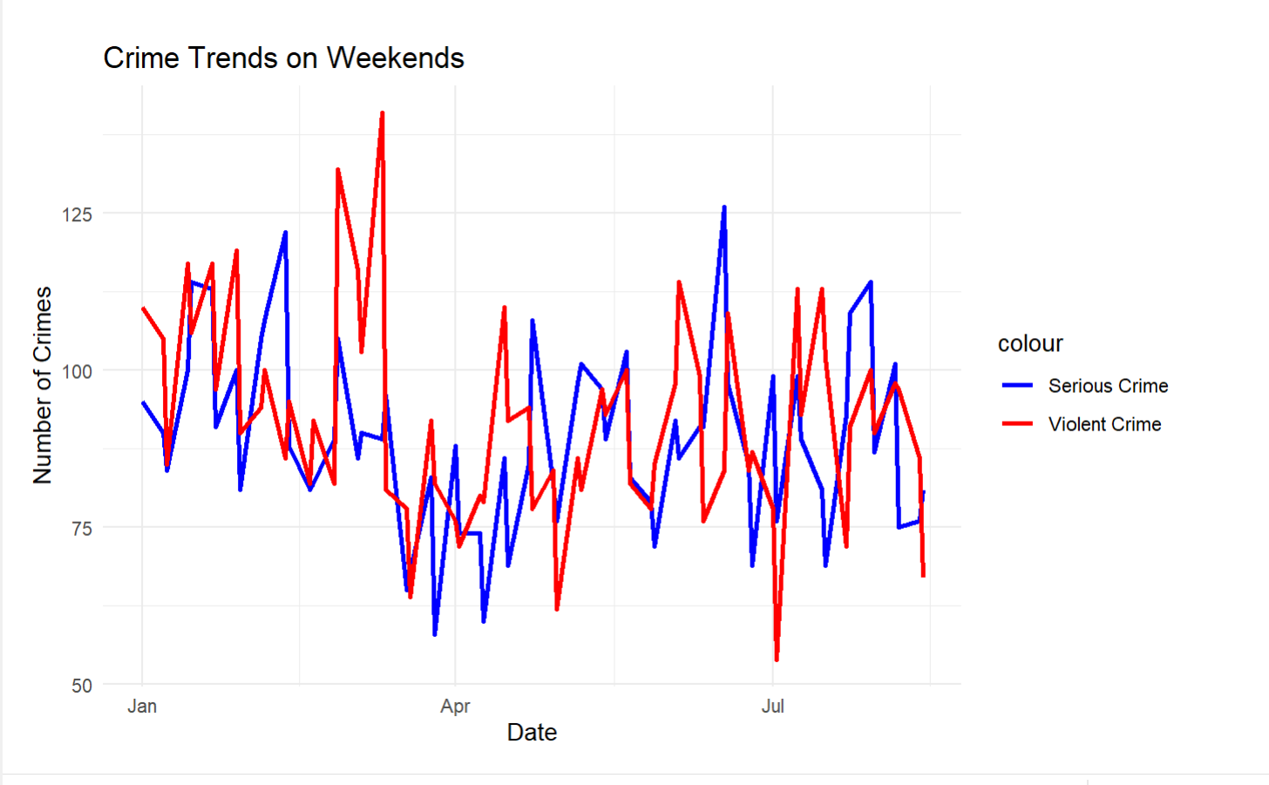
EDA (Exploratory Data Analysis)​

Slide 15
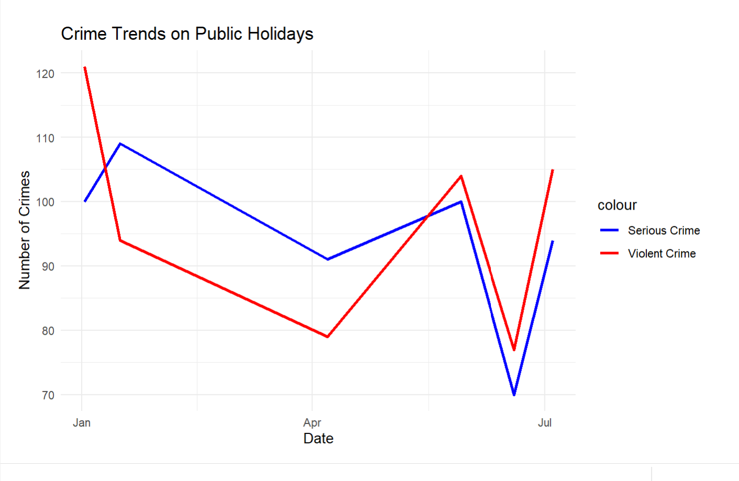
EDA (Exploratory Data Analysis)​

Slide 16
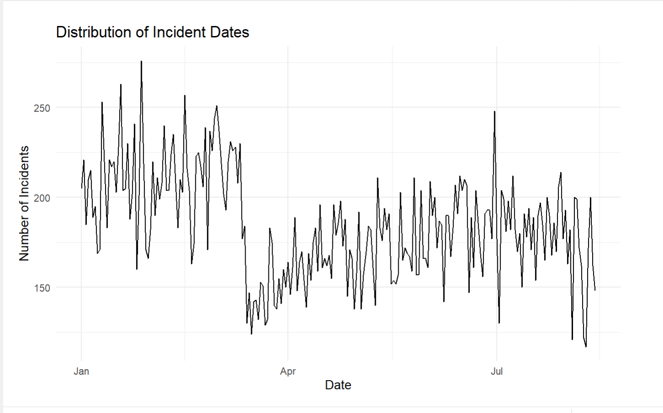
EDA (Exploratory Data Analysis)​

Slide 17
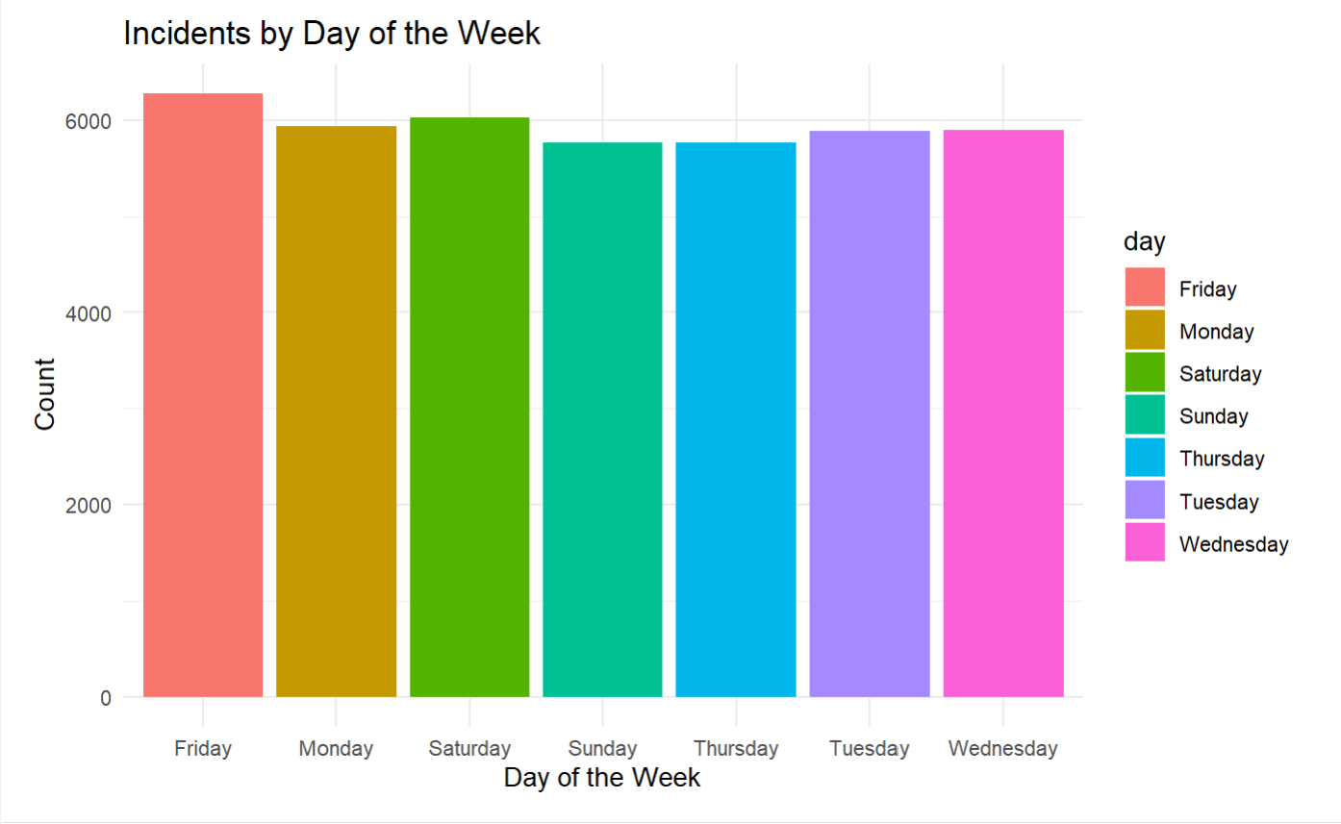
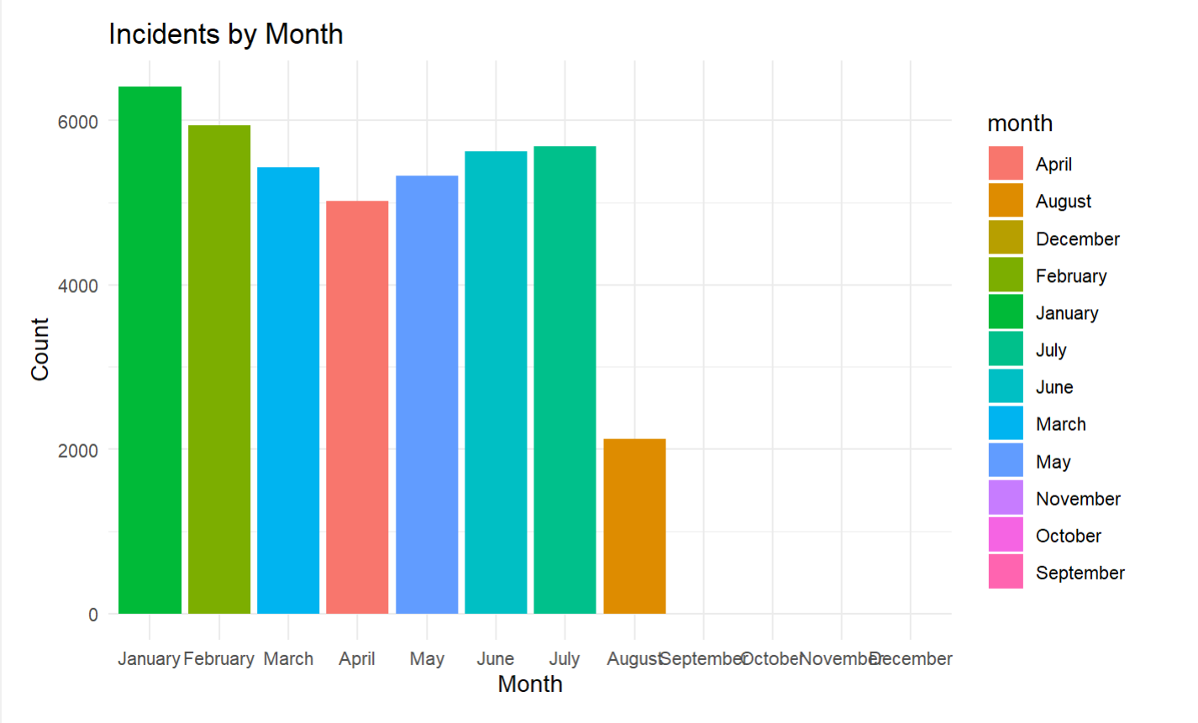
EDA (Exploratory Data Analysis)​

Slide 18
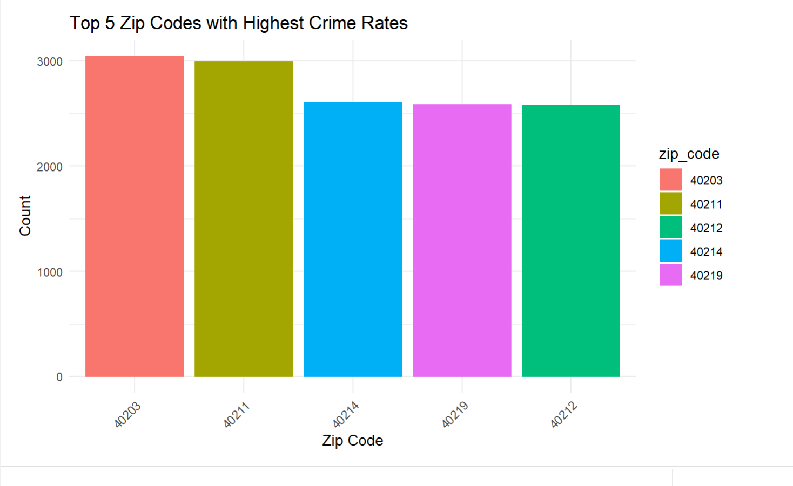
EDA (Exploratory Data Analysis)​

Slide 19
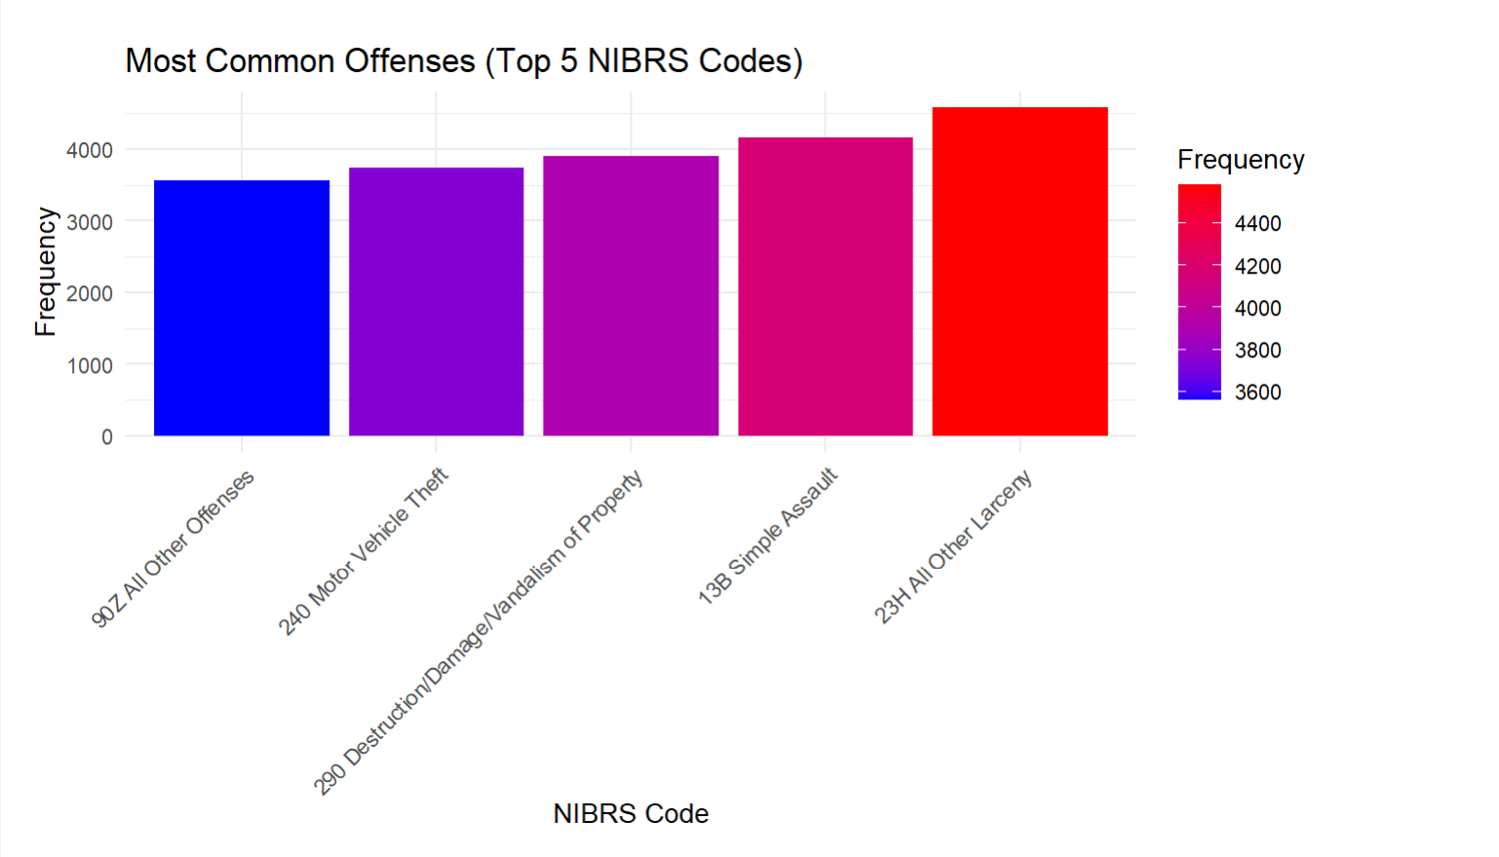
EDA (Exploratory Data Analysis)​

Slide 20
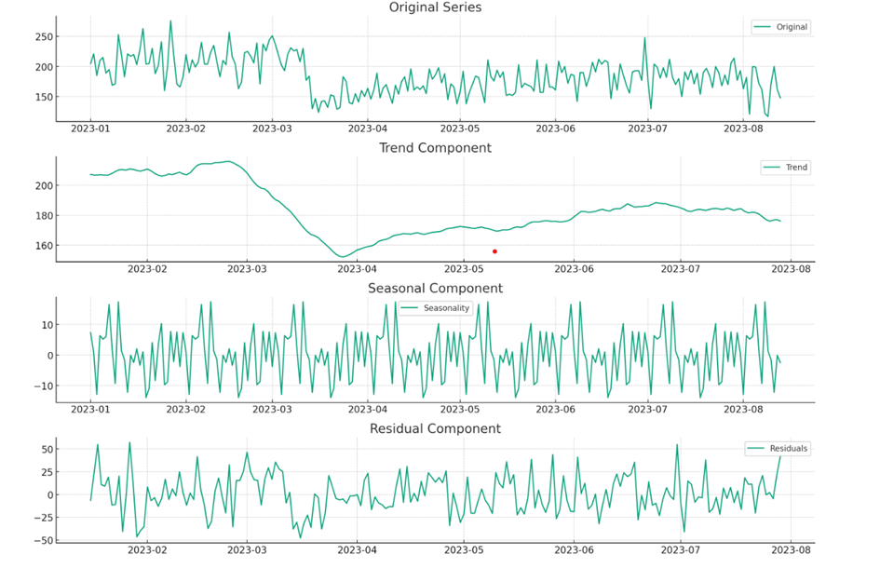
Time Series Analysis

Slide 21
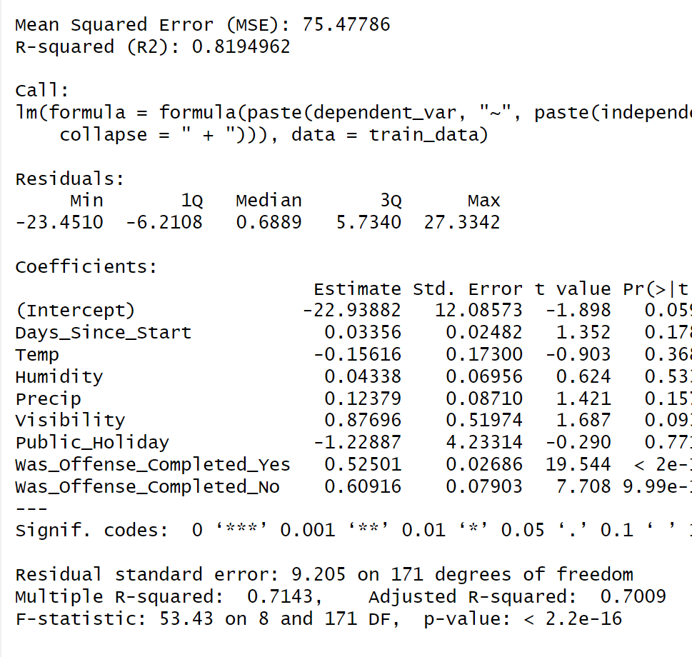
Serious crime model
'Days_Since_Start'
'Temp' (Temperature)
'Humidity'
'Precip' (Precipitation)
'Visibility'
'Public_Holiday'
'Was_Offense_Completed_Yes'
'Was_Offense_Completed_No'

Slide 22
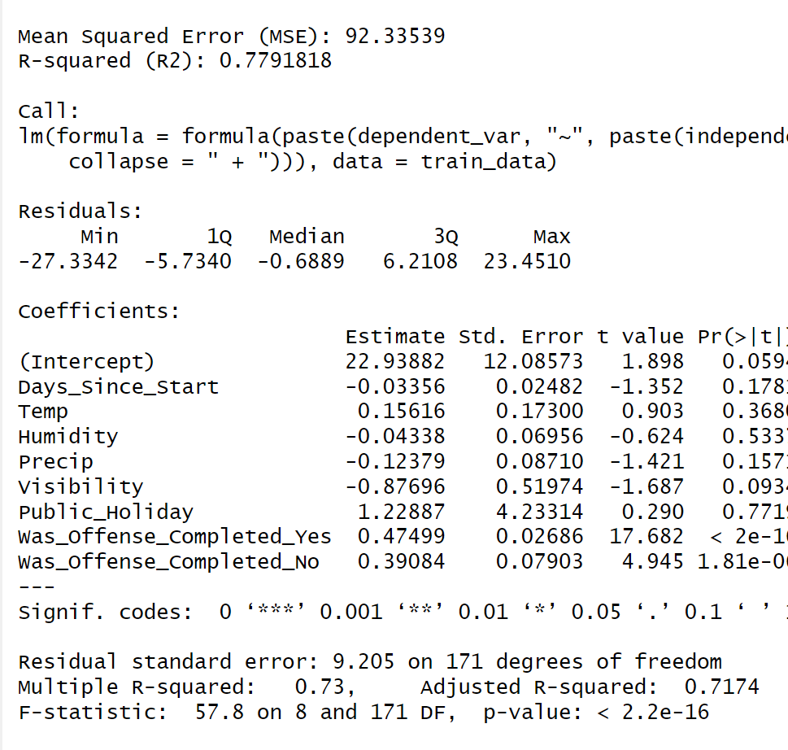
Violent crime model
'Days_Since_Start'
'Temp' (Temperature)
'Humidity'
'Precip' (Precipitation)
'Visibility'
'Public_Holiday'
'Was_Offense_Completed_Yes'
'Was_Offense_Completed_No'

Slide 23
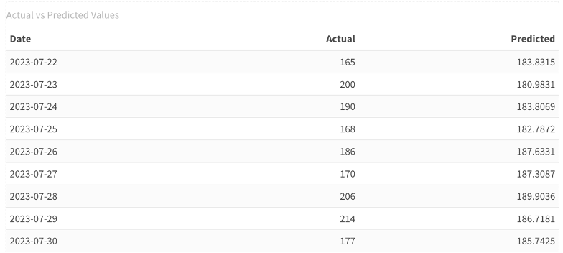
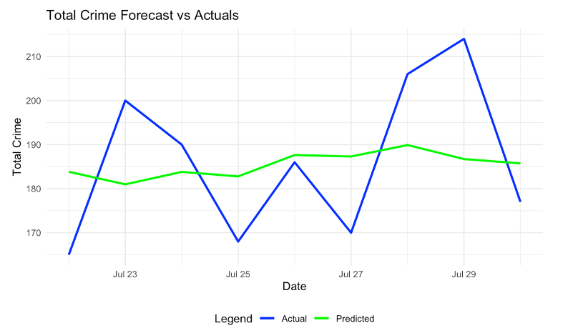
Arima Time Forecast (July 22,2023 – July 30,2023)
Louisville
order=c(1, 1, 2)

Slide 24
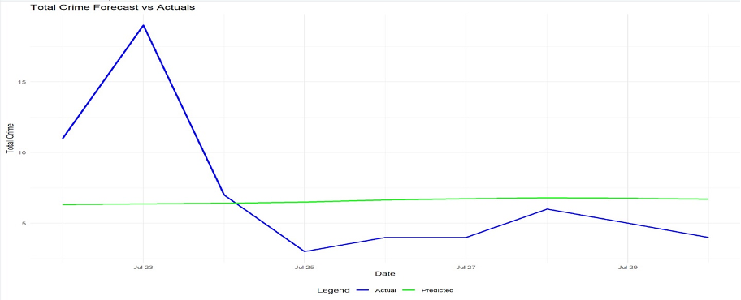
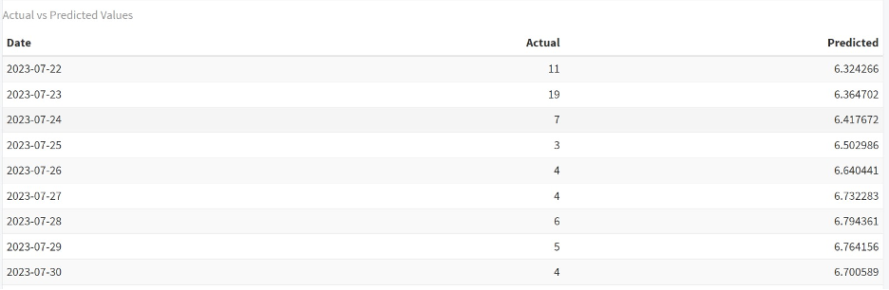
Arima Time Forecast (July 22,2023 – July 30,2023)
Louisville, Division-4, Beat 1

Slide 25
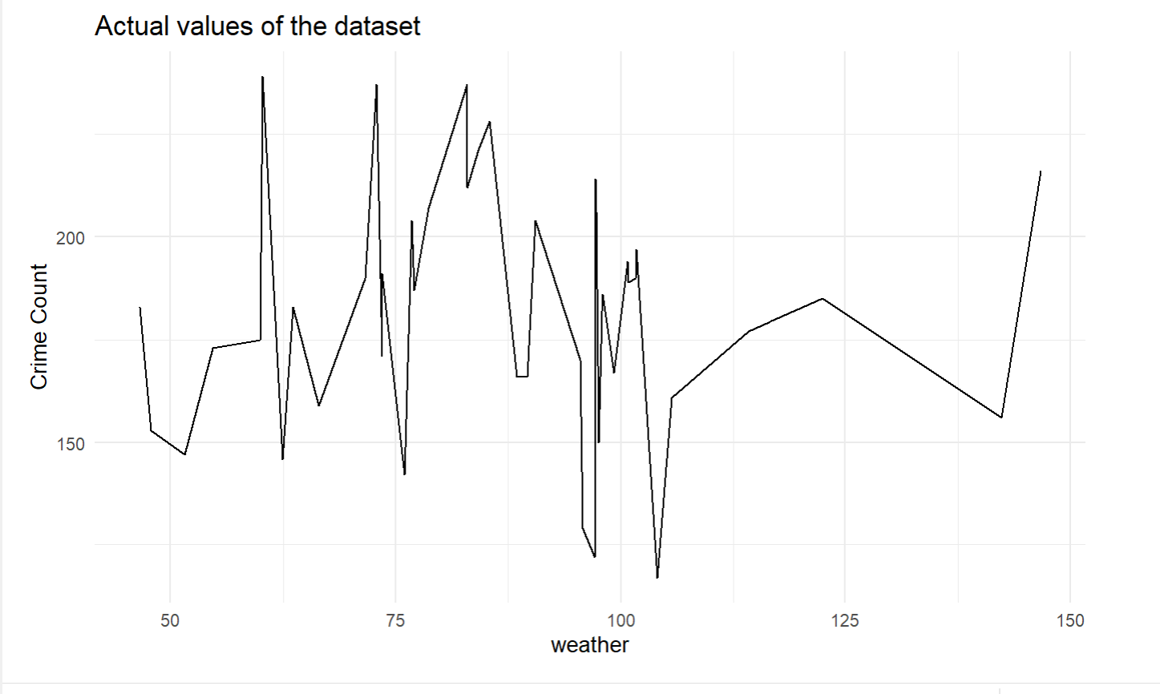
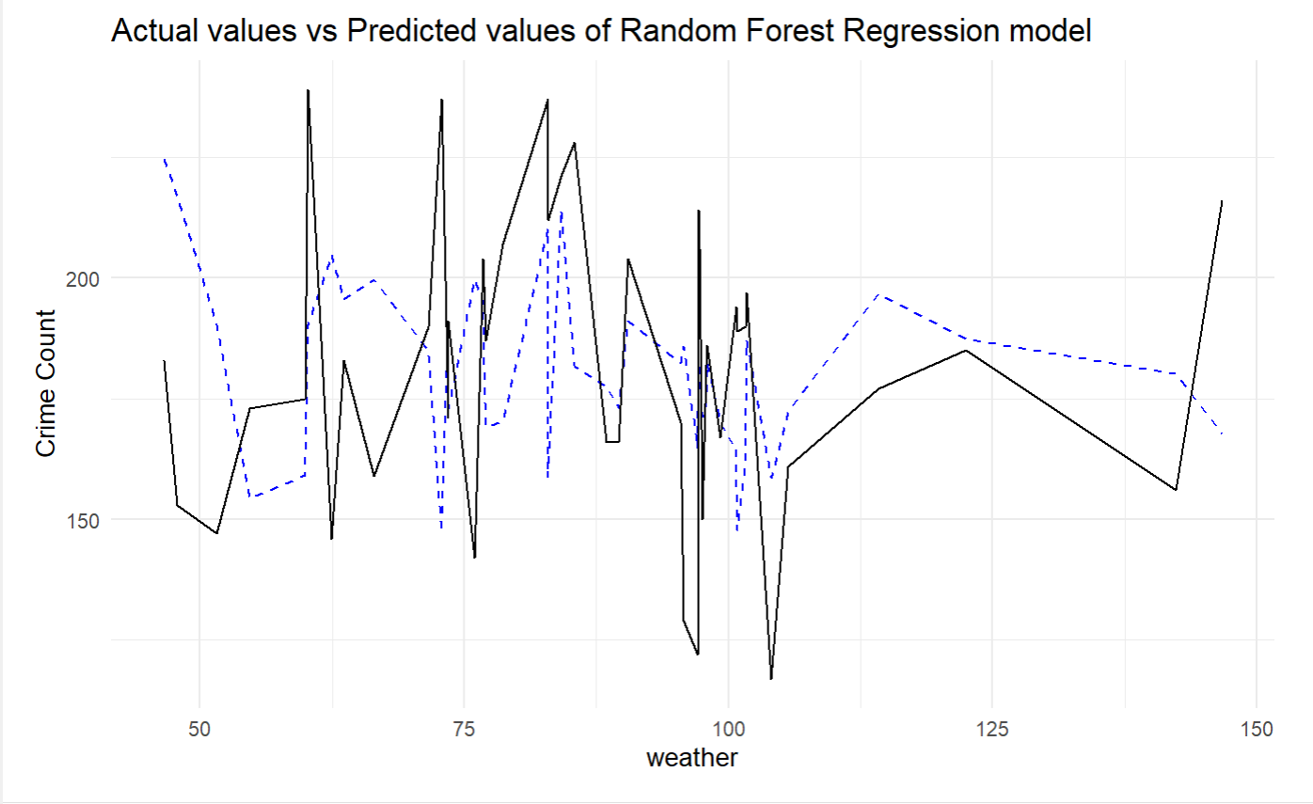
Random Forest Regression

Slide 26
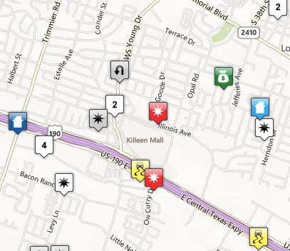
Advantages and Conclusion of Crime Data Analysis
Advantages of Crime Data Analysis:
Informed Decision-Making: Empowers law enforcement with data-driven insights.
Resource Allocation: Efficiently allocates resources to high-crime areas.
Predictive Policing: Anticipates and prevents criminal activities.
Community Engagement: Improves relations through transparency.
Conclusion:
Enhanced Public Safety: Identifies and addresses crime hotspots for community safety.
Optimized Policing Strategies: Fine-tunes tactics based on evolving crime patterns.
Continuous Improvement: Adapts strategies for ongoing effectiveness.
Collaboration and Information Sharing: Encourages unity among agencies for a stronger fight against crime.

Slide 27

This Photo by Unknown author is licensed under CC BY-SA.

