Slide 1
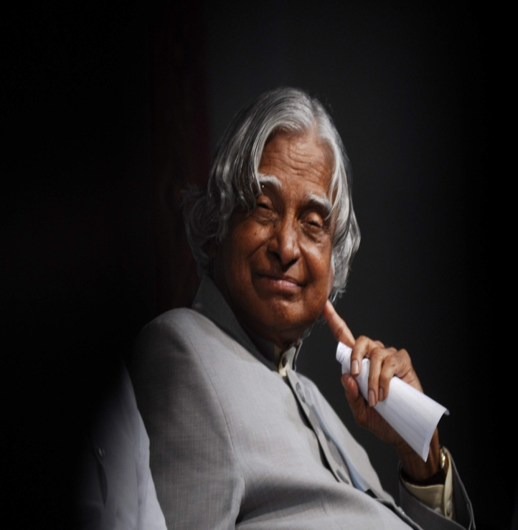
A. P. J. Abdul Kalam

Slide 2
Avul Pakir Jainulabdeen Abdul Kalam
Abdul Kalam was born October 15, 1931, into a poor family and raised in Rameswaram in the state of Tamil Nadu. In india
His father had only one boat to support his family.
Kalam was a hardworking boy right from the beginning. At the tender age of five,

Slide 3
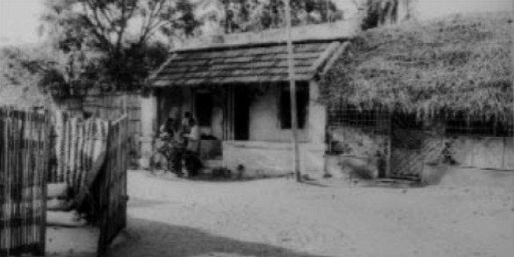
He’s started selling newspapers to help his father support the family. He did this job in the evenings after school. He also spent a great deal of time on his studies.

Slide 4
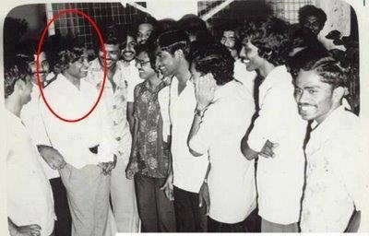
Kalam was fascinated by physics and mathematics. Kalam completed his graduation from Saint Joseph’s College, Trichurapally in 1954. In 1955, he enrolled at the Madras Institute of Technology.

Slide 5
Kalam missed an opportunity to become a fighter pilot for the Indian Air force.
He Was On The Ninth Spot On The List, And There Were Only Eight Openings
The First Eight Shortlisted Candidates Were Recruited.
In 1960, Kalam Became Involved With (DRDO)’s Aeronautical Development Establishment.

Slide 6
Kalam was known as the ‘Missile Man’ of India due to his continued, successful work with ballistic missiles and launch vehicle technology.
In 1969, Kalam Was Made The Project Director For Satellite Launch Vehicles And Was Shifted To ISRO
(“Indian Space Research Organization”)

Slide 7
Kalam was honored with many awards, including the highest civilian award in the country, the Bharat Ratna (1997). His other awards include Padma Bhushan (1981) and Padma Vibhushan (1990) Kalam became the President of the largest democracy of the world –India – on July 25, From (2002 to 2007)

Slide 8
A fun fact about APJ Abdul Kalam is that although he was a Muslim, he was also a strict vegetarian.
Kalam is the first unmarried president and scientist in India.

Slide 9
Dr APJ Abdul Kalam Has Passed Away on 27 July 2015 “ But His Inspiring Words Will Live On Forever ”

Slide 10


