Slide 1
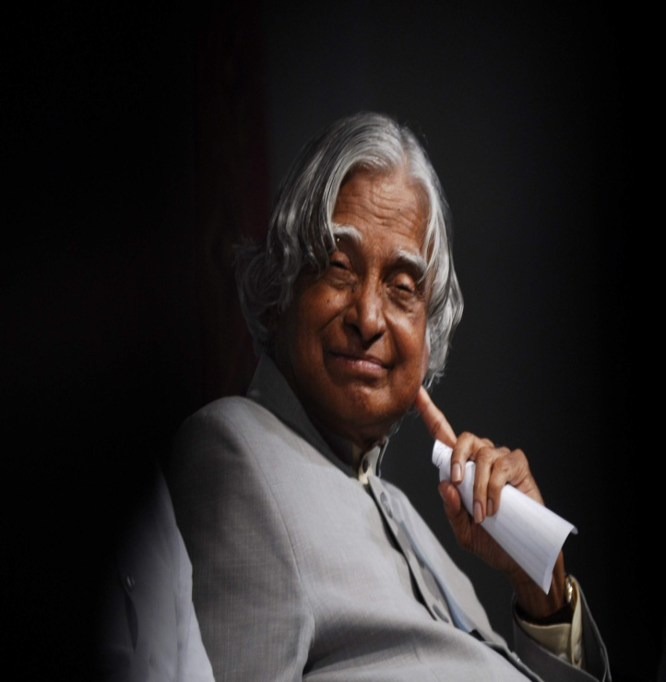
A. P. J. Abdul Kalam

Slide 2
Avul Pakir Jainulabdeen Abdul Kalam
Abdul Kalam was born October 15, 1931, into a poor family and raised in Rameswaram in the state of Tamil Nadu. In india
His father had only one boat to support his family.
Kalam was a hardworking boy right from the beginning. At the tender age of five,

Slide 3
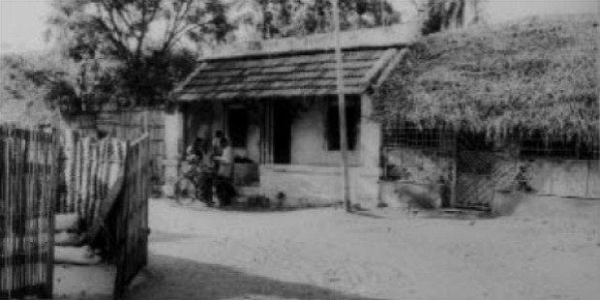
He’s started selling newspapers to help his father support the family. He did this job in the evenings after school. He also spent a great deal of time on his studies.

Slide 4
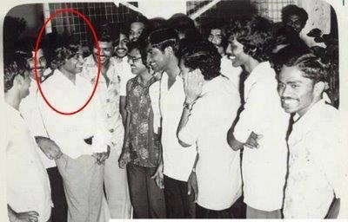
Kalam was fascinated by physics and mathematics. Kalam completed his graduation from Saint Joseph’s College, Trichurapally in 1954. In 1955, he enrolled at the Madras Institute of Technology.

Slide 5
Kalam missed an opportunity to become a fighter pilot for the Indian Air force.
He was on the ninth spot on the list,

Slide 6
Add a Slide Title - 1

Slide 7
Add a Slide Title - 2

Slide 8
Add a Slide Title - 3

Slide 9
Add a Slide Title - 4

Slide 10
Add a Slide Title - 5

