Slide 1
TECHTROOPS DAY2
TABLES AND UPDATED SETS

Slide 2
Tables & Update sets:
Create table with all field types and observe the functionality of all fields
Create table by Replicating Incident table
Create 2 custom tables to extend the other table
Observe the schema map of different tables.
Create 2 choice fields: country,state add the choices and check the dependency.
Check the dot walking for the caller and assigned to fields in the incident table
Create a filter of software category records to visible software groups.
Create a filter 'active true,category network,state new. and make it visible to everyone.
create a dot walking in the incident for caller, Assignment group,Configuration item.
caller - mail, Mobile phone,Manager
Assignment group - Description, manager
configuration item - Location, Assigned to,Model ID.
Create a filter without the network category, and the state is new or in progress and make it visible to the hardware group .
Observe the Schema map.
Observe the dictionary override functionality.
Create a filter with a state new and Category network this filter should be visible only to the users Part of the network group.
1. Create 2 tables named as copy of incident, copy of user same like OOB user and incident form.
2. Create a table by unchecking the create module checkbox and observe the functionality
3. Create a table by adding to the existing incident application.
4. Create fields by using form layout, form design and form builder
5. check the functionality of these field types Field types:
String,reference,choice,list,image,url,wiki,date,date/time,true/false,currency create fields in 3 ways
Create a dependency On the table create two choice fields Operating system and Os Versions
Operating system - Windows,Ubuntu,Linux,Mac OS .
OS Versions : 2007,windows10,windows11,Ubuntu 21.10,Ubuntu 20.04.3 LTS,Gentoo,Debian,Big Sur,Monterey
for selection of
⇒ Windows -2007,windows10,windows11
⇒ Ubuntu - Ubuntu 21.10,Ubuntu 20.04.3 LTS,
⇒ Linux - Gentoo,Debian,
=>Mac OS - Big Sur,Monterey
create a dot walking in the incident for caller, Assignment group,Configuration item.
caller - mail, Mobile phone,Manager
Assignment group - Description, manager
configuration item - Location, Assigned to,Model ID.
Create a filter without the network category, and the state is new or in progress and make it visible to the hardware group .
Create one table named as Brillio Parent with (name(string-display-true),Phone(string-readonly),Manager(reference-user-mandatory),Email
create 2 child tables Brillio child1, Brillio child2, check the functionality by extending brillio parent.
Check the dictionary override functionality with above tables try to override read only, mandatory, display, default value,dependency values.
Create related list of incident, problem, in the brillio parent table
Create an auto-number for brillio parent table .
1. Create one table named as Wipro students with columns:
Name(string),Phone(string),Email(string),Qualification(Choice).
Create 2 user accounts (Sai , Ramu) and 2 Roles(internal, external). And add internal to Sai, external to Ramu, Create at least 15 records with your batch data.
2. Create a custom role named as ‘ServiceNow’, create all table level ACL to ServiceNow roles.
3. Provide this ‘ServiceNow’ role to Both Ramu and Sai.

Slide 3
Give All fields read access to internal role and Phone field read access to external role, Check what access Ramu will get , What access to Sai will get.
Create one more user named shiva with XYZ role, Give write access to the name field. Check how sai and Ramu behavior changes on the name field.
Check if we can add multiple roles in the same ACL.
I want to ensure that Ramu can read only name,phone.
I want to ensure Sai to read only qualification and Email fields.
I want to give delete access only to the Sai.
Give name field write access only to itil.
Prove application access and Table level access is different, By giving different roles table acl’s and application & module.
Update sets:
Local updateset
Merge update sets functionality
Updatesourse and Export Import process testing.
Backout update set functionality.
Parent or Batch update functionality.

Slide 4
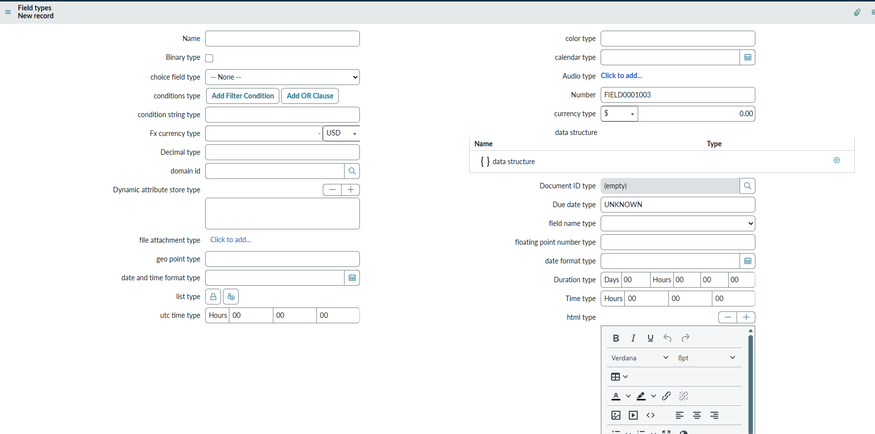
ALL 56 field types of table

Slide 5
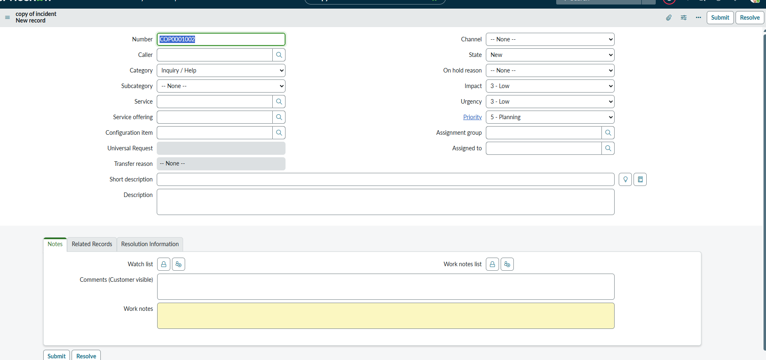
Create table by Replicating Incident table

Slide 6
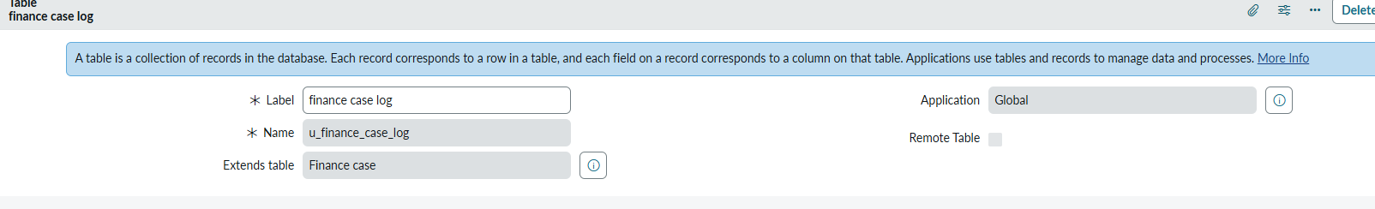
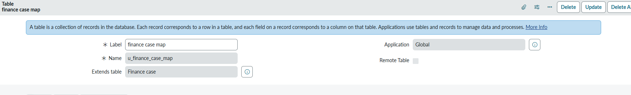
Create 2 custom tables to extend the other table CUSTOM TABLE FINANCE CASE AND CHILD TABLES FINANCE CASE LOG AND FINANCE CASE LOG

Slide 7
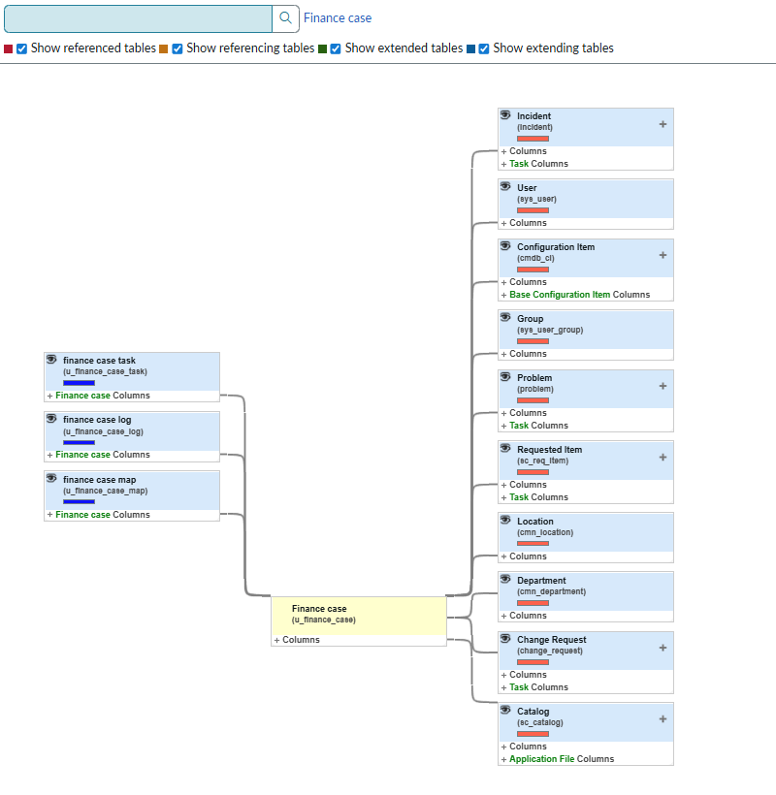
Observe the schema map of different tables.

Slide 8
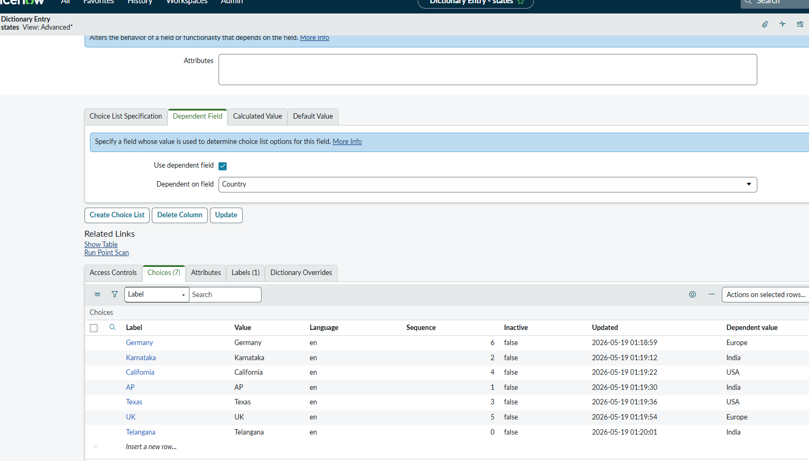
Create 2 choice fields: country,state add the choices and check the dependency.

Slide 9
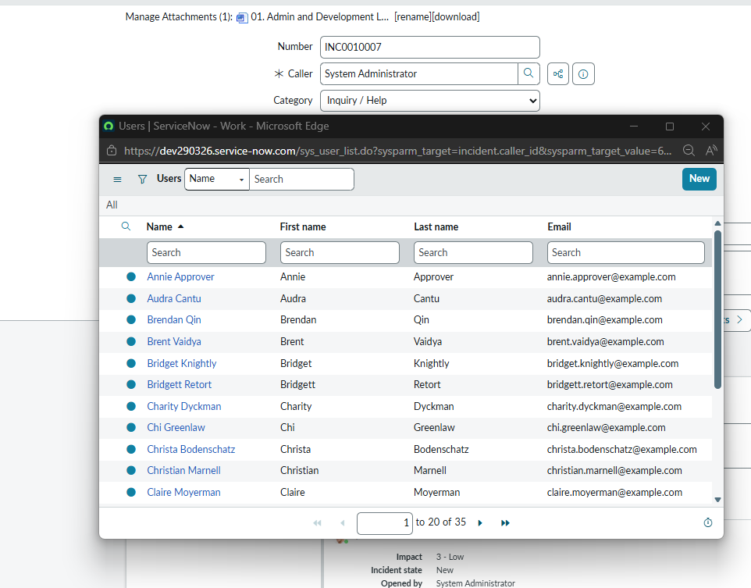
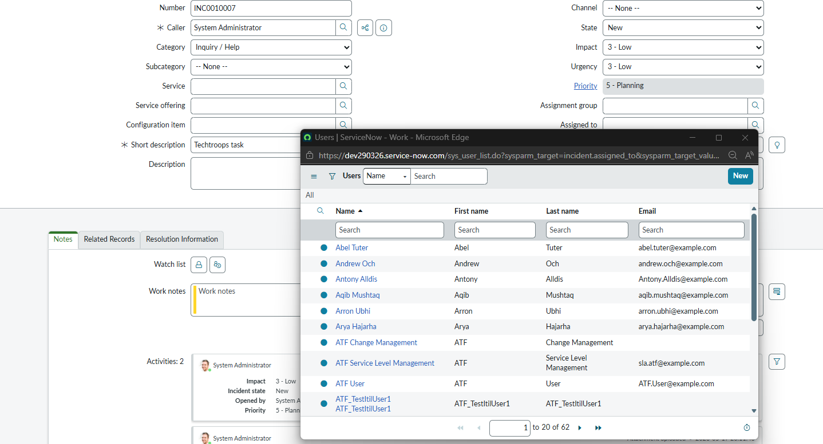
Check the dot walking for the caller and assigned to fields in the incident table

Slide 10
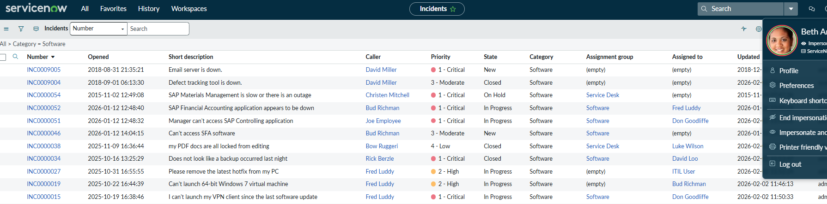
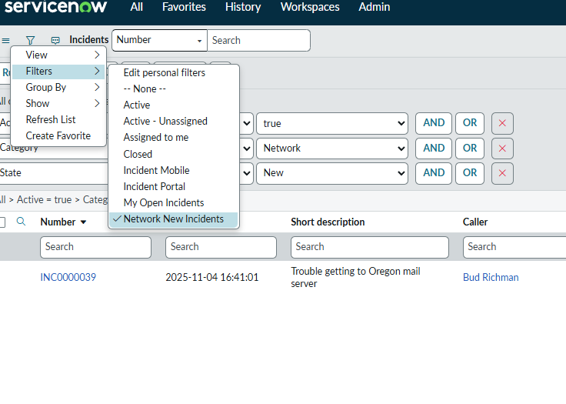
Create a filter of software category records to visible software groups. & Create a filter 'active true,category network,state new. and make it visible to everyone

Slide 11
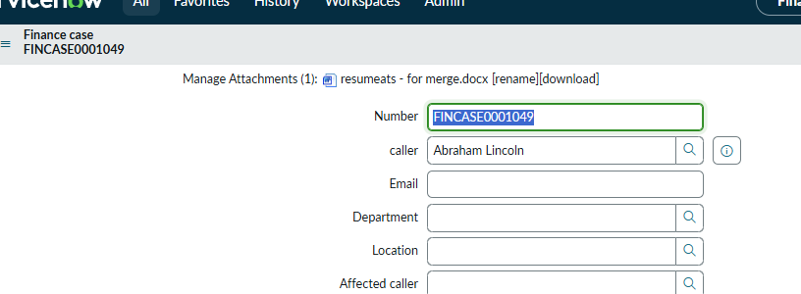
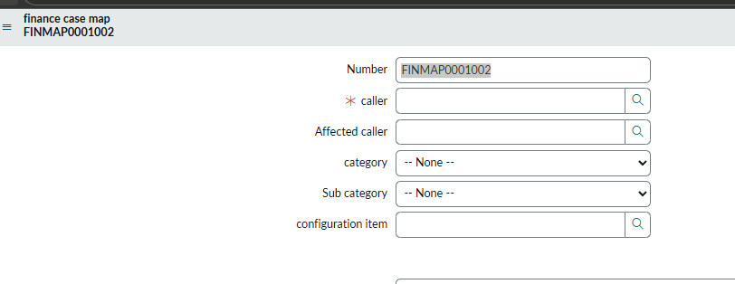
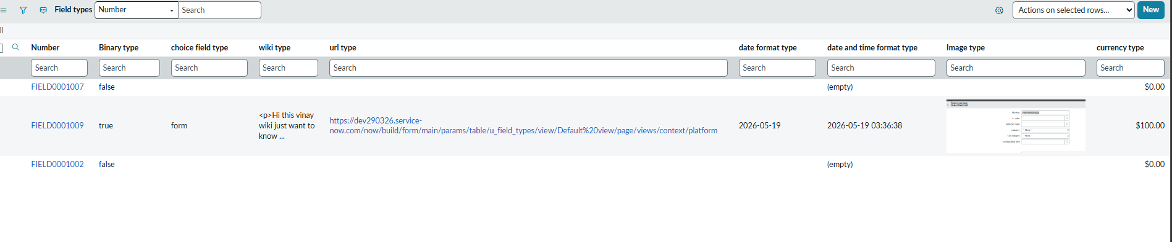
1 Observe the dictionary override functionality parent finance case and child finance case mandatory 2 Create a table by unchecking the create module checkbox and observe the functionality no modules tables accessed in 3ways 1 custom table.list 2.direct url-/customtable_list.do 3.tables->open list 4String,reference,choice,list,image,url,wiki,date,date/time,true/false,currency –columns,form designer,dictionary

Slide 12
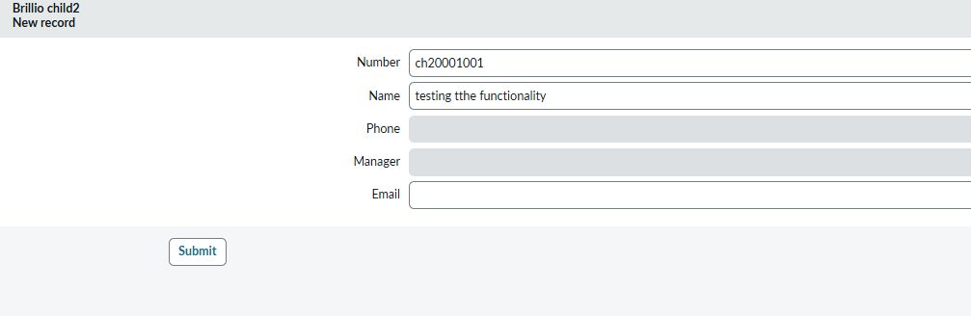
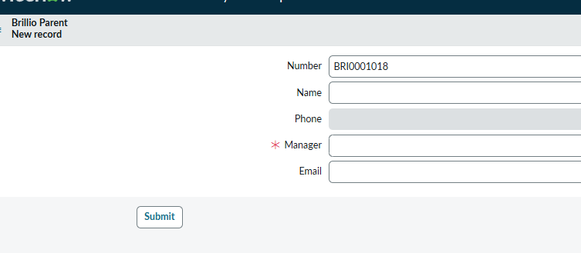
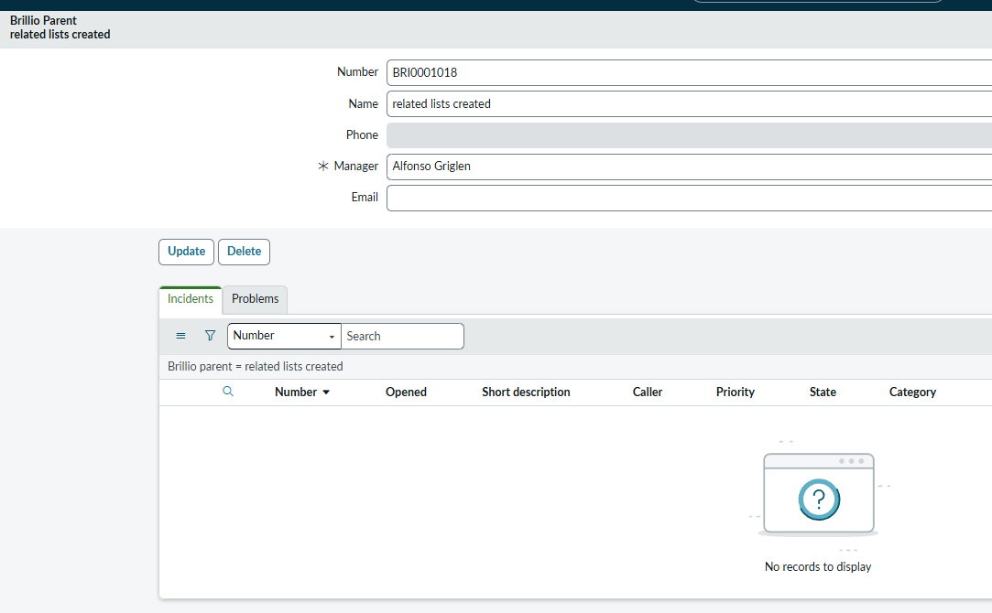
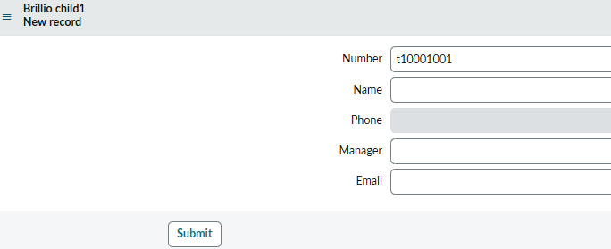
Create one table named as Brillio Parent with (name(string-display-true),Phone(string-readonly),Manager(reference-user-mandatory),Email create 2 child tables Brillio child1, Brillio child2, check the functionality by extending brillio parent. Check the dictionary override functionality with above tables try to override read only, mandatory, display, default value,dependency values. Create related list of incident, problem, in the brillio parent table Create an auto-number for brillio parent table .

Slide 13
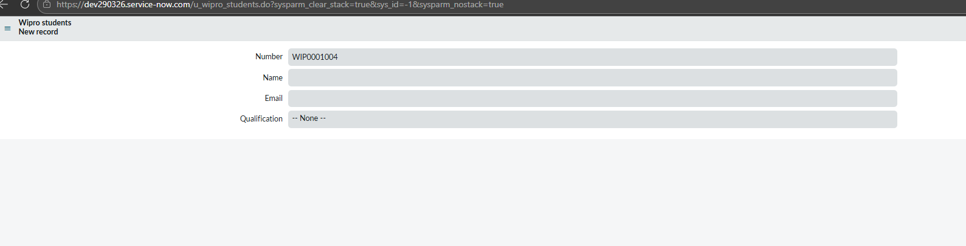
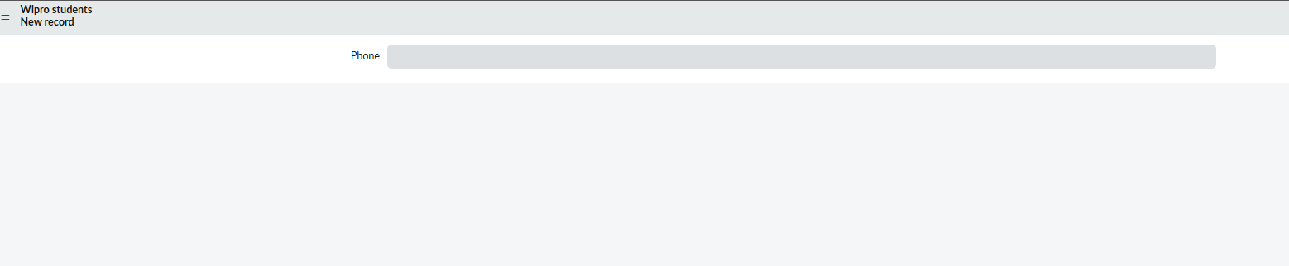
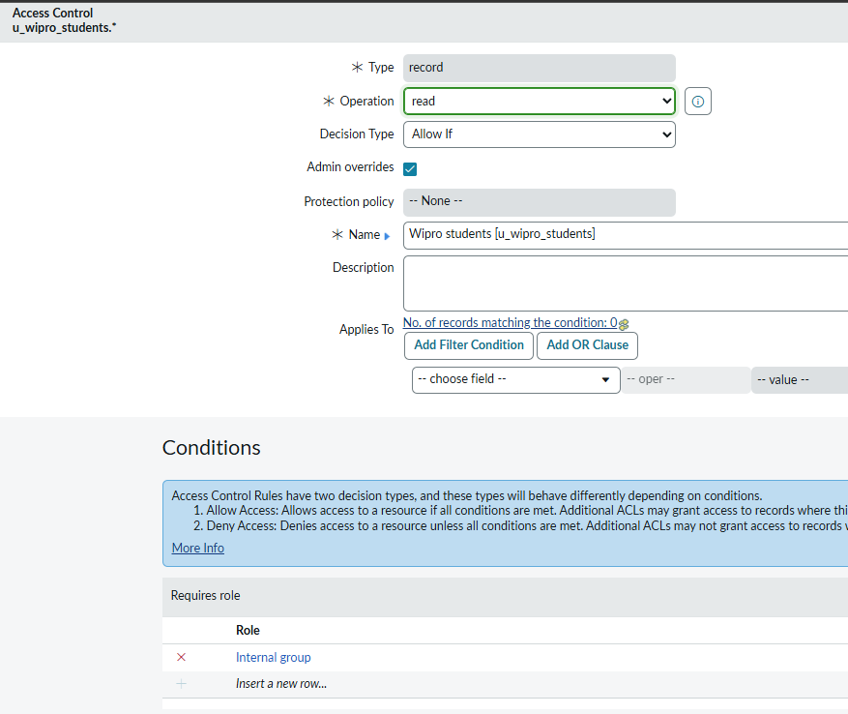
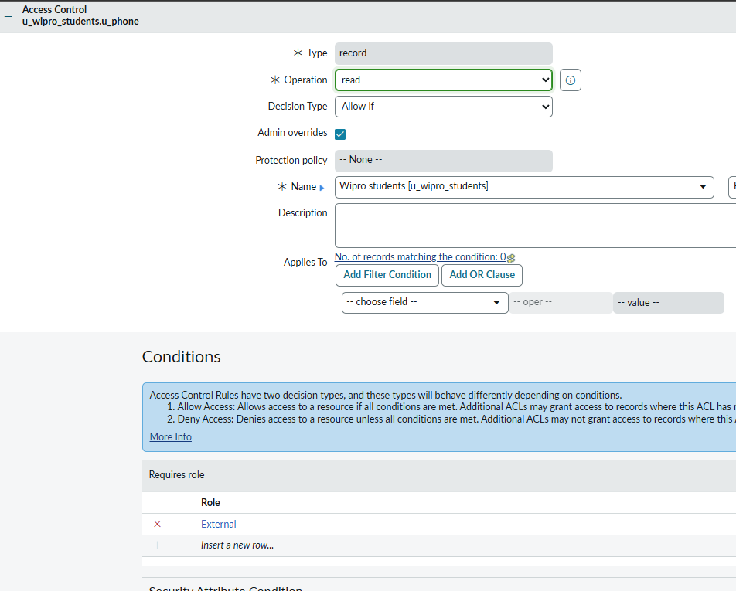
1. Create one table named as Wipro students with columns: Name(string),Phone(string),Email(string),Qualification(Choice). Create 2 user accounts (Sai , Ramu) and 2 Roles(internal, external). And add internal to Sai, external to Ramu, Create at least 15 records with your batch data. 2. Create a custom role named as ‘ServiceNow’, create all table level ACL to ServiceNow roles. 3. Provide this ‘ServiceNow’ role to Both Ramu and Sai. Give All fields read access to internal role and Phone field read access to external role, Check what access Ramu will get , What access to Sai will get. Create one more user named shiva with XYZ role, Give write access to the name field. Check how sai and Ramu behavior changes on the name field. Check if we can add multiple roles in the same ACL. I want to ensure that Ramu can read only name,phone. I want to ensure Sai to read only qualification and Email fields. I want to give delete access only to the Sai. Give name field write access only to itil. Prove application access and Table level access is different, By giving different roles table acl’s and application & module.

