Slide 1


INSUR AI
Project.
2026
INSURAI
- CORPORATE Policy Automation & Intelligence System
AI-POWERED INSURANce Automation Framework
Presented By :
Batch E
:Vinay
:Swarsha
:Maruthi

Slide 2

INSURAI CORPORATE POLICY AUTOMATION & INTELLIGENCE SYSTEM
Problem Statement :
The insurance industry relies heavily on manual and rule-based workflows across policy review, claims processing, fraud detection, and compliance monitoring, resulting in:
High operational costs ($45–60 per policy)
Slow processing times (3–5 hours per policy)
Limited fraud detection (~45% accuracy)
Complex compliance (500+ regulatory rules)
EXISTING SOLUTIONS & LIMITATIONS
During my research, I analyzed current approaches:
PROPOSED SOLUTION – INSURAI
Manual Processing Systems
→ Time-consuming, prone to human errors
Basic Automation Tools (e.g., Guidewire, Duck Creek)
→ Primarily rule-based with limited AI capabilities
→ High enterprise licensing costs
Specialized ML Solutions (e.g., Shift Technology)
→ Focus on single functions (fraud detection only)
→ Lack end-to-end integration
Identified Gap: No comprehensive, AI-driven platform integrating policy, claims, fraud, and compliance in one system
INSURAI is an AI-powered automation framework integrating:
Policy Intelligence (NLP-based document analysis)
Smart Claims Processing (ML-driven validation)
Fraud Risk Scoring (Real-time detection, targeting 85%+)
Compliance Automation (Continuous monitoring)

Slide 3
INSURAI CORPORATE POLICY AUTOMATION & INTELLIGENCE SYSTEM
INSURAI ARCHITECTURE :
Presentation Layer
React UI • Admin Dashboard • Analytics
Data Access Layer (JPA)
Repositories • Entities • ORM Mapping
API Layer — Spring Boot
REST Controllers • JWT Security • RBAC
Database Layer
MySQL (Relational) • MongoDB (Documents) • Redis (Cache)
Service Layer — Business Logic
Policy Services • Claims • Fraud • Compliance
ML Integration Layer Java ML Stack
Weka (ML) • DL4J • NLP Libraries • Tika (OCR)

Slide 4
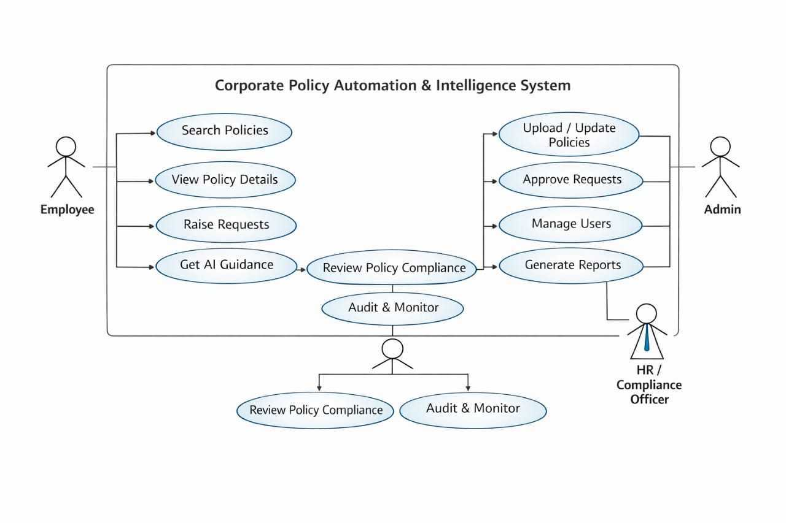
INSURAI CORPORATE POLICY AUTOMATION & INTELLIGENCE SYSTEM
INSURAI - USE CASE DIAGRAM:

Slide 5
INSURAI CORPORATE POLICY AUTOMATION & INTELLIGENCE SYSTEM
INSURAI - MODULES:
AUTHENTICATION & USER MANAGEMENT
SECURE LOGIN
JWT AUTHENTICATION
ROLE-BASED
SMART CLAIMS PROCESSING ENGINE
AUTOMATED CLAIM VALIDATION
WORKFLOW MANAGEMENT
SETTLEMENT PROCESSING
FRAUD RISK SCORING SYSTEM
ML DETECTION
REAL-TIME RISK ALERTS
POLICY INTELLIGENCE ENGINE
AI-POWERED POLICY ANALYSIS,
NLP EXTRACTION
COMPARISON
DOCUMENT MANAGEMENT SYSTEM
SECURE FILE UPLOAD, OCR PROCESSING, AND DOCUMENT STORAGE
COMPLIANCE AUTOMATION
• RULE VALIDATION
• AUDIT TRAILS
• MONITORING
AI/ML INTELLIGENCE ENGINE
CORE NLP, PREDICTION MODELS, AND RECOMMENDATION SYSTEM
ANALYTICS & DASHBOARD
REAL-TIME INSIGHTS, KPIS, AND PERFORMANCE MONITORING
NOTIFICATION SYSTEM
EMAIL/SMS ALERTS, REMINDERS, AND SYSTEM NOTIFICATIONS
ADMIN CONTROL PANEL
SYSTEM CONFIGURATION, USER MANAGEMENT, AND RULE ADMINISTRATION

