Slide 1


SafetyEye Ai-Powered Workplace Occupancy & Safety Monitor
Team 8 J Sneha, J Saketh, B Akshitha

Slide 2
ABSTRACT
Purpose: Develop an AI-based system that uses video surveillance feeds to monitor workplace occupancy levels and detect safety compliance violations in real-time.
Scope: The platform helps office and industrial space managers improve space utilization and ensure employees follow safety protocols such as wearing helmets, vests, and other PPE.
Key Innovation: Automated detection using YOLOv8 deep learning model trained specifically on construction site safety datasets.

Slide 3
INTRODUCTION
Problem Context:
Workplace safety violations are a leading cause of industrial accidents
Manual safety monitoring is time-consuming and error-prone
Traditional surveillance systems lack intelligent analysis capabilities
Need for automated, real-time safety compliance monitoring
Why AI-Powered Solution?
24/7 automated monitoring without human fatigue
Instant violation detection and alerting
Consistent application of safety standards
Data-driven insights for safety management

Slide 4
Existing Approaches
Method | Advantages | Limitations
Manual Inspection | Direct human oversight | Time-intensive, inconsistent
Basic CCTV | Continuous recording | No automated analysis
Rule-based Systems | Simple logic | Limited adaptability
Generic AI Models | Broad detection | Poor domain-specific accuracy
Research Gap: Lack of specialized AI models trained specifically for construction site PPE detection with real-time processing capabilities.

Slide 5
PROBLEM STATEMENT
Challenge: Current workplace safety monitoring relies heavily on manual processes that are inconsistent, delayed, and cannot provide comprehensive coverage of large industrial sites.
Specific Issues:
- Missing helmet detection in real-time - Lack of automated vest compliance monitoring - No instant alerting for safety violations - Insufficient data for safety trend analysis
Solution Requirement: An intelligent system that can automatically identify safety compliance violations and generate immediate alerts with visual evidence.

Slide 6
OBJECTIVES
Primary Goals:
Identify safety compliance violations such as missing helmets and vests
Generate real-time visualizations and alerts to improve safety
Present results via a live dashboard along with E-mail alerts
Provide data analytics for safety trend monitoring
Success Metrics:
Real-time detection with <1 second latency
High accuracy PPE detection (>82% precision)
Automated alert generation within seconds
Comprehensive compliance reporting

Slide 7
PROPOSED SYSTEM OVERVIEW
Video Input
AI Processing
Violation Detection
Alert Generation
Dashboard Display
Core Components:
Data Prep Module - Load & process YOLO-formatted images
Model Training Module - Train YOLOv8 for PPE detection
Detection Module - Real-time PPE violation spotting
Alert Module - Send notifications for missing gear
Dashboard Module - Live view + compliance statistics
Workflow

Slide 8
DATASET
Data Characteristics:
YOLO-formatted annotations present in diverse construction site scenarios
Multiple classes: Hardhat, Mask, NO-Hardhat, NO-Mask, NO-Safety Vest, Person, Safety Cone, Safety Vest, machinery, vehicle.
Various lighting and angle conditions
Model Architecture: YOLOv8 (You Only Look Once version v8)
Training Strategy:
Data augmentation for robustness
Hyperparameter tuning for accuracy optimization
Validation using mAP, precision, and recall metrics

Slide 9
REQUIREMENTS
Requirements:
Processing speed: <1 second per frame
Accuracy: >81% detection precision
Scalability: Multiple camera feed support
Reliability: 24/7 operation capability
Technology Stack:
AI Framework: YOLOv8, PyTorch
Backend: Python, OpenCV
Frontend: Streamlit
Libraries: Ultralytics, Pandas, NumPy
Training Platform: Kaggle
Notifications: SMTP(email system)

Slide 10
SYSTEM MODULES
1. Data Preprocessing Module:
Image loading and formatting
YOLO annotation processing
Train/validation/test split
2. Model Training Module:
YOLOv8 model initialization
Custom dataset training
Performance evaluation
3. Real-time Detection Module:
Video stream input processing
Live inference pipeline
Bounding box overlay generation
4. Alert System Module:
Violation detection logic
Multi-channel notifications
Alert logging and tracking
5. Dashboard Module:
Live video display with overlays
Compliance statistics visualization
Historical violation data

Slide 11
KEY FEATURES
1. Real-time Detection:
Live video stream analysis
Frame-by-frame PPE identification
Instant violation flagging
2. Smart Alerting:
Email notifications for violations
Dashboard popup alerts
Violation severity classification
3. Comprehensive Reporting:
Compliance statistics dashboard
Downloadable violation logs
Historical trend analysis
4. User-friendly Interface:
Intuitive Streamlit web interface
Live video feed with detection overlays
Administrative controls and settings

Slide 12
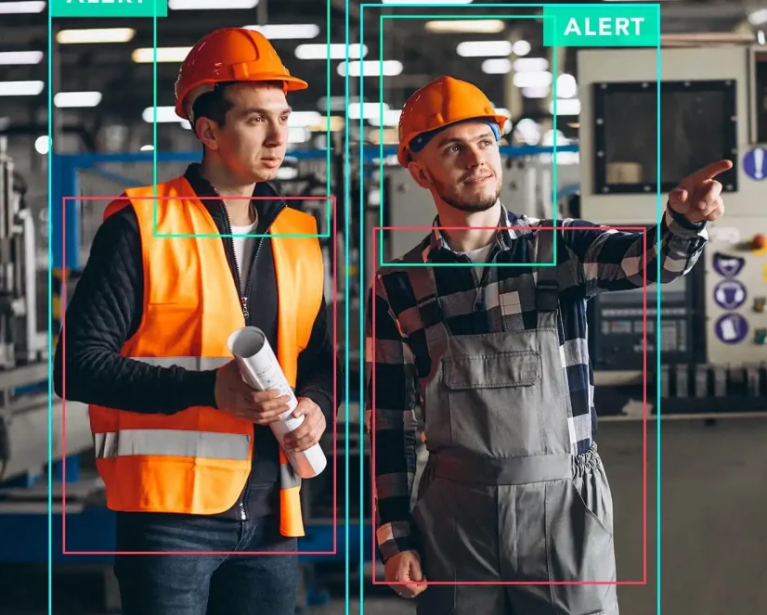
Model Performance
Epochs: 100
Optimizer: SGD
mAP@0.5: 81
Precision: 90
Recall: 74
Deployment: CPU & GPU

Slide 13
PPE Detection Classes
Violation Rules:
Critical:
Person detected without helmet
High:
Person detected without safety vest
Medium:
Person detected without face mask
Composite:
Multiple PPE violations simultaneously
PPE Type | Detection Accuracy | Alert Priority
Hard Hat | High | Critical
Safety Vest | High | High
Face Mask | Medium | Medium
Person | High | Base Detection

Slide 14
INNOVATIVE SOLUTIONS
Achievements:
Successfully Detects Missing PPE In Real-time
Handles Various Lighting Conditions
Works Across Different Camera Angles
Minimal Processing Delay
Challenges & Solutions:
Occlusion → Strategic Camera Placement
Lighting → Model Robustness Training
Speed → Optimized Yolov8 Implementation
Commercial Applications:
Construction Sites - Manufacturing - Mining – Warehouses
Future Enhancements:
Additional PPE Types (Boots, Gloves, Goggles)
Mobile App Version
Multi-site Monitoring
Market Impact:
Reduced Workplace Accidents
Cost Savings From Prevention

Slide 15
THANKYOU

