Slide 1

Mastering GitHub Collaboration
Boost your team's productivity and streamline your workflow with GitHub. Discover powerful tools for collaboration, project management, and code development.
VK
by Vinay Kumar

Slide 2
Inviting Collaborators to a Repository
Adding Contributors
Roles and Permissions
Grant access to specific users or groups, allowing them to contribute to your repository.
Set clear permissions, such as read-only, write, or administrative access, based on individual responsibilities.

Slide 3
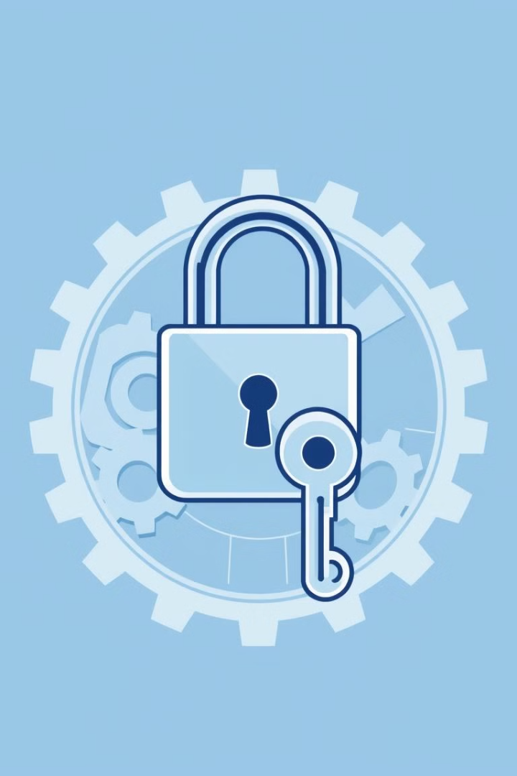
Configuring Repository Access Permissions
Read-Only
Write
Allow users to view code, issues, and pull requests but not make changes.
Enable users to make changes to code and open pull requests.
Admin
Grant full control over the repository, including managing permissions, merging pull requests, and deleting branches.

Slide 4



Managing Organizational Accounts and Teams
Organization Management
Team Collaboration
Create and manage organizations, adding members and defining permissions for different teams.
Organize teams based on projects or roles, facilitating shared workflows and communication.

Slide 5
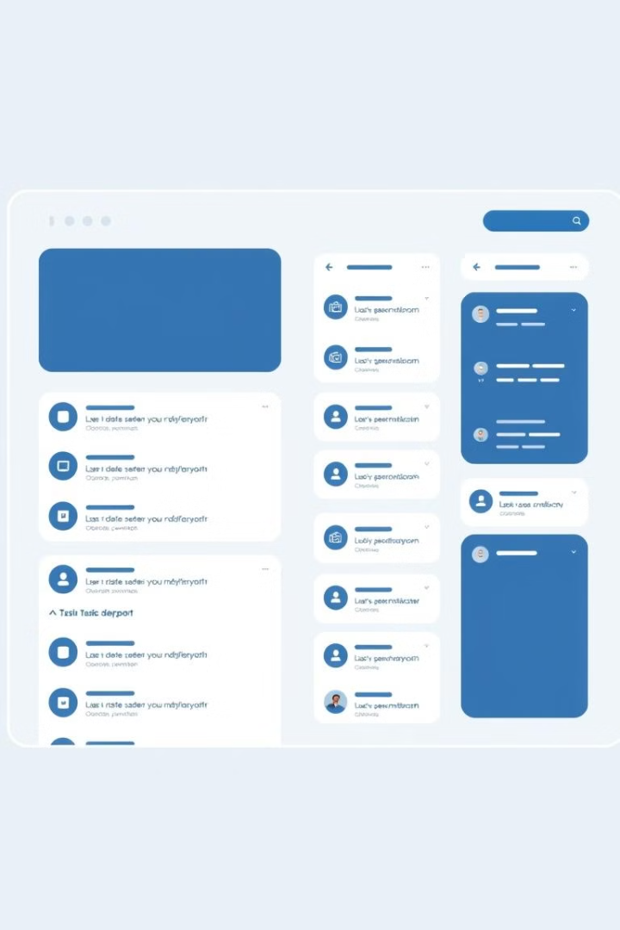
Creating and Organizing GitHub Projects
1
Project Creation
Start new projects by creating a repository and defining initial tasks and milestones.
2
Project Organization
Organize projects into distinct repositories, enabling clear separation and streamlined collaboration.
3
Version Control
Utilize branching and merging techniques for effective version control, ensuring smooth project evolution.

Slide 6



Kanban Boards and Project Automation
Task Management
Visualize project progress using Kanban boards, tracking tasks through different stages.
Automation
Automate tasks and workflows using GitHub Actions, streamlining processes and improving efficiency.

Slide 7

Tracking Issues and Pull Requests
1
2
Issue Tracking
Pull Requests
Report and manage bugs, feature requests, and other issues efficiently.
Review code changes, collaborate on improvements, and ensure high-quality code contributions.

Slide 8

Leveraging GitHub's Collaborative Features
Unlock the full potential of GitHub for seamless collaboration, streamlined project management, and efficient code development.

