Slide 1
Welcome to Mars. Please Don’t Die.
Gaia Rossi 1933502 - Alessio Vernarelli 1946128 - Beatrice Vinciguerra 1933209
Laboratory of Advanced Programming
Sapienza University of Rome

Slide 2
Table of contents
Description
User stories & Mockups
Architectural diagram
Technologies used
Containerization
Demo

Slide 3
Description
A distributed automation platform capable of ingesting heterogeneous sensor data, normalizing it into a unified internal representation, evaluating simple automation rules dynamically to allow both manual and automatic activation of actuators, and providing a real-time dashboard for habitat monitoring and plots showing recent history of data.
Welcome to Mars. Please Don’t Die.

Slide 4
User Stories & Mockups
As a Mars operator, I want to visualize current data coming from REST sensors so that I can monitor the situation.
As a Mars operator, I want to visualize telemetries coming from sensors so that I can monitor the situation.
As a Mars operator, I want to be able to select the specific sensor data I want to plot so that I can analyze them in detail.
As a Mars operator, I want to be able to manually refresh values captured by the sensors so that I can get the most up to date information.
As a Mars operator, I want to set the value of the refreshing interval so that I can decide the frequency.
As a Mars operator, I want to add an automation rule to automate my reaction to the environment.
As a Mars operator, I want to update the threshold of an automation rule so that I can customize my rules.
As a Mars operator, I want to delete an automation rule so that I can get rid of it if I don’t need it anymore.
As a Mars operator, I want to be able to visualize the actual state of all the actuators so that I can monitor the situation.
As a Mars operator, I want to manually change the state of the actuators so that I can have more control.
As a Mars operator, I want the values over the threshold to be highlighted so that I can easily understand what is happening.
As a Mars operator, I want to see some metrics (average, max, min) about received data so that I can analyse them.
As a Mars operator, I want to see the last triggered automation rule so that I know when the system reacts automatically.
As a Mars operator, I want to be able to export useful data into pdf files so that I can process them offline.
As a Mars operator, I want to be able to activate/disable an automation rule so that I can have more flexibility and handle critical situations.
As a Mars operator, I want to be able to see the list of automation rules, so that I can manage them.
Welcome to Mars. Please Don’t Die.

Slide 5
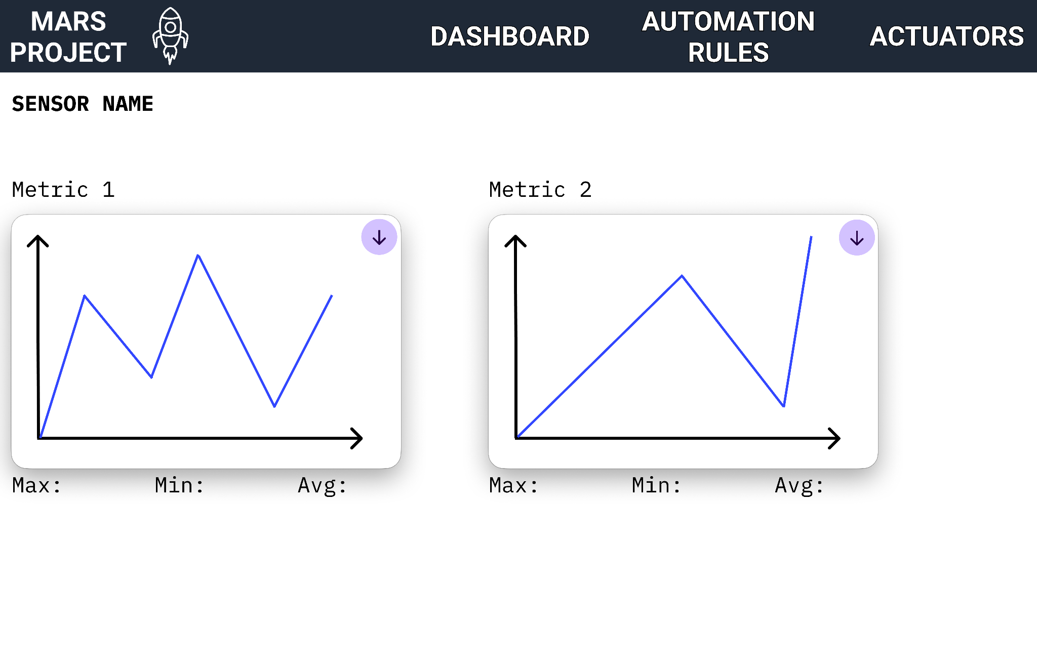
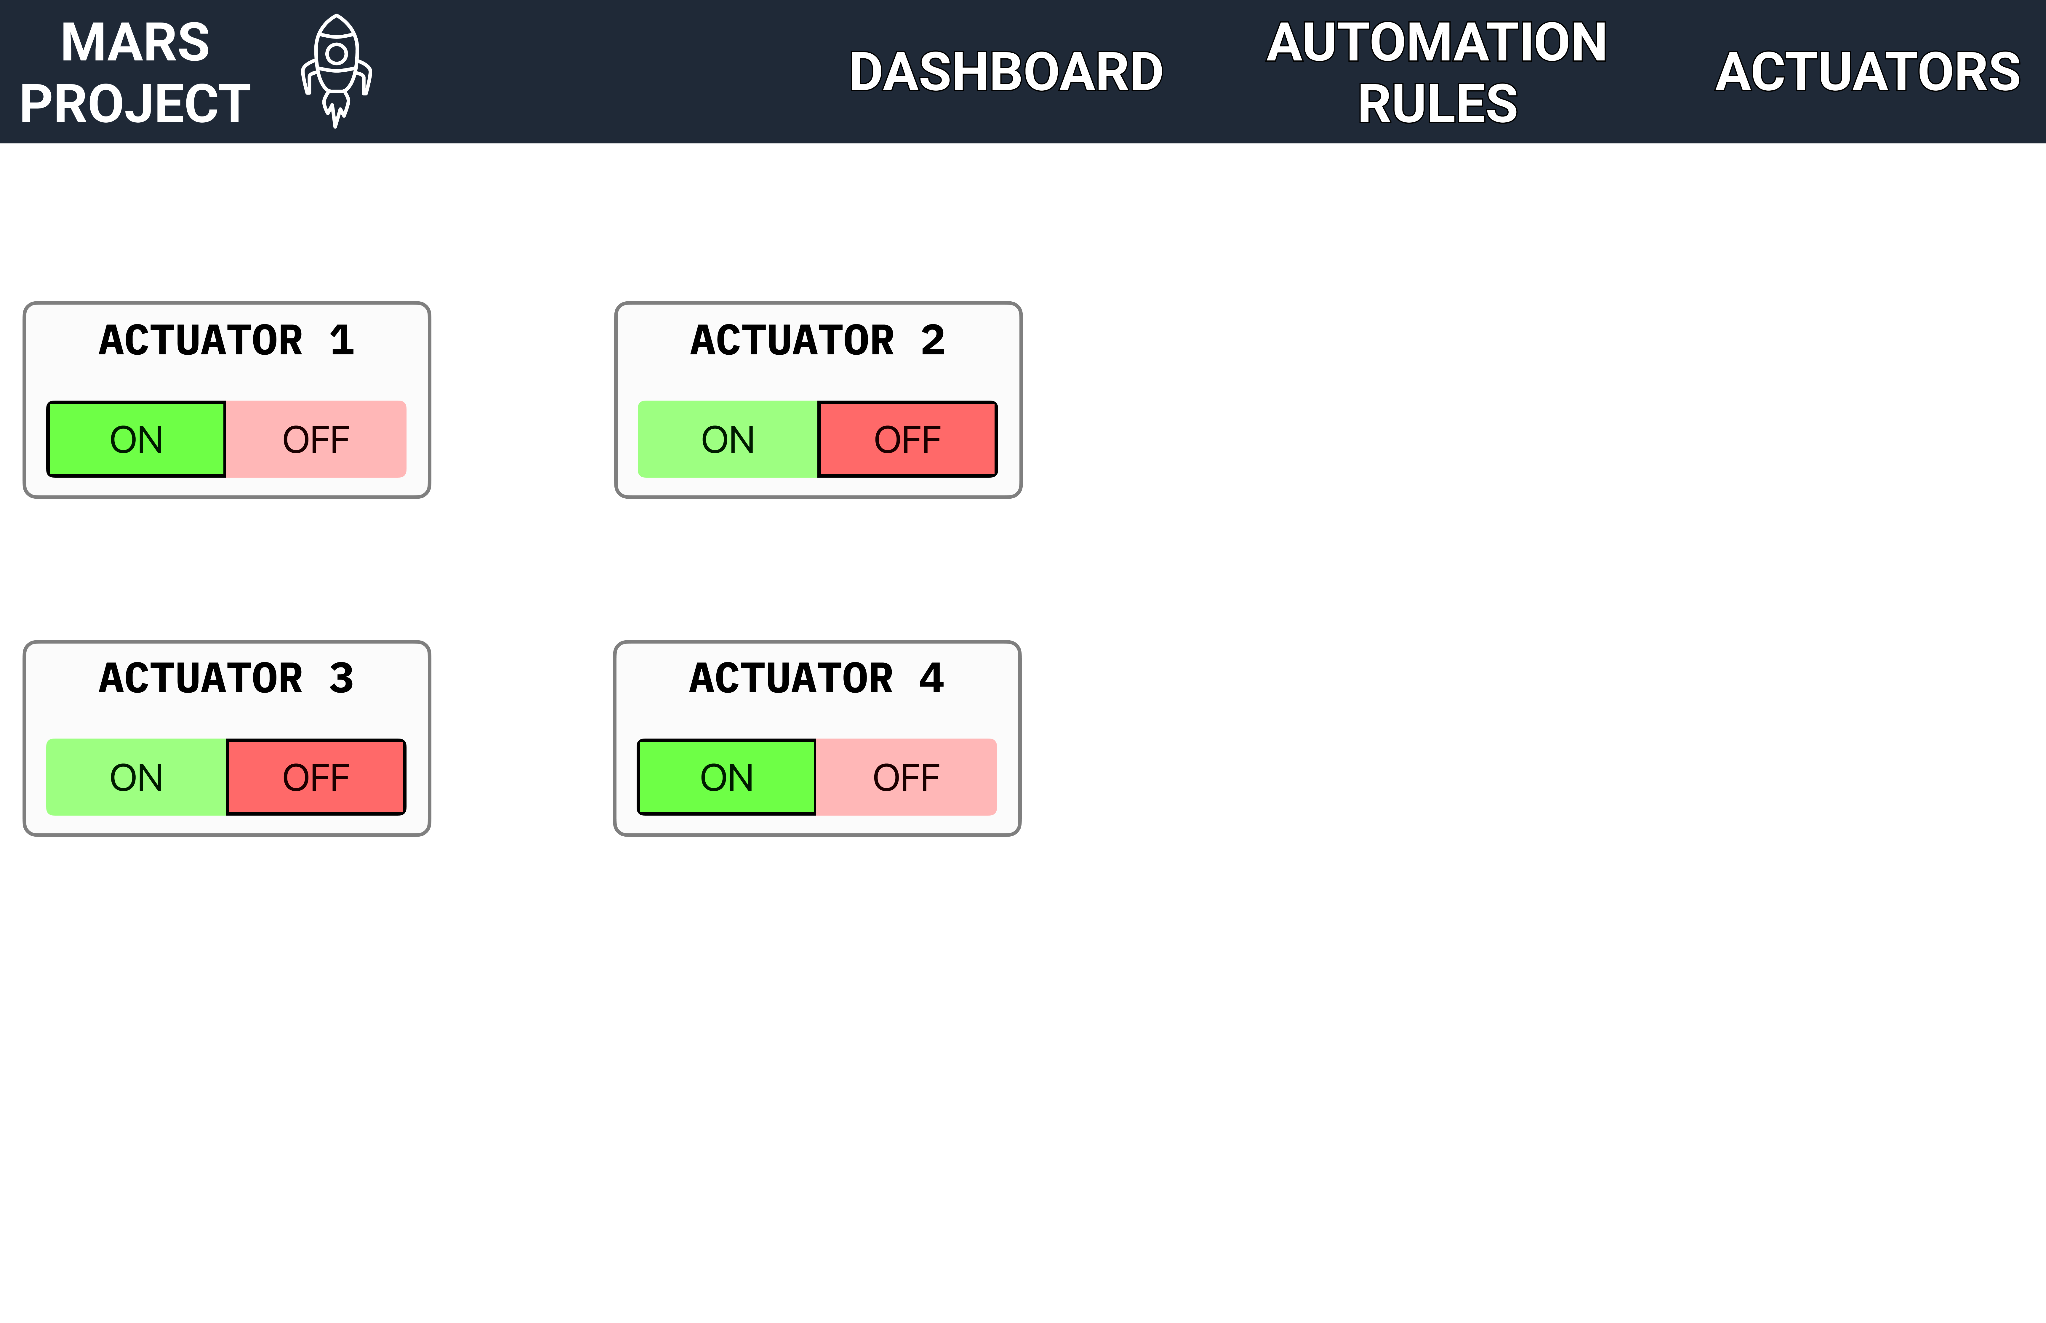
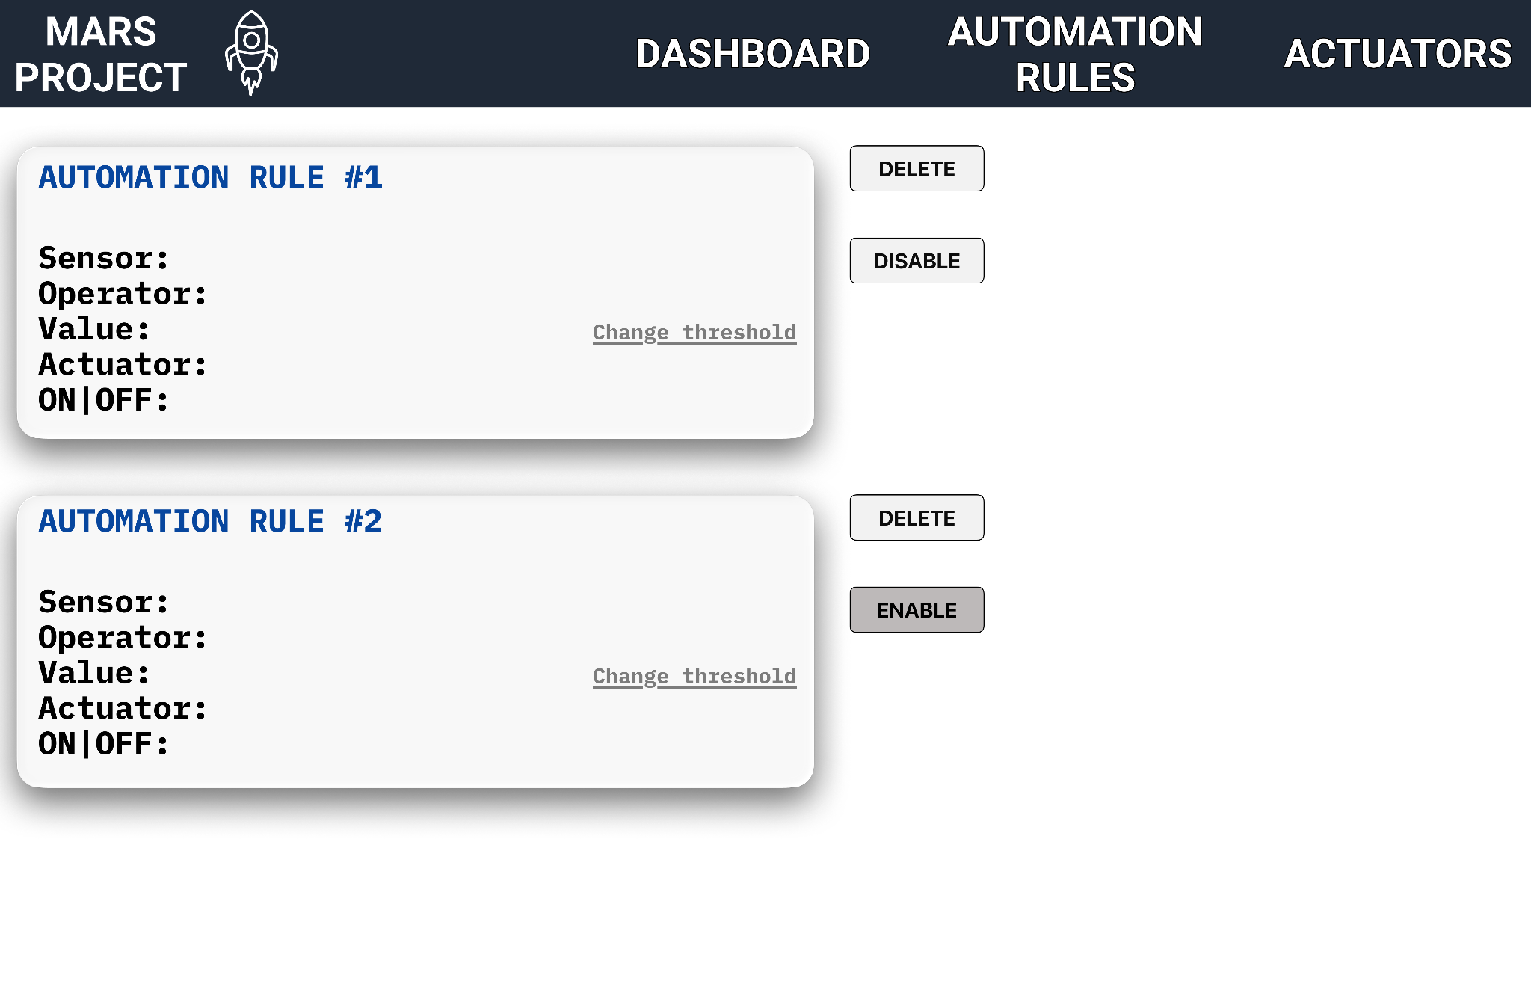
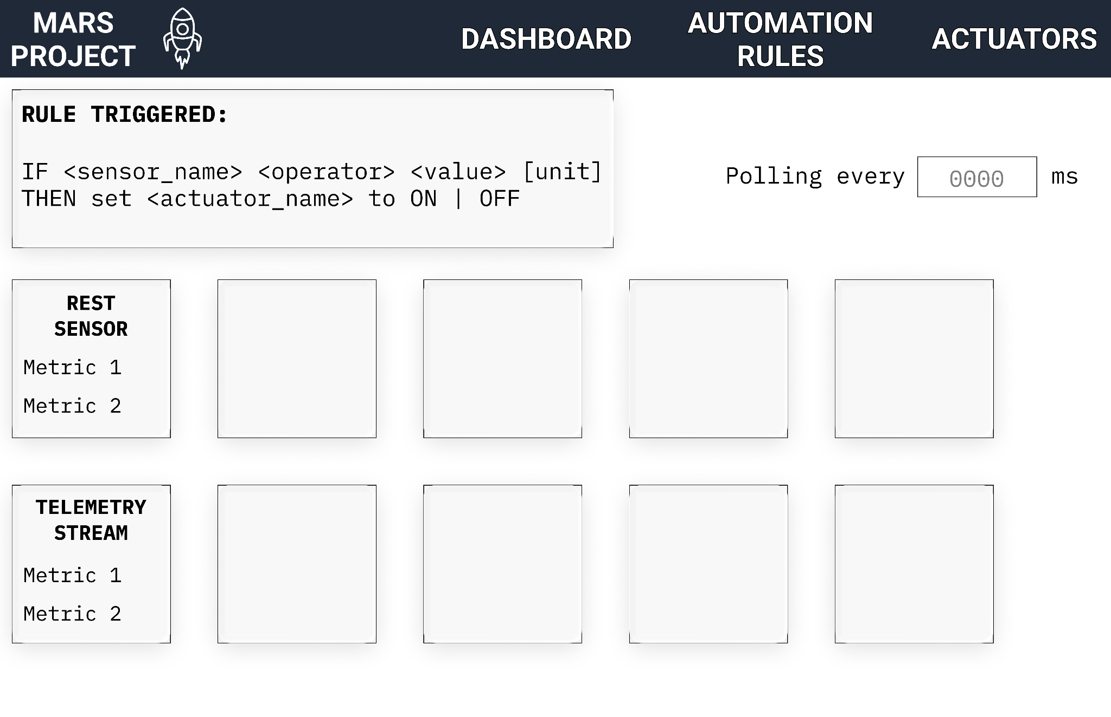
Description
ADD A NEW RULE
Welcome to Mars. Please Don’t Die.

Slide 6
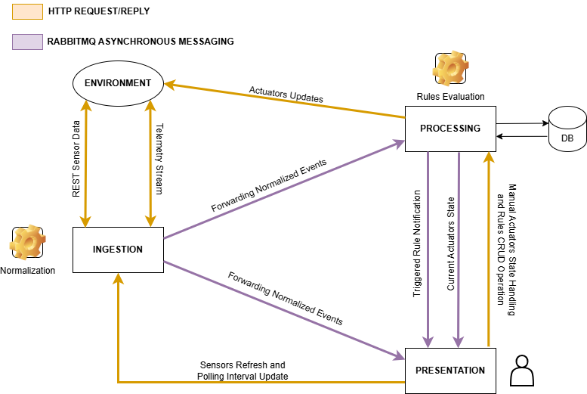
Architectural
diagram
Welcome to Mars. Please Don’t Die.

Slide 7
Unified Event Schema
public class NormalizedEvent {
private String sourceId;
private SourceType sourceType;
private String schema;
private String timestamp;
private String status;
private List<Measurement> measurements;
…
}
public class Measurement {
private String metric;
private Double value;
private String unit;
…
}
public enum SourceType {
REST,
STREAM
}
Welcome to Mars. Please Don’t Die.

Slide 8





Technologies used
Docker
Spring Boot
RabbitMQ
PostgreSQL
HTML, CSS, JavaScript
Welcome to Mars. Please Don’t Die.

Slide 9

Containers
simulator
ingestion
postgres
processing
rabbitmq
presentation
Welcome to Mars. Please Don’t Die.

Slide 10
It’s demo time!

Slide 11
Thank you for your attention!

