Slide 1

Exploratory Data Analysis
Go-to-Market Insight for Cab Investment Firm
Vin Brun | November 11, 2024

Slide 2
Agenda
Executive Summary
Problem Statement
Approach
EDA
EDA Summary
Recommendations

Slide 3
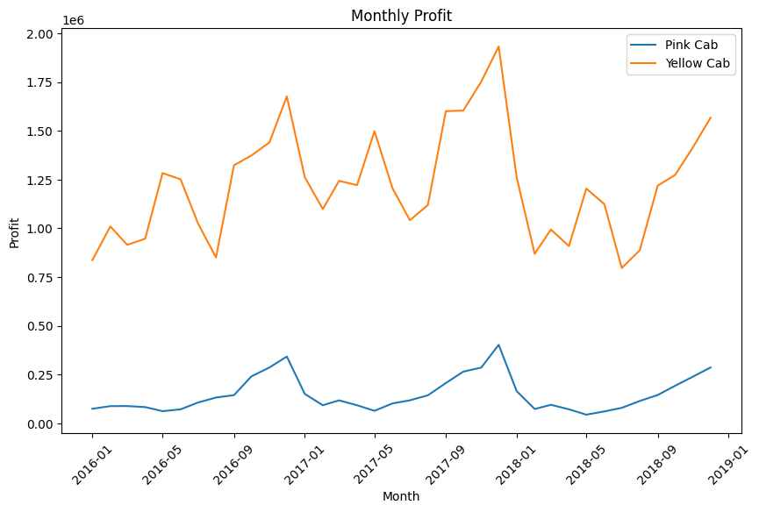
Executive Summary
Objective: Identify the best cab company for investment.
Key Findings:
Yellow Cab outperforms Pink Cab in all key metrics: rides, revenue, profit, and customer retention.
Seasonal trends show higher demand from October to December for both companies.
Despite a slight decline in profit margins, Yellow Cab remains the more lucrative investment opportunity.
Recommendation: XYZ should invest in Yellow Cab.

Slide 4
Problem Statement
Problem: Determine whether Pink Cab or Yellow Cab is the better investment for XYZ.
The cab industry has shown resilience against the rise of ride-hailing apps.
Analyzing customer demographics, financial performance, and market share is crucial for informed decision-making.

Slide 5
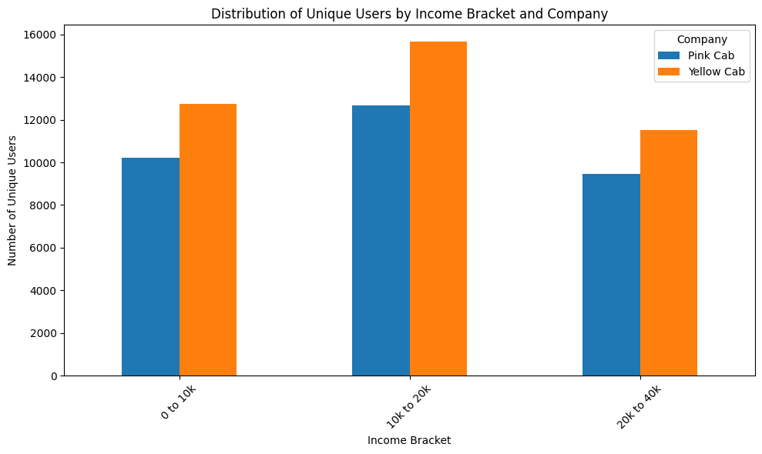
Approach: Data Preparation
Merged datasets: Cab_Data, Customer_ID, Transaction_ID, and City.
Duplicates were removed, and missing values were handled.
Key metrics, such as the Profit Margin Ratio and customer retention rates, were calculated.

Slide 6
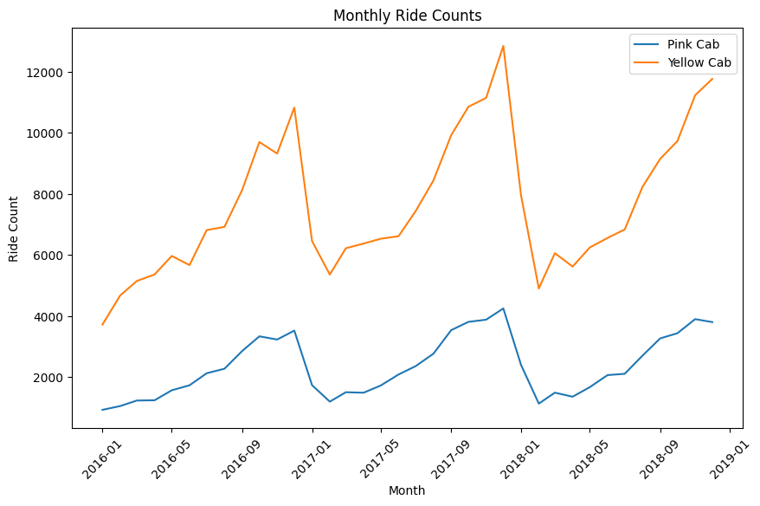
Approach: Analytical Techniques
Ratio Analysis: Profit Margin Ratio.
Market Trends: Analyzed seasonal patterns and geographic performance.
Customer Insights: Retention and income segmentation.

Slide 7
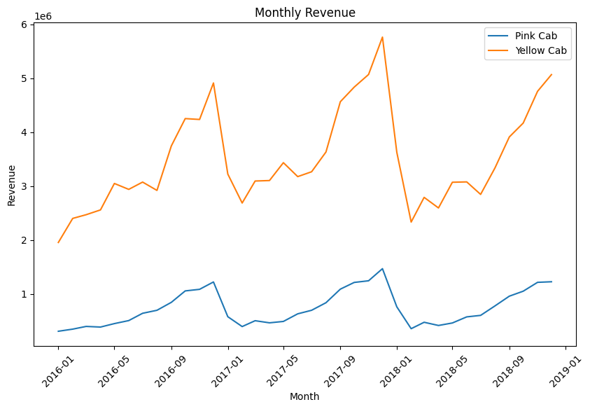
EDA: Key Metrics Overview
Yellow Cab has higher revenue and profit across all months.
Pink Cab consistently underperforms compared to Yellow Cab.

Slide 8
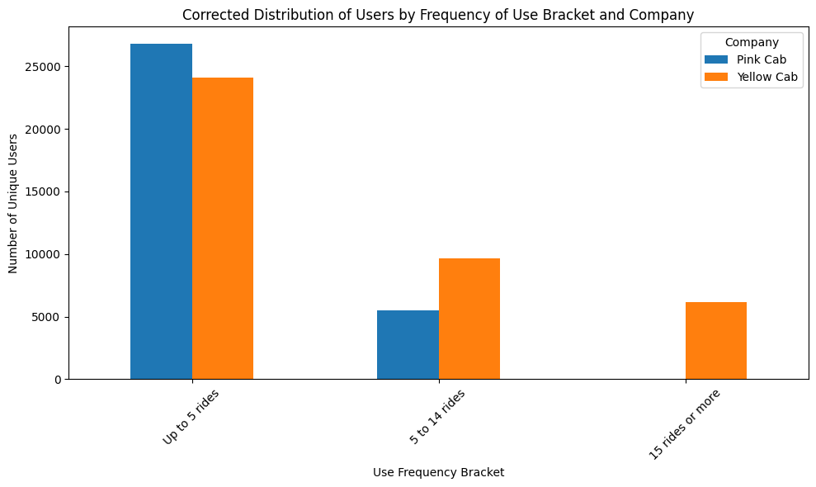
EDA: Customer Retention
Yellow Cab retains 186% more customers with five or more rides compared to Pink Cab.

Slide 9
EDA: Market Trends
Seasonal peaks are observed from October to December.
Both companies exhibit similar seasonal trends.

Slide 10
EDA: Profitability Insights
Although declining, Yellow Cab's profit margin ratio remains higher than Pink Cab's.

Slide 11
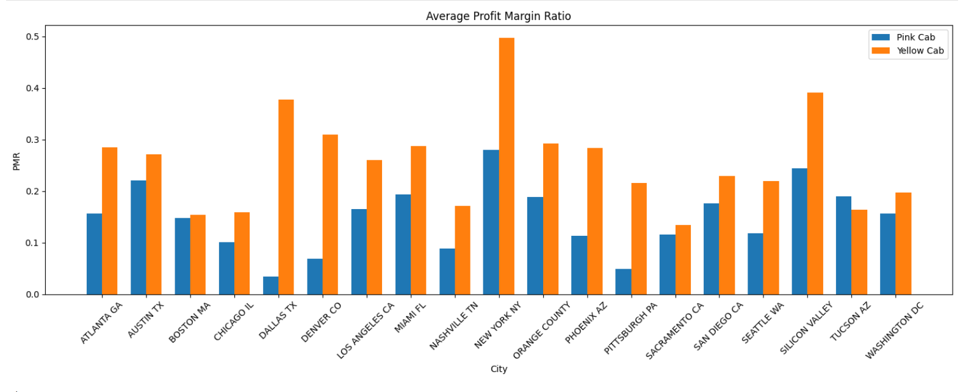
EDA: Geographic Performance
Yellow Cab holds a dominant position in most major cities.

Slide 12
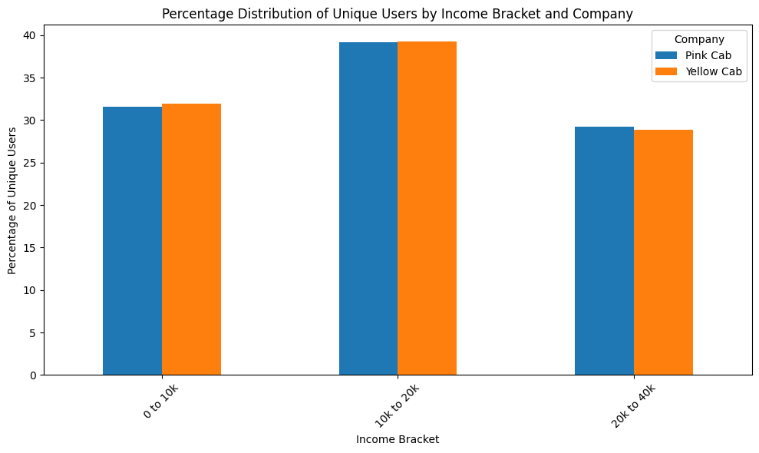
EDA: Income Segmentation
Similar income distribution between companies suggests equivalent customer appeal.

Slide 13
EDA Summary
Yellow Cab consistently outperforms Pink Cab in:
Ride counts, revenue, and profit.
Customer retention (especially recurring customers).
Geographic dominance in major cities.
Seasonal trends show increased demand from October to December for both companies.
Profit margin ratios indicate that Yellow Cab's profitability is higher, despite experiencing a slight decline over time.
Income distribution is nearly identical for both companies, suggesting similar customer demographics.

Slide 14
Recommendations
Investment Recommendation:
Invest in Yellow Cab: Higher revenue, profit, and customer retention rates.
Monitor trends in profit margins and operational costs to ensure sustained profitability.
Capitalize on seasonal peaks with targeted marketing and promotional activities.

Slide 15
Thank You

