Slide 1
Marketing Campaign
Present by Olaoluwa Vincent AJAYI . PhD.

Slide 2
Contents
Objectives
To analyses factor that influences the customers' decision to subscribe to a term deposit.
Examine the performance of the campaign team
To build a model that can predict if a client will subscribe to a term deposit or not.
Business Understanding
Data Understanding
Data Preparation
Modelling
Evaluation
Deployment

Slide 3
Business Understanding
The data is related with direct marketing campaigns of a Portuguese banking institution.
The marketing campaigns were based on phone calls. Often, more than one contact to the same client was required, in order to access if the product (bank term deposit) would be (or not) subscribed.

Slide 4
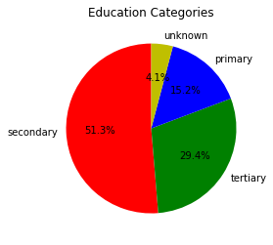
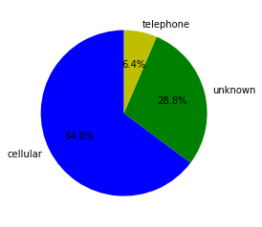
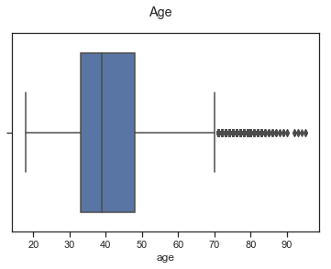
Data Understanding Customer Profile

Slide 5
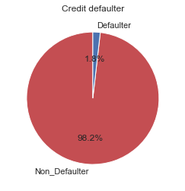
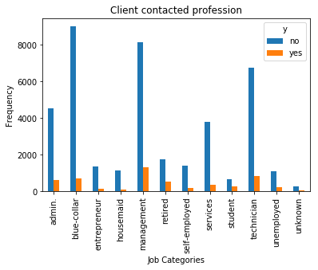
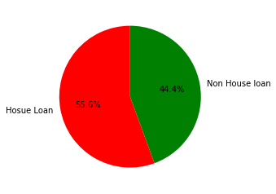
Data Understanding Customer Profile

Slide 6
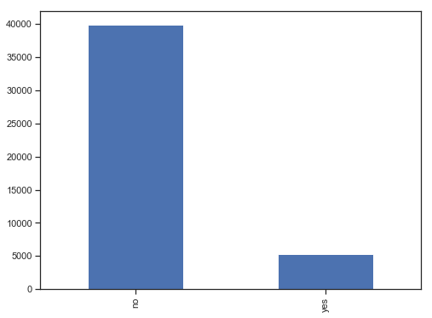
Campaign Team performance
From total 45211 clients contacted, we observed that 88% of the customers have not subscribed, while only 12% subscribed.
This implies that the campaign has not been successful.

Slide 7
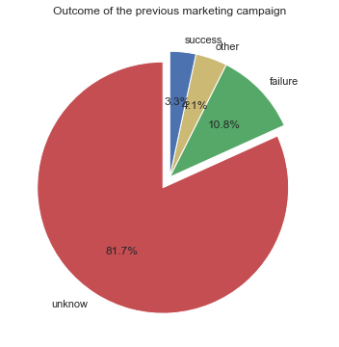
Why has the campaign not been successful?
1. The attitude of the campaign team toward the clients have been very poor because on 3.3% of the total clients contacted rated their past campaign performance excellent (success), 11% rated the performance as poor (failure) while 82% of them decided not to comment about the performance.

Slide 8

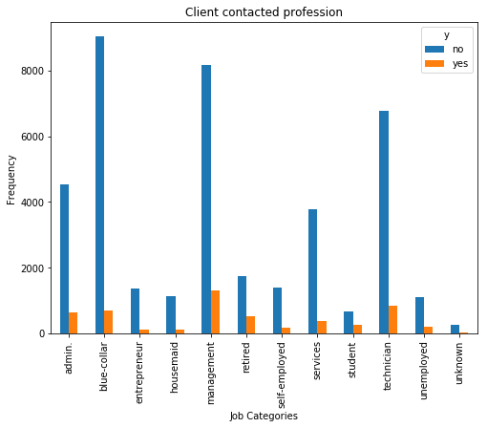
Why has the campaign not been successful?
2. The team have been contacting wronged job categories.
Management (21%, 25%) and students(2%, 5%) jobs categories are a return to scale, while Blue collar(22%,13%) and entrepreneur (3%, 2%) are decrease return to scale.

Slide 9
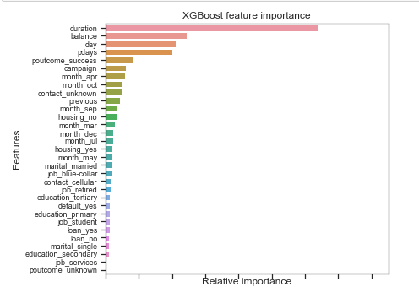
Data Preparation Cluster Analysis and Feature importance

Slide 10
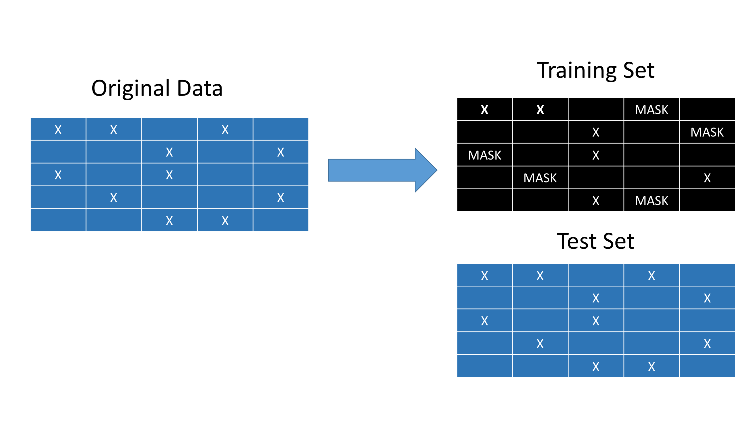
Model Training & cross Evaluation
X_train, X_test, y_train, y_test = train_test_split(x, y, test_size=0.2, random_state=42)

Slide 11
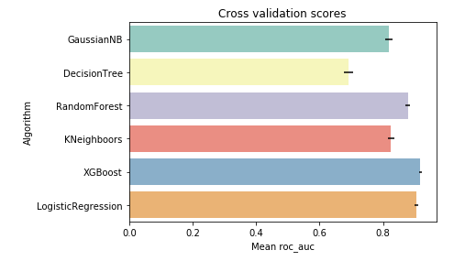
Model Evaluation

Slide 12
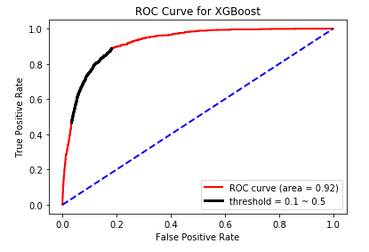
Best model selected
XGBoost Classifier performs better than other selected
Accuracy is 0.91%
Precision is 0.66%
Recall is 0.47%
F1 score is 0.55%

Slide 13
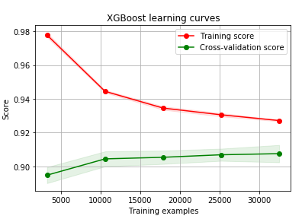
Diagnostic Test and Check for overfitting

Slide 14
Recommendation
The marketing campaign has not been a success. Therefore, the Bank needs to call for immediate action and seek better means to reach out to the clients.
The clients that called by cellular tend to invest than other means of communication. Therefore, the team should be encouraged to use cellular when contacting the clients.
Duration' has a strong positive effect on the clients saying 'yes’. The team need to spend more time when contacting the customers.

Slide 15
Recommendation
The campaign team need to improve on their customer services.
Management and students jobs categories are a return to scale, while Blue collar, housemaid, entrepreneur, and self-employed are decrease return to scale. Therefore, students and management job categories need to be more contacted when compared with other job categories.

Slide 16
Thank you

