Slide 1
NOVA AI: Transforming E-commerce Engagement
A comprehensive guide for Advanced, E-commerce Platform Managers
Vivatech AI
Vincent de Paul NZOTEGOUONG
September 04, 2026
Made with SlideMaker.app

Slide 2

NOVA AI: Transforming E-commerce Engagement
Welcome to the NOVA AI presentation, where we explore an innovative AI-powered solution designed to enhance e-commerce conversion rates and recover abandoned carts. By intelligently analyzing visitor behavior, NOVA AI tailors interventions to individual contexts, ensuring that each customer receives the most relevant assistance. This presentation will cover the business challenges faced by e-commerce platforms, the AI-driven solution we propose, and the roadmap for implementation and compliance. Join us as we delve into the future of personalized online shopping experiences.
Made with SlideMaker.app

Slide 3

Overview of NOVA AI
AI-Driven Conversion Rates
Real-Time Visitor Response
NOVA AI leverages advanced algorithms to enhance e-commerce conversion rates by analyzing visitor behavior in real-time, leading to more effective engagement strategies.
The system intelligently responds to visitor actions, determining the best course of action—whether on-site assistance, email recovery, or no intervention—based on contextual data.
Contextual Decision Making
NOVA AI ensures that interventions are tailored to individual visitor contexts, optimizing the customer experience and minimizing unnecessary communications.
Made with SlideMaker.app
Photo by Igor Omilaev

Slide 4
The Challenge of Visitor Conversion
Valuable Visitors Leave
Data Overload
Generic Responses Fail
E-commerce sites lose approximately 70% of valuable visitors who abandon their carts, resulting in significant revenue loss. This highlights the need for targeted interventions to improve conversion rates.
E-commerce platforms generate vast amounts of behavioral data, including product views and cart activity. However, most businesses struggle to leverage this data effectively for personalized engagement.
Current strategies often employ a one-size-fits-all approach, leading to poorly targeted interventions. This generic response fails to engage visitors meaningfully, resulting in missed conversion opportunities.
Made with SlideMaker.app

Slide 5
Understanding Visitor Behaviour
Key Engagement Metrics
Targeted Interventions
Product views indicate interest levels.
Differentiate treatment for anonymous vs. identified users.
Time spent on pages reflects engagement depth.
Utilize engagement metrics to tailor recovery strategies.
High cart abandonment rates signal intervention needs.
Implement timely interventions to reduce abandonment.
Made with SlideMaker.app

Slide 6
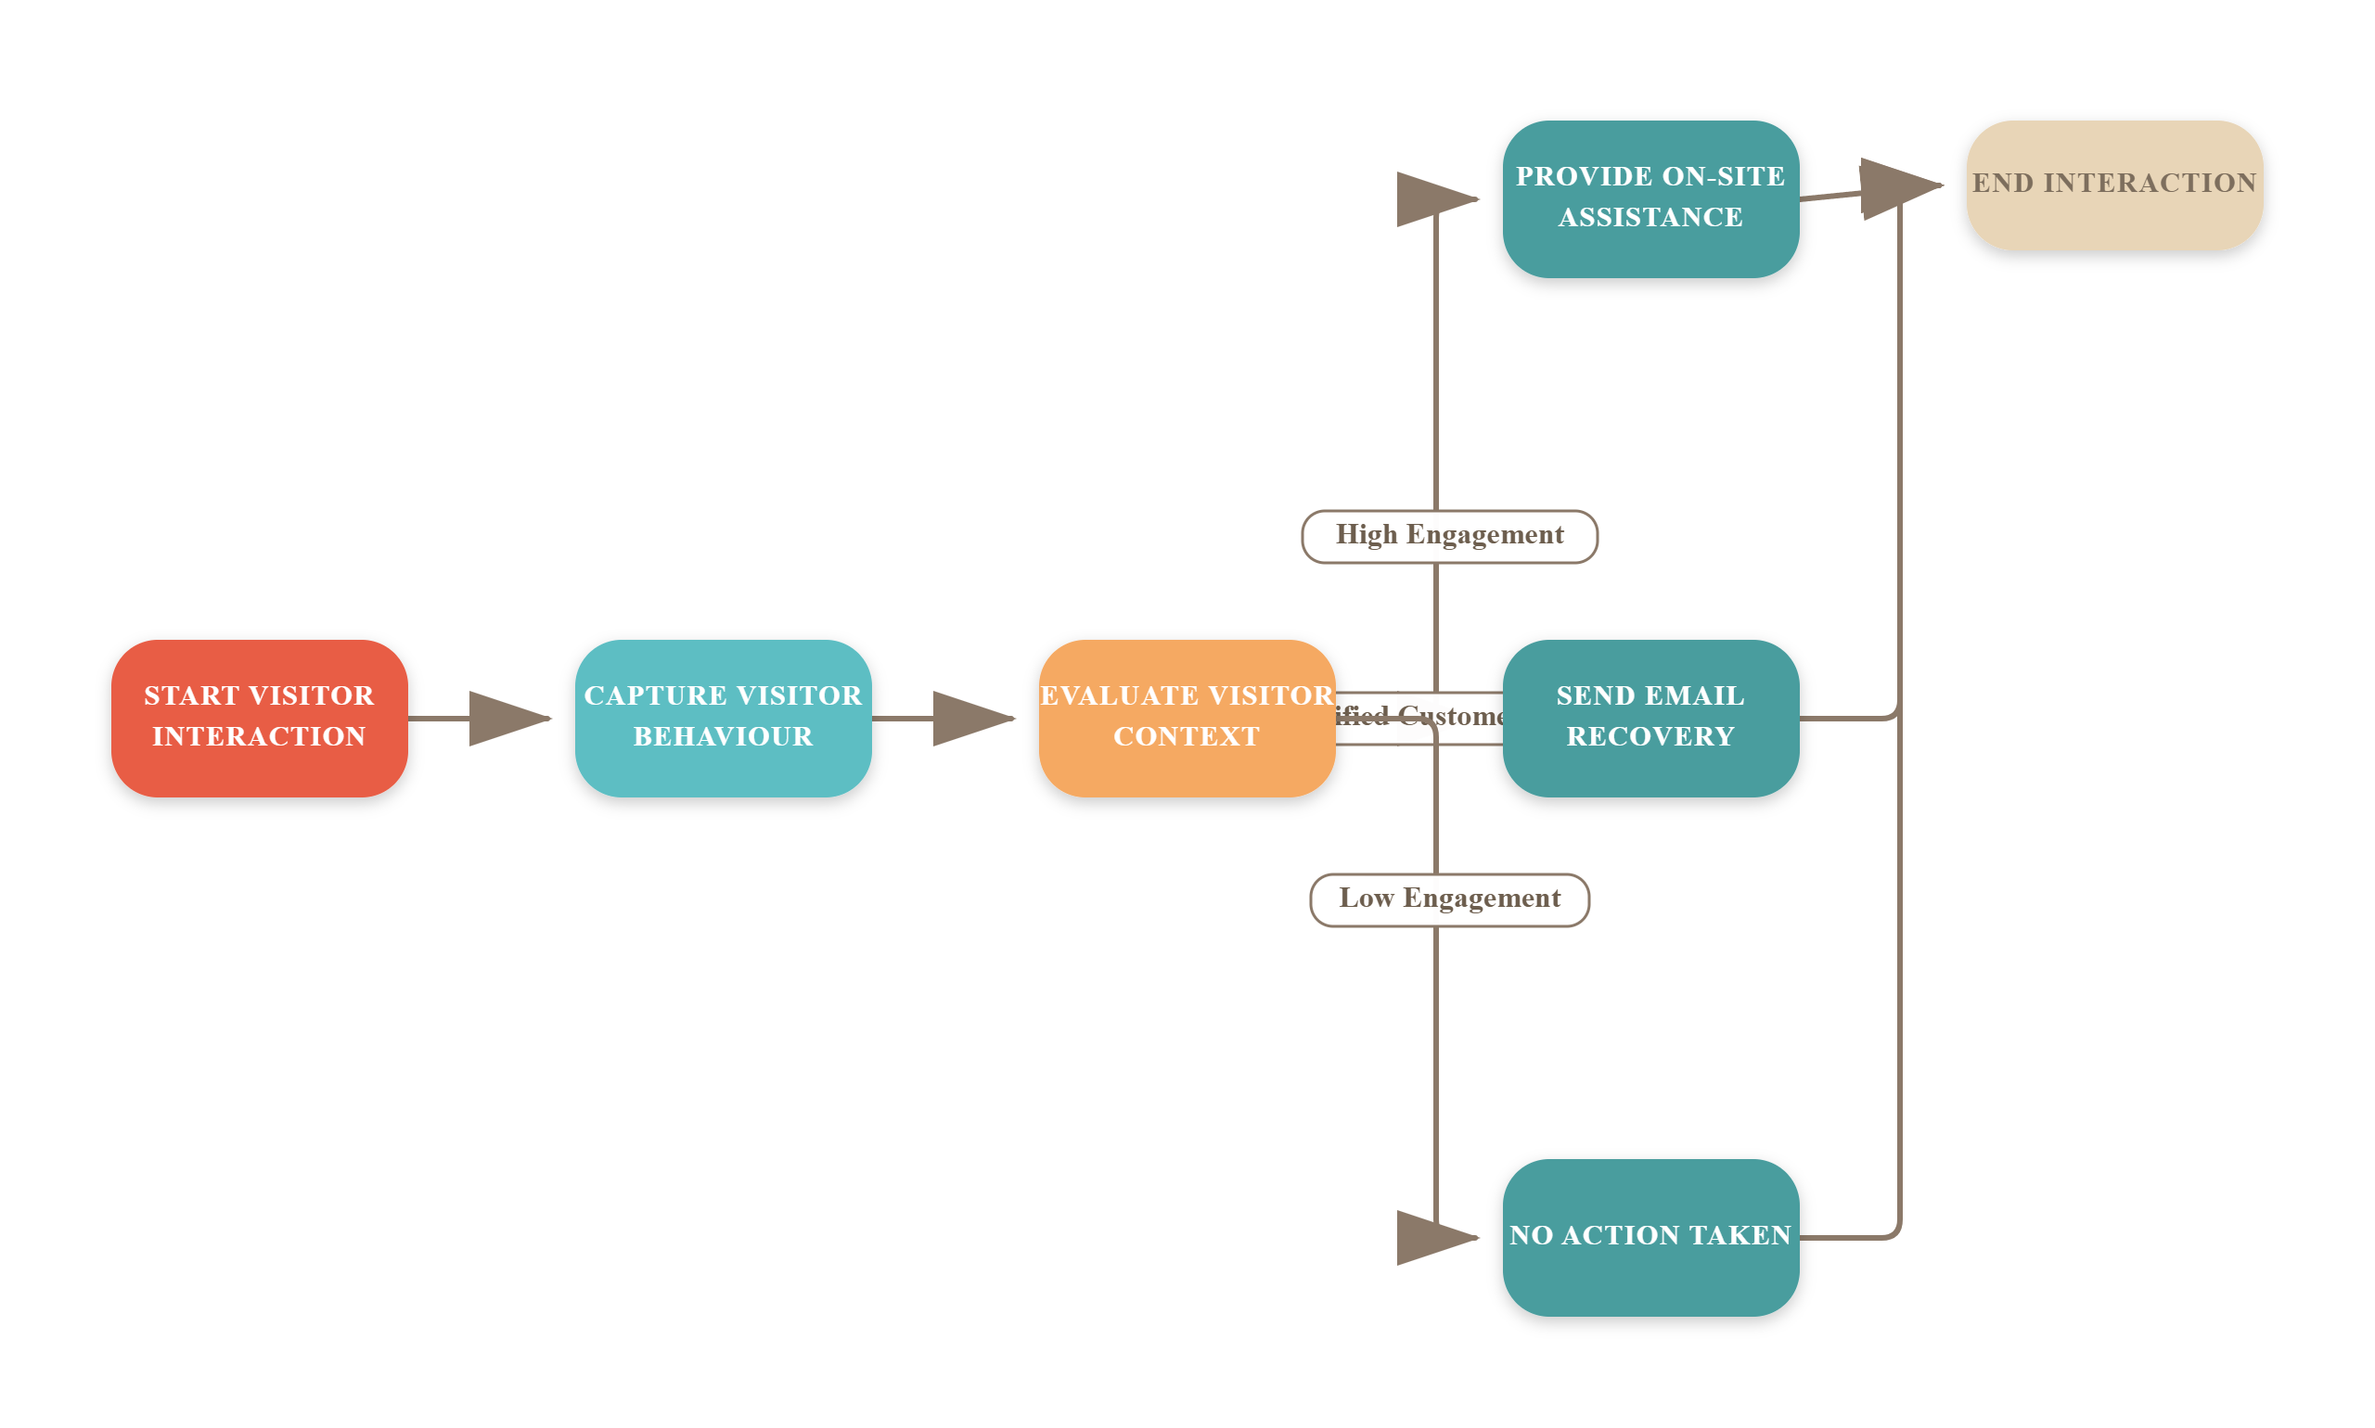
NOVA AI Workflow
Made with SlideMaker.app

Slide 7

Proof of Concept (POC)
E-commerce Integration
The POC seamlessly integrates an e-commerce site with n8n, enabling automated workflows that respond to visitor actions in real-time, enhancing operational efficiency.
Real-time Data Processing
Visitor events trigger a webhook that processes data instantly, allowing for immediate AI-driven decisions based on user behavior and context, improving engagement.
AI Decision Layer
Utilizing OpenAI technology, the AI decision layer assesses visitor context, ensuring tailored interventions that maximize conversion opportunities and minimize unnecessary outreach.
Photo by Growtika
Made with SlideMaker.app

Slide 8

NOVA AI Architecture Overview
This visual representation illustrates the end-to-end architecture of NOVA AI, showcasing how visitor events trigger AI-driven decisions. Key components include the n8n webhook, behavior analysis, and action execution pathways. The takeaway is the seamless integration of AI into e-commerce workflows, enhancing visitor engagement and conversion rates.
Made with SlideMaker.app

Slide 9

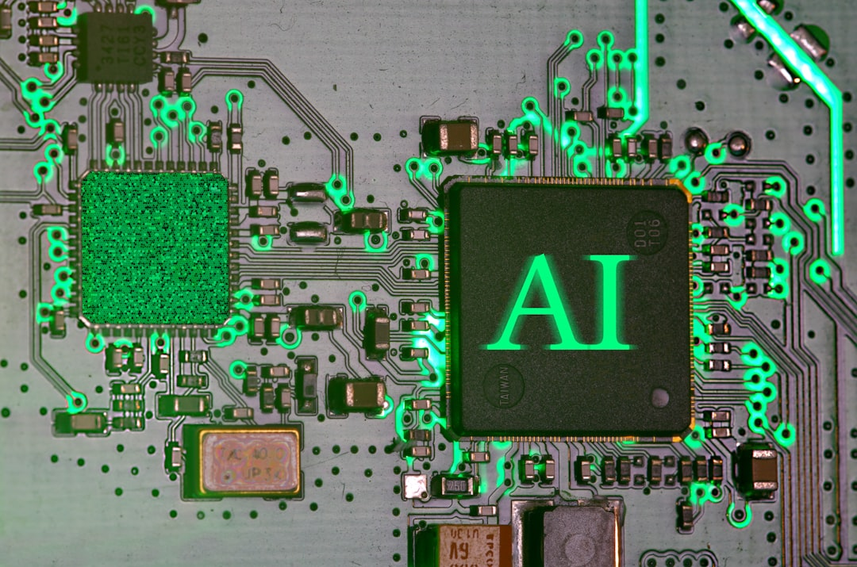

Business Case for NOVA AI
Improved Conversion Rates
Reduced Manual Efforts
NOVA AI can increase conversion rates by up to 20%, translating to significant revenue growth for e-commerce platforms, especially in competitive markets.
By automating campaign management, NOVA AI reduces manual efforts by approximately 50%, allowing teams to focus on strategic initiatives rather than repetitive tasks.
Photo by sarah b
Photo by Immo Wegmann
Enhanced Targeting Efficiency
NOVA AI's intelligent interventions lead to a 30% reduction in wasted marketing resources, ensuring communications are relevant and timely for each visitor.
Photo by Markus Winkler
Made with SlideMaker.app

Slide 10

Projected ROI Analysis
Time Frame | Projected ROI (%) | Key Assumptions
12 Months | 150% | Existing visitor data available
36 Months | 300% | Variable AI usage with traffic
Integration Costs | Medium | Depends on infrastructure
Conversion Uplift | To be validated | Pilot phase required
Made with SlideMaker.app

Slide 11

Risk Management
AI Decision-Making Errors
Privacy Concerns
Incorrect AI decisions can lead to poor customer experiences, potentially resulting in a 20% drop in customer satisfaction scores, impacting long-term loyalty and revenue.
Data handling must comply with GDPR regulations, ensuring visitor consent and minimizing data usage to avoid potential fines of up to €20 million or 4% of annual revenue.
Over-Intervention Risks
Excessive customer outreach can lead to fatigue, with studies showing a 30% increase in unsubscribe rates when customers receive too many communications, harming engagement.
Made with SlideMaker.app
Photo by Glenn Carstens-Peters

Slide 12
Compliance Approaches for NOVA AI
EU AI Act Compliance
GDPR Compliance
Assessed as a minimal-risk use case, allowing for streamlined deployment.
Mandates strict controls on personal data handling, including consent management.
No high-impact decisions involved, reducing regulatory burden.
Emphasizes data minimization and purpose limitation to protect user privacy.
Requires ongoing human oversight to ensure compliance with AI decisions.
Requires transparency in data processing and user rights management.
Made with SlideMaker.app

Slide 13
How to Implement NOVA AI
1
Conduct a Proof of Concept (POC)
Validate the technology and assumptions behind NOVA AI by developing a POC that demonstrates the AI decision-making process and its integration with the e-commerce platform.
2
Initiate a 60-Day Pilot
Select a limited traffic segment and partner with Chleo to conduct a controlled pilot. Measure conversion rates and gather data on AI performance through A/B testing.
3
Monitor and Optimize
During the pilot, continuously monitor the AI's performance, customer experience, and compliance with regulations. Use insights gained to optimize the system before full deployment.
4
Prepare for Full Deployment
If the pilot meets predefined KPIs, plan for full deployment by integrating NOVA AI with existing systems, ensuring compliance, and establishing ongoing support and governance.
Made with SlideMaker.app

Slide 14
Transformative Impact on E-commerce
30%
25%
2.5x
Increase in Conversion Rates
Reduction in Cart Abandonment
Enhanced Customer Engagement
Expected uplift through targeted AI interventions
Significant decrease with personalized recovery strategies
Through context-aware, timely interventions
Made with SlideMaker.app

Slide 15
Next Steps
Review POC Findings
Analyze the outcomes from the POC to identify strengths and weaknesses in the AI decision-making process, ensuring alignment with business objectives and user experience goals.
Develop Deployment Plan
Create a comprehensive deployment strategy based on pilot results, including timelines, resource allocation, and integration with existing systems to ensure smooth implementation.
Engage Stakeholders
Involve key stakeholders for feedback and additional funding, ensuring their insights are incorporated into the final deployment strategy to enhance buy-in and support.
Made with SlideMaker.app

Slide 16
Conclusion
In summary, NOVA AI effectively transforms visitor behavior into actionable insights, enhancing conversion rates through context-aware interventions. The POC and MVP validate the technology's potential, while compliance measures ensure responsible deployment. The next critical step is a 60-day pilot to validate assumptions and refine the approach. If successful, NOVA can significantly elevate e-commerce strategies, driving both revenue and customer satisfaction. Thank you for your attention; I welcome your questions.
Made with SlideMaker.app

