Slide 1

5G Networks
Vince Huynh

Slide 2
What is 5G?
5G simply refers to the next and newest mobile wireless standard based on the IEEE 802.11ac standard of broadband technology
In 5G, the network service area is divided into small geographical areas called cells. All the 5G wireless devices in a cell communicate by radio waves with a local antenna and low power automated transceiver (transmitter and receiver) in the cell.
The local antennas are connected with the telephone network and the Internet by a high-bandwidth optical fiber or wireless backhaul connection

Slide 3
The ADVANTAGES OF 5G
The new 5G wireless devices include 4G LTE support as well to establish a connection with the cell and to connect to the internet at locations where 5G access is not available.
5G can support up to a million devices per square kilometer, while 4G supports only up to 100,000 devices per square kilometer.
5G operates on 3 different spectrum bands.
- Low-band spectrum – Expect peak speeds up to 100Mbps
- Mid-band spectrum – Expect peak speeds up to 1Gbps
- High-band spectrum – Expect peak speeds up to 10Gbps

Slide 4
The ADVANTAGES OF 5G (Cont.)
High & increased peak bit rate (Up to 10Gbps connections to endpoints in the field)
Larger data volume per unit area (i.e. high system spectral efficiency)
High capacity to allow more devices connectivity concurrently and instantaneously (100 percent coverage)
More bandwidth
Lower battery consumption
Better connectivity irrespective of the geographic region where you are in
A larger number of supporting devices (10 to 100x number of connected devices)
Lower cost of infrastructural development
Higher reliability of the communications (One millisecond end-to-end round trip delay)

Slide 5
Where 5G is being used?
Internet of Thongs – IoT
Health care
Public safety and infrastructure
Autonomous vehicles
Manufacturing
Entertainment/Gaming
Supply-chain management
Energy

Slide 6
How can it work?
5G will utilize the advance access technologies such as Beam Division Multiple Access (BDMA) and Non and quasi-orthogonal or Filter Bank Multicarrier (FBMC) Multiple Access

Slide 7
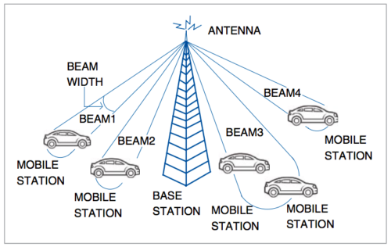
Beam-division multiple-access (BDMA)
The base station allocates separate antenna beam to each mobile phone or mobile station
All the mobile stations communicate with base station when these are in its line-of-sight (LoS) and all the beams are distinct for each individual station.
So simultaneous data transmission is possible to different mobile stations at different angles
To support more number of users, the beam should be divided. Mobile stations located at similar angles can share one beam to communicate with the base station

Slide 8
IS IT SAFE TO USE?
European Union
‘The strict and safe exposure limits for electromagnetic fields recommended at EU level apply for all frequency bands currently envisaged for 5G’ (European Commission, 2017)
Australia
‘Although the 5G mobile phone network is new, limits set in safety standards, our understanding of the evidence of health effects and the need for more research have not changed.’ (ARPANSA, 2019)

Slide 9
FUN FACTS
5G handsets, as they become available, comply with stringent testing standards that cover all the frequencies they can operate at, and at their maximum power, so these handsets will be safe to use, and will not increase the risk of explosion
There is no credible scientific evidence linking 5G or mobile technologies to the spread of Coronavirus

Slide 10
SOURCES
https://krazytech.com/technical-papers/5g-wireless-technology
https://www.electronicsforu.com/resources/learn-electronics/bdma-technology-5g-network
https://www.vodafone.com/what-we-do/public-policy/mobiles-masts-and-health/health-the-science-and-evidence/is-5g-safe-to-use

Slide 11

Thank You
someone@example.com

