Slide 1
Exploring Airline Passenger Satisfaction and On Time Performance Micro Project # 1 <Repository link>
Vincent Vitale
October 5, 2025

Slide 2
Problem Statement
Airline companies aim to enhance customer satisfaction and reduce delays. Using passenger and operational flight data, this project will seek to identify which flight related and service-related factors most influence overall passenger satisfaction and on time performance.

Slide 3
Hypothesis Formulation
Business-class travelers and longer flights are associated with higher customer satisfaction due to enhanced in-flight services.
Null Hypothesis:
There is no relationship between flight distance, class, or travel type and passenger satisfaction.
Secondary Hypothesis:
Shorter flights experience more departure delays due to tight scheduling and quick turnaround times.

Slide 4
Acquire
Dataset:
Airline Passenger Satisfaction Dataset
Source:
Kaggle
Size:
129k Records
Key Variables:
Passenger Demographics (Age, Gender)
Travel Details (Flight Distance, Class, Type of Travel)
Service Ratings (Wi-fi, On Board Services, In Travel Entertainment)
Operational Data (Departure and Arrival Delays)
Target Variable (Satisfaction)

Slide 5
Prepare
Converted categorical fields into numerical and binary form.
Filled missing values (Arrival Delay in Minutes)
Detected and capped outliers in Flight Distance
Created new variable Flight Distance_Capped for cleaner modeling
Validated transformations and confirmed dataset integrity.

Slide 6
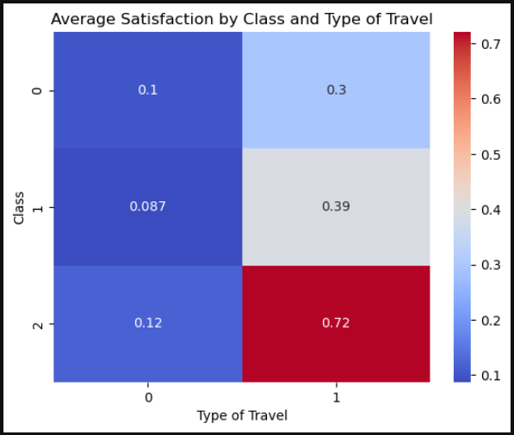
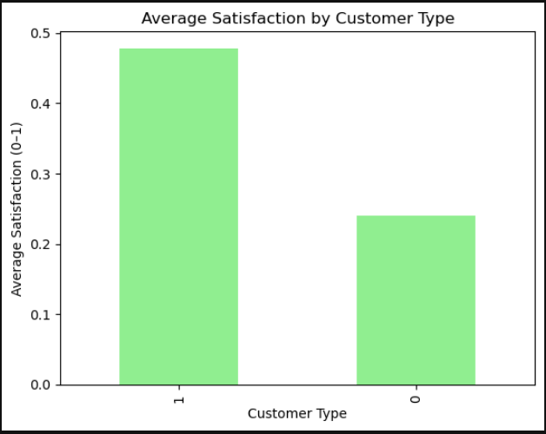
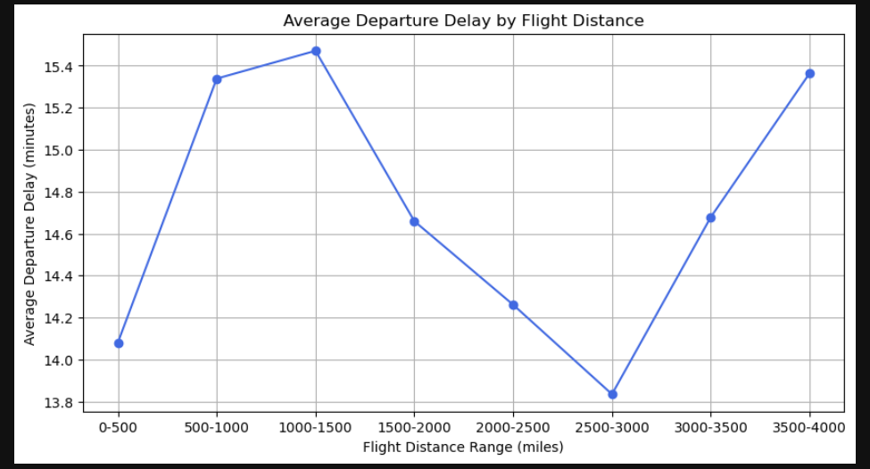
Analyze data
Created Bar charts and Line Charts to represent data.

Slide 7
Report
<communicate results>

Slide 8
Act
<apply results, connect results with the chosen problem statement or business question>

