Slide 1
Exploring Airline Passenger Satisfaction and On Time Performance Micro Project # 1 Github Project
Vincent Vitale
October 5, 2025

Slide 2
Problem Statement
Airline companies aim to enhance customer satisfaction and reduce delays. Using passenger and operational flight data, this project will identify which flight-related and service-related factors most influence overall passenger satisfaction and on-time performance.
Using passenger + operational fields, identify which flights or service factors most influence:
Overall passenger satisfaction
On-time performance

Slide 3
Hypothesis Formulation
Airline service and flight characteristics may shape how customers rate their trips, and operational factors especially route length, may explain differences in on time performance.
Outcomes analyzed: satisfaction (0/1) and departure delays (minutes)
Primary Hypothesis(H₁):
Mean satisfaction differs by Class, Type of Travel, and Customer Type (H₀: no differences)
Secondary Hypothesis(H₁)
Mean departure delay differs across flight-distance groups (H₀: no differences)
Expectation:
Business & Loyal = higher satisfaction; mid range distances = higher average delays.

Slide 4
Acquire
Analyze a public Airline Passenger Satisfaction dataset combining passenger demographics, service ratings, and delay minutes, sufficient to study satisfaction and on time performance in one table.
Dataset:
Airline Passenger Satisfaction Dataset
Source:
Kaggle – Airline Passenger Satisfaction
Size:
129,880 Rows, 25 columns.
Key Variables:
Passenger Demographics (Age, Gender)
Travel Details (Flight Distance, Class, Type of Travel)
Service Ratings (Wi-fi, On Board Services, In Travel Entertainment)
Operational Data (Departure and Arrival Delays)
Target Variable (Satisfaction)
Outcome Variables:
Satisfaction (0/1)
Departure delay (minutes)

Slide 5
Prepare
Cleaned and standardized the table so service factors and delays are directly comparable and ready for simple group testing.
Encode categorical: Gender (Male=1/Females=0), Customer Type (Loyal=1/Disloyal=0), Type of Travel (Business=1/Personal=0), Class (Business=2/EcoPlus=1/Eco=0), Satisfaction (Satisfied=1/Neutral-or-Dissatisfied=0).
Handled missing data: 393 null values in Arrival Delay in Minutes, filled in with 0.
Outliers (Flight Distance): Detected with IQR rule and capped; created Flight_distance_Adjusted for analysis.
Sanity Check: Confirmed Shapes/Types and inspected distribution after transformations.

Slide 6
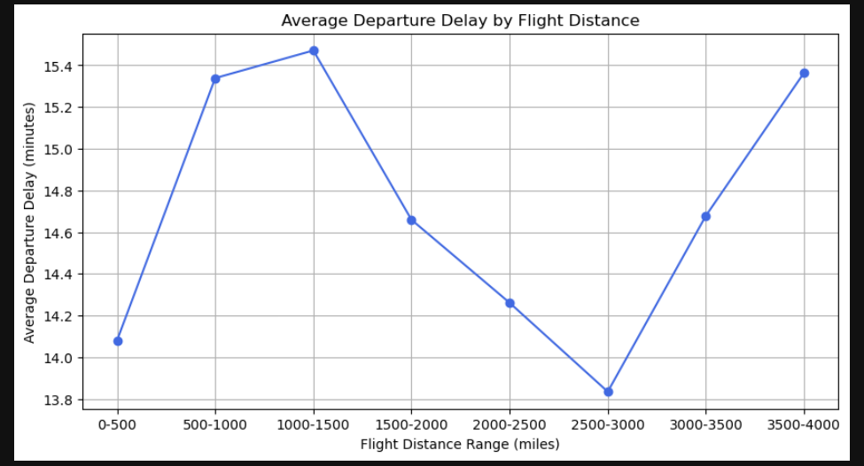
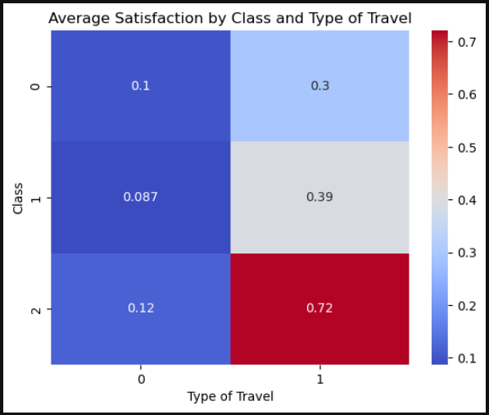
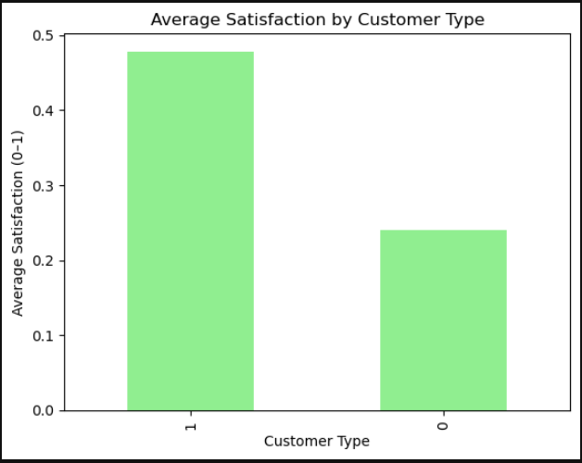
Data Patterns
Summarized patterns with simple group comparisons and distance binning to link service factors to satisfaction and route length to delays.
Delays vs Distance:
Midrange routes show the lowest average departure delay, while short and very long routes are higher.
Satisfaction by class X travel type: Premium Cabin + Business travel has the highest satisfaction; economy and leisure have the lowest.
Customer type effect:
Returning customers rate service roughly 2 times higher than first time customers.

Slide 7
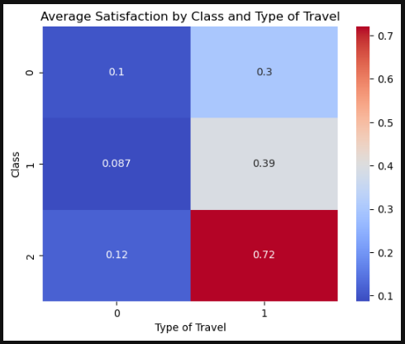
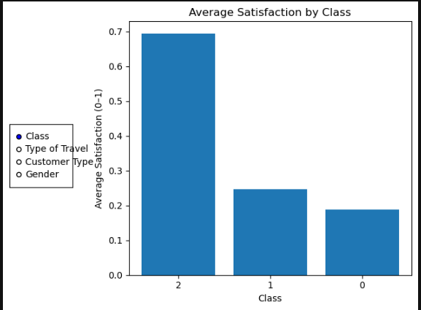
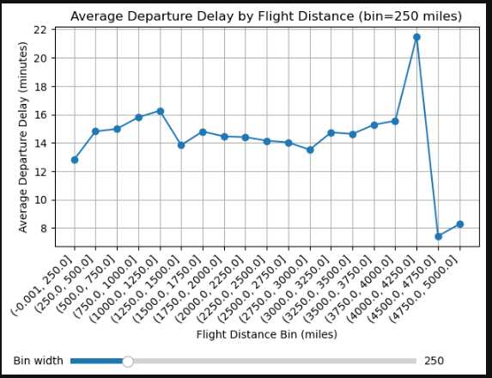
Data Paterns
Satisfaction by class X travel type: Premium Cabin + Business travel has the highest satisfaction; economy and leisure have the lowest.
Satisfaction by class : Premium averages ~0.69 satisfaction, versus 0.25 for standard and 0.18 for basic, roughly a 3x gap.
Avg Departure Delay by Flight Distance: Delays hover roughly 13-16 minutes across most distances, indicating no simple linear trend with route length.

Slide 8
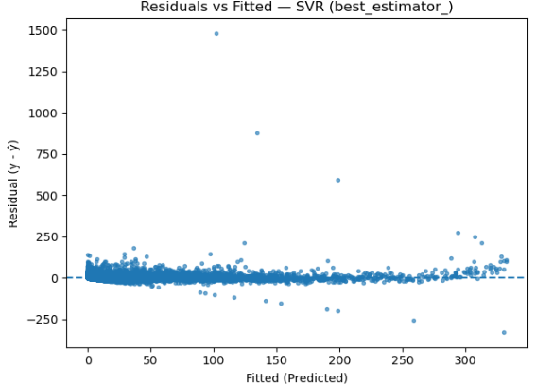

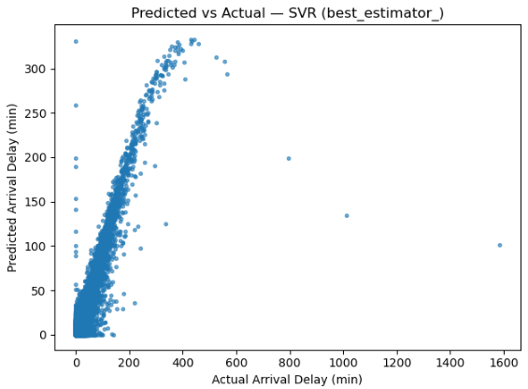
Results – Model Performance
The MLPRegressor achieved the lowest RMSE and highest R Squared, indicating slightly better fit than Ridge and Linear. SVR underperformed on this feature space. Given interpretability needs, Ridge remains a strong, nearly equivalent alternative
Why I didn’t pick SVR:
Predicted vs Actual: Points bunch below the 45 degree line and saturated.
Residuals vs Fitted: Cone/Megaphone shape and several huge positives, large outliers the model can't capture.

Slide 9
Summary
Analysis shows that service tier and traveler type are strongly associated with higher satisfaction, and departure delays vary systematically by route length.
Key Findings:
Business class and Loyal customers report the highest average satisfaction; effects are strongest for Business class on Business travel.
Departure delays differs across flight-distance bins, with a mid-range bump visible in the line plot.
Suggestions:
Align service amenities to trip purpose(business travelers in premium cabins yield the best satisfaction signal).
Target operational improvements on mid-distance routes where delays cluster.
Limitations:
Single table with no date/airport fields; no weather data.
Observational survey data; associations, not causation.

Slide 10
Act
Deploy Ridge (α=3) to predict arrival delay and drive targeted actions.
Strategy:
Use the Ridge model with scaling and one hot encoding to forecast arrival delay. At dispatch, flag flights whose predicted delay exceeds 11 minutes to trigger tighter turn checks on short haul legs and contingency on very long routes. For customers, send proactive updates and small amenities where satisfaction is most elastic.
Operations:
Monitor predicted delays and auto trigger turn-time checks and crew/gate coordination on flagged flights. Use the model’s typical absolute error to set alert thresholds.
Customer Experience
Prioritize proactive notifications, connection guidance, and small amenities on economy-leisure and first-time itineraries. Keep premium and business steady where satisfaction is already high.
Measure – Ship – Improve
Track on time %, average arrival delay, rebook rate, and satisfaction by segment. Retrain monthly, log CV RMSE vs holdout to catch drift. Next: stabilize long-haul bins and add weather data.

