Slide 1
Exploring Airline Passenger Satisfaction and On Time Performance Micro Project # 1 https://github.com/vince760/ANA500
Vincent Vitale
October 5, 2025

Slide 2
Problem Statement
Airline companies aim to enhance customer satisfaction and reduce delays. Using passenger and operational flight data, this project will identify which flight-related and service-related factors most influence overall passenger satisfaction and on-time performance.
Using passenger + operational fields, identify which flights or service factors most influence:
Overall passenger satisfaction
On-time performance

Slide 3
Hypothesis Formulation
Airline service and flight characteristics may shape how customers rate their trips, and operational factors especially route length, may explain differences in on time performance.
Outcomes analyzed: satisfaction (0/1) and departure delays (minutes)
Primary Hypothesis(H₁):
Mean satisfaction differs by Class, Type of Travel, and Customer Type (H₀: no differences)
Secondary Hypothesis(H₁)
Mean departure delay differs across flight-distance groups (H₀: no differences)
Expectation:
Business & Loyal = higher satisfaction; mid range distances = higher average delays.

Slide 4
Acquire
Analyze a public Airline Passenger Satisfaction dataset combining passenger demographics, service ratings, and delay minutes, sufficient to study satisfaction and on time performance in one table.
Dataset:
Airline Passenger Satisfaction Dataset
Source:
Kaggle – Airline Passenger Satisfaction
Size:
129,880 Rows, 25 columns.
Key Variables:
Passenger Demographics (Age, Gender)
Travel Details (Flight Distance, Class, Type of Travel)
Service Ratings (Wi-fi, On Board Services, In Travel Entertainment)
Operational Data (Departure and Arrival Delays)
Target Variable (Satisfaction)
Outcome Variables:
Satisfaction (0/1)
Departure delay (minutes)

Slide 5
Prepare
Cleaned and standardized the table so service factors and delays are directly comparable and ready for simple group testing.
Encode categorical: Gender (Male=1/Females=0), Customer Type (Loyal=1/Disloyal=0), Type of Travel (Business=1/Personal=0), Class (Business=2/EcoPlus=1/Eco=0), Satisfaction (Satisfied=1/Neutral-or-Dissatisfied=0).
Handled missing data: 393 null values in Arrival Delay in Minutes, filled in with 0.
Outliers (Flight Distance): Detected with IQR rule and capped; created Flight_distance_Adjusted for analysis.
Sanity Check: Confirmed Shapes/Types and inspected distribution after transformations.

Slide 6
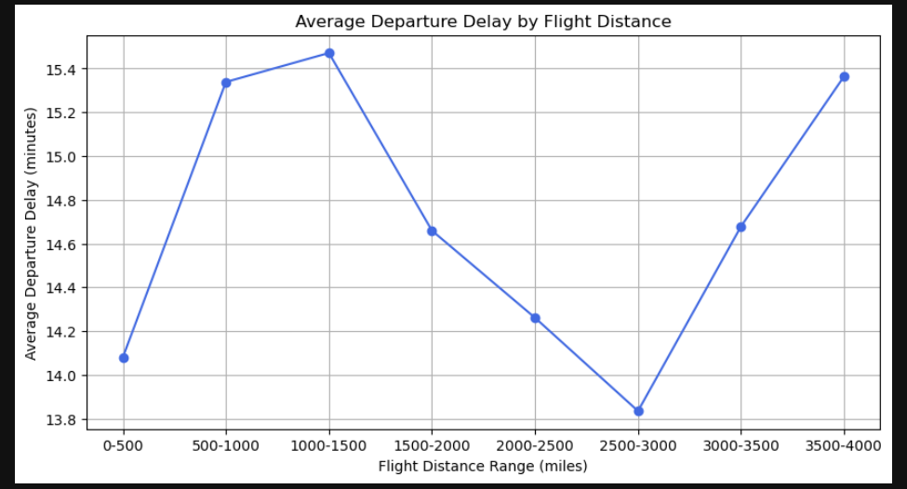
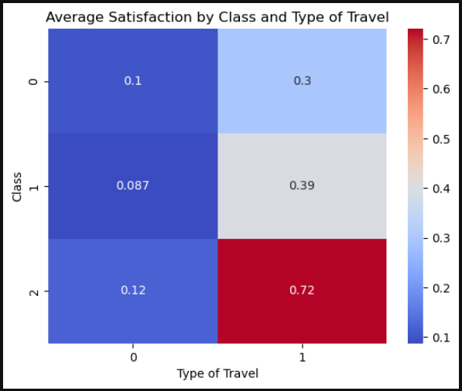
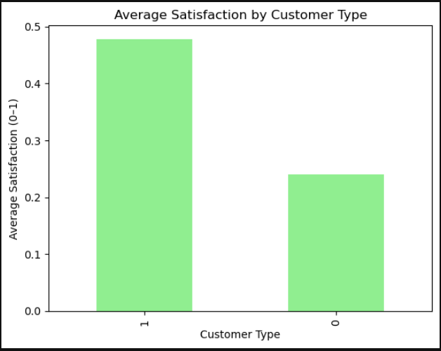
Analyze data
Summarized patterns with simple group comparisons and distance binning to link service factors to satisfaction and route length to delays.

Slide 7
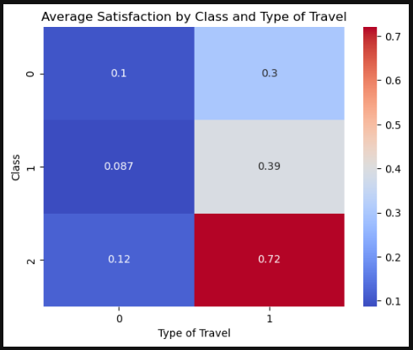
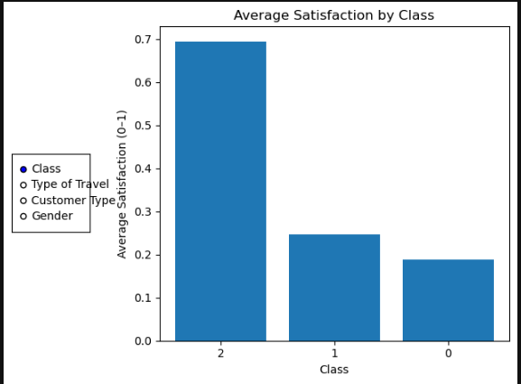
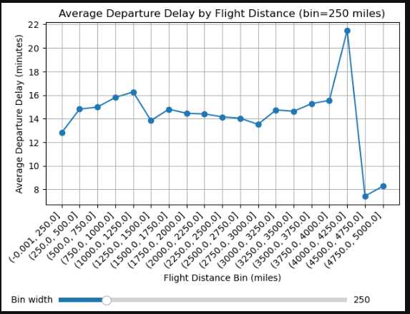
Analyze data

Slide 8
Report
Analysis shows that service tier and traveler type are strongly associated with higher satisfaction, and departure delays vary systematically by route length.
Key Findings:
Business class and Loyal customers report the highest average satisfaction; effects are strongest for Business class on Business travel.
Departure delays differs across flight-distance bins, with a mid-range bump visible in the line plot.
Suggestions:
Align service amenities to trip purpose(business travelers in premium cabins yield the best satisfaction signal).
Target operational improvements on mid-distance routes where delays cluster.
Limitations:
Single table with no date/airport fields; no weather data.
Observational survey data; associations, not causation.

Slide 9
Act
<apply results, connect results with the chosen problem statement or business question>

