Slide 1
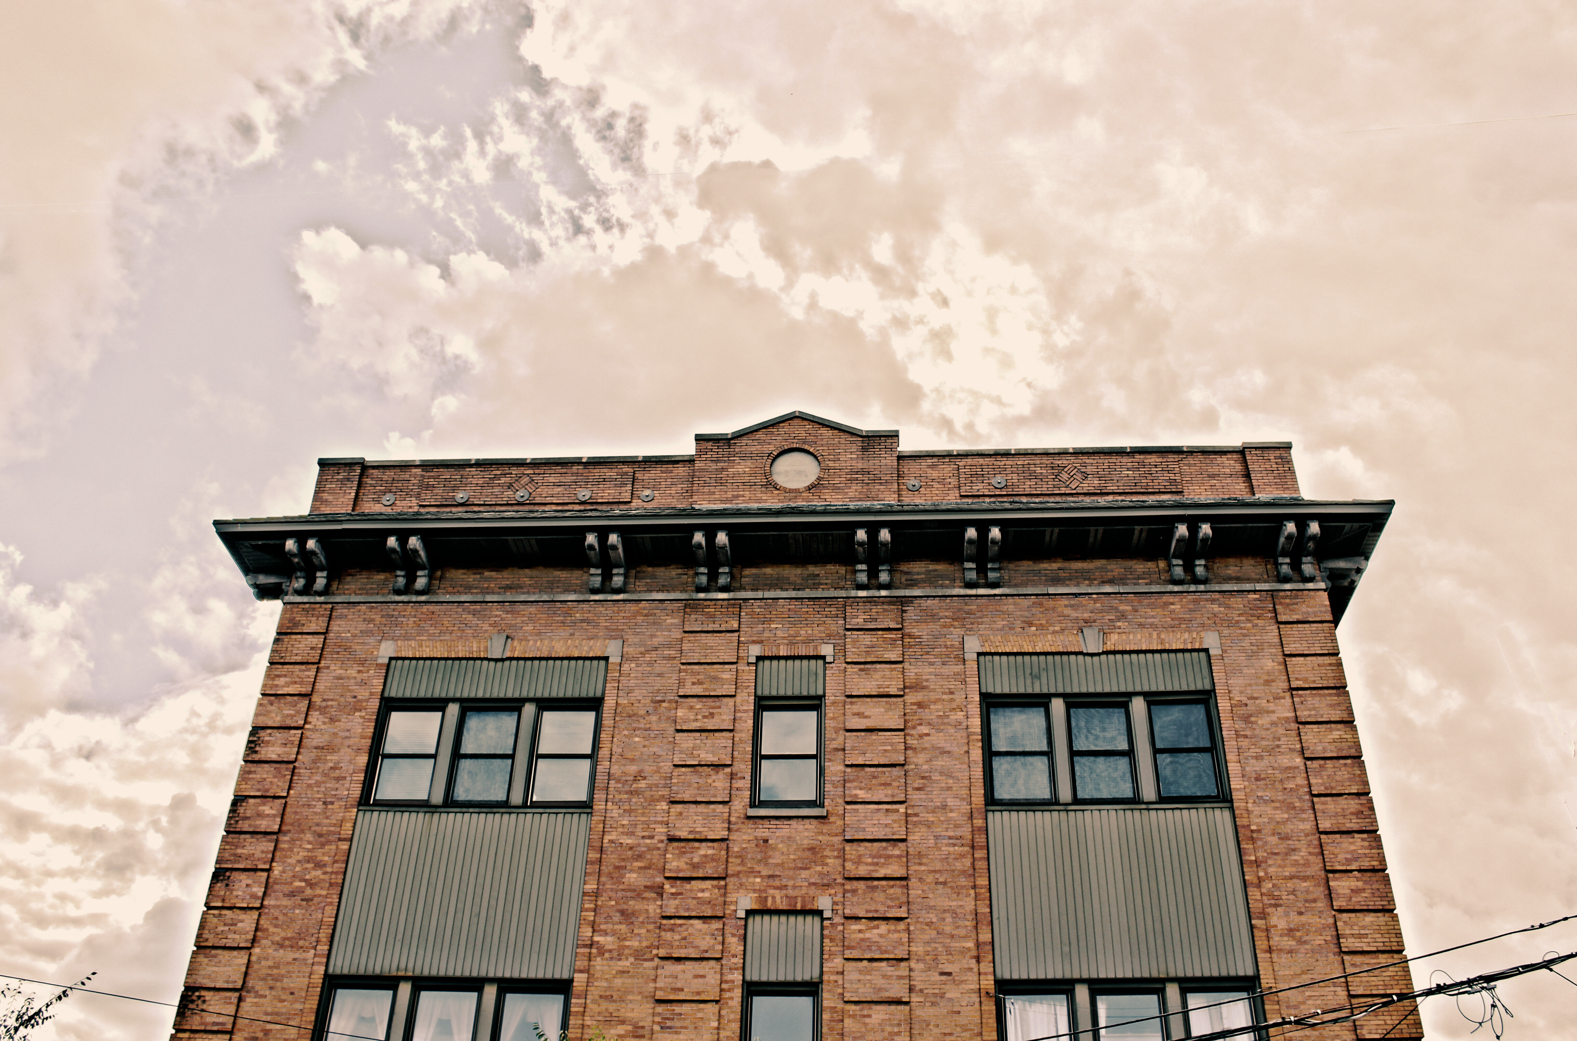

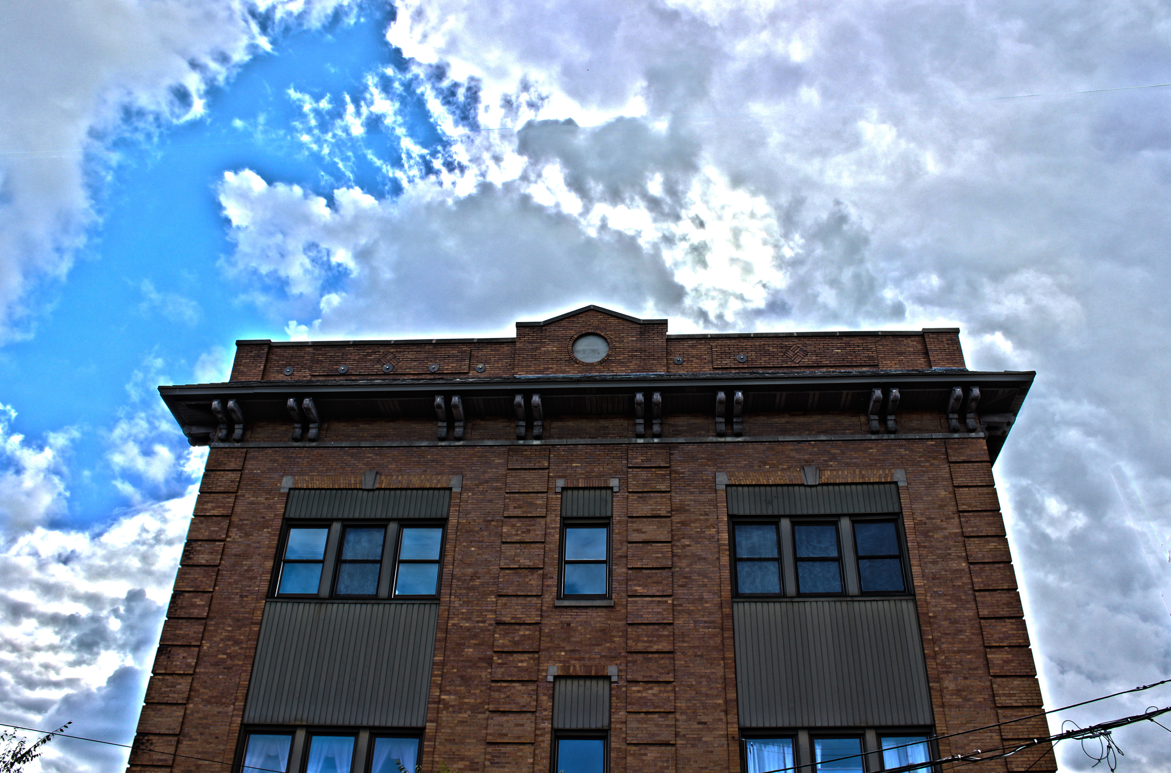
Love God. Love Others.

Slide 2
Point 1
Sub Point

