Slide 1
E-sports

Slide 2
Problem
E-sports is new
People that want to get into e-sports have little to zero experience with the business industry, and many aspiring individuals can be taken advantage of.
Mainly, young adults/youth who have very little life experience, and a lot of big business people are in their to take advantage of them.

Slide 3
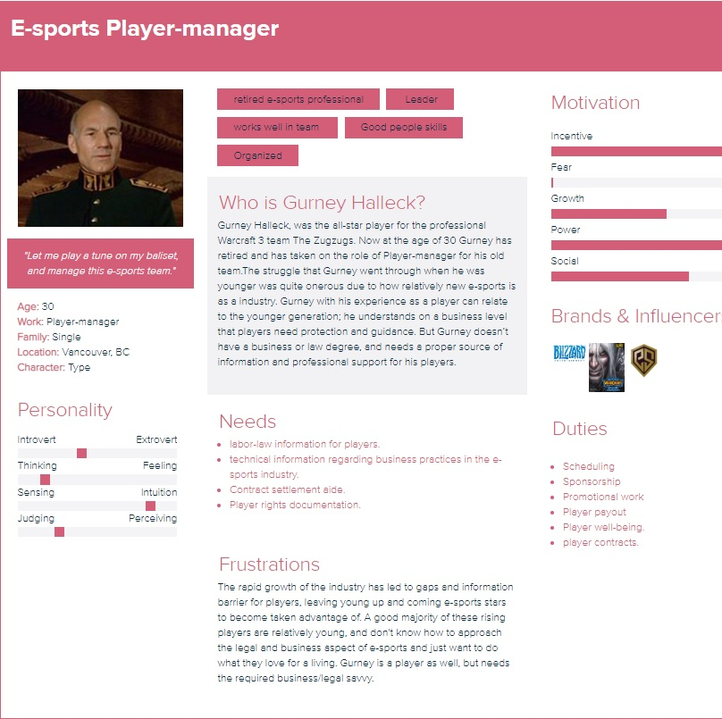
Target
E-sports Player manger:

Slide 4
Talk to your user

Slide 5
Solution 1
Provide a legal resource for player-managers that will contain:
-legal documentation
-labor law documentation.
-Attorney contact.
-contract aide.

