Slide 1
Ms. Joan Thanos
A Persona:

Slide 2

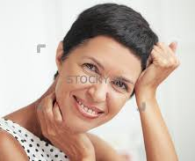
A Profile
Age: 45
Location: Vancouver B.C.
Occupation: Office Manager at Deloitte Canada

Slide 3
Characteristics
Ms. Thanos is a busy professional woman.
Ms. Thanos is intelligent, detail and family-orientated.
Ms. Thanos has expertise in office communication.
Ms. Thanos is experienced reading complex and detailed material.

Slide 4
Goals:
Primary goals are to advise and help navigate her son’s fledgling e-gaming career.
To create a meaning dialogue with her child, so that a channel for clear and honest communication is available to deal with any potential issues.
To provide helpful legal advice so her son can protect himself and advance in his chosen career.
To provide a resource for her son when challenges arise that are outside his career.

Slide 5
Needs:
Ms. Thanos needs important information to be laid out clearly and concisely.
Ms. Thanos needs access to important resources outside the site.
Ms. Thanos needs a accessible resource to which she can direct her son.
Ms. Thanos needs a resource that is regularly updated to reflect changes in a new industry.

